Slide 1
Bunch Compression using Static Fields
Weishi Wan
Advanced Light Source
Lawrence Berkeley National Laboratory
FEIS 2013 - Femtosecond Electron Imaging and Spectroscopy
Key West, Florida
Dec. 11, 2013

Slide 2
Time Varying vs Static Fields
Advantages of the static field
  Simpler technology
  No timing issue
  Ease of operation
Disadvantage of the static field
  Less flexibility
Both widely used in particle accelerators
Integral component of FELs
Won’t work for UED/UEM without
RF cavity to flip the sign of <δEδt>
M. Gao et. al., Optics Express 20, 12048 (2012)

Slide 3
Prelude: A High Resolution Streak Camera
Streak camera developed at LBNL achieved high temperal resultion (world record at the time).
For UV light, resolution reached 233 fs.
For X-ray, resolution around 600 fs.
Good scientific results obtained using those cameras
How do we improve?
J. Feng et. al., Proc. of SPIE 5920, 592009 (2005)
J. Feng et. al., APL 91, 134102 (2007)

Slide 4
Early Involvement in Bunch Compression
A miniaturized TOFI to compress 10 keV electron bunches

Slide 5

A New Proposal by Grzelakowski and Tromp
K. P. Grzelakowski R. M. Tromp, Ultramicroscopy 130, 36 (2013)

Slide 6
One More Way from the Old Days: Alpha Magnet
Higher energy particles longer path
Translational invariance along y
Focusing in the x-z plane
Achromatic for all energy at a
specific incidence angle
H. A. Enge, RSI 34, 385 (1963)
M. Borland, Ph. D Thesis SLAC-r-402 (1981)

Slide 7
A Little Bit of Modeling
Charge line model (1440)
Slit rounded the corner a bit
Does not affect the trajectory
How do these approaches
compare with each other?

Slide 8







Three Simplified Cases
Spherical capacitor:
(Kepler system)
Uniform magnet field:
(covers miniTOFI)
Alpha magnet:
$$T=2πk\sqrt{\frac{m}{{\left(−2E\right)}^{3}}}$$
$$T=\frac{2πγm}{B}$$
$$L∝\sqrt{p}∝\sqrt{γβ}$$
$$E=E_{k}+V$$
type | ratio of slope
uniform field | 1
mini TOFI | 1.15
mini TOFI (grad) | 0.78
$$v∝β$$
$$T∝\sqrt{\frac{γ}{β}}$$
$$V=−\frac{k}{r}$$
Kepler’s third law
What about
Relativistic effect?

Slide 9
Kepler’s problem
At 1 eV, simulation agrees with analytical formula well
At 100 keV, relativistic effect starts to show.
Kepler’s third still a good approximation

Slide 10
Comparison

Slide 11
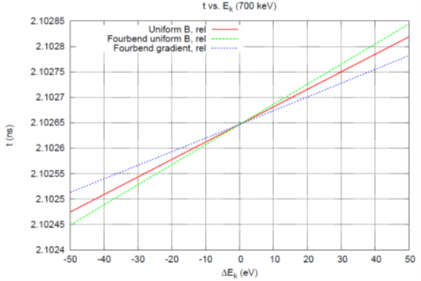
Comparison at 100 keV
type | ratio of slope
uniform field | 1
mini TOFI | 1.15
mini TOFI (grad) | 0.78
Kepler | 13.65

Slide 12
Comparison at 700 keV
type | ratio of slope
uniform field | 1
mini TOFI | 1.15
mini TOFI (grad) | 0.78
Alpha magnet | 0.39

Slide 13
One Last Thing about the Spherical Capacitor
Central radius: 55 mm
Outer electrode radius: 60 mm
Inner electrode radius: 50 mm
Limited to ~200 keV

Slide 14
Summary
Bunch compression using static field has certain advantages that make it an attractive method
Spherical capacitor is more effective (compact) compared to methods using magnetic field
Spherical capacitor is limited to low energy (~200 keV) due to the difficulty of high voltage
At higher energy (>300 keV), where magnetic field have to be used, uniform field is somewhat better
Since all the examples considered have the same number of crossings (with the possible exception of the alpha magnet) Coulomb scattering effect plays similar role for all cases.

