Slide 1

Plasmon Charge Density
Probed By
Ultrafast Electron Microscopy
UST
PHYSICAL BIOLOGY Center for
ULTRAFAST SCIENCE & TECHNOLOGY
Sang Tae Park and Ahmed H. Zewail
California Institute of Technology
2013.12.09. Femtosecond Electron Imaging and Spectroscopy Workshop

Slide 2
Outline
Structural dynamics
  ultrafast electron microscopy
    design
    capability
Visualization of plasmons
  photon-induced near field electron microscopy
    interaction of electron and (plasmon) field
    induced charge density
Notes:
First, I will briefly summarize ultrafast electron microscopy, UEM, and then plasmon visualization using photon-induced near filed electron microscopy, PINEM.

Slide 3
Part I: Structural Dynamics
Ultrafast electron microscopy

Slide 4
Motivation
Structural dynamics
  direct visualization of microscopic/macroscopic manifestation of bonding interaction
    microscopic, atomic motions
    macroscopic beyond lattice unit cell
  complimentary to spectroscopy
    full picture of dynamics and interplay between electronic and nuclear interactions
Notes:
The structural dynamics aims to resolve the change of nuclear structure, and provide a full picture of interplay between electrons and nuclei.

Slide 5
Electron probe
light ~500 nm
x-ray ~1 Å
electron ~2 pm
advantages
  vs. optical microscopy
    very high spatial resolution
  vs. x-ray diffraction
    table-top instrument
      compact source
      easier manipulation of beam
    stronger interaction
      10⁶ electrons vs. 10¹² x-ray for diffraction
      thickness comparable to optical depth
    nuclear information
      rather than charge density
disadvantages
  space-charge effect
  poor coherence
  aberration
  multiple scattering
  sample preparation
    requires thin specimen
  requires high vacuum
  unselective
    atomic rather than molecular
Notes:
As a structural probe, electrons have many advantages over other techniques. In particular, its short de Broglie wavelength and strong interaction with matter make it an ideal tool to study nanometric objects. However, electrons also have disadvantages as well, notably space charge effect and a relatively poor coherence due to its generation and manipulation.

Slide 6
Transmission electron microscopy
high resolution
  atomic detail
    Cs and Cc aberration correction
versatile
  diffraction (parallel & converged)
  imaging (transmission & scanning)
  spectroscopy (plasmon & atomic)
specimen
  <100 nm thick, nm to μm size
  in situ (real time, temperature, field, ...)
- combinations
momentum-selected imaging
energy-filtered TEM
Notes:
Utilizing electrons as probe, transmission electron microscopy can achieve a very high resolution in imaging. It is also versatile and can be operated in imaging, diffraction, and spectroscopy modes with either parallel or converged illumination. Furthermore, these operations can be combined to provide more information. Therefore, TEM has been an essential tool in material characterization, and in situ TEM has been widely utilized to observe structural changes under external stimuli in real time.

Slide 7
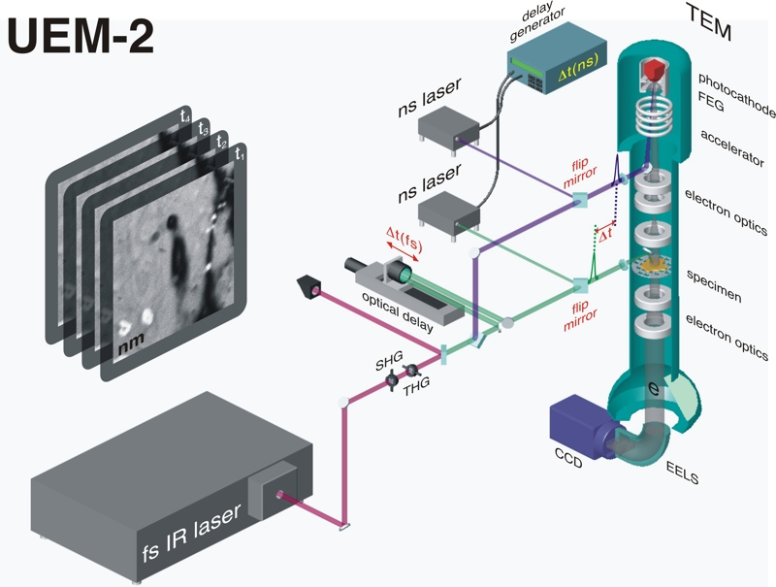
Ultrafast electron microscopy
p
e
stroboscopic, time-resolved , pump-probe electron microscopy
  modified TEM (FEI, Tecnai)
    photoemission gun and specimen photoexcitation
    UEM-1: 120 keV Wehnelt geometry with 50 μm LaB₆ flat cathode
    UEM-2: 200 keV FEG geometry with 16 μm LaB₆ flat cathode
  pump-probe set up
    ultrafast laser pulses to initiate
      SpectraPhysics Tsunami HP (Ti:sapphire, 800 nm, 110 fs, 6 W, 80 MHz)
      Coherent Talisker (Nd:YAG, 1064 nm, 16 ps, 80 μJ, 0 – 200 kHz)
      Clark MXR Impulse (Yb-fiber, 1038 nm, 250 fs, 20 W, 100 kHz – 25 MHz)
    ultrashort electron pulses to probe
      ~500 fs in low current mode
      10 ns in nanosecond mode
  spatial resolution
    up to conventional TEM resolution (albeit signal limited)
  versatility
    imaging
    diffraction
    spectroscopy
    combinations
UEM-2
FHG
Notes:
UEM aims to resolve ultrafast structural dynamics using stroboscopic pump-probe technique, where femtosecond laser pulses initiate dynamics in specimen, and ultrashort electron pulses capture transient structures. Shown in this slide is a schematic of the second generation UEM at Caltech, which is a commercial TEM equipped with energy filter, and modified with optical ports and mirrors for photoemission and photoexcitation. 1038 nm fundamental output of Yb-fiber laser is doubled and quadrupled for specimen and source, respectively, and also nanosecond lasers are used for longer time delay. One aspect of this setup is that optical pump and electron probe beams propagate almost parallel along the z axis direction down the column.

Slide 8
Design considerations
energy filter
in situ
DTEM
cathode size
electron density
energy spread
compression
aberration
correction
spatial
resolution
signal
temporal
resolution
pulse length
TEM
radiation damage
acquisition time
repetition rate
UEM
drift
stability
specimen
dynamics
Notes:
This diagram illustrates the objectives and approaches in various electron microscopy techniques. Conventional TEM is designed to achieve highest possible spatial resolution. Single-shot microscopy, such as in situ TEM and DTEM, aims for temporal resolutions in order to follow a single event in real time, whereas UEM achieves subpicosecond temporal resolution via stroboscopy. What is common in here is a competition with signal.

Slide 9
Resolutions vs. signal
photoemission density ↔ repulsion
cathode size ↔ emittance
condenser thruput ↔ aberration
repetition rate ↔ specimen recovery
acquisition time ↔ specimen drift
Stroboscopic signal
  total number of electrons per acquisition
Temporal resolution
  electron pulse duration
    photoemission energy spread
    space charge effect (number of electrons per pulse)
    compression
Spatial resolution
  Cs aberration
    cathode size & condenser settings
  Cc aberration
    energy spread (space charge effect & compression)
  specimen stability
    repeated dynamics
← laser duration plays little role for < 1 ps
Notes:
The stroboscopic signal is a product of electron density, source size, lens throughput, as well as repetition rate and acquisition time. Changing any parameter inevitably affects spatial or temporal resolution. Notably, space charge effect is the greatest hurdle that we need to overcome, or at least work around.

Slide 10
Electron phase space characterization
Dispersion: electrons disperse due to energy spreads.
Cross ocrrelation: PINEM temporally selects coincident electrons while discretely changing energies.
We can characterize intrinsic duration and dispersion coefficient.
total electron duration
δt = 580 fs >> 250 fs
∂t/∂E = -180 fs/eV
~100 e⁻ at cathode
1.82 eV
Park, Kwon, Zewail, New J. Phys. 14, 053046 (2012)
Notes:
This slide shows the measurement of space charge effect on energy spread and temporal broadening. We found that dispersion is ~200 fs per 1 eV energy spread, and ~100 electrons per pulse results in energy spread of ~4 eV.

Slide 11
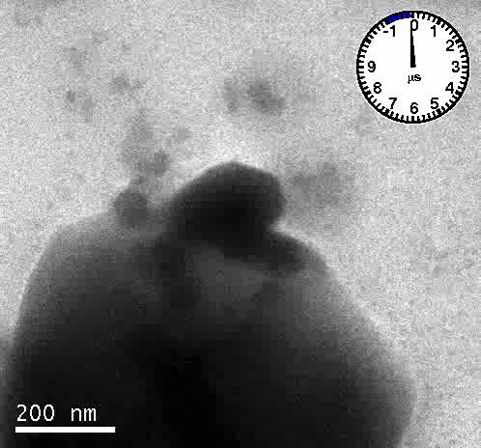
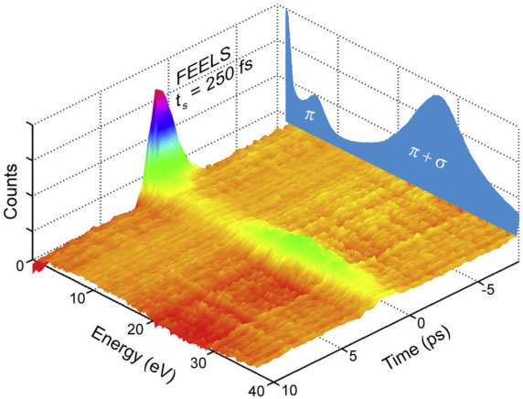
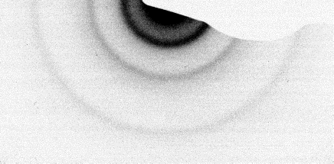
Versatility in UEM
imaging
diffraction
spectroscopy
Cu[TCNQ]
7×7×0.7 μm
-60 ps
MWCNT
graphite
Y
X
100
002
004
+60 ps
Notes:
This slide shows three different modes of operations: imaging to monitor macroscopic position change, diffraction to monitor microscopic lattice dynamics, and spectroscopy to probe electronic dynamics.

Slide 12
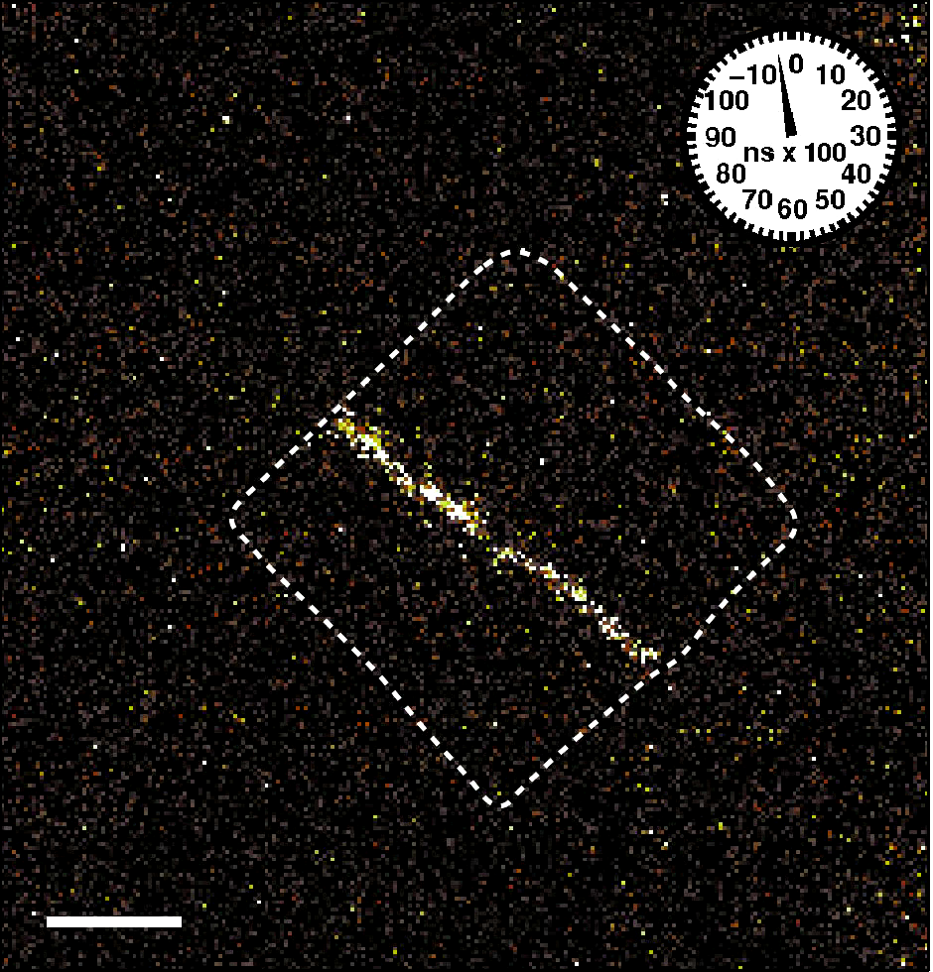
Versatility (combinations)
momentum selected imaging
diffraction contrast
momentum selection
dark field imaging
Fe(pz)Pt(CN)₄
605×605×20 nm
200 nm
energy filtered imaging
bright field image
energy filtering
dark field imaging (PINEM)
graphite 4 nm step
E
E
1 μm
1 μm
Notes:
The next slide demonstrates the versatility in combinational modes, momentum selected imaging and energy-filtered imaging.
Top left shows the bright field imaging of a nanoparticle that undergoes spin-crossover phase transition during which the lattice expands. By selecting a single Bragg spot, its dark field imaging reveals the region where the local lattice orientation satisfies Bragg condition.
Bottom panel shows energy-filtered imaging, which is the technique employed for PINEM. In PINEM, electrons interact with light scattering off the particle, in this case a thin graphite strip, and gain or lose multiple quanta of photon energies. By selecting those electrons for energy-filtered imaging, we can map that interaction.

Slide 13
Part I summary

Slide 14
Part II: Plasmons
Photon-induced near field electron microscopy
Notes:
The second part of the talk is on the visualization of plasmons using PINEM.

Slide 15
Visualization of plasmons
Plasmon
  collective oscillation of free electrons
  localized surface plasmons (LSP) in nanoparticles
    field confinement and enhancement
    geometry dependent
Can we see it ?
Can we see where and how strong ?
How do we visualize plasmon modes ? E, P, or ρ ?
Notes:
Plasmon is a collective oscillation of free electrons in metal. In particular, localized surface plasmons in nanoparticles exhibit field confinement and enhancement. Here, we will ask and try to answer questions, “Can we see the geometry dependence?”, “How do we visualize plasmon modes?”, and “Can we see the electrons?”

Slide 16
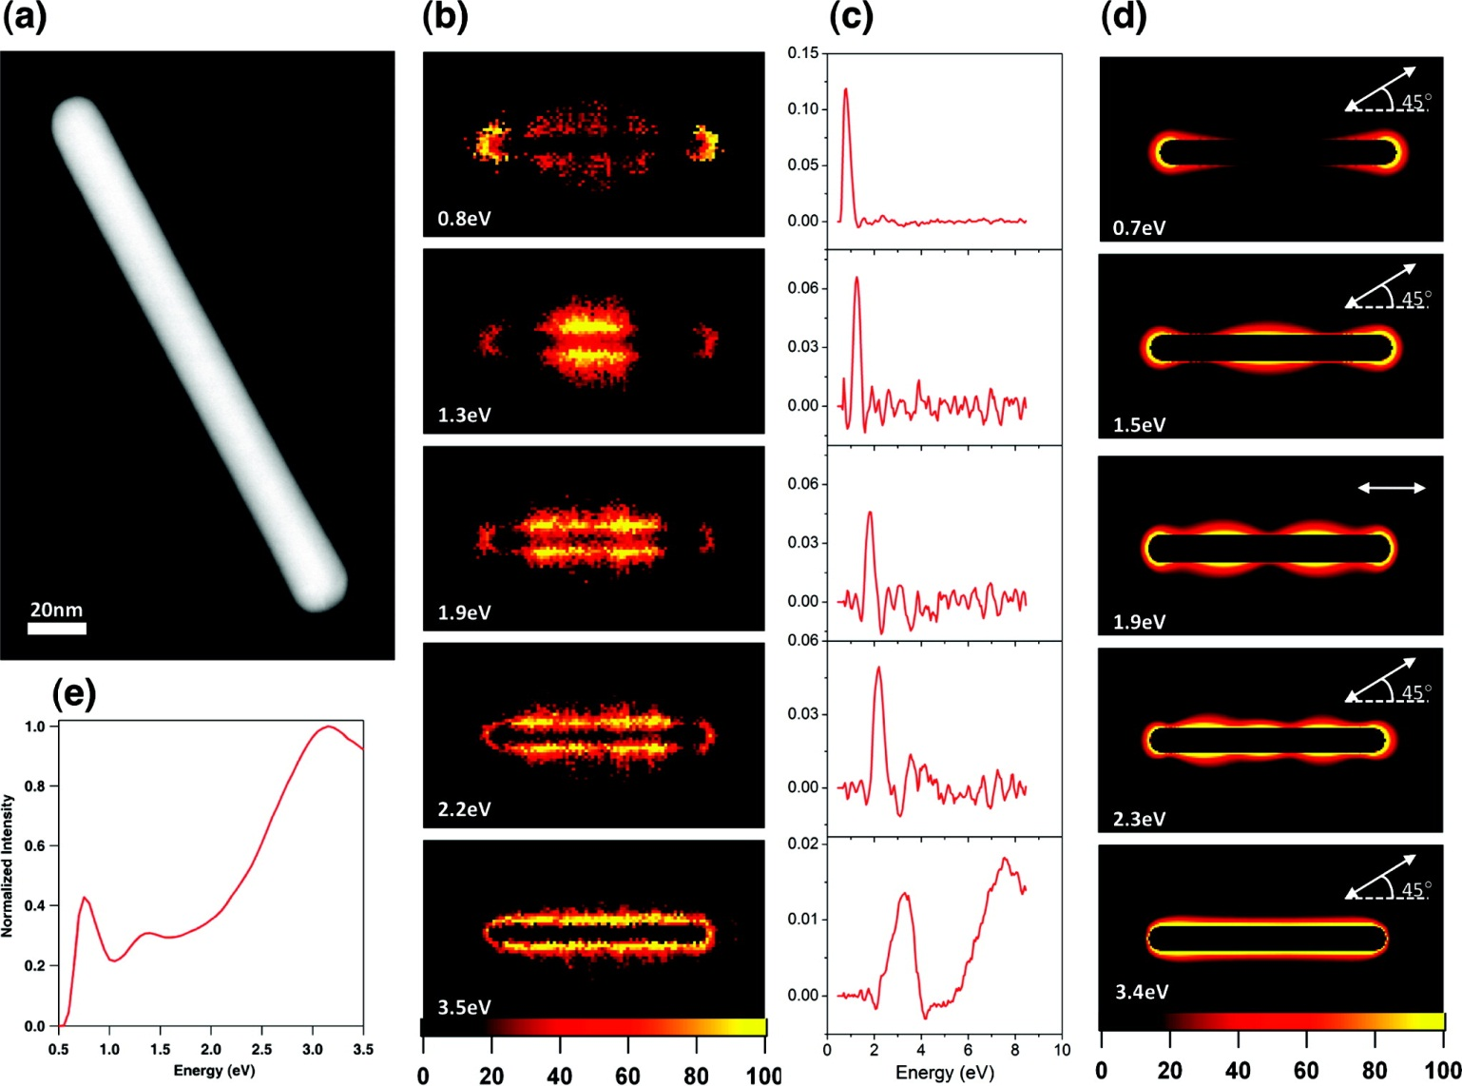
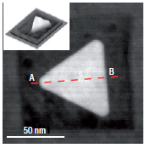
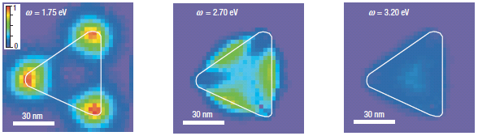
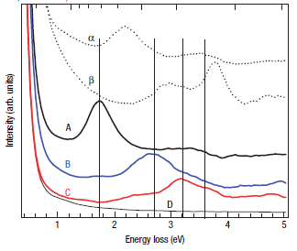
EELS spectral imaging
HAADF
SI
STEM/ADF
STEM/EELS/MVSA
78 x 10 nm
192 x 20 nm
A
C
B
STEM-EELS
EELS
Nelayah, Nat. Phys. 3, 348 (2007)
Guiton, Nano Lett., 11, 3482 (2011)
Notes:
In the recent years, “EELS spectral imaging” has been applied to map plasmon modes in nanoparticles.

Slide 17
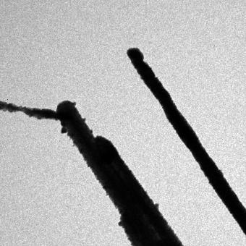
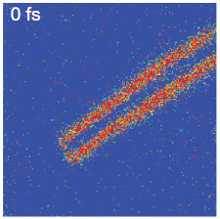
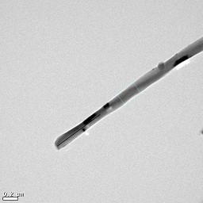
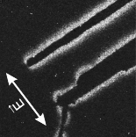
EEGS imaging in (S)TEM electron energy gain spectroscopy in electron microscopy
Photon-induced near field electron microscopy (PINEM)
  plasmons are excited by laser.
  electrons interact w/ plasmon fields and gain/lose energies.
  energy-filtered image w/ electrons that have gained energies
  measures/maps the “electron interaction” w/ the field
In EELS, probe electrons excite plasmons.
TEM bright field image
of silver wire
“PINEM” dark field image
of silver wire
TEM bright field image
of carbon nanotube
Electron energy selection
“PINEM” image
of carbon nanotube
Δt = -2 ps
Δt = 0 ps
gain
loss
Energy
domain
Space
domain
E
E
Notes:
Similarly, electron energy gain spectroscopy can be used to study optically excited plasmons, and its imaging was termed photon induced near field electron microscopy, PINEM. In PINEM, plasmons are excited by the incident laser, and probe electrons interact with plasmon field and exchange photon energies, which drastically changes electron energy spectrum. By selecting those electrons that gained photon energies, we can form the PINEM image which maps the “electron-plasmon interaction”.
Now we understand its temporal behavior, and energetics fairly well, but spatial pattern is not.

Slide 18
Theoretical solution
Time-dependent Schrödinger Equation
  Hamiltonian in Coulomb gauge
  initial state
  first order solution
  field integral
  for envelope function
  for wavefunction
  transition probability
  electron population density
Park, Lin, and Zewail, New J. Phys. 12, 123028 (2010)

Slide 19


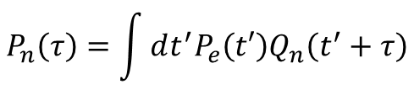
Behavior of phenomenon
Theory quantitatively agrees with experiments.
  spatial & polarization
  temporal
  energetics
Localized
  within 60 nm around nanoparticles
Allows a temporal mapping
  cross-correlation with optical pulse
  higher order by multiple photons
Conserves energy
  discretely changed by photon energy
$$P_{n}\left(τ\right)=\int{dt^{′}P_{e}\left(t′\right)Q_{n}\left(t^{′}+τ\right)}$$
$$Q_{n}∝{\left\{I_{p}\left(t\right)\right\}}^{n}$$
$$\left\langle E_{n}\right\rangle =\left\langle E_{0}\right\rangle +nℏω$$

Slide 20
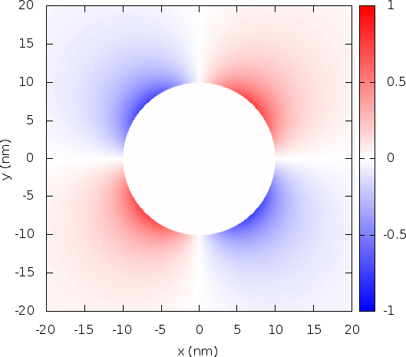
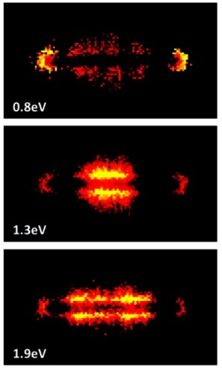

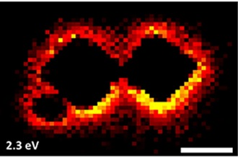
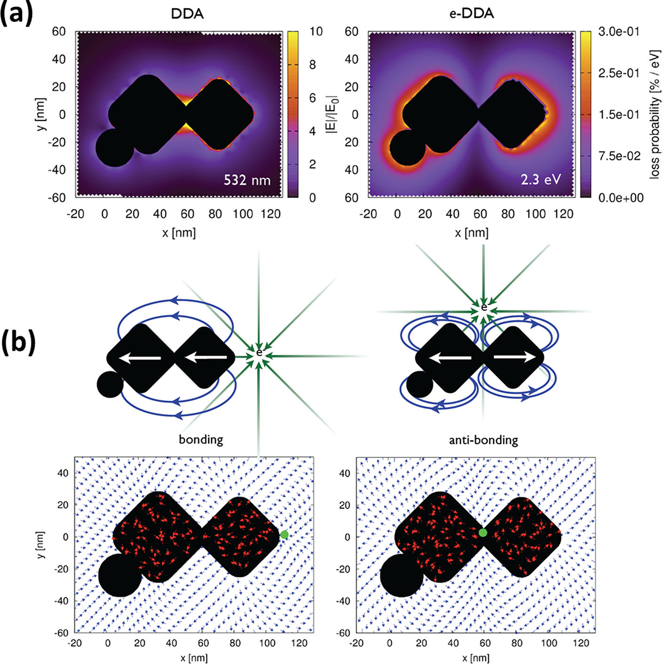



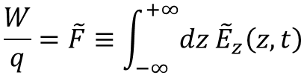


Degree of interaction in EEGS
“field integral”
Probability
$$I_{+1}\left(x,y\right)∝{\left|\tilde{F}\right|}^{2}$$
Interaction
$$\frac{W}{q}=\tilde{F}≡\int_{−∞}^{+∞}{dz{ \tilde{E}}_{z}\left(z,t\right)}$$
for $z=vt$ at $\left(x,y\right)$
Electric field
$E\left(r,ω\right)$ by plasmon (from light scattering)
$$E=\left(E_{x},E_{y},E_{z}\right)$$
$$∇∙E=ρ/ε_{0}$$
Ez at t = 0
I (EELS)
|E| (DDA)
I (EELS)
z = vt
I (simulation)
|E| (DDA)
Garcia de Abajo, New J. Phys. 10, 073035 (2008)
Park, et. al., New J. Phys. 12, 123028 (2010)
Guiton, Nano Lett., 11, 3482 (2011)
Mirsaleh-Kohan, J. Phys. Chem. Lett. 3, 2303 (2012)
Notes:
To describe PINEM, we solved time-dependent Schroeding equation where the interaction term can be expressed as the mechanical work performed by the electromagnetic wave on the moving electron, and we will call this “field integral, F”. Then the signal probability in PINEM image is related to the electric field via the interaction term, F, and efforts have been made to correlate the signal and the electric field in both PINEM and EELS plasmon mapping. That correlation has been successful for some cases, but not for others. That is in part due to the fact that the signal and the field integral are scalar values in 2D projection plane whereas the electric field is a three-component vector quantity in 3D space. Note that only the z component is integrated along the electron trajectory in the field integral, whereas we are often more interested in the x and y components. Nevertheless, Maxwell’s equation tells us that these components have a certain relation, which we will examine as follows.

Slide 21



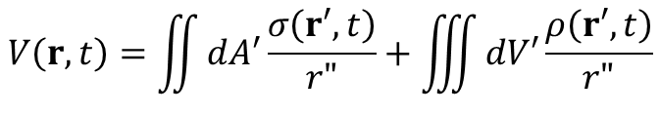


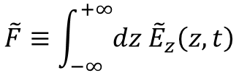
Near field approximation in Coulomb gauge
Field integral
$$\tilde{F}≡\int_{−∞}^{+∞}{dz{ \tilde{E}}_{z}\left(z,t\right)}$$
for $z=vt$ at $\left(x,y\right)$
near field = Coulomb field of instantaneous charges
Electric field
$$=−∇V−\frac{∂A}{∂t}$$
near field approximation
$$E$$
$$V\left(r,t\right)=\iint{dA′\frac{σ\left(r′,t\right)}{r"}}+\iiint{dV′\frac{ρ\left(r′,t\right)}{r"}}$$
Coulomb potential
Induced charge
$$σ=\hat{n}∙P$$
$$ρ=−∇∙P$$
linear material
Polarization
Notes:
First we invoke “near field approximation” for simplicity, because we know that the PINEM signal is only significant around nanoparticles. In near field approximation in Coulomb gauge, we can ignore vector potential, and the near field is given by a gradient of scalar potential only, which becomes Coulomb field of instantaneous charges. Furthermore, for a linear material, volume charge density vanishes and we only need to consider surface charge density.

Slide 22
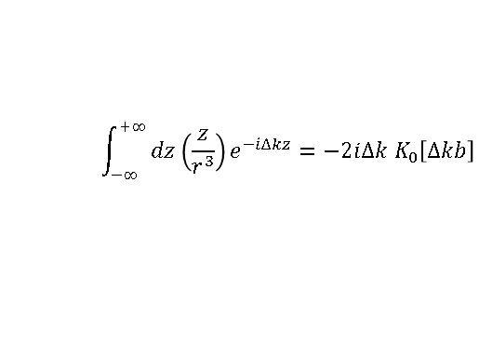
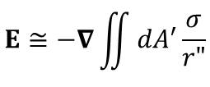

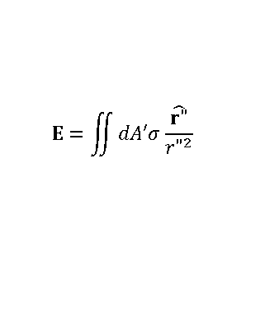
Evaluating the field integral
total electric field
total field integral
volume integral
mechanical work
convolution
charge fields
charge field integrals
charge near fields
$$E=\iint{dA′σ\frac{\hat{r"}}{{r"}^{2}}}$$
$$\int_{−∞}^{+∞}{dz{\left(\frac{z}{r^{3}}\right)e}^{−i∆kz}}=−2i∆k K_{0}\left[∆kb\right]$$
induced charge density
$$E≅−∇\iint{dA′\frac{σ}{r"}}$$
induced polarization
incident light
$$\tilde{F}≡\int_{−∞}^{+∞}{dz{ \tilde{E}}_{z}\left(z,t\right)}$$
light scattering
Notes:
Then we revise the integration scheme, and change the order of field integral and volume/area integral. Previously we evaluate the total electric field and then the field integral. Fundamentally, this light scattering results from the induced charges, and therefore instead for total electric field, we can evaluate the field integrals for individual charges first, and then sum them together to obtain the total field integral. With the near field approximation, the alternative procedure becomes simple because we now have Coulomb fields of charges, whose integral is simply given by a modified Bessel function of the second kind, and summation becomes convolution.

Slide 23
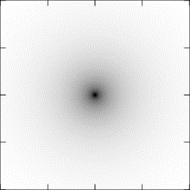
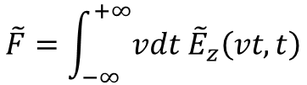


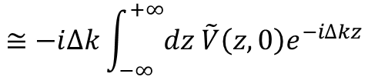

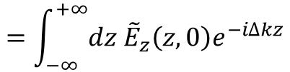
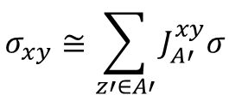
Near field integral
Mechanical work
$$\tilde{F}=\int_{−∞}^{+∞}{vdt {\tilde{E}}_{z}\left(vt,t\right)}$$
Fourier transform of electric field
$$=\int_{−∞}^{+∞}{dz{ \tilde{E}}_{z}\left(z,0\right)e^{−i∆kz}}$$
$$∆k≡\frac{ω}{v}$$
F.T. of Coulomb potential
$$≅−i∆k\int_{−∞}^{+∞}{dz \tilde{V}\left(z,0\right)e^{−i∆kz}}$$
Convolution of projected charge
$$∝K_{0}\left[∆kb\right] ⨂{ σ}_{xy}$$
$$b=\sqrt{x^{2}+y^{2}}$$
σ_{xy} = all the charges in electron trajectory along z at (x,y).
$$σ_{xy}≅\sum_{z′∈A′}{J_{A′}^{xy}σ}$$
K₀ = (long-range) Coulomb field interaction of each charge oscillation.
Convolution accounts for contributions from all the charge densities.
100 nm
Park and Zewail, Phys. Rev. A (submitted)
Notes:
Due to the nature of TEM (and in order to utilize 2D convolution), we convert the charge density distribution into “projected charge density” which, simply speaking, is a projection of charge density on the nanoparticle surface onto the XY image plane, with Jacobian factor. As mentioned, K0 function describes Coulomb field interaction of individual charge density, and as shown in the plot, it is slowly-decaying, diffuse function of distance, because Coulomb interaction is a long range interaction. Finally, convolution accounts for all the charge density in the particle.

Slide 24

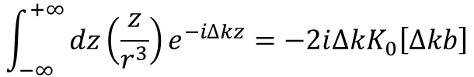
Theory of “near field integral”
$$ℱ\left\{\frac{z}{r^{3}}\right\}=−2i∆kK_{0}\left[∆kb\right]$$
near field = instantaneous Coulomb field
  field integral of Coulomb field is K₀.
near field integral = convoluted charge density
  projected charge density:
  general case:
  y-invariant:
    cylinder, strip
$$\int_{−∞}^{+∞}{dz{\left(\frac{z}{r^{3}}\right)e}^{−i∆kz}}=−2i∆kK_{0}\left[∆kb\right]$$
Park and Zewail (submitted)
Notes:
K0 is modified Bessel function of the second kind

Slide 25

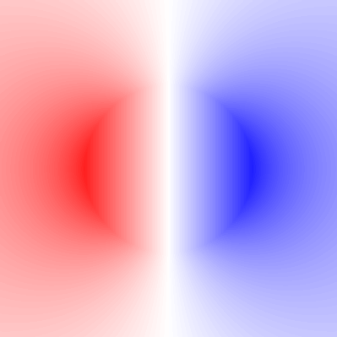
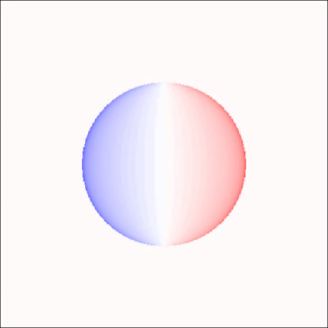

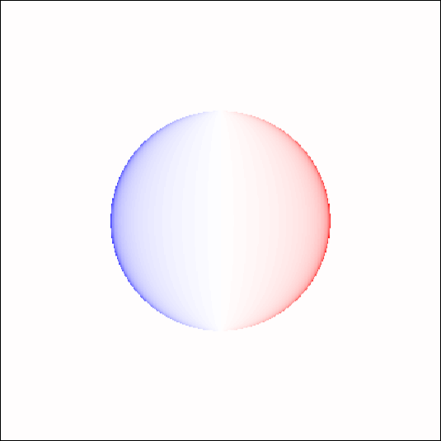
Evaluating the field integrals
Convoluting the charge density
y
x
E_{z}
field integral
y
z
E_{z}
E_{z}
x
E_{z}
-Im[F₀]
P_{x}
radiation
polarization
σ=n·P
induced charges
F is a blurred map of charges.
near field integral
σ_{xy}
-Im[F_{c}]
σ
projection
100 nm
Notes:
This slide compares the two procedures to obtain the field integral. Incident light excites oscillating polarization which radiates in space and we integrate this radiation field to obtain the field integral. Alternatively, we evaluate charge density distribution and its projection, then K0 convolution gives “near field integral” which retains most of field integral. Here, now we can see that the field integral is a “blurred map of charge density”, and blurring profile is given by K0 of impact distance. A simple Rayleigh scattering shown in here creates an oscillating dipole charge density, and the field integral directly reflects that dipole character.

Slide 26















Multipole case: silver nanorod (192×20 nm)
ħω
e⁻
x
z
y
192 nm
charge density is the direct source of the E field and the PINEM signal.
P_{x}
|E| at z=0
1.10 eV
2.54 eV
3.10 eV
Coulomb field
σ_{xy}
σ
convolution
-Im[F_{c}]
charge blobs
|F_{c}|²
Notes:
A more complex system, 200 nm long silver nanorod, studied by STEM-EELS was shown in the earlier slide. In the bottom, PINEM field integral and PINEM image are simulated at three different resonance energies. PINEM images show two, four, and six blobs. We calculate the surface charge density, and its projection. We can see that the field integral is a blurred map of charge density, and those blobs in PINEM image correspond to extrema of charge density oscillation. We also can see that electric field outside the particle can be well understood from the charge density distribution. Namely, charge density is the direct source of electric field and field integral, and consequently PINEM signal.

Slide 27
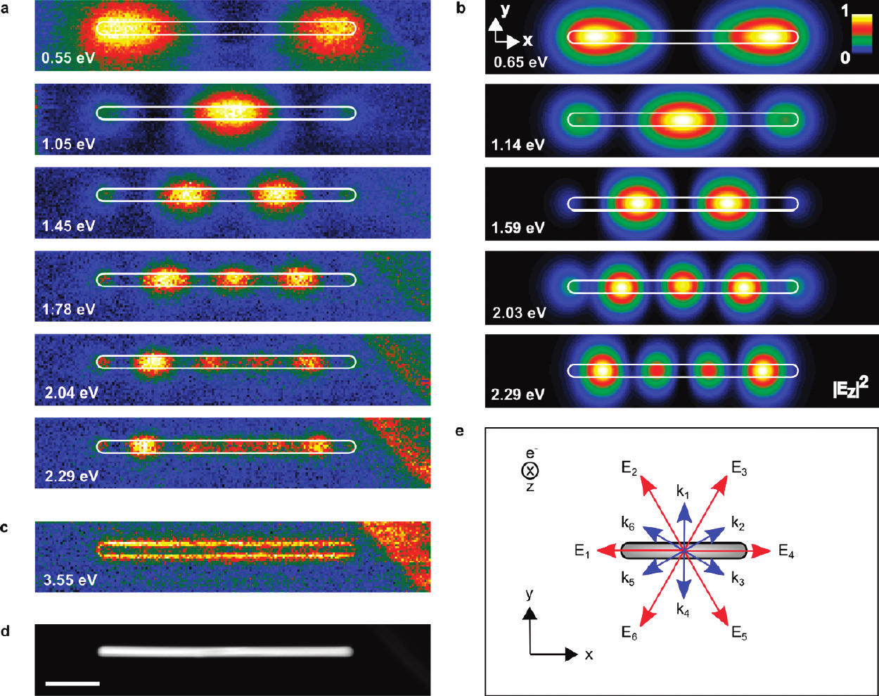



EELS and PINEM: 500 nm nanorod
STEM-EELS
induced charge density
near field integral
PINEM
1.10 eV
l=1
2.54 eV
l=3
3.10 eV
l=5
Y @ 3.63 eV
l’=1
Rossouw, Nano Lett., 11, 1499 (2011)

Slide 28
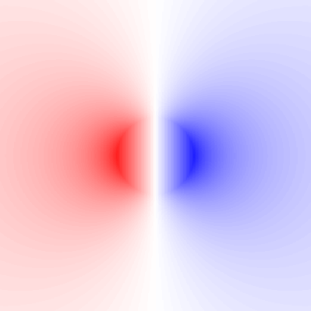
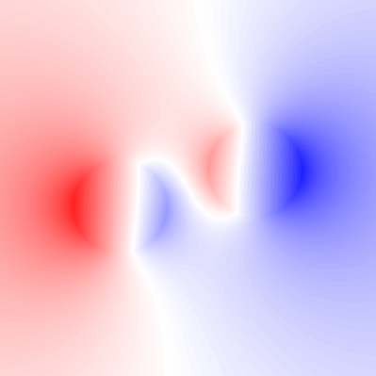
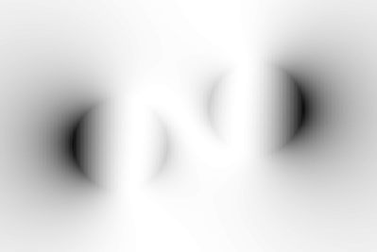
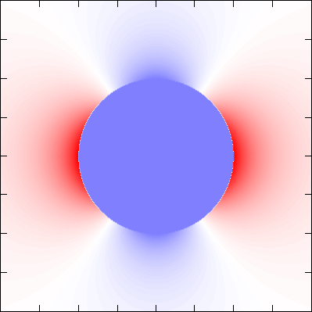
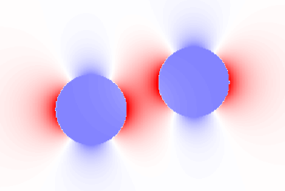
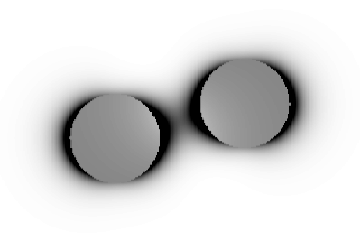
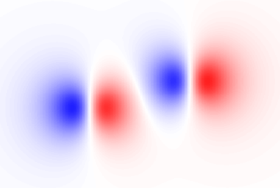
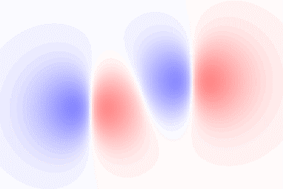
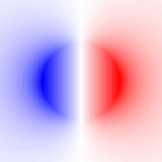
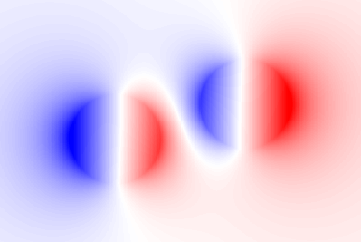



Comparisons to F
F
|F|²
Ex(0)
|E(0)|
E maximum (E_{x} at z=0)
E_{z} maximum (E_{z} at z=h)
V maximum (V at z=0)
σ and ρ
P
Ez
$$E≈−∇V$$
V(0)
$$V\left(0\right) \sim F$$
σ_{xy}
$$F∝K_{0}⊗σ_{xy}$$
Px
Notes:
A single nanorod was the example where electric field and STEM-EELS are well correlated. However, a dimer and its junction field is a different story. Here shown is a simple dimer of two nanospheres, fairly aligned to incident light polarization in x axis. Its field is stronger in between particles, whereas PINEM signal is weaker there. It is more evident if we plot the field integral and the dominant field component, Ex. Ex from particles add up together whereas there is destructive interference and a node in F. This can be understood if we plot two monomers separately. Again we can see that the field integral is a blurred map of charge density which shows positive, negative, positive, negative blobs. What is interesting is that Coulomb potential is well correlated to the field integral. Since the electric field is a gradient of Coulomb potential in near field approximation, we may approximately interpret that the electric field strength is correlated to the slope of PINEM field integral, not the absolute value of PINEM intensity. This point is particularly important at nodes in F and V at the junction, but also true where F simply decays.

Slide 29
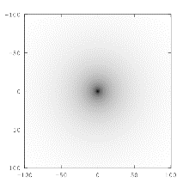
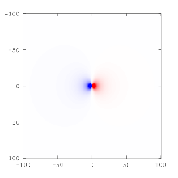
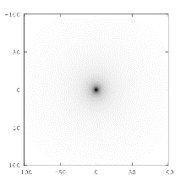
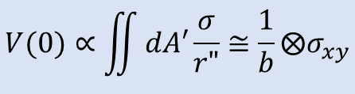
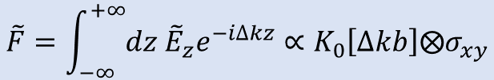

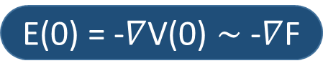



Comparisons
$$K_{0}≅−\log_{}{}$$
$$\tilde{F}=\int_{−∞}^{+∞}{dz{ \tilde{E}}_{z}e^{−i∆kz}}∝K_{0}\left[∆kb\right]⨂σ_{xy}$$
$$E_{x}\left(0\right)∝\iint{dA′σ\frac{x"}{{r"}^{3}}}≅\frac{x}{b^{3}}⨂σ_{xy}$$
E maximum (E_{x} at z=0)
E_{z} maximum (E_{z} at z=h)
V maximum (V at z=0)
σ and ρ
P
$$E_{z}\left(h\right)∝\iint{dA′σ\frac{z"}{{r"}^{3}}}≅\frac{h}{{\sqrt{b^{2}+h^{2}}}^{3}}⨂σ_{xy}$$
$$V(0)∝\iint{dA′\frac{σ}{r"}}≅\frac{1}{b}⨂σ_{xy}$$
F $\sim$ V(0)
E(0) = -$∇$V(0) $\sim$ -$∇$F
F, V(0), Ez(h) reflect σ, ρ

Slide 30
Part II summary
EEGS measures the electron-plasmon interaction.
  “PINEM image” spatially maps the interaction (not the field itself).
    PINEM field integral = mechanical work by electromagnetic wave (E_{z})
  “PINEM” visualizes charge density via Coulomb interaction.
    PINEM field integral = K₀-convolution of projected charge density.
      K₀[Δkb] describes Coulomb interaction of an oscillating charge density.
      Convolution accounts for the total interaction.
PINEM can visualize the plasmon mode:
  convoluted charge density projection
    plasmon is a collective oscillation of free electrons.
  related to Coulomb potential
    |E| is correlated to the slope, not the absolute intensity, of PINEM image.
  correlated to E_{z} maximum (≠ |E| maximum)
also applicable to EELS
Notes:
In summary, PINEM does measure and map the “interaction of electron with field”. Near field approximation allows one to express that field as Coulomb field of instantaneous charge density, and then we can also see that PINEM is a “blurred map of charge density”. The charge density is the fundamental source of the electric field as well as the field integral. We also showed that Coulomb potential is more correlated to the field integral than the electric field does, which is also applicable to EELS.

Slide 31



Acknowledgement
Advisor
  Prof. Ahmed H. Zewail
Funding
  Moore foundation
  NSF
  AFOSR
UEM-1
  Dr. Vladimir Lobastov
  Dr. Ramesh Srinivasan
  Dr. Jonas Weissenrieder
  Dr. David Flannigan
  Dr. Petros Samartzis
  Dr. Anthony Fitzpatrick
  Dr. Ulrich Lorenz
UEM-2
  Dr. J. Spencer Baskin
  Dr. Hyun Soon Park
  Dr. Oh-Hoon Kwon
  Dr. Brett Barwick
  Dr. Volkan Ortalan
  Dr. Aycan Yurtserver
  Dr. Renske van der Veen
  Dr. Haihua Liu
  Dr. Byung-Kuk Yoo
  Dr. Mohammed Hassan
PINEM experiments

