Slide 1
Femtosecond low-energy electron diffraction and imaging
A. Paarmann, M. Müller, S. Lüneburg, R. Ernstorfer
Femtosecond Electron Imaging and Spectroscopy
Dec. 11th, 2013

Slide 2
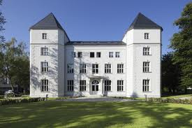
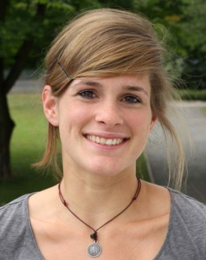
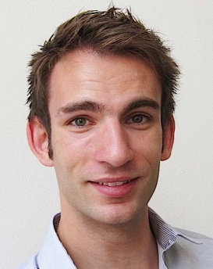
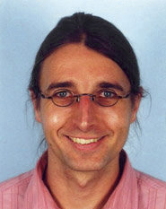
Acknowledgements
FHI Berlin
Max Planck Research Group
“Structural and Electronic Surface Dynamics”
Nanometer Structure Consortium, Lund University
Magnus Borgström
Martin Hjort
Anders Mikkelsen
Lars Samuelson
Melanie Müller
Sebastian Lüneburg
Ralph Ernstorfer

Slide 3
Ultrafast Electron Diffraction & Microscopy
Pump-probe:
Ultrafast temporal resolution
Diffraction / Microscopy:
Structural (atomic) resolution
+
time scale: 100 fs
length scale : Å … nm
10 MeV
Relativistic electron diffraction
1 MeV
Transmission
electron microscopy
Transmission
electron diffraction
Gas phase
electron diffraction
100 keV
Charge per pulse
Electron energy
Reflection high-energy
electron diffraction
Scanning
electron microscopy
10 keV
1 keV
Low-energy
electron diffraction /
microscopy
+ High surface sensitivity
+/- Very sensitive to electric fields
+ Little sample damage
100 eV

Slide 4
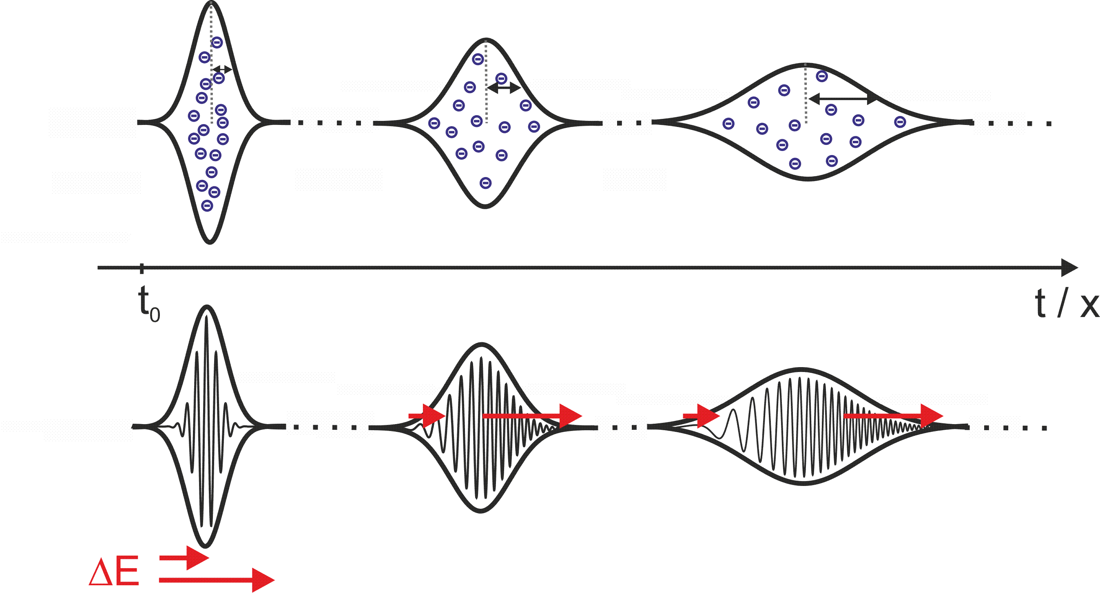
Major Challenge at Low Energies: Electron Pulse Duration
Delivering < 100-fs electron pulses at sub-kV energies is a big challenge !
Space charge
Vacuum dispersion
Time-resolved experiments:
Short propagation time → Compact design
Single / few electron pulses at high rep-rate
Nanotips as electron gun !
First time-resolved LEED: Karrer, Osterwalder et al., Rev. Sci. Instrum., 72 , 4404 (2001)
4

Slide 5
Electron Pulse Duration: Simulations
0
0.9
0
tip
dispersion
U_{tip} = -200 V
d = 100 μm
E₀ = 0.5 eV
path length difference
sample
5
Paarmann et al., J. Appl. Phys. 112, 113109 (2012)
Notes:
Left Plot:
Sigma = 10°, d=100 um, V=-200 V
Right Plot:
V = -200 V, d = 100 um

Slide 6
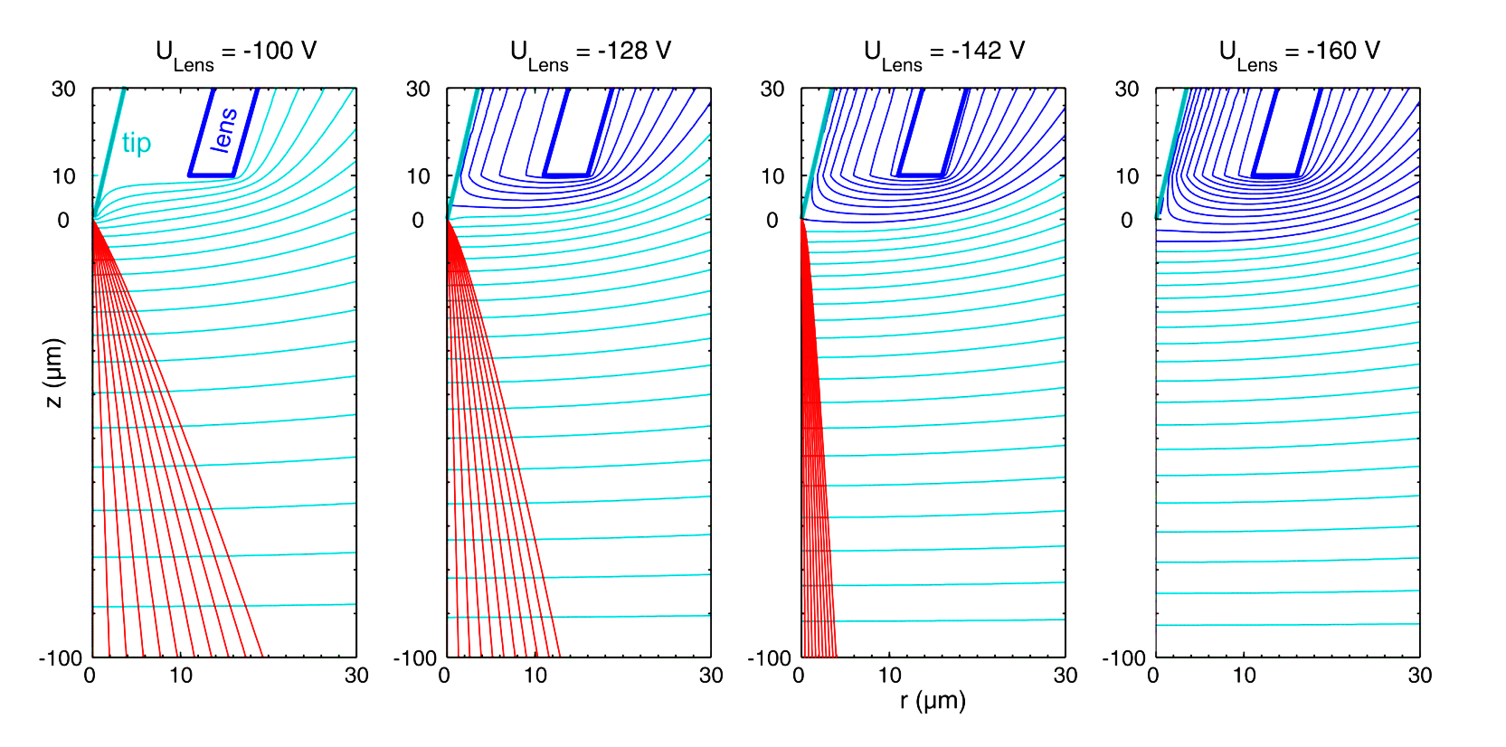
Beam Collimation for Diffraction: ‚Lens Behind the Tip‘
Macrolens
Microlens
U_{tip} = -100 V
Paarmann et al., J. Appl. Phys. 112, 113109 (2012)
U ≤ -100 V
U > -100 V
Lüneburg et al., Appl. Phys.
Lett. 103 , 213506 (2013)
Collimation (Focussing) due to plate-capacitor-like field lines
Typically < 5 μm spot size on the sample
suppression of DC field enhancement + current
Disadvantage: dispersive pulse broadening enhanced

Slide 7
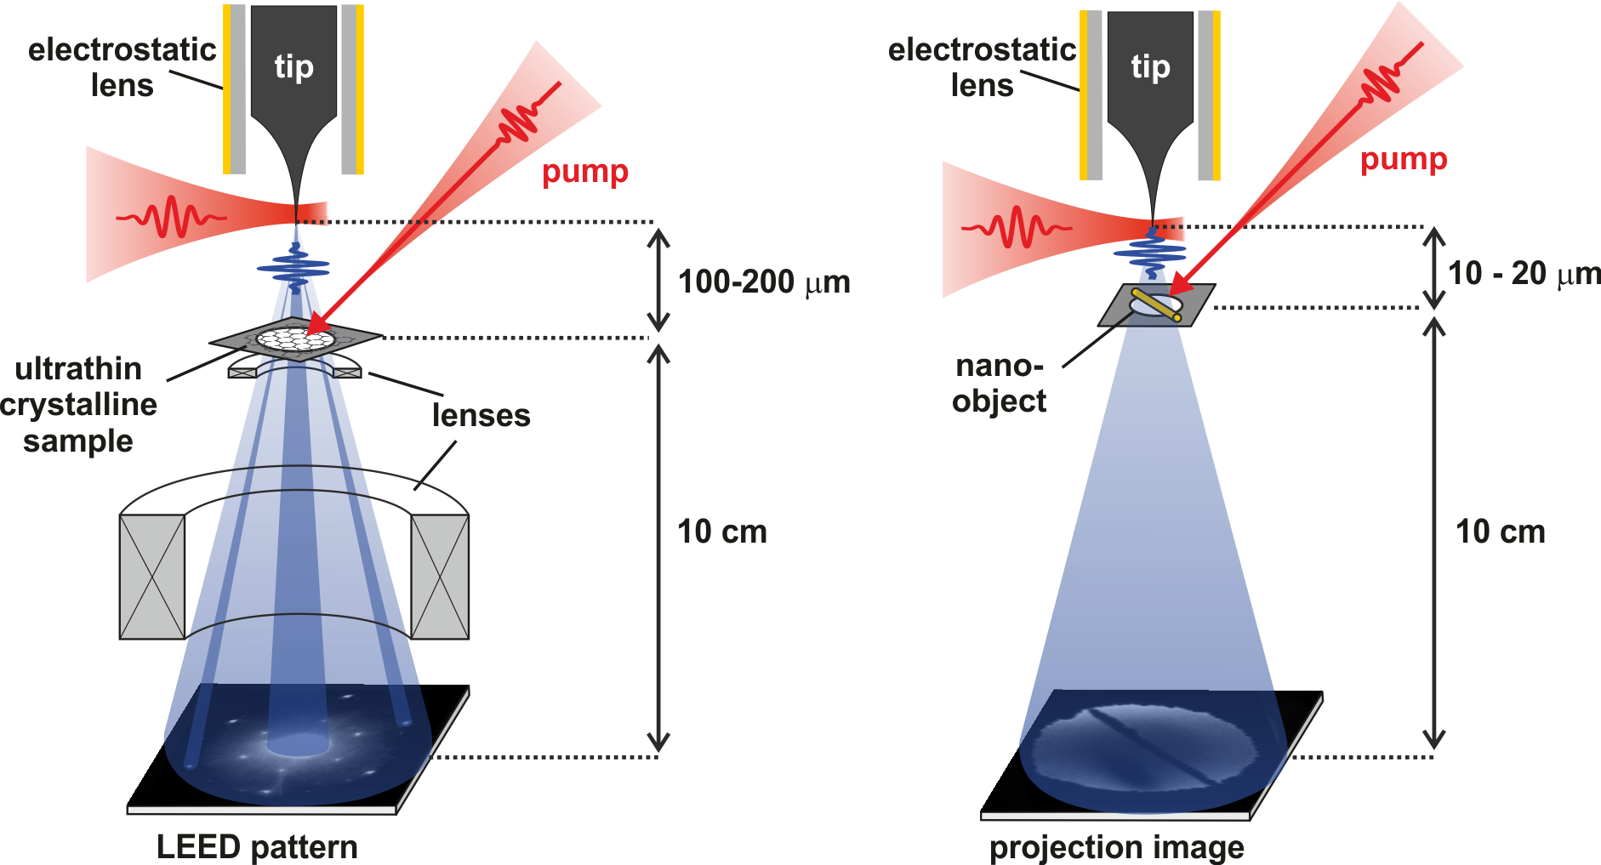
Experimental Concepts
Time-Resolved Low-Energy
Electron Diffraction (trLEED)
Time-Resolved Point Projection Microscopy (trPPM)
Atomic structural dynamics with high surface sensitivity
Ultrafast dynamics in 2D and quasi-2D systems
Ultrafast imaging of nano-scale systems
Spatially resolved probing of
transient electric fields
7

Slide 8
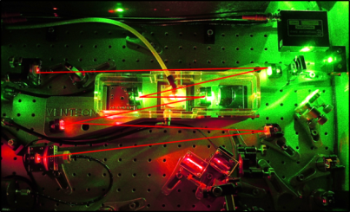
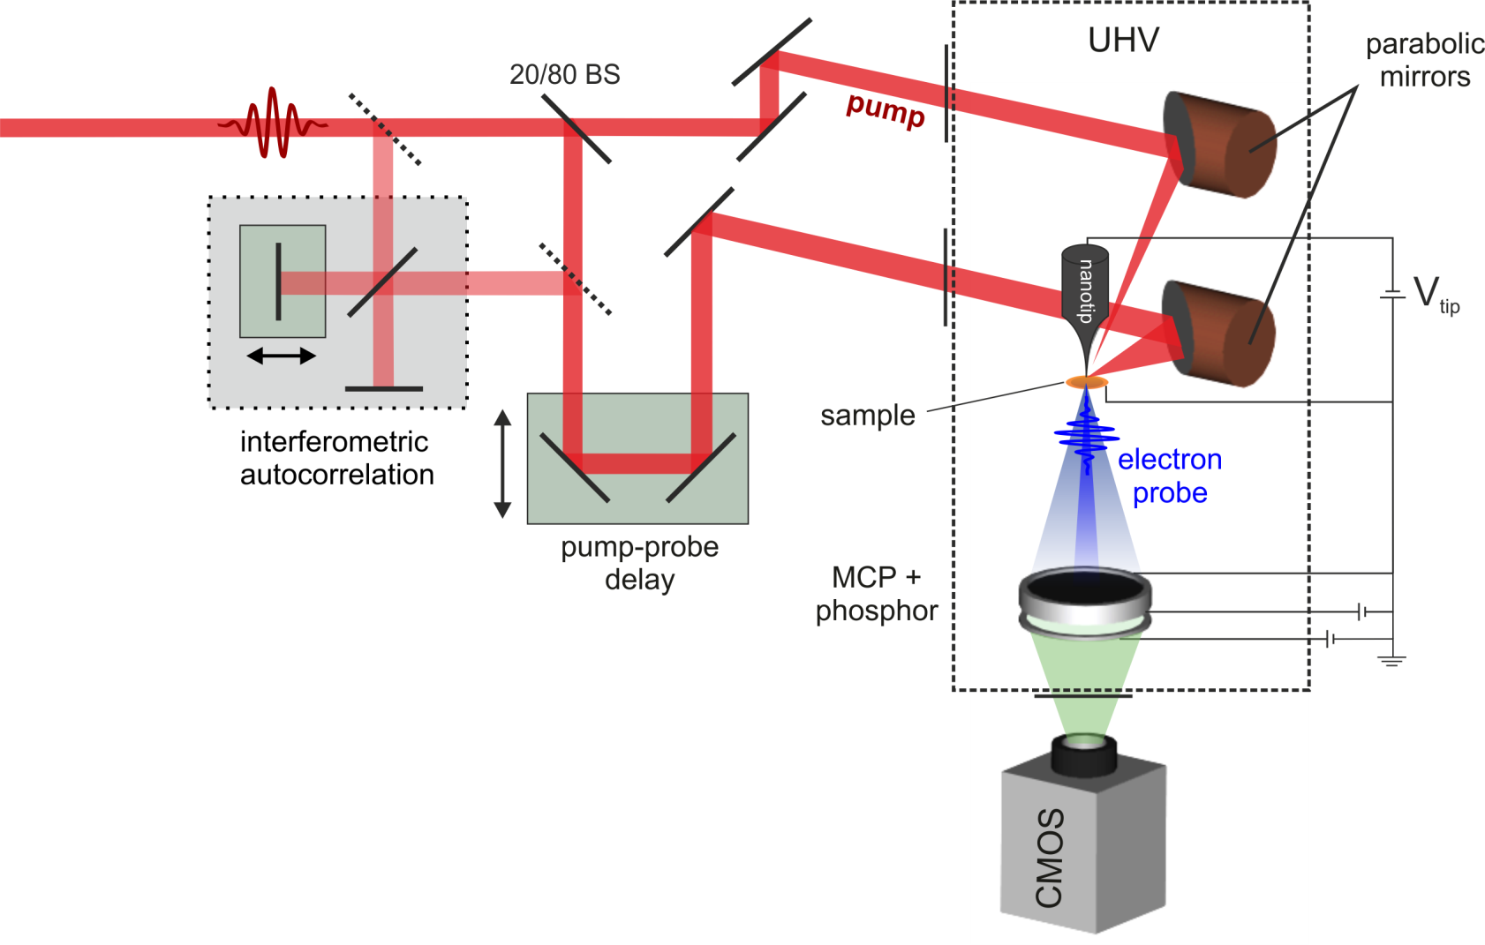
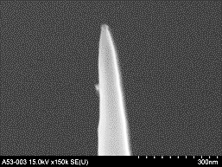
Experimental Setup
Ti:Sa oscillator
80 MHz, 2 nJ, 5 fs
Cavity dumped Ti:Sa
1 MHz, 30 nJ, 16 fs
Regenerative Ti:Sa amplifier
200 kHz, few μJ, 50 fs
100 nm
0.18 e⁻/pulse

Slide 9
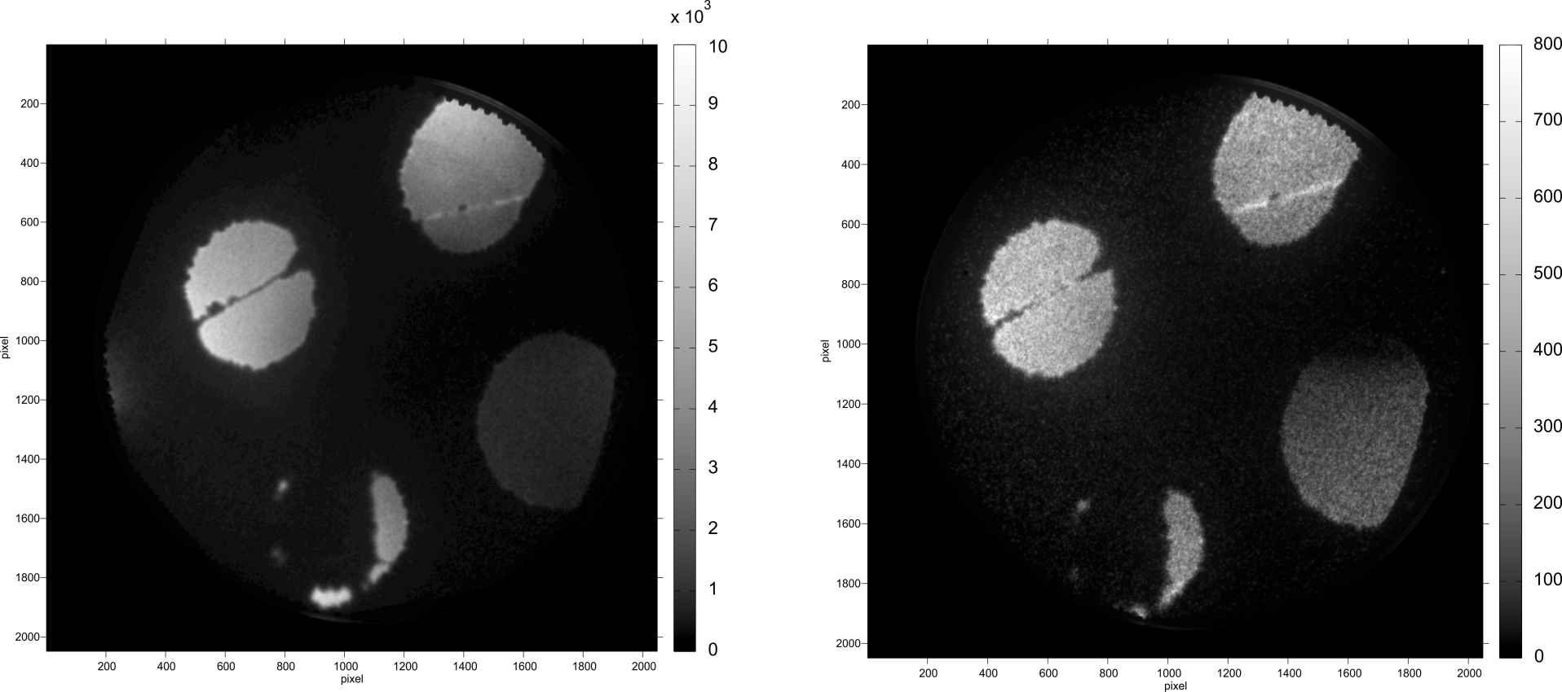
Point Projection Imaging with fs-Electron Pulses
60 nm gold nanowires on quantifoil (2 μm holes)
DC field emission
Laser-triggered emission
Electron energy | 150 V
Tip-sample distance | 25 μm
Integration time | 0.5 s
Electron energy | 100V
Tip-sample distance | 25 μm
Integration time | 1 s
Laser power | 10 mW

Slide 10
Transmission LEED of single-layer graphene
Unpublished data …

Slide 11
Space Charge Dynamics
Generate space charge from a metal surface/edge and detect deflection of the probe electron beam
Pt pinhole
Cu TEM grid edge
Laser | Coherent RegA | 200 kHz, 50 fs
Pump | Power | 31 mW
 | Fluence | 50 mJ/cm²
Probe | Power | 1.3 mW
Tip-sample distance |  | 300 μm
Electron energy |  | 261 eV
Lens bias |  | -702 V

Slide 12
Space Charge Dynamics
Unpublished data …

Slide 13
Space charge dynamics
Unpublished data …

Slide 14
Transient Electric Fields at Photoexcited Semiconductor Nanowires
time-resolved Point projection microscopy
Semiconducting InP nanowires
Diameter: 30 nm, length: 1.5 μm
Placed on quantifoil substrate
Hjort et al., ACS Nano 6, 9679 (2012)
Laser | Cavity dumped | 1 MHz, 16 fs
Pump | Power | 660 μW
 | Fluence | 300 μJ/cm²
Probe | Power | 1.4 mW
Tip-sample distance |  | ~ 20 μm
Electron energy |  | 70 eV
Lens bias |  | -345 V

Slide 15
Nanowire Local Field Dynamics
Unpublished data …

Slide 16
Nanowire Local Field Dynamics
Unpublished data …

Slide 17
Outlook: „Divergent Beam LEED“
Unpublished data …

Slide 18
Summary
Extremely compact, versatile machine for time-resolved low-energy electron diffraction and microscopy
Large scattering cross section of low energy electrons
Best suited for low-dimensional systems
High sensitivity to local electric fields
First observation of real-space local field dynamics at semiconductor nanowires
Resolution in microscopy mode: < 200 fs, ~ 30 nm
Resolution in diffraction mode: < 2 ps, < 0.02 Å⁻¹
Thanks for your attention!

