Slide 1
Multi-GeV Electron Radiography for Applications at MaRIE
FEIS Workshop 2013
Frank Merrill, LANL
12/9-12/12

Slide 2
Outline
LANL is considering using 12 GeV for fast, transmission imaging of dynamic systems.
Penetrating mm samples
Providing <μm resolution
Providing multi-frame, short exposure images.
Parasitically using electrons from an FEL driver.
MaRIE (Matter and Radiation in extremes) and the multi-probe diagnostic hall (MPDH)
Example: proton radiography and x-ray imaging characterizing “slow” casting processes.
Using 12 GeV electron beams for high resolution charged particle radiography.

Slide 3
The Team at Los Alamos
Frank Merrill, Konstantin Borozdin, Joseph Febritius, Robert Garnett, Fesseha Mariam, Christopher Morris, Alexander Saunders, Peter Walstrom,

Slide 4
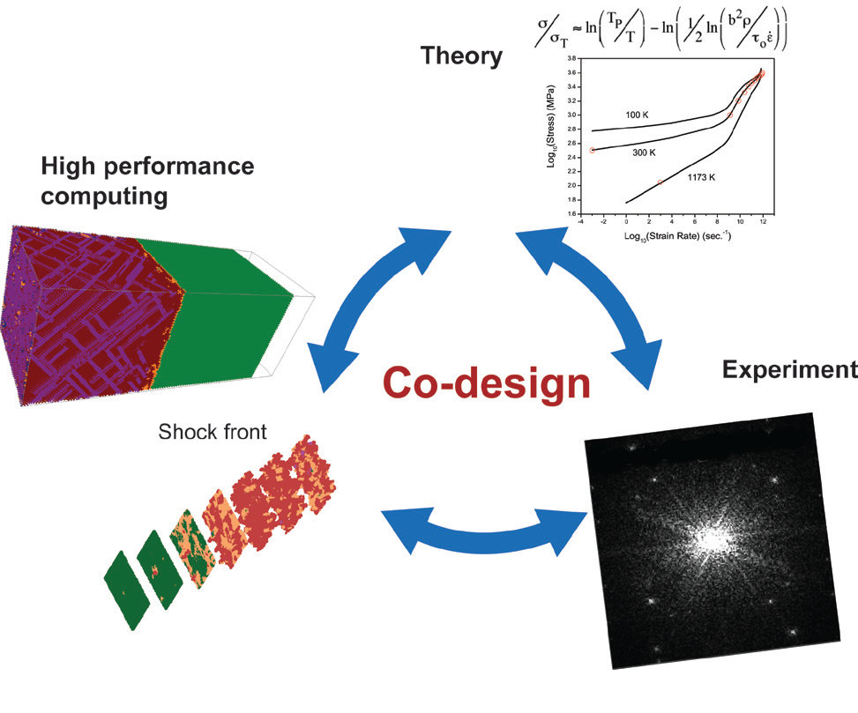
MaRIE is being developed to provide the tools for co-design; solving multi-billion dollar material development challenges.
Example:
Today it takes approximately 20 years to certify a new structural material for advanced fission reactors, a pace inconsistent with the needed nuclear renaissance to solve our energy challenge. A process-aware understanding of materials performance is defined as a predictive understanding of how materials processing affects ultimate performance.
Serendipity in the hands of the intuition has been remarkably successful, but the ultimate goal of “materials by design” is the ability to write a chemical formula on a chalkboard and deduce the bulk material properties. While that is a distant goal, it is within our grasp to use theory to direct in which way to guide synthesis or take the next in situ data point in a sample.
Co-design: science based approach which seamlessly couples theory, experiment, and simulation tools with deliberate feedback in “real time” to efficiently predict and control materials properties.

Slide 5
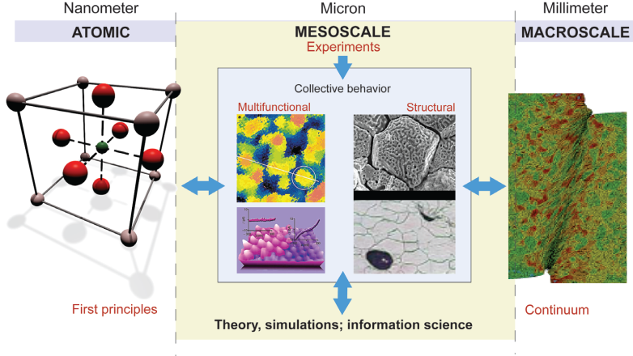
Multi-Probe Diagnostic Hall (MPDH) combines the probes required to characterize dynamic material properties.
FEL x-rays
Electrons
Protons
We need to measure at the micron length scale in ~mm samples.

Slide 6
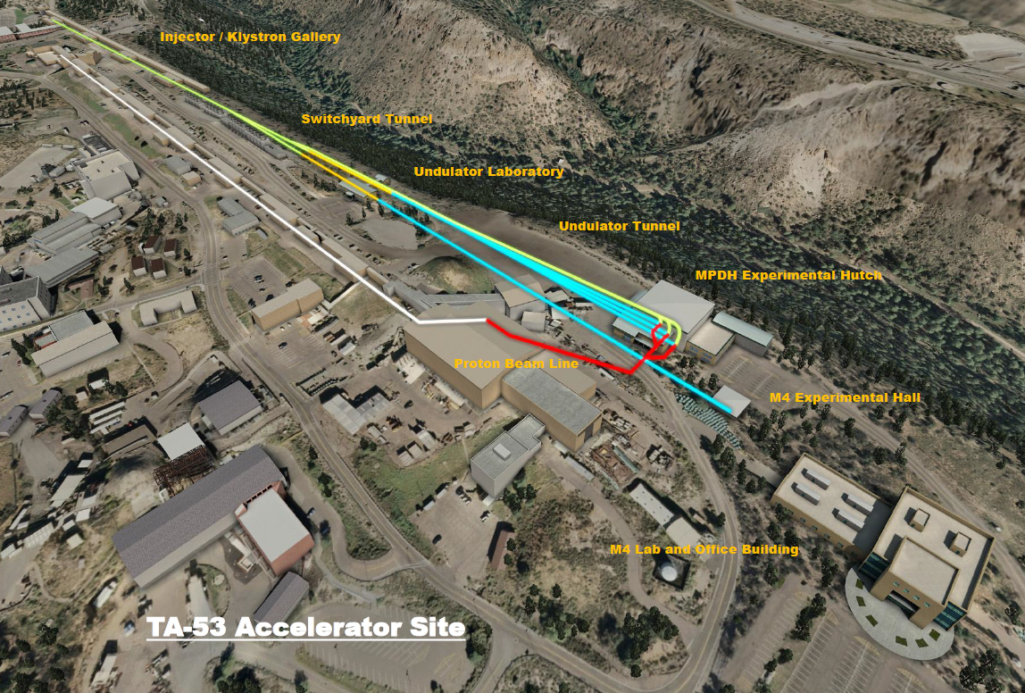
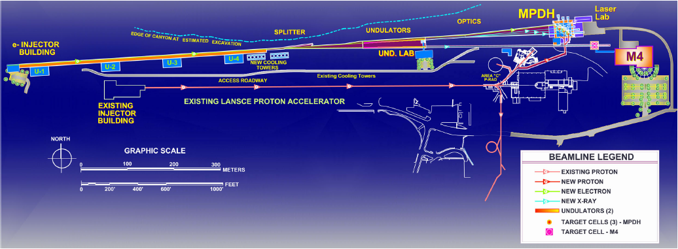
MPDH combines the measurement capabilities of x-rays, protons and electrons.
12 GeV electron accelerator would be installed next to the existing 800 MeV proton accelerator.
X-rays, electrons and protons would converge on end-stations in the MPDH.

Slide 7
X-rays from the APS have been combined with protons at LANSCE to diagnose melting and casting processes.
60 μm resolution
5 μm resolution

Slide 8

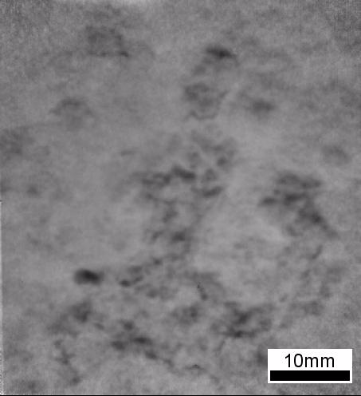
100 micron thick sample of 90% Al and 10% Indium
Similarly complex processes occur in shocked systems, but on a much faster time scale (fs to ns).
28 KeV x-rays through 200 micron sample
800 MeV protons through 6 mm sample
300 μm
A. Clarke, S. Imhoff, P. Gibbs, J Cooley, C. Morris, F. Merrill et al., Proton Radiography Peers into Metal Solidification. Scientific Reports 3, 2020; DOI:10.1038/srep02020 (2013)
http://www.nature.com/srep/2013/130619/srep02020/full/srep02020.html

Slide 9
40 keV X-rays: Micro (0.1 mm 1-5 μm resolution)
800 MeV protons: Macro (10 mm, ~100 μm resolution) we need a fast, bright, high-resolution, meso-scale diagnostic:
12 GeV Electrons: Meso (1 mm, 1-10 μm resolution)
60 μm resolution
5 μm resolution

Slide 10
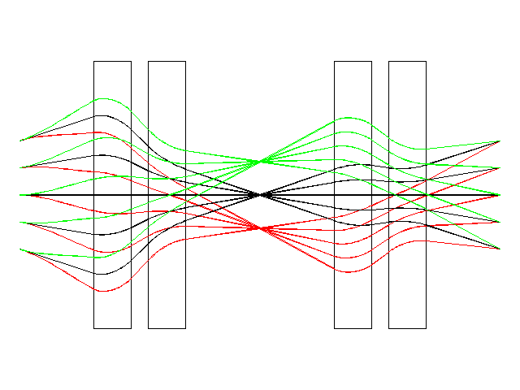
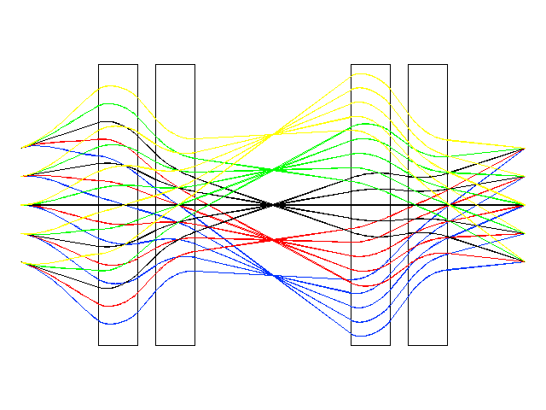
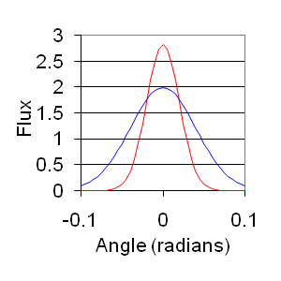
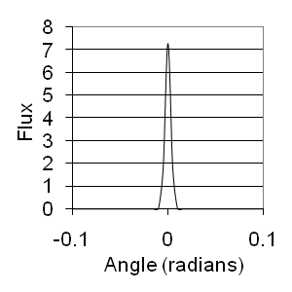
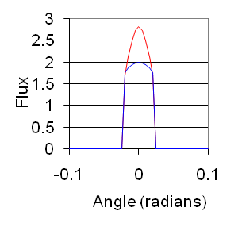
Charged particle radiography has been extensively developed at LANSCE with protons.
Incident Beam
After Object
After Collimator
Measured transmission provides information of object thickness
Transmission
Using a collimator allows the radiography to be tailored to the object. Contrast is no longer determined by physical constants but can be optimized.
Collimator

Slide 11
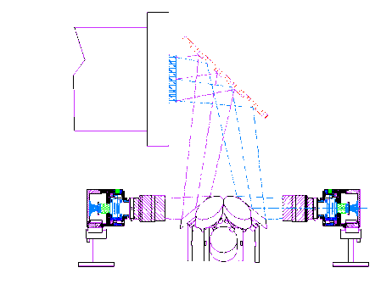
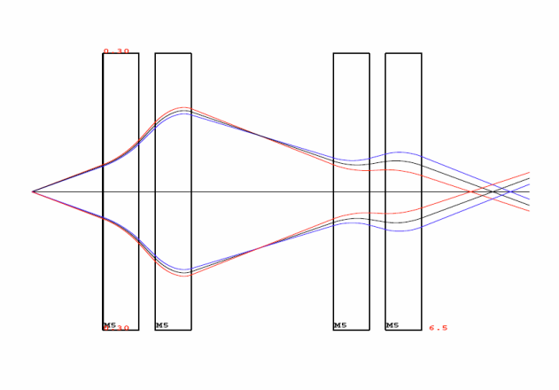



Resolution of proton radiography is presently limited to >20 μm at 800 MeV.
Object scattering - introduced as the protons are scattered while traversing the object.
Chromatic aberrations- introduced as the protons pass through the magnetic lens imaging system.
Detector blur- introduced as the proton interacts with the proton-to-light converter and as the light is gated and collected with a camera system.
Object Scattering
Chromatic Aberrations
Detector Blur
800 MeV
775 MeV
750 MeV
Scintillator
Image Location
Pellicle
Proton position at image
Proton Beam
Incident proton
l
Camera
Higher energy charged particles are required to improve resolution.

Slide 12
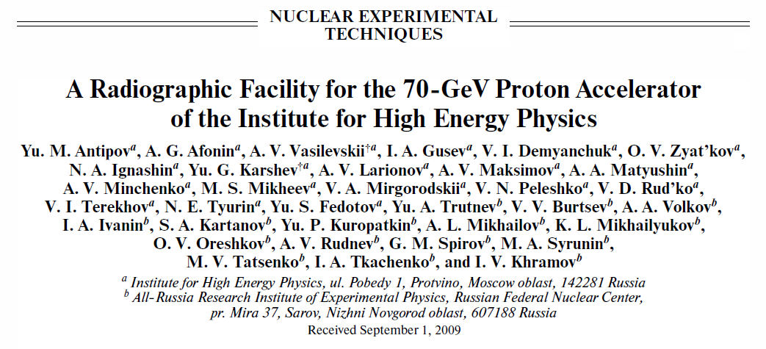
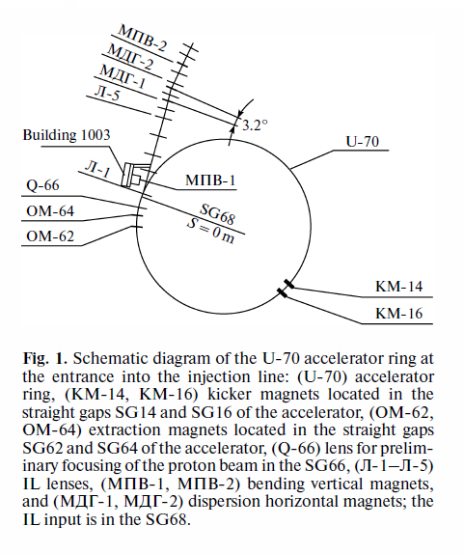
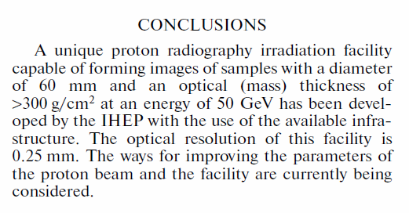
An accelerator built in Protvino, Russia for high energy physics experiments in the ‘70s is the “dream machine” for thick object radiography.

Slide 13
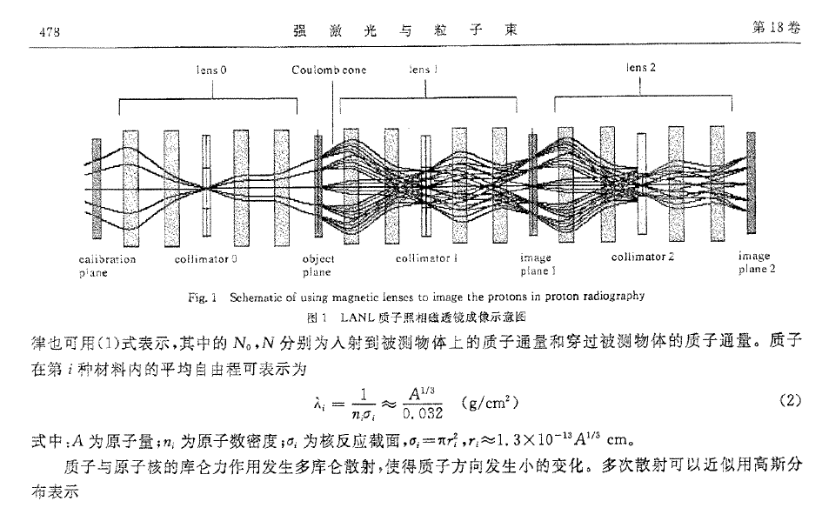
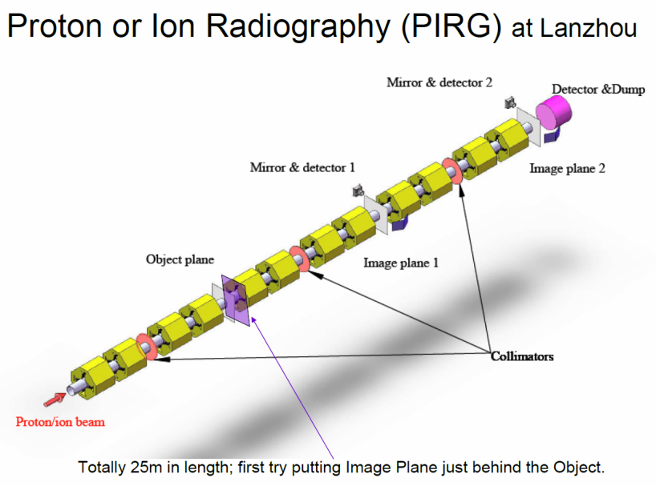
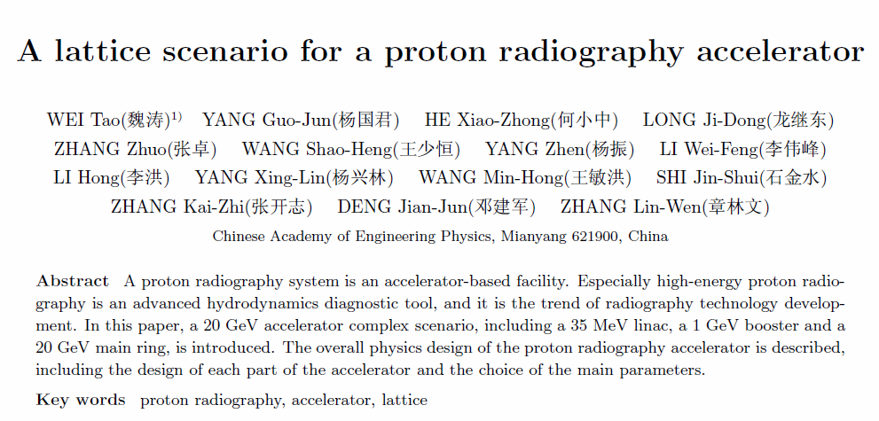
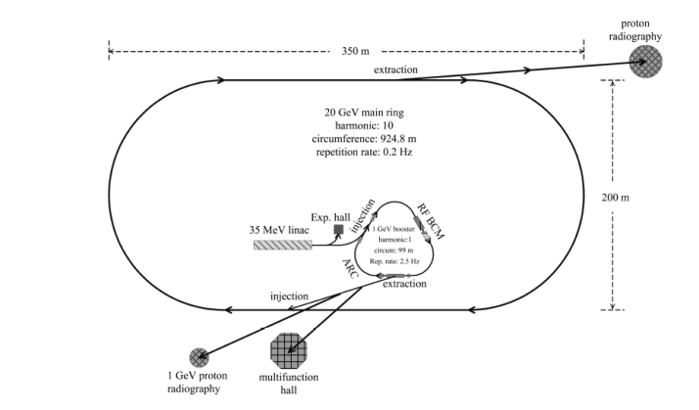
Chinese scientists are publishing designs for a 20 GeV proton radiography system

Slide 14
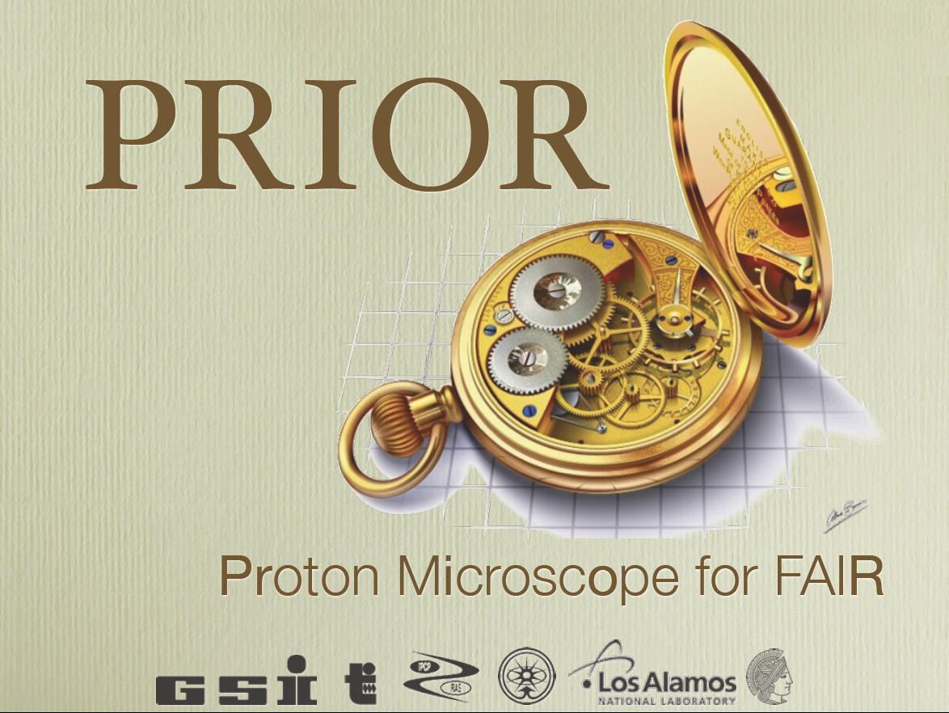
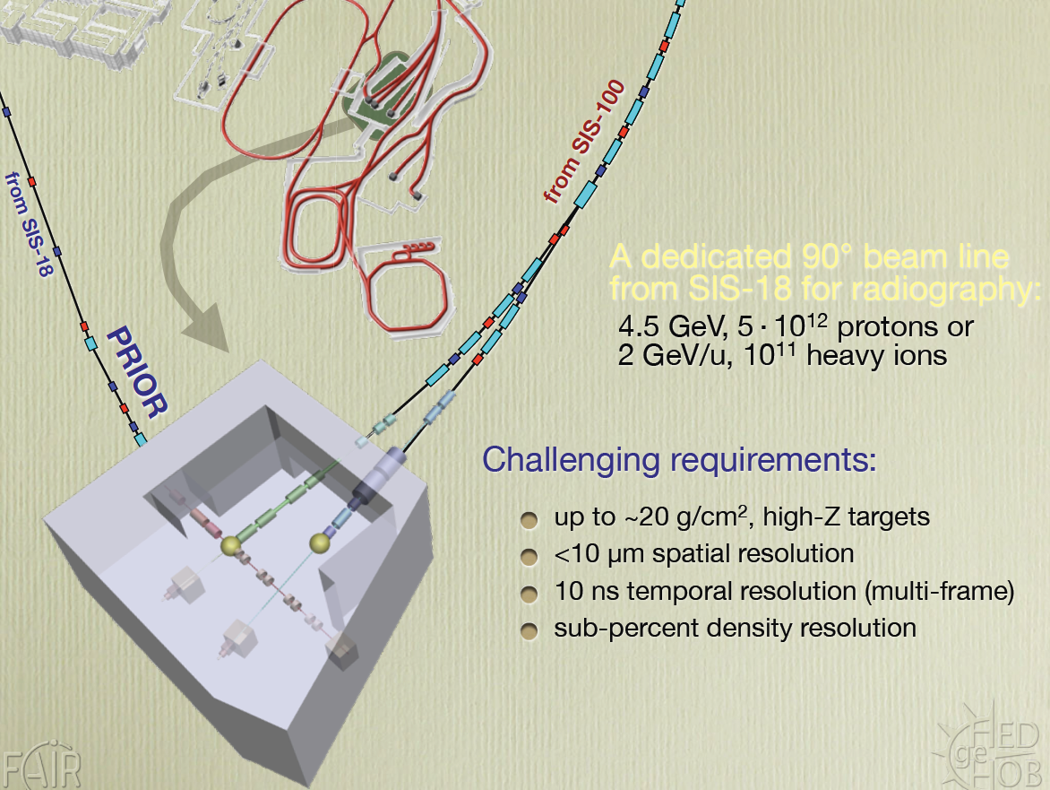
The PRIOR collaboration is building a microscope at GSI with the goal of 10 μm resolution, which will be the highest resolution proton radiography system in the world.

Slide 15
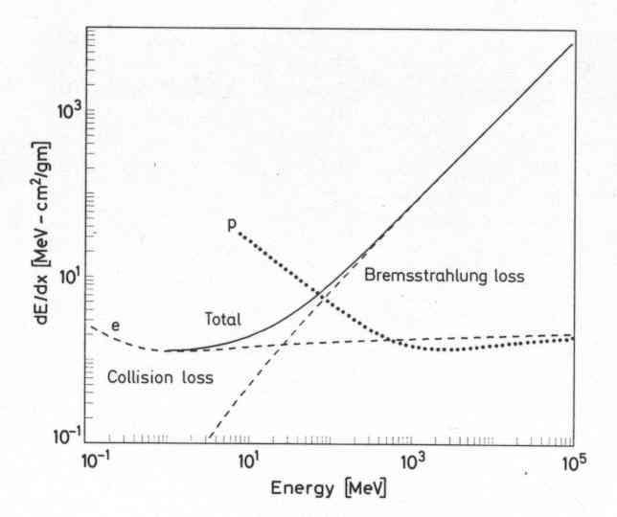
Electrons have different interaction channels above 30 MeV
dE/dx nearly constant (logarithmically increasing) for protons above 1 GeV. Therefore, dP/P decreases with higher energy improving chromatic aberrations.
dE/dx linearly increases for electrons above critical energy. Typically ~30 MeV. Therefore, dP/P for Bremsstrahlung interacting electrons does not decrease with higher energy, restricting applications to thin systems.

Slide 16
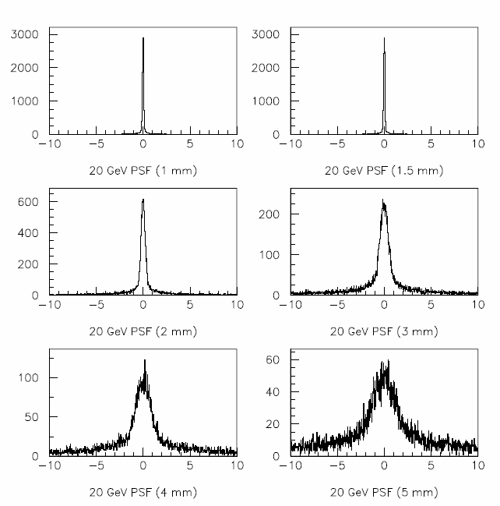
Multi-GeV Electrons are sensitive probes for high resolution for thin object radiography.
Iron Object of Various Thicknesses
12 GeV electron point spread function
Most Monte Carlo simulations do not properly take account for the energy-angle correlation
Down to 100 nm FWHM.
Bremsstrahlung radiation generates a long tail in energy, which results in long-range blur.

Slide 17
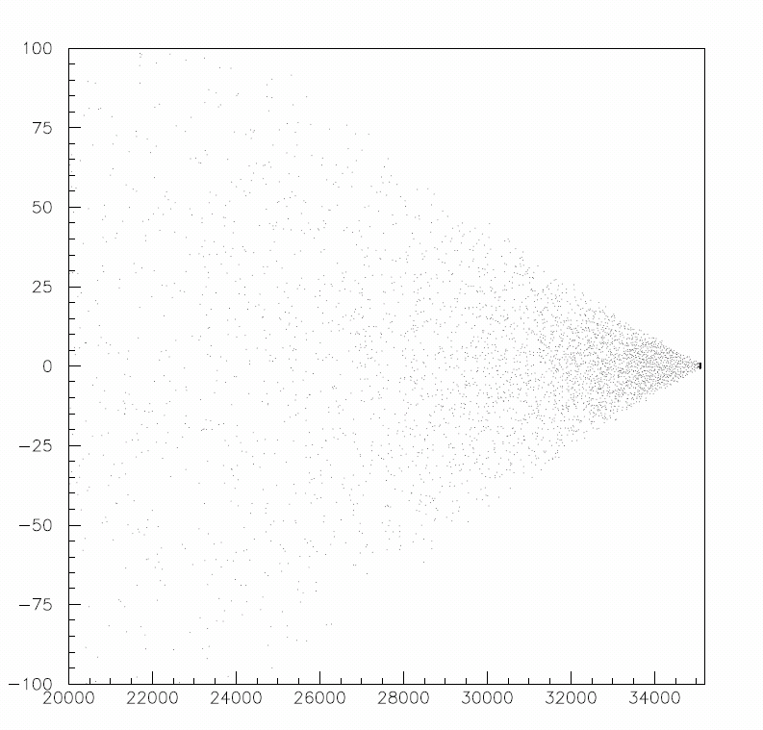
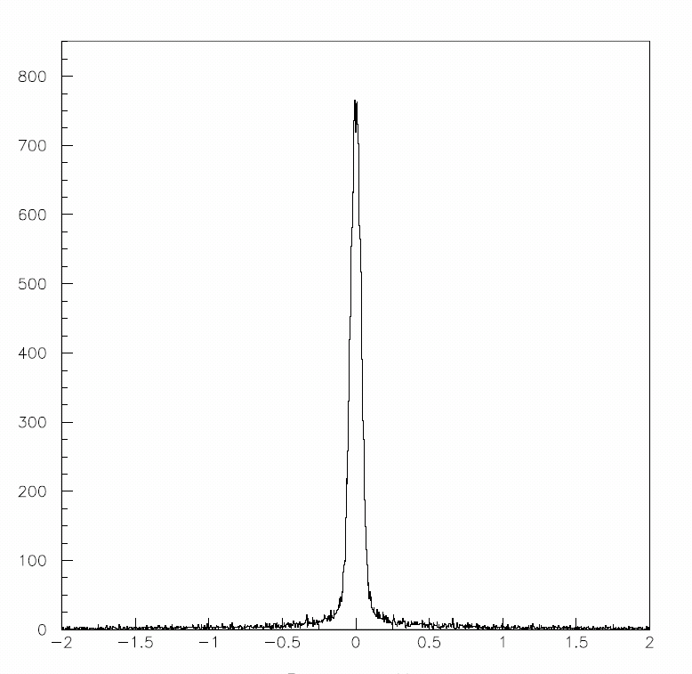
Energy spread of electrons reaching the image location result in blur in the imaging system.
Most Monte Carlo simulations do not properly take account of the energy-angle correlation.
Long-range blur
counts
Position at Image Location (microns)
Position at Image Location (microns)
Point Spread Function 1mm Fe Sample
Energy (MeV)
100 nm FWHM

Slide 18
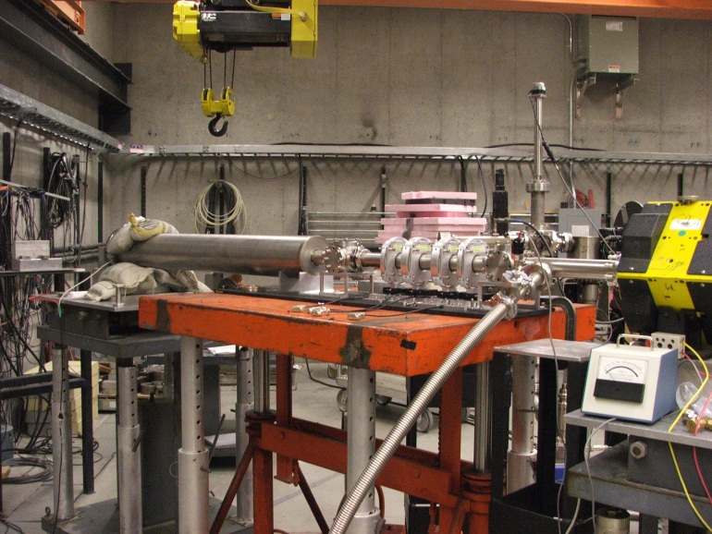
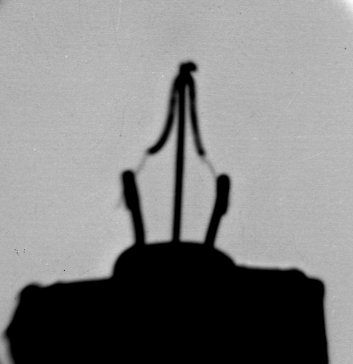
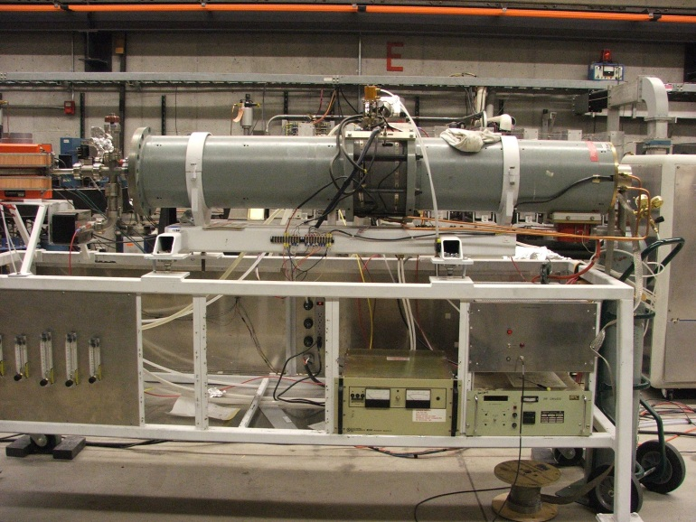
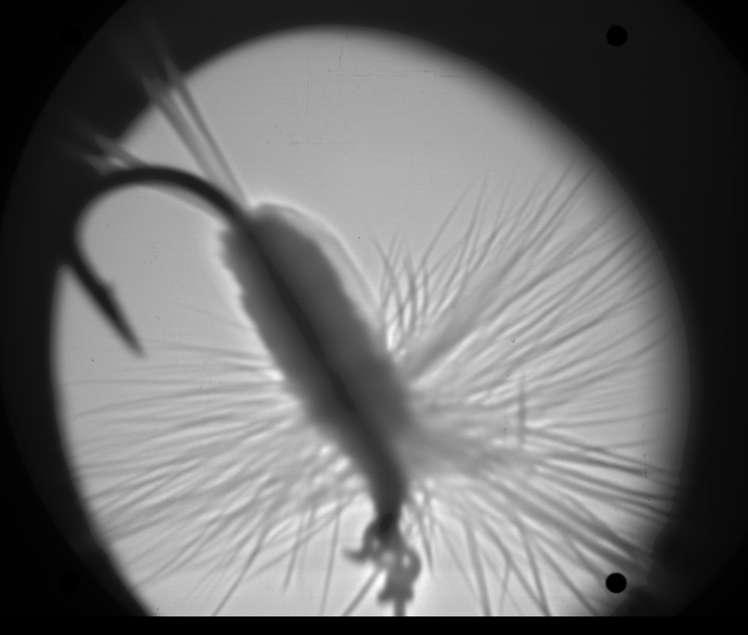
LANL has investigating high energy electron microscopy for thin object applications at 30 MeV
Light Bulb Filament
PMQ Magnifier
Fly
30 MeV Accelerator

Slide 19
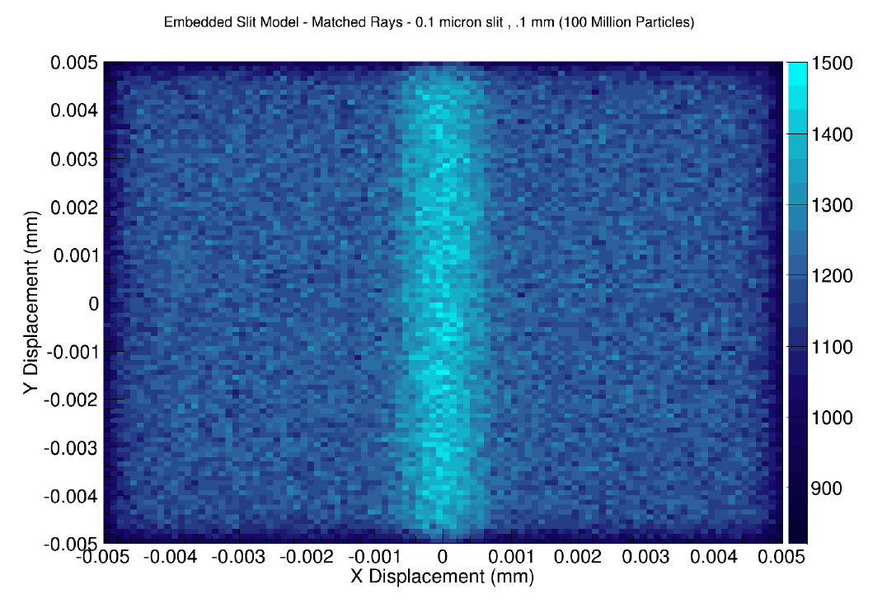
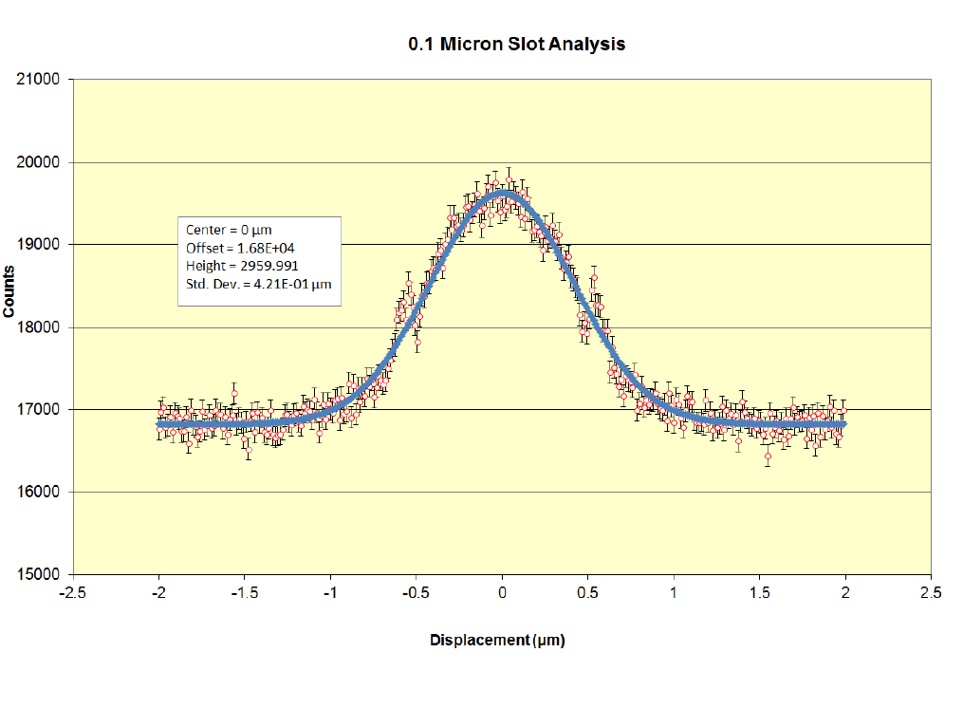
We have developed a GEANT4 simulation of the radiography system to simulate performance.
GEANT4 Simulations show ~0.5 μm resolution (RMS), in agreement with EGS predictions.
Simulation of an electron radiography of a 100 nm slot in a 100 μm uranium plate.

Slide 20
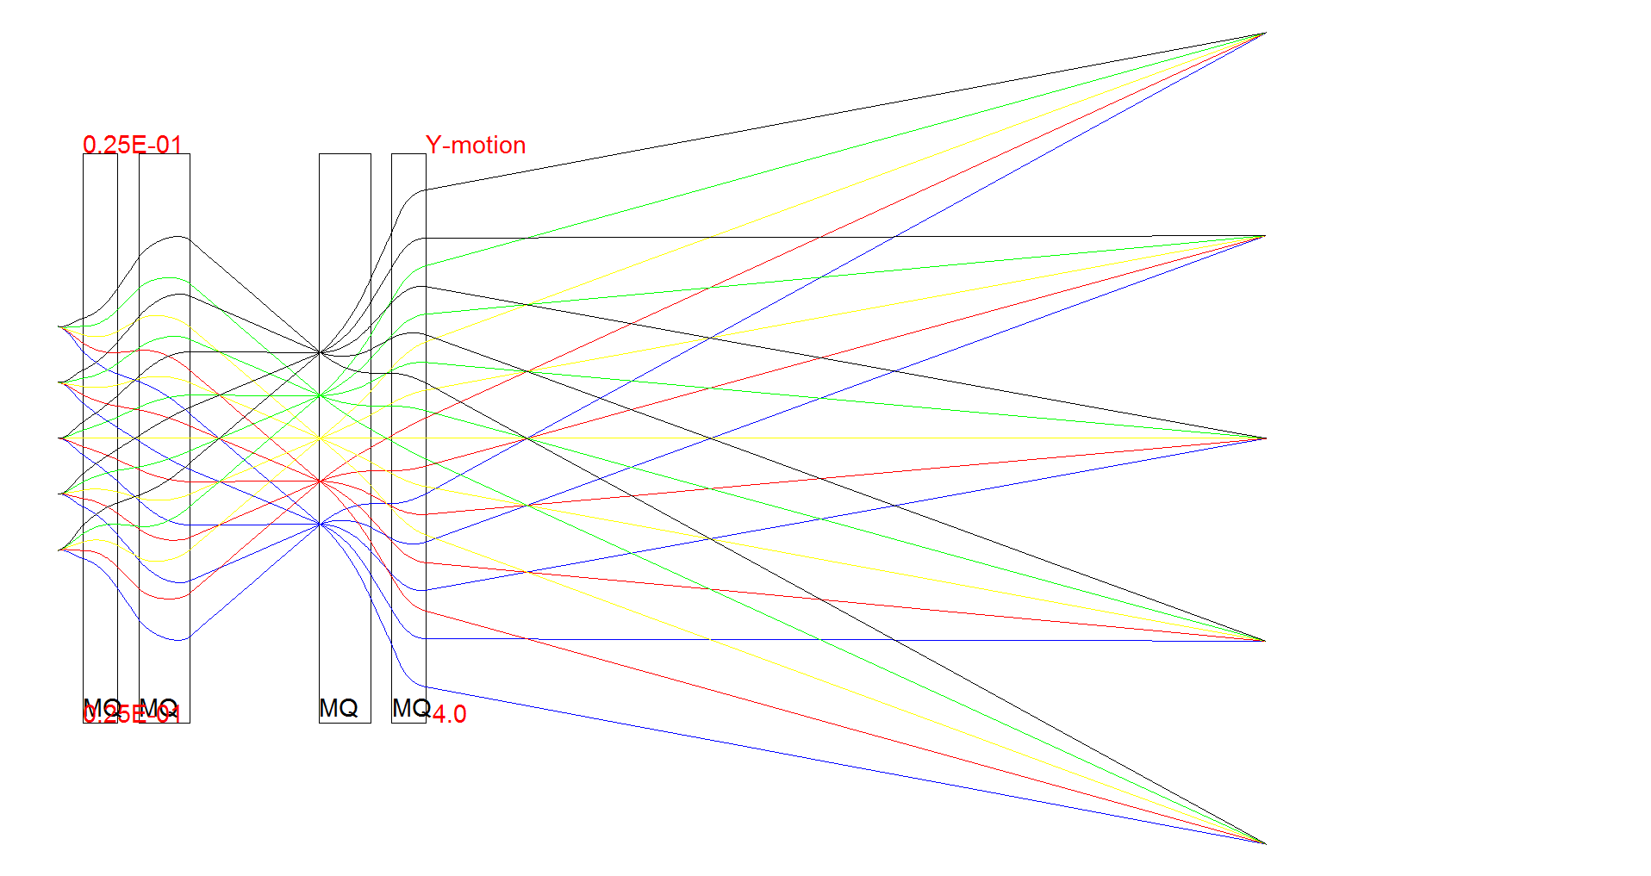
We need to test these concepts by fielding a high energy electron radiography system.
object
image
14 m
14 m is the minimum focal length and provides a x4 magnification.
Longer focal lengths and thus higher magnification is desired to minimize the effect of detector resolution.

Slide 21
Conclusions
The cost effective development of advanced materials requires the development of new measurement techniques, especially at the meso-scale.
LANL has proposed the MaRIE facility, with electron radiography as the fast, bright, high-resolution, meso-scale imaging technique.
12 GeV electron radiography appears to be a “simple” extension of existing techniques, but the next step is to demonstrate the capability of electron radiography.

Slide 22
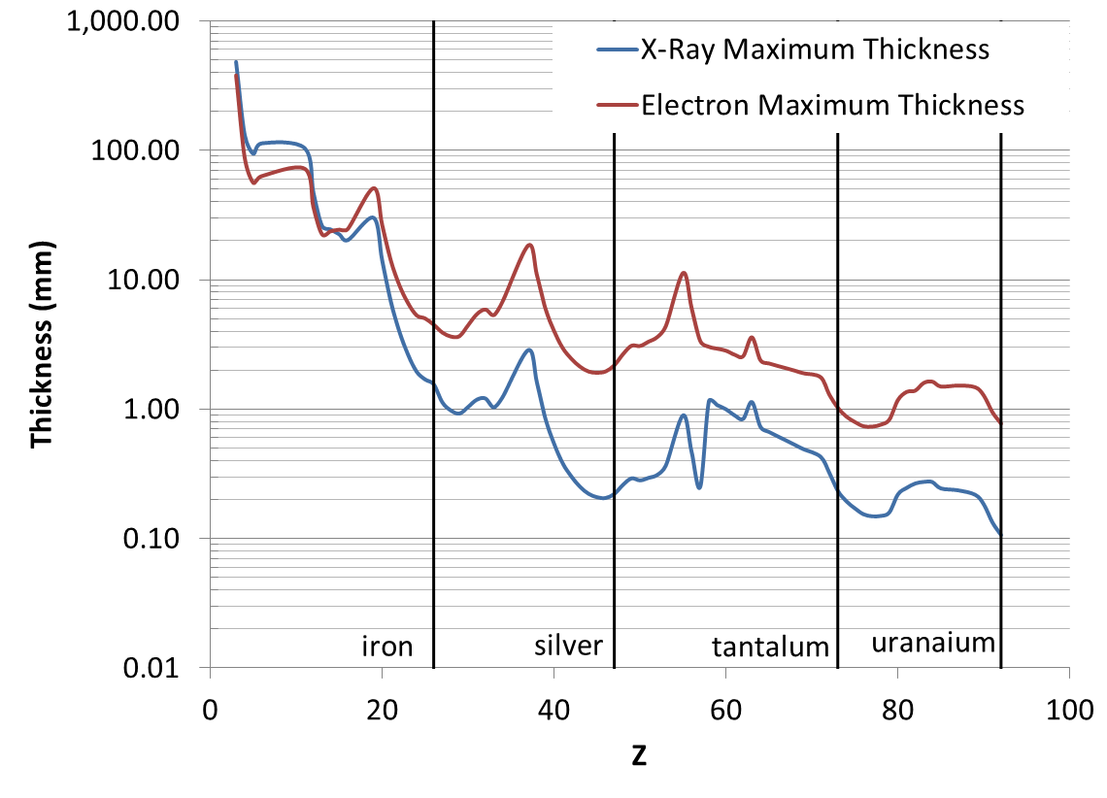
Initial calculations show that 12 GeV electrons can look through mm samples with micron resolution.

Slide 23
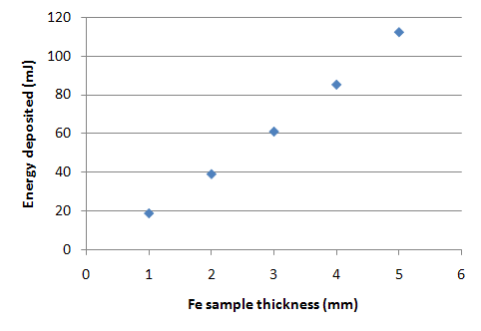
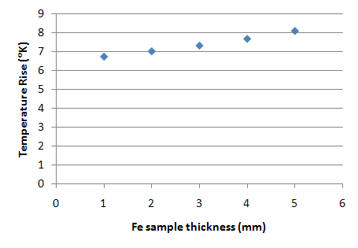
e- Beam Heating
e⁻
e⁺
1 mm
γ
e⁻
Use EGS5 to calculate energy deposition as a function of cylinder length

Slide 24
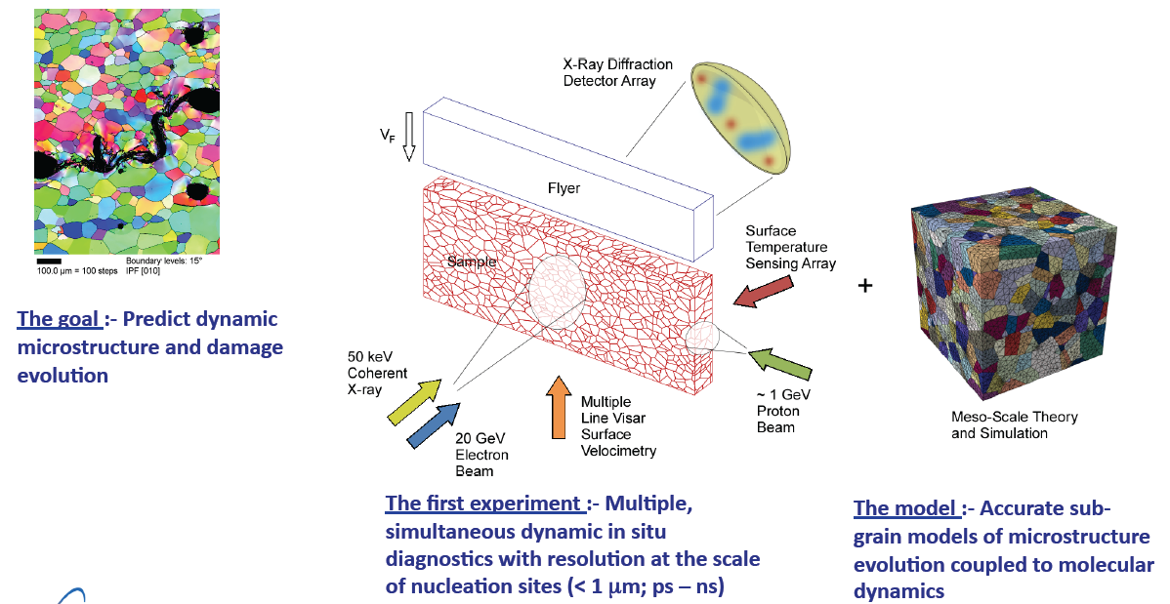
MaRIE: Matter and Radiation In Extremes
MPDH: Multi-Probe Diagnostic Hall
12 GeV Electron Beam

Slide 25
Goals
Determine the ultimate resolution of the imaging system and compare to predictions.
Identify the fundamental thickness limits of this imaging system.
Develop and measure the performance of image formation detectors (scintillators, Cerenkov radiation…)
Investigate Collimation schemes (contrast generation versus radiation generation).
Experimental Requirements
Ideally we would test with 12 GeV electrons, but any multi-GeV electron beam would provide a test of these concepts.
Minimize energy spread <1% (at the expense of bunch compression)
≥ 14 meters for a quadruplet magnifying lens system
Matching section (3-4 quadrupoles to prepare position-angle correlation at object to partially cancel second order chromatic aberrations)
Illuminate 1-2 mm object
Location to insert objects
Location to insert “collimators”
Installation of a converter (scintillator) and image collection system
>10⁹ electrons in a “reasonable” exposure time (<minutes)

Slide 26
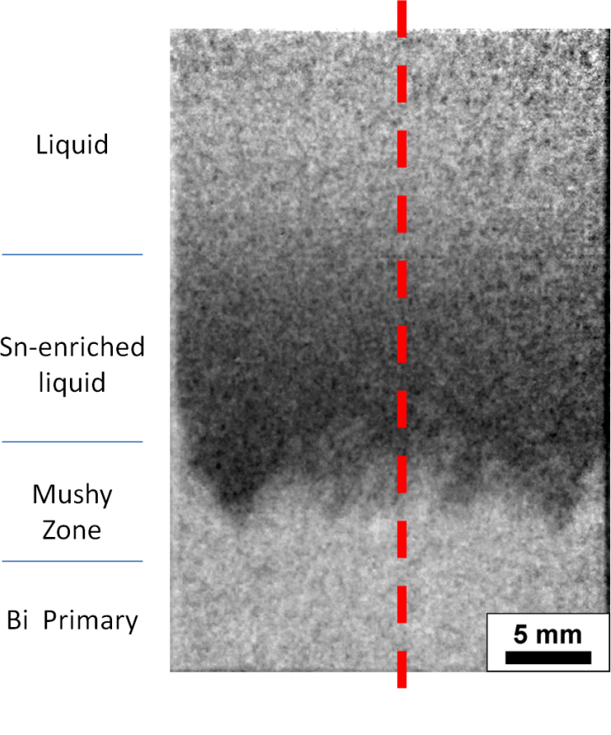
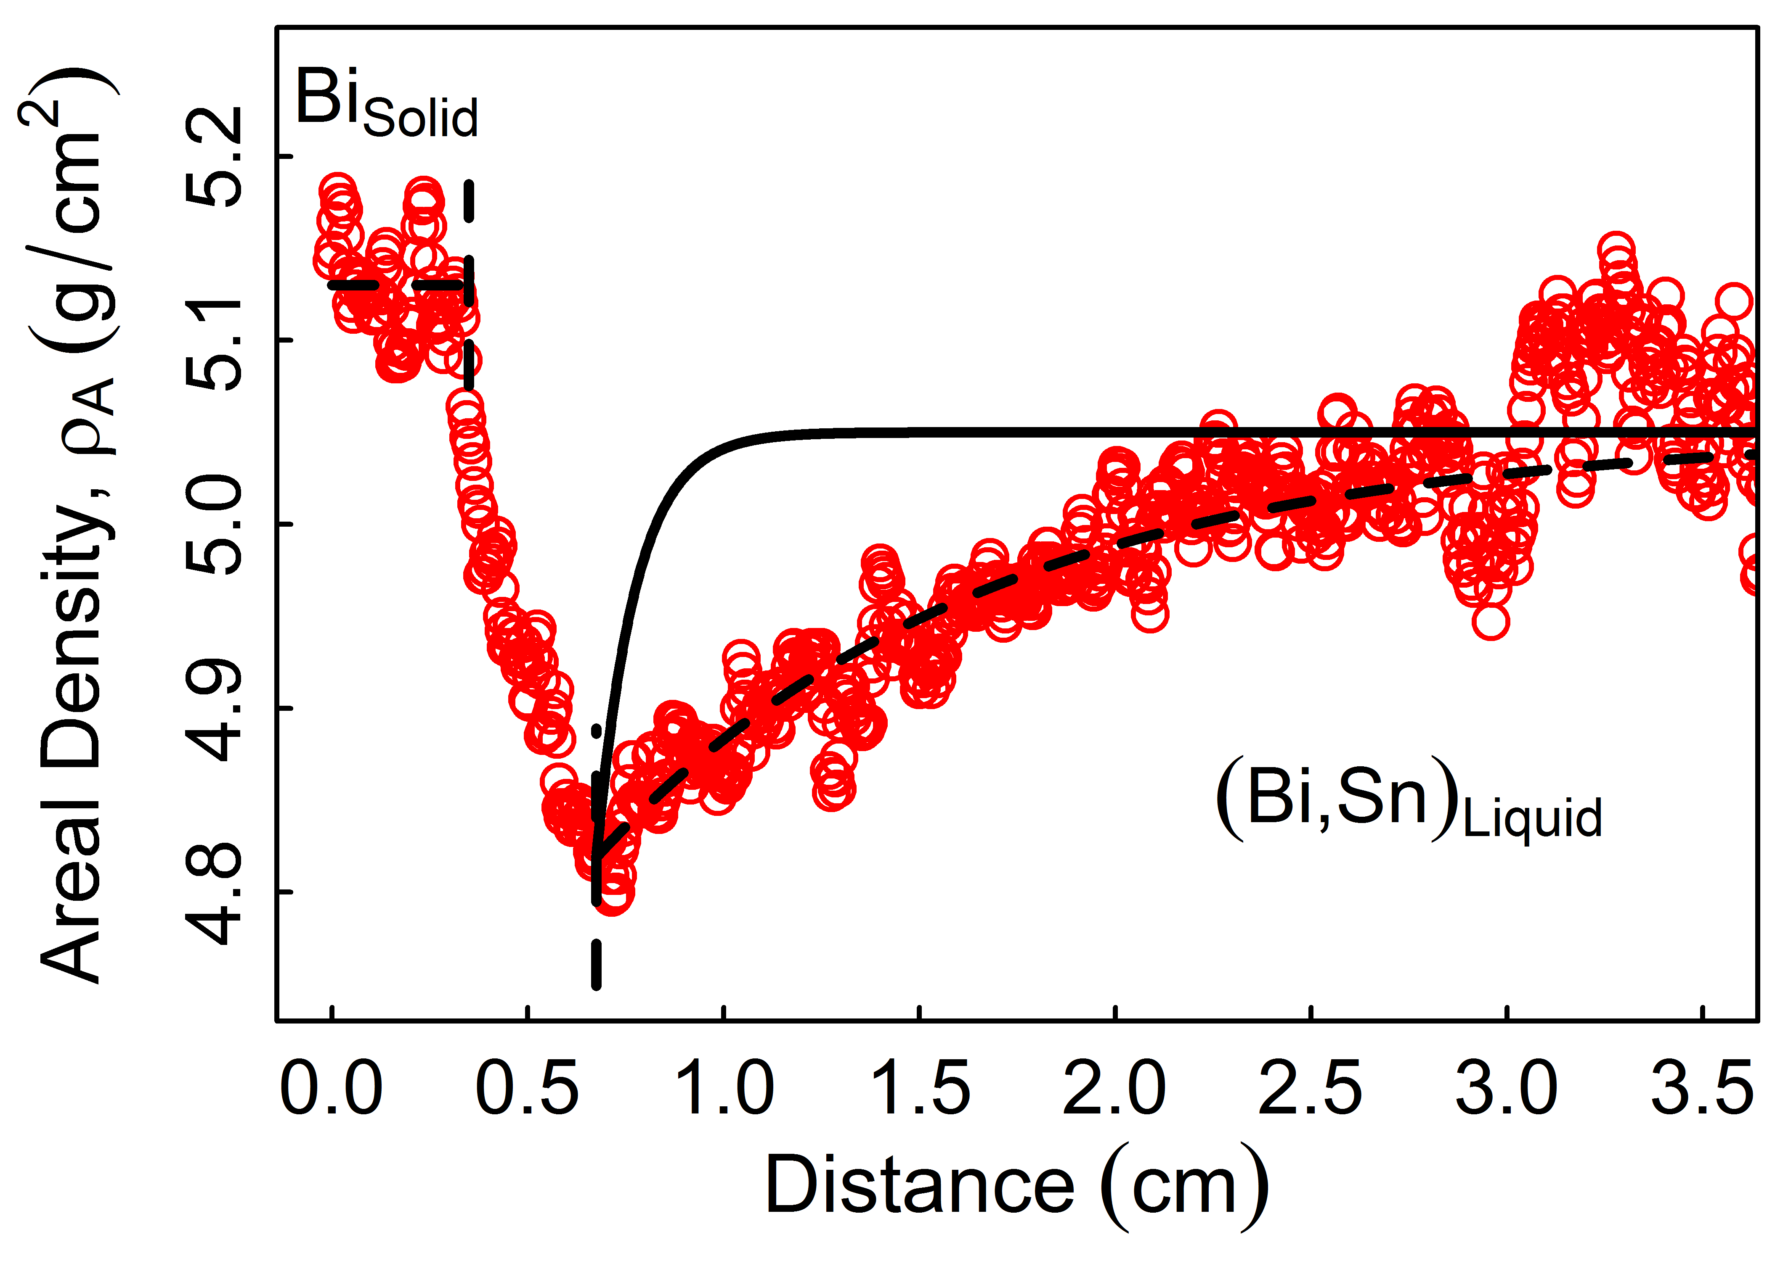
Micro and meso-scale measurements can inform model development which can ultimately be tested at the macro-scale.
Bi-30 at.%Sn,
6 mm thick
Pure diffusion
Proton Imaging and Relative Density Profile Associated with Solute Partitioning during Solidification

Slide 27
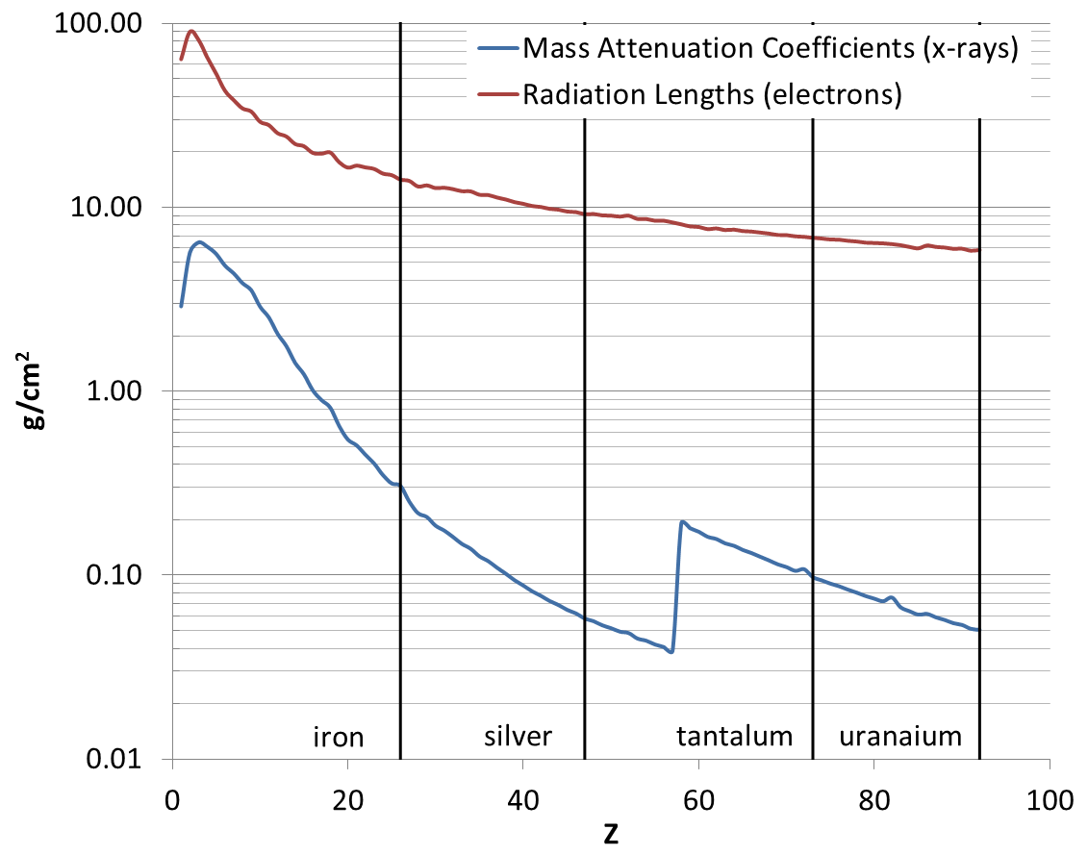
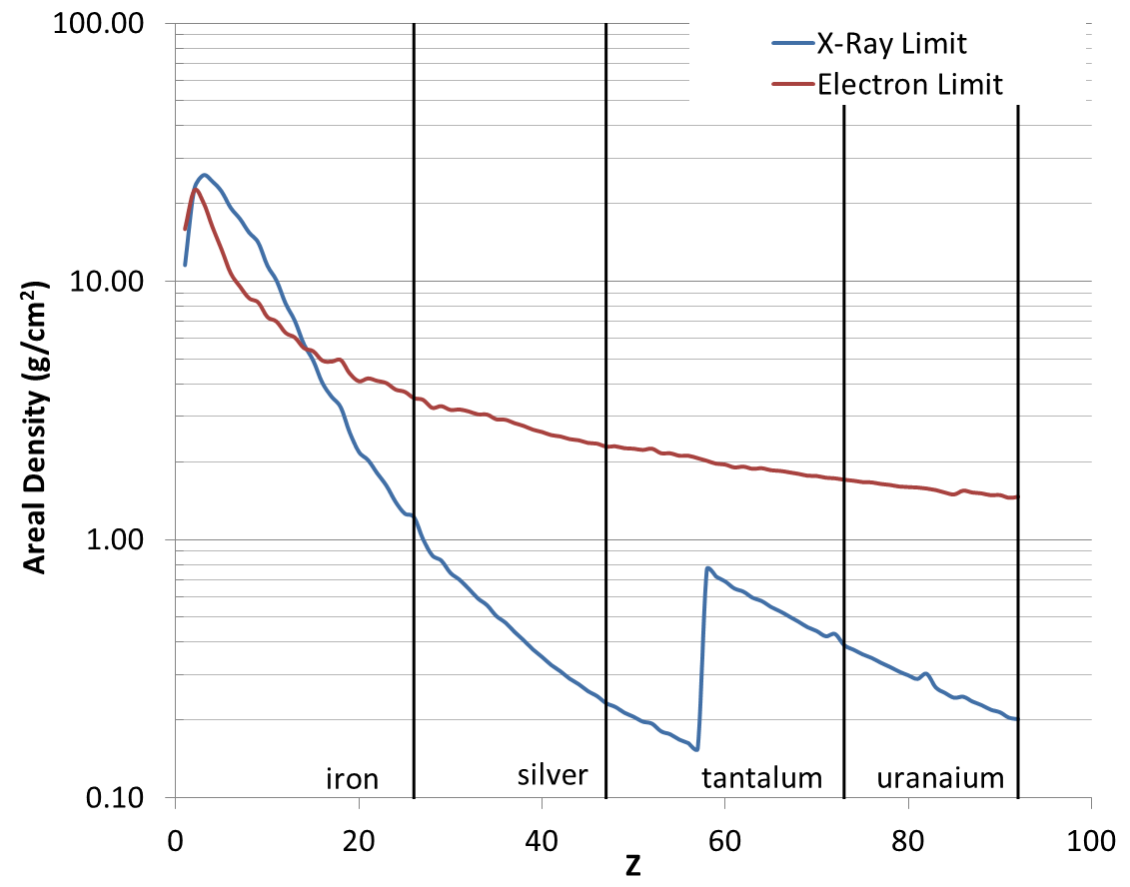

Slide 28
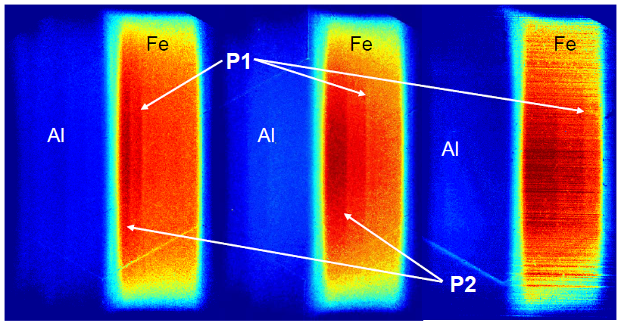
pRad is Typically Used for Dynamic Imaging; Two Wave Phase Transition in Fe (Al Flyer Plate)
P1 (shock) and P2 (bcc α to hcp ε phase transition) wave fronts propagate (L to R)
Al impacting Fe backed by sapphire @ 1.45 km/s (175 kbar in Fe)
3 camera times captured separated by 500 ns
P.A. Rigg et. al, “Proton radiography and accurate density measurements: a window into shock wave processes”, Phys. Rev. B 77, 2008, 220101(R)
C.L. Schwartz et. al, “Solid-solid phase transformation science on proton radiography facilities”, LA-UR 11-06173, High Energy Proton Microscopy Workshop, Los Alamos National Laboratory, October 2011

Slide 29
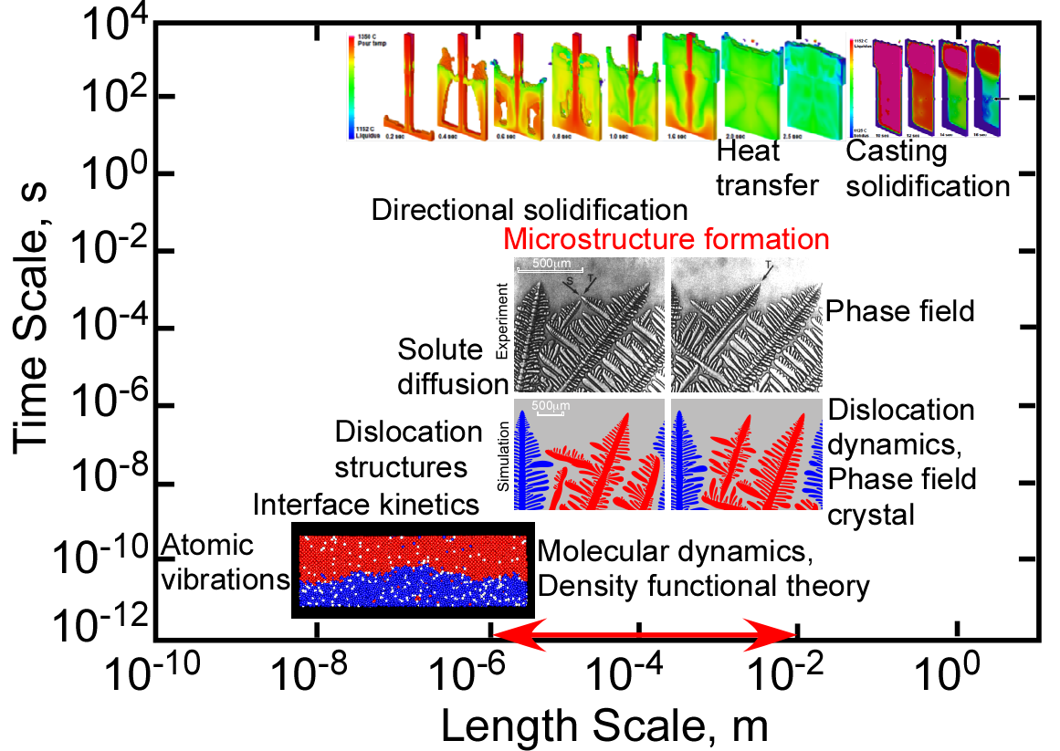
Example: Study of casting processes has allowed us to tackle many of these same challenges with “slow” processes.
Casting models do not incorporate microstructure
(e.g. TRUCHAS at LANL)

Slide 30
Proton (Large Volume, High Density) Versus X-ray (Small Volume, Low Density) Imaging

Slide 31
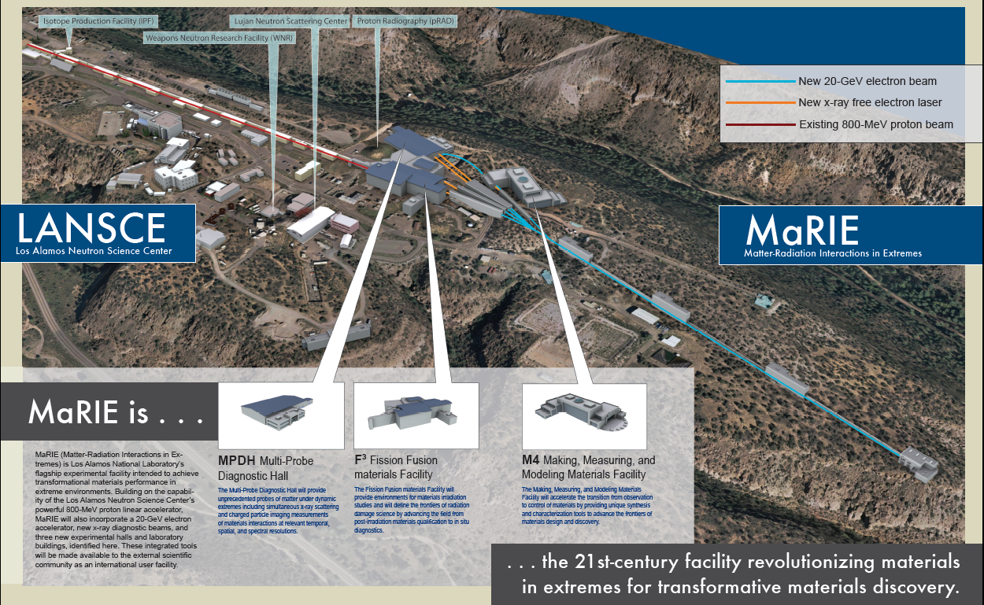
A 12 GeV electron accelerator will be built to drive the MaRIE FEL. The same beam can be used for high resolution charged particle radiography.

Slide 32
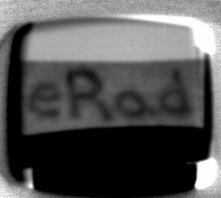
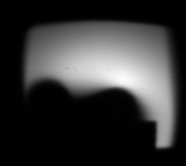
Electrons are more sensitive to thin objects, but this also generates difficulties at higher energies..
Hand written “eRad”
1” wide
Pilot “Golden Pen” ink containing 17% copper (<0.001 thick)
5x10¹¹ electrons
Magnetic field of a refrigerator magnet
~500 Gauss field at magnet surface
Electrons deflected by the B field are intercepted at the collimator location.
Contour of B field
Al Stand

Slide 33
Abstract
The material science community is presently limited by diagnostics in both the fabrication of materials and measuring the resulting materials characteristics of these new fabrication techniques. Because of this limitation the community is forced into an empirical mode of material fabrication, where expert judgment is used to guide manufacturing processes and the resulting materials are inspected and tested for the desired characteristics. This development approach can be time consuming and costly. The solution to this problem is to improve our fundamental understanding of materials, which requires the development of new diagnostics capable of measurement at the micron length scale, during both processing and during testing. These new measurements will enable a fundamental understanding of material characteristics allowing the development of predictive models, which will in turn enable material engineering by design rather than today’s empirical approach. Solving this problem has become a grand challenge for the materials science community. Los Alamos plans to address this challenge through the development of new diagnostics capable of measurements at the smallest length scales through the Multi-Probe Diagnostic Hall (MPDH) at the planned MaRIE (Material and Radiation In Extremes) Facility. One of the probes will be a coherent photon beam generated by an FEL driven by a multi-GeV electron beam. The photons will be used for diffraction measurements as well as radiography of relatively thin samples (nearly single grains). The same multi-GeV electron beam can be used to directly radiograph thicker systems (many grains or “bulk” material), providing high resolution measurements of the density distribution of materials during both fabrication and dynamic testing. This technique, electron radiography or eRad, that has been identified by LANL as one of the probes required to meet this grand challenge has never been demonstrated with high energy electrons. We propose to begin development of this technique with the electron beam available at
FACET.

