Slide 1
Cool Beams for
Ultrafast Electron Imaging
Jom Luiten
FEIS 2013
Key West, Dec 12, 2013
Department of
Applied Physics

Slide 2
What is not yet possible?
few/single shot electron diffraction of macromolecules
ultrafast nano-diffraction★
ultrafast imaging with near-atomic resolution★
Higher coherence required!
★ Without throwing away electrons

Slide 3
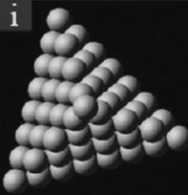
Coherent electron sources
conventional
point-like source
transverse coherence length

charge per pulse

‘Heisenberg’
coherence
noble-metal covered W(111) single-atom emitter:
full spatial coherence
(Chang et al., Nanotechnology 2009)

Slide 4
Coherent electron sources
conventional
point-like source
transverse coherence length

charge per pulse

‘Heisenberg’
coherence
noble-metal covered W(111) single-atom emitter:
full spatial coherence
(Chang et al., Nanotechnology 2009)

Slide 5
Why ultracold?
conventional
point-like source
conventional
extended source


charge per pulse


coherence
transverse coherence length

Slide 6
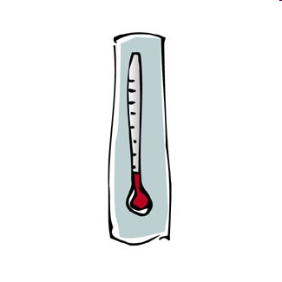
Why ultracold?
conventional
point-like source
ultracold
extended source


charge per pulse


coherence
transverse coherence length

Slide 7
Ultracold electron source
I
I
N ≤ 10¹⁰ Rb atoms,
R = 1 mm, n ≤ 10¹⁸ m⁻³
T ≈100 µK
Magneto-Optical Trap (MOT)

Slide 8
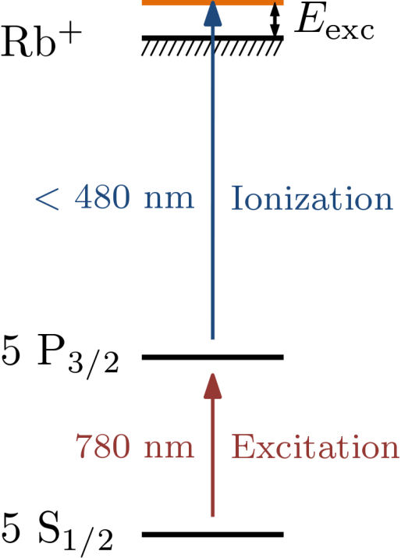
Ultracold electron source
I
I
Electron temperature
plasma effects
Ultracold Plasma
Killian et al., PRL 83, 4776 (1999)

Slide 9
Ultracold electron source
I
I
T_{e}≈ 5000 K (0.5 eV) → 10 K
conventional
photo & field emission sources
Rb⁺
e⁻
Claessens et al.,
PRL 95, 164801 (2005)
V
V
Taban et al.,
EPL 91, 46004 (2010)
Ultracold beams!

Slide 10
Ultracold electron source
I
I
T_{e}≈ 5000 K (0.5 eV) → 10 K
conventional
photo & field emission sources
Rb⁺
e⁻
Claessens et al.,
PRL 95, 164801 (2005)
V
V
Taban et al.,
EPL 91, 46004 (2010)
Ultracold beams!

Slide 11
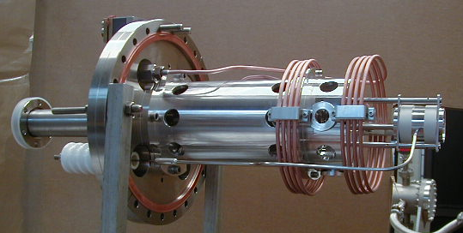
The cold electron (and ion) source
Claessens et al., PRL 95, 164801 (2005)
Claessens et al., Phys. Plasmas 14, 093101 2007
Taban et al., PRSTAB 11, 050102 (2008)
Reijnders et al., PRL 102, 034802 (2009)
Taban et al., EPL91, 46004 (2010)
Reijnders et al., PRL 105, 034802, (2010)
Reijnders et al. JAP 109, 033302 (2011)
Debernardi et al., JAP 110, 024501 (2011)
Vredenbregt & Luiten, Nature Phys. 7, 747 (2011)
Debernardi et al., New J. Phys 14 083011 (2012)
Engelen et al., Nature Commun. 4, 1693 (2013)
Engelen et al. Ultramicroscopy 136, 73 (2014)
Engelen et al., New. J. Phys. 15, 123015 (2013)

Slide 12
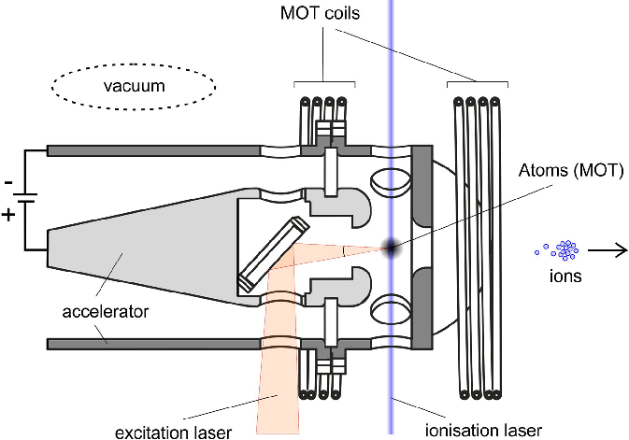
The cold electron source
Atom trap inside coaxial accelerator
+
-
electrons

Slide 13
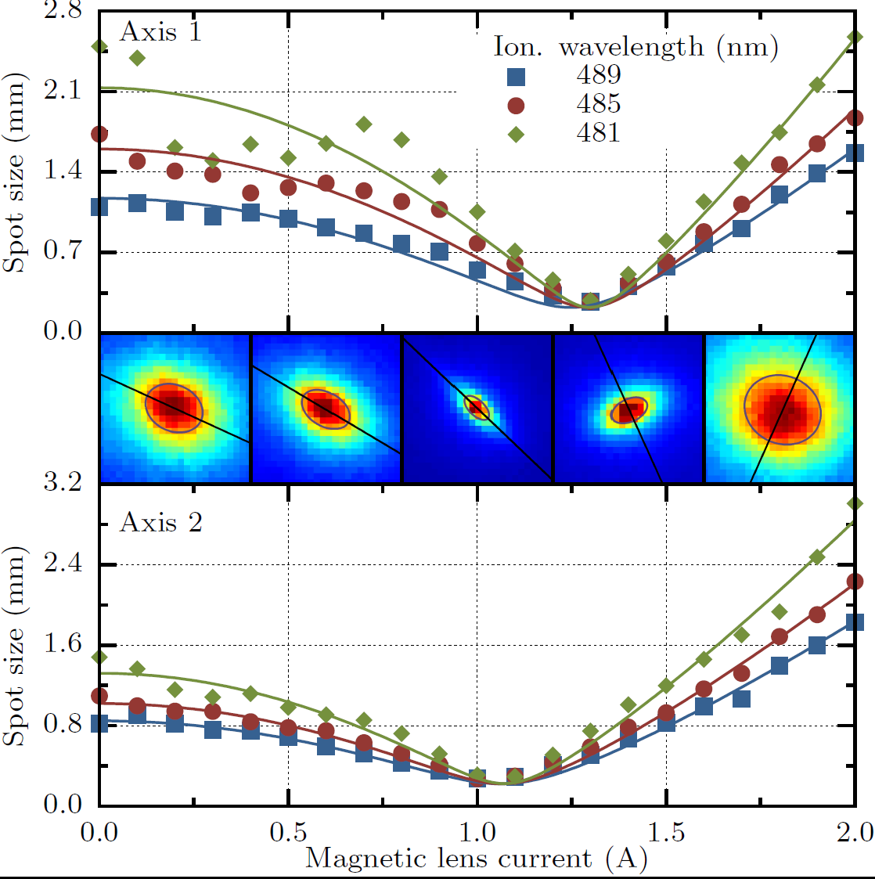
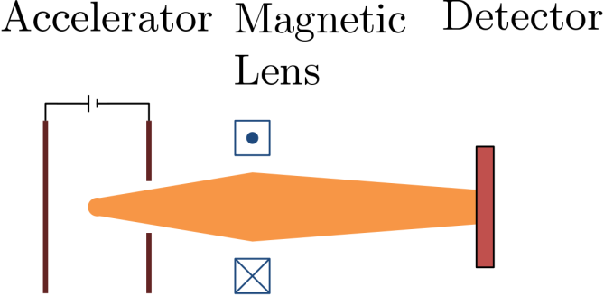
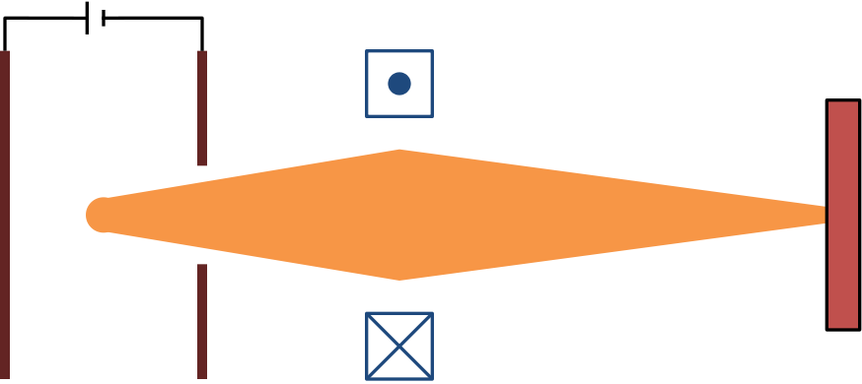
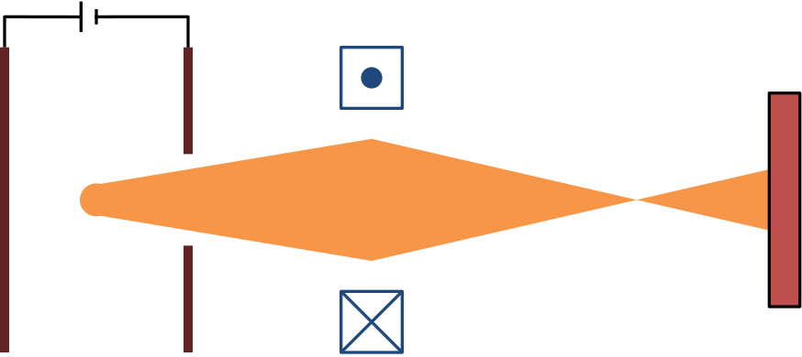
Femtosecond ionization: solenoid waist scan
1
2
1
2
3
3

Slide 14
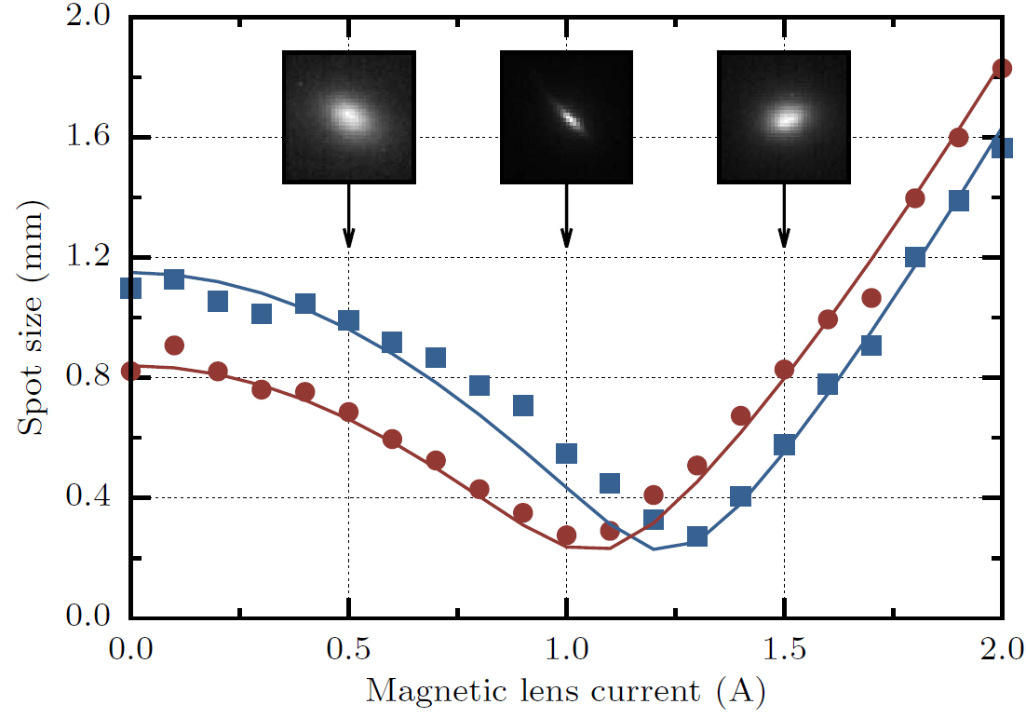
Femtosecond ionization: solenoid waist scan
1
2
3
normalized emittance:

Slide 15
Femtosecond ionization: solenoid waist scan
1
2
3
normalized emittance:

Slide 16
Femtosecond ionization: solenoid waist scan
1
2
3
normalized brightness:

Slide 17
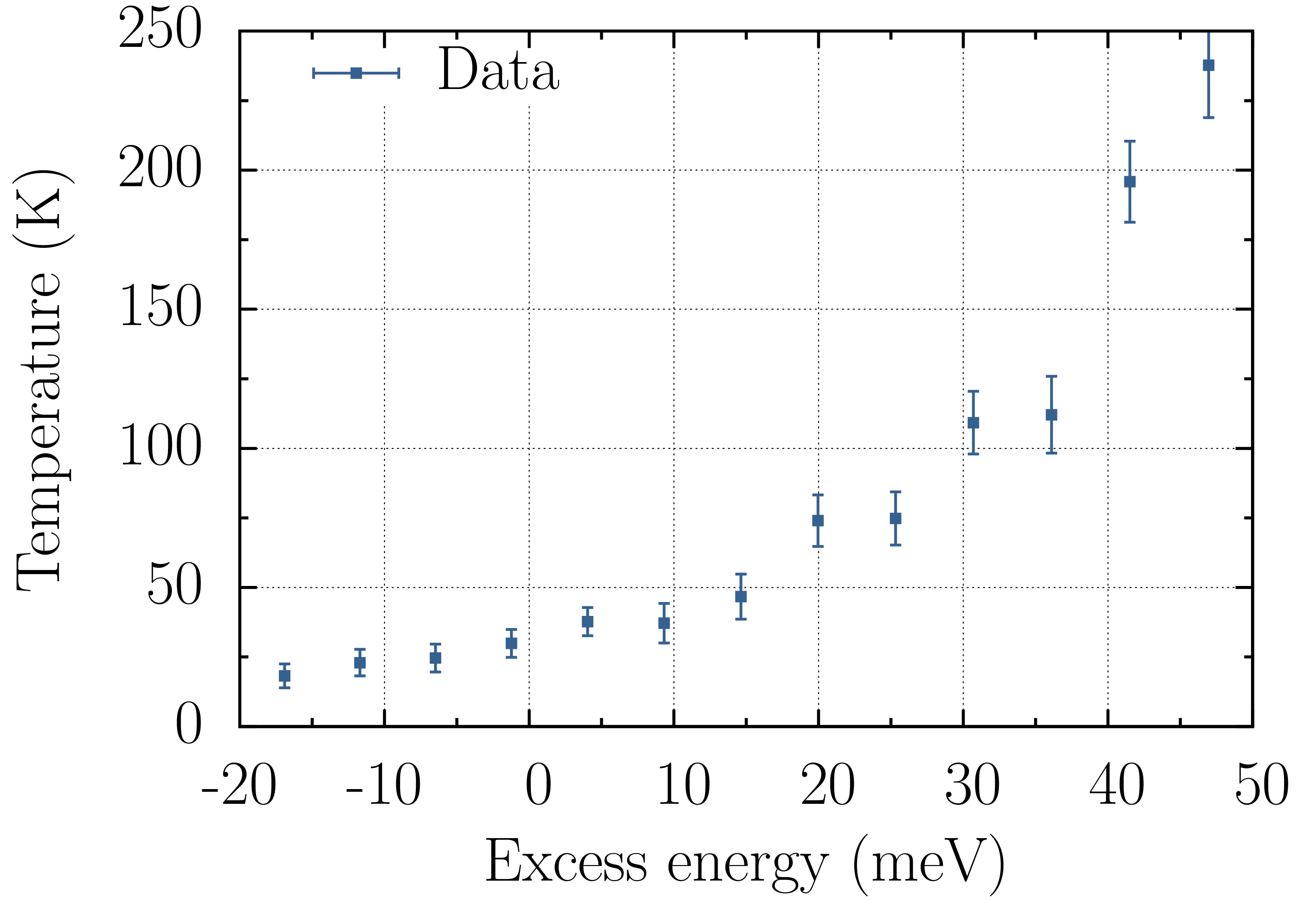
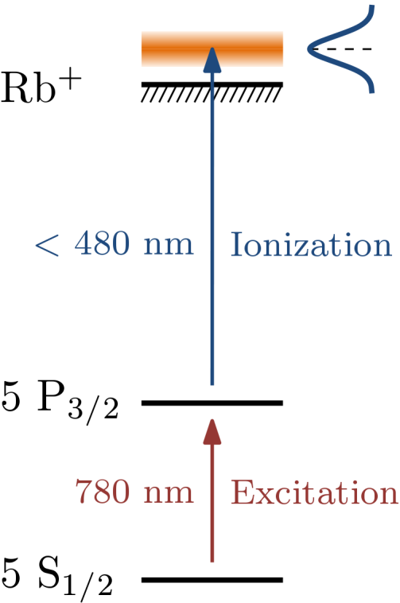
Temperature vs. Excess Energy
t_{ion} = 100 fs
U = 2.8 keV
Q = 0.2 fC
Engelen et al.,
Nat. Commun. (2013)
T ≈ 20 K

Slide 18
Temperature vs. Excess Energy
t_{ion} = 100 fs
U = 2.8 keV
Q = 0.2 fC
?
Engelen et al.,
Nature Comm. (2013)
Expected:
σ_{λ} = 4 nm → T_{source} ≥ 200 K

Slide 19
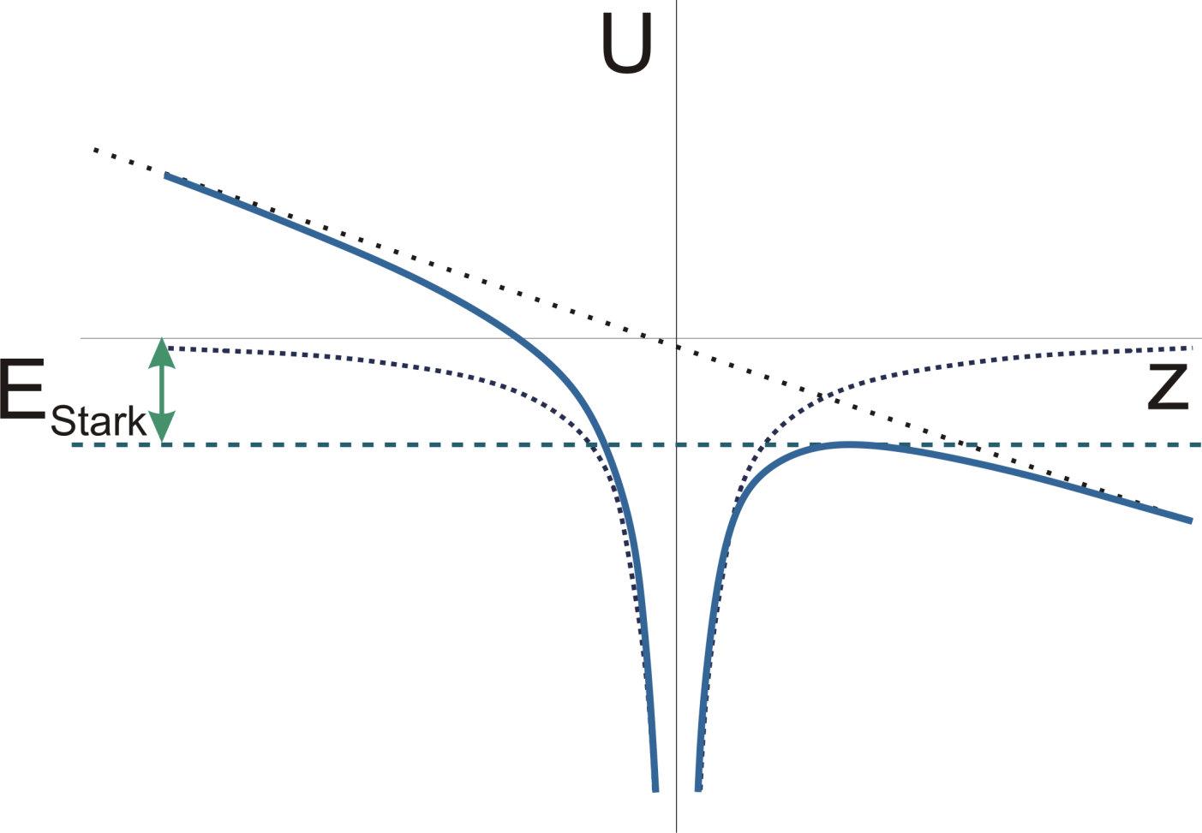
Dynamics ionization process
Potential energy landscape

Slide 20
Dynamics ionization process
Schottky effect
Excess energy

Slide 21
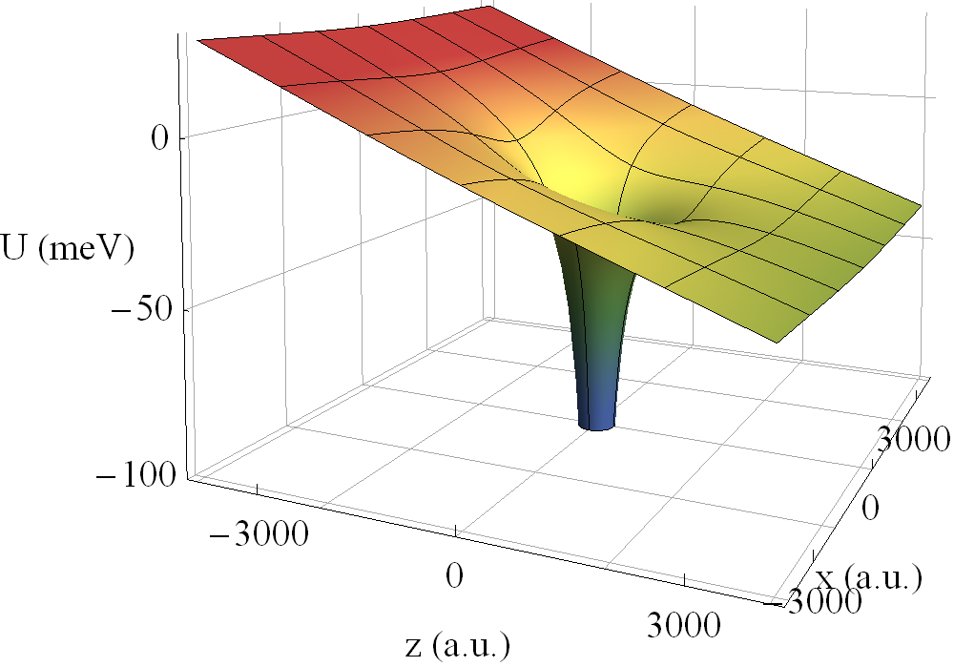
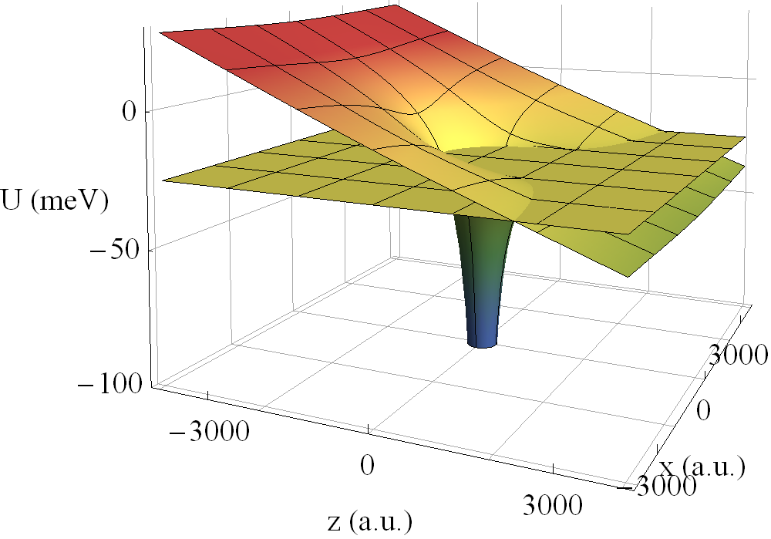
Electron trajectories → source ‘temperature’

Slide 22
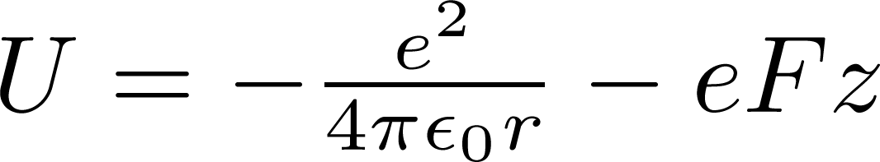
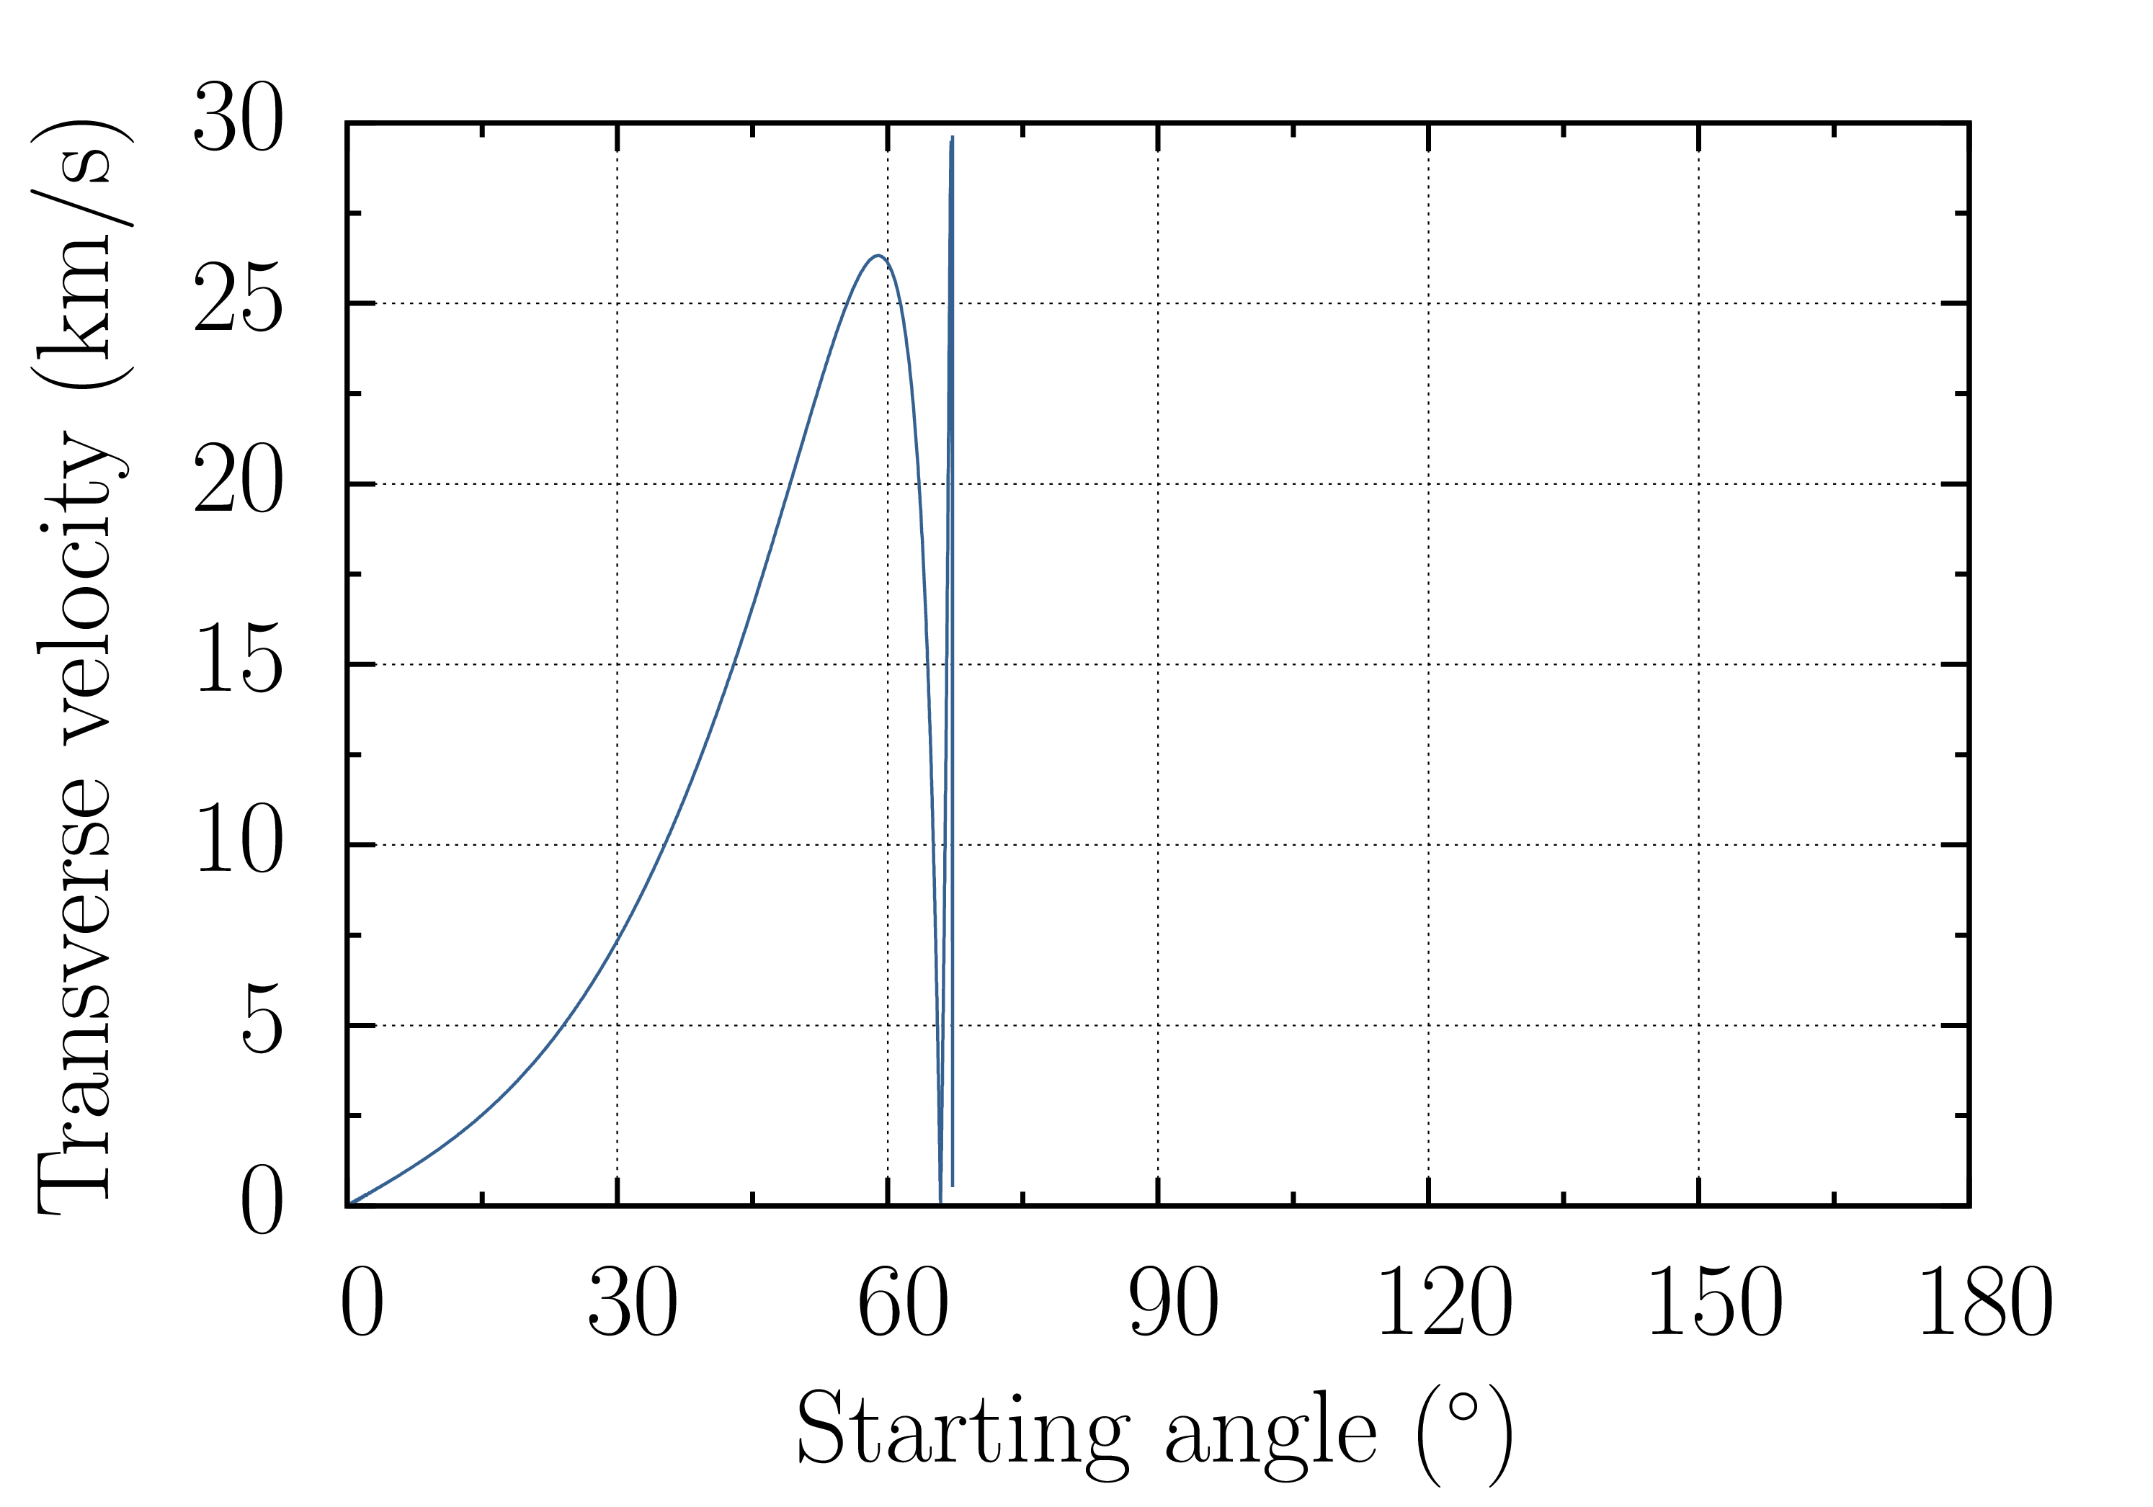
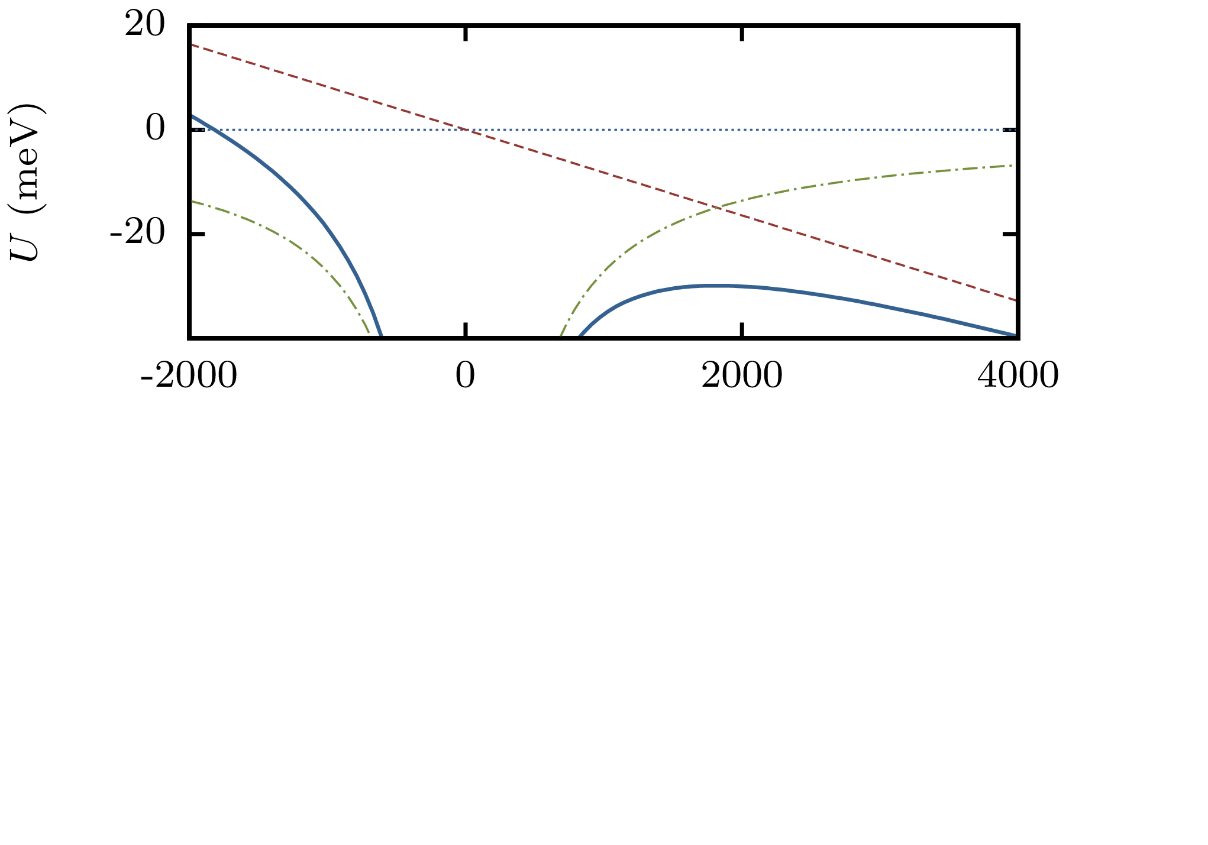
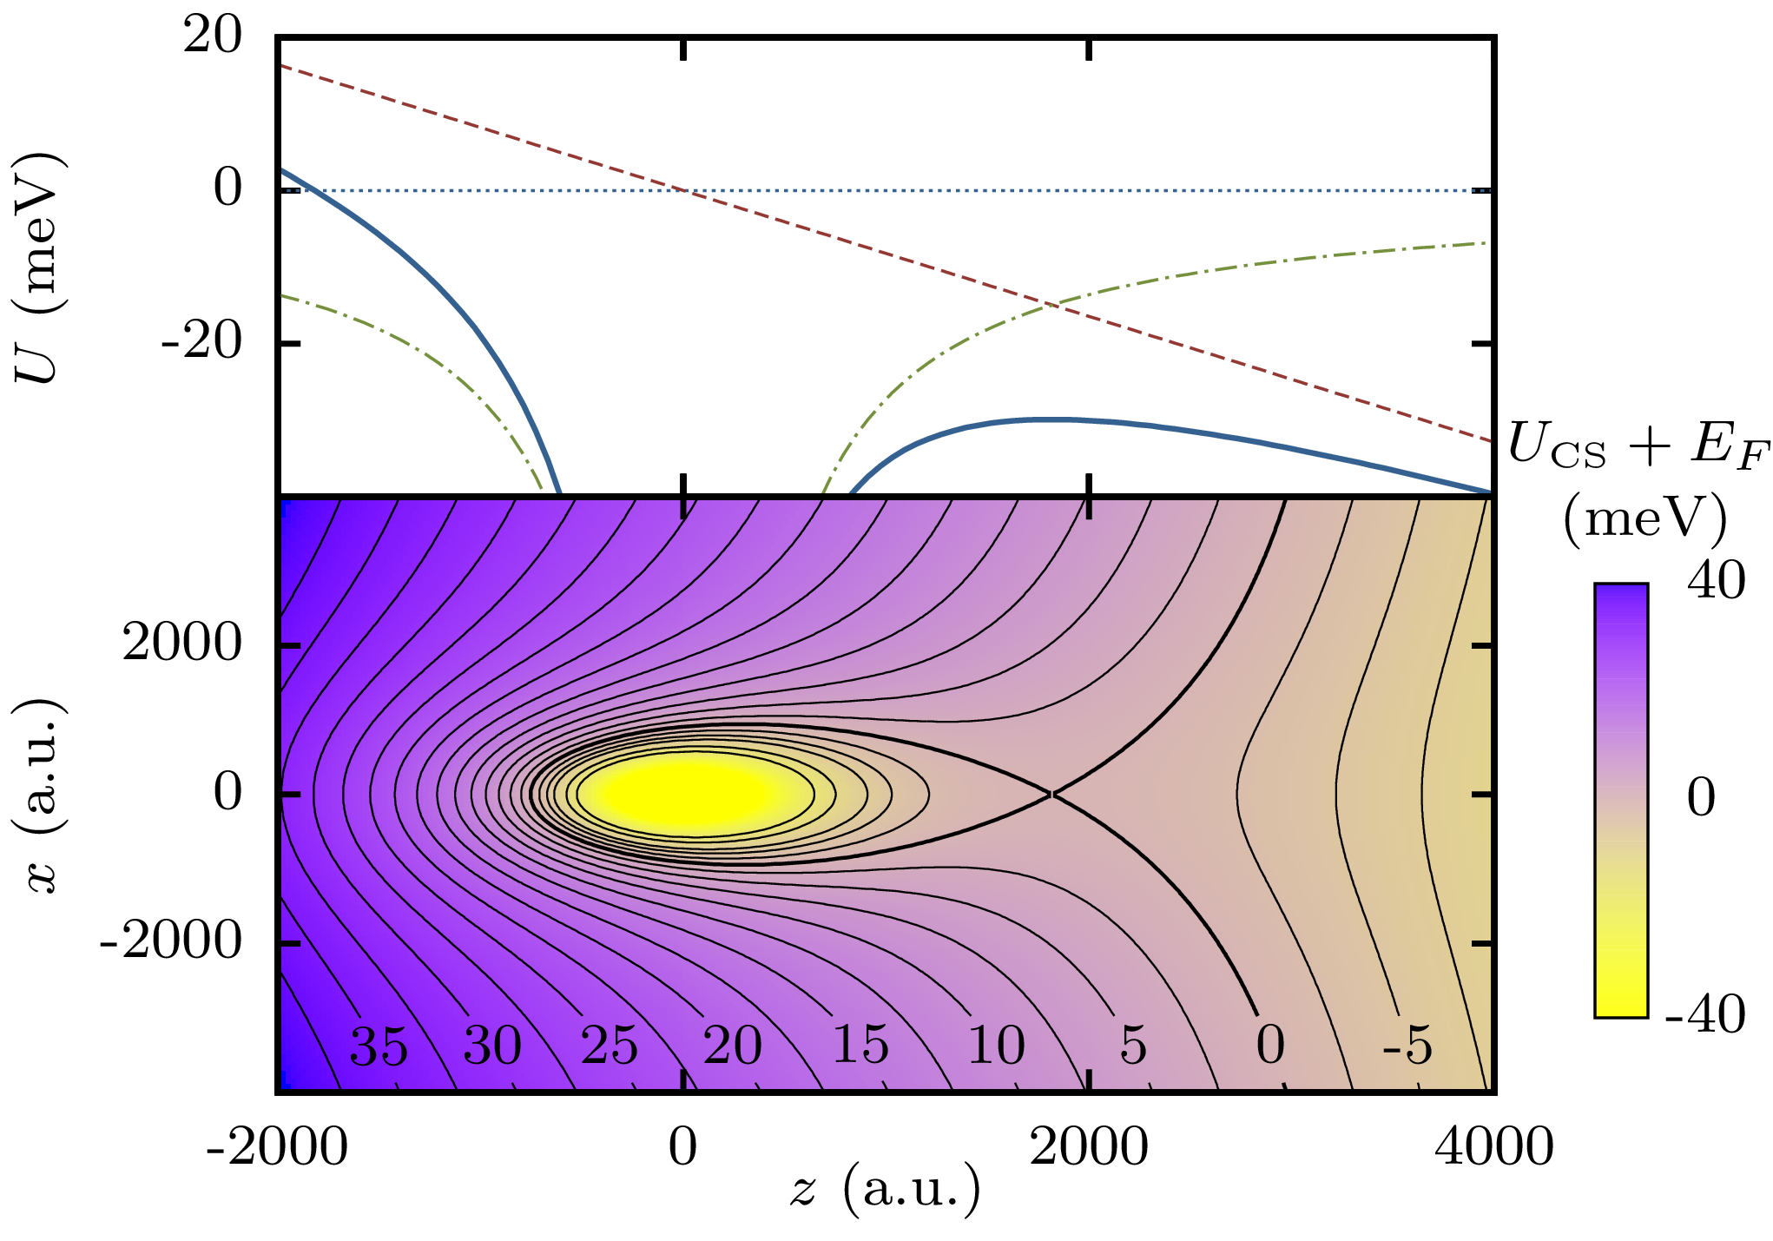
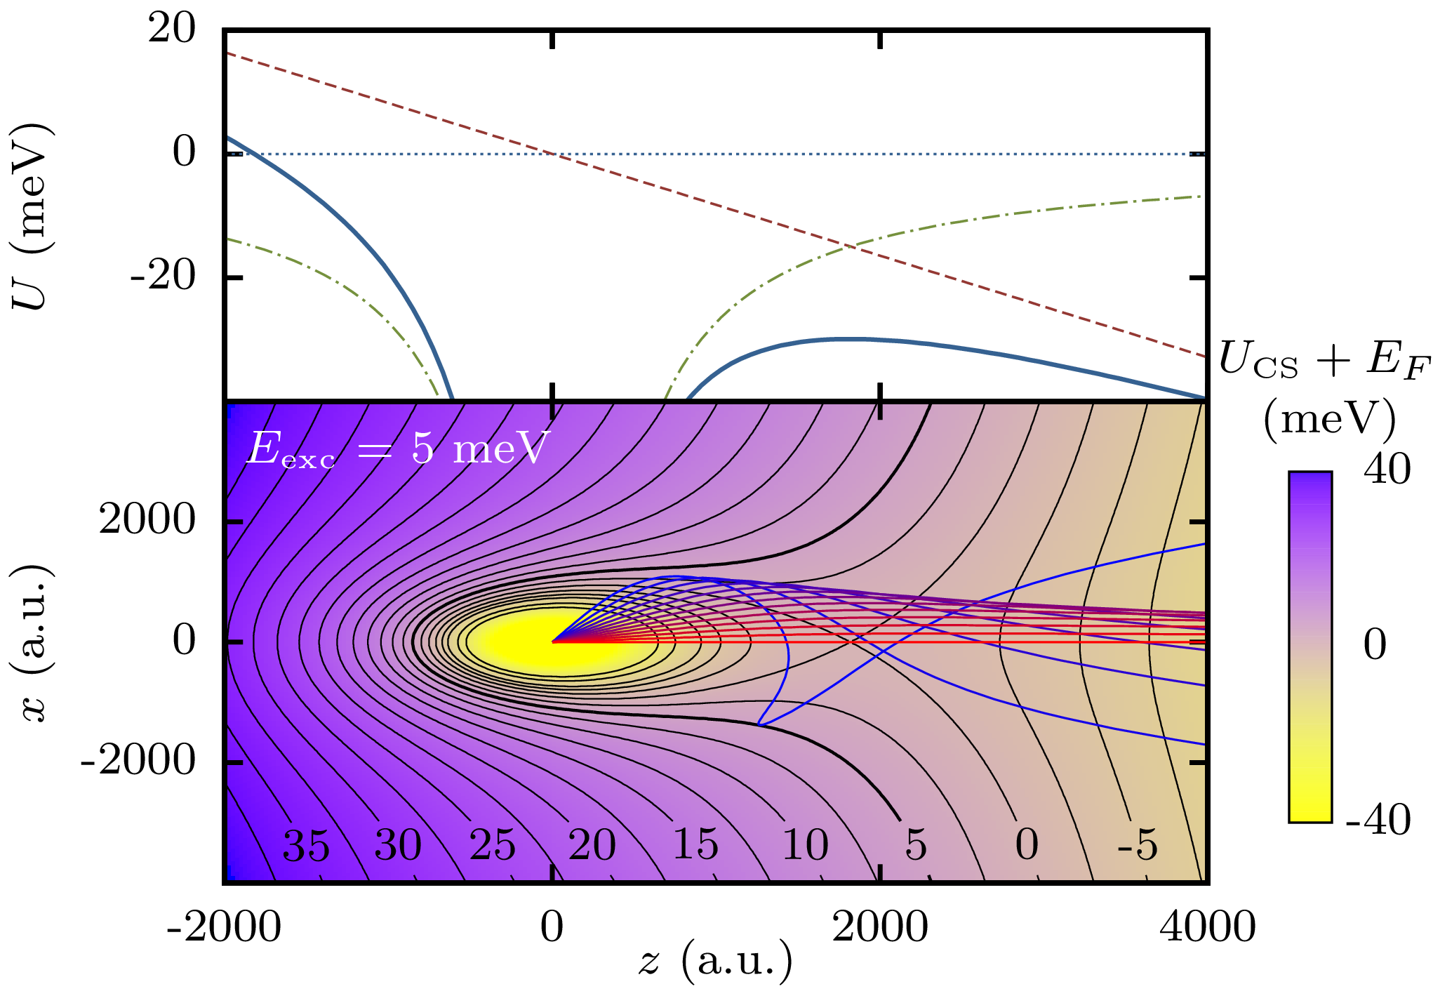
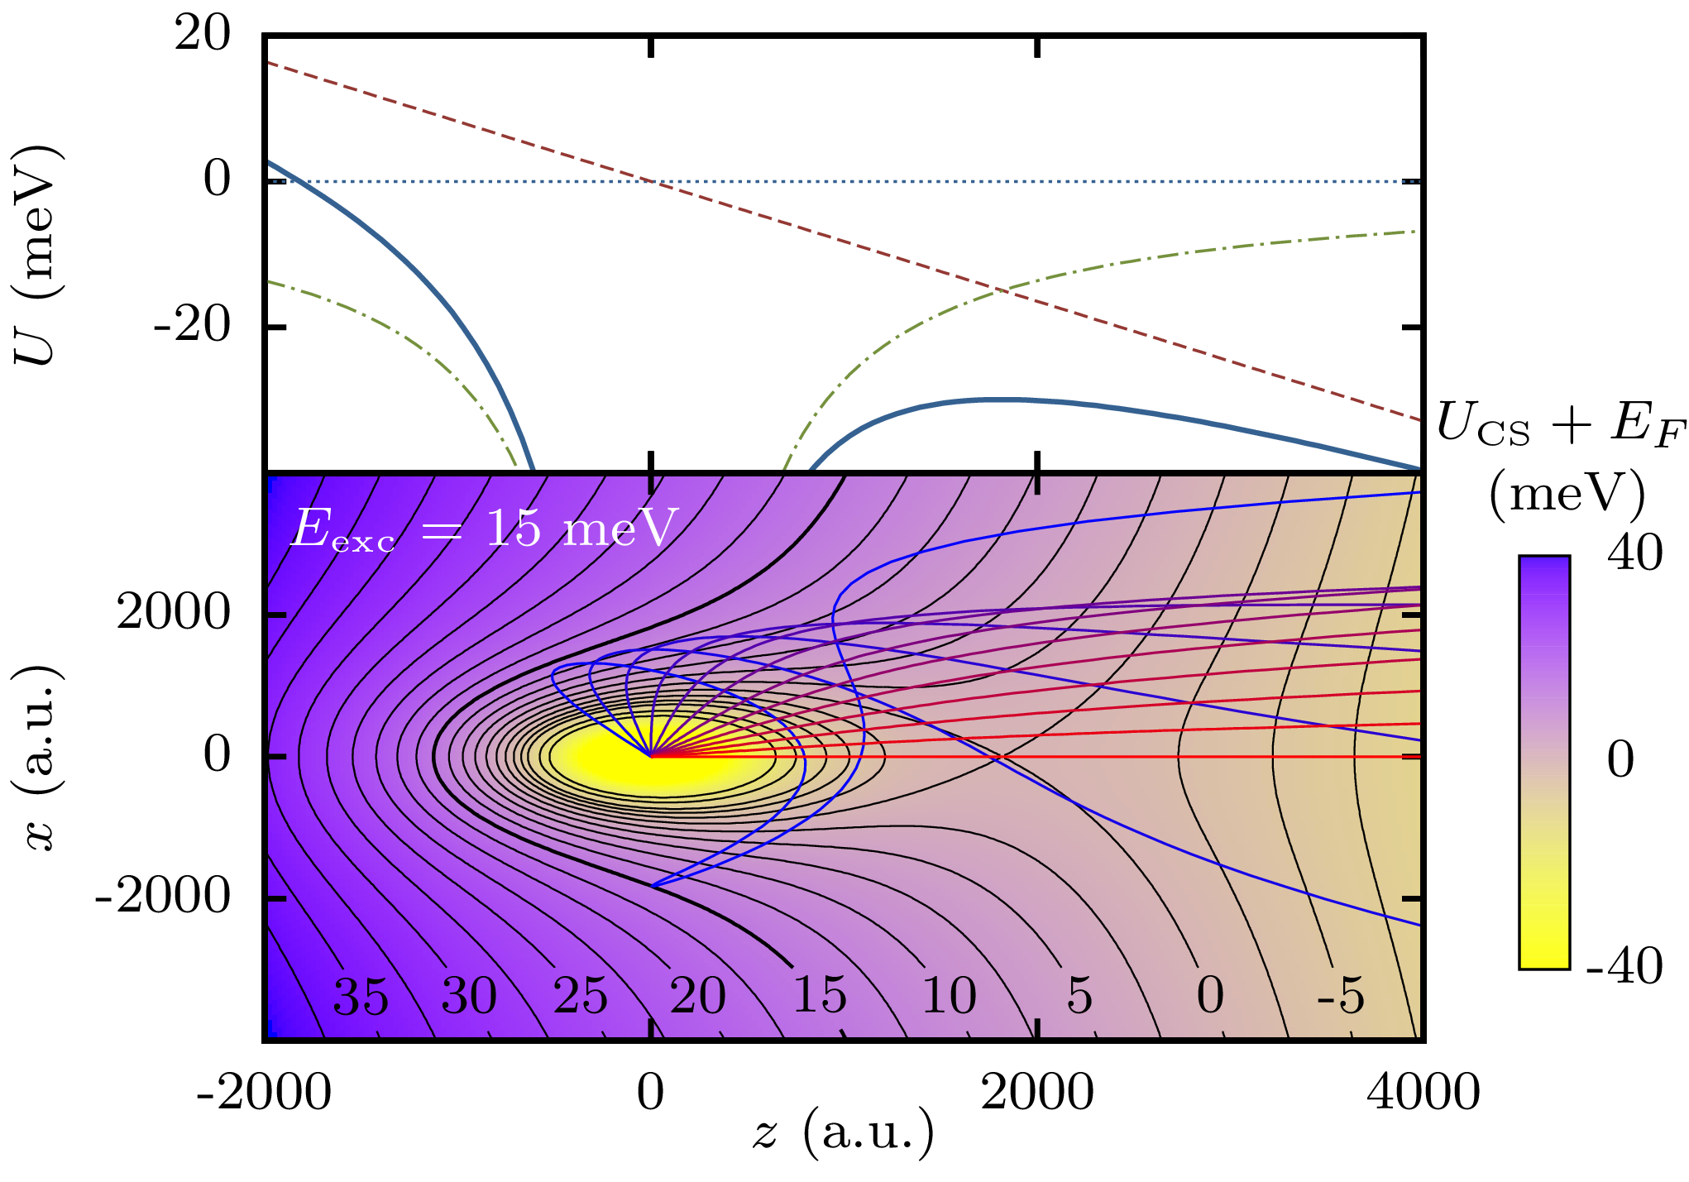
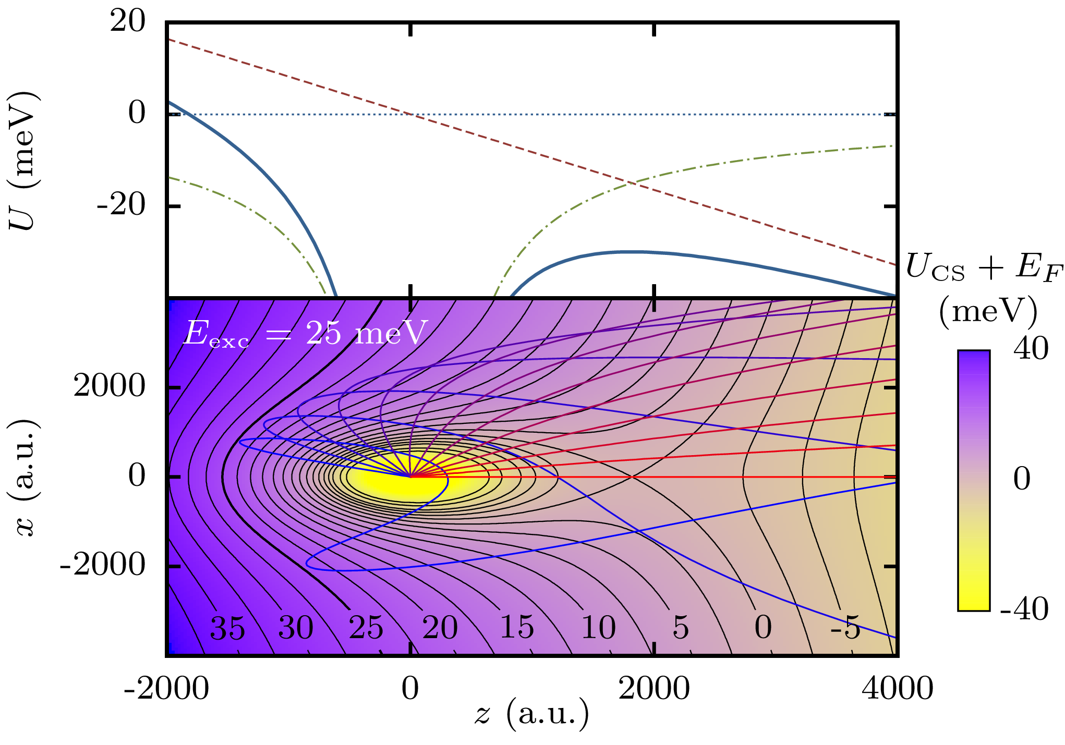
Analytical Temperature Model
Potential Energy
T (K)
E_{exc} (meV)
σ_{θ} → T
Electrons escape
mostly in forward direction
Bordas et al., Phys. Rev. A 58, 400 (1998)

Slide 23
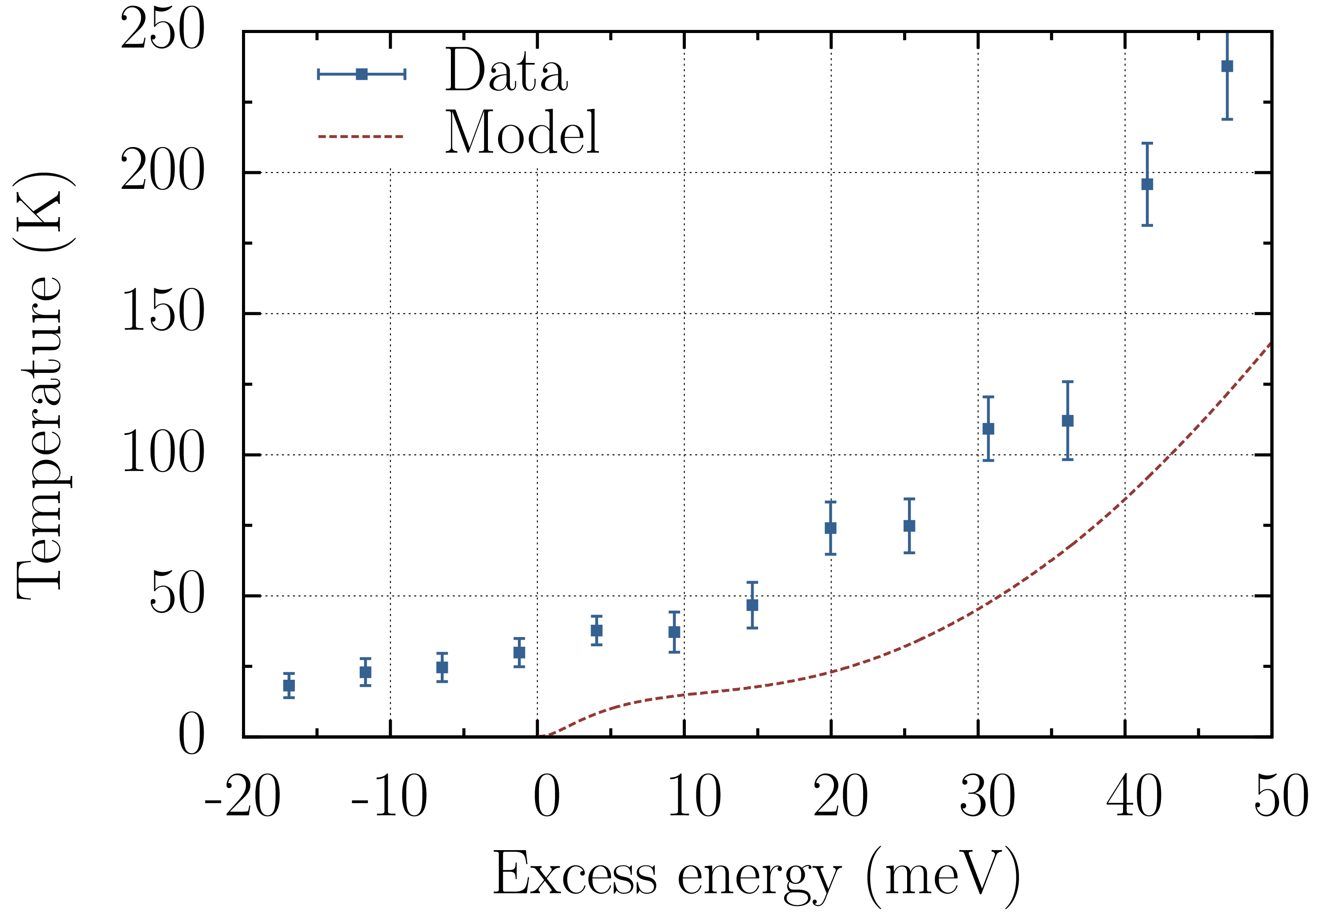
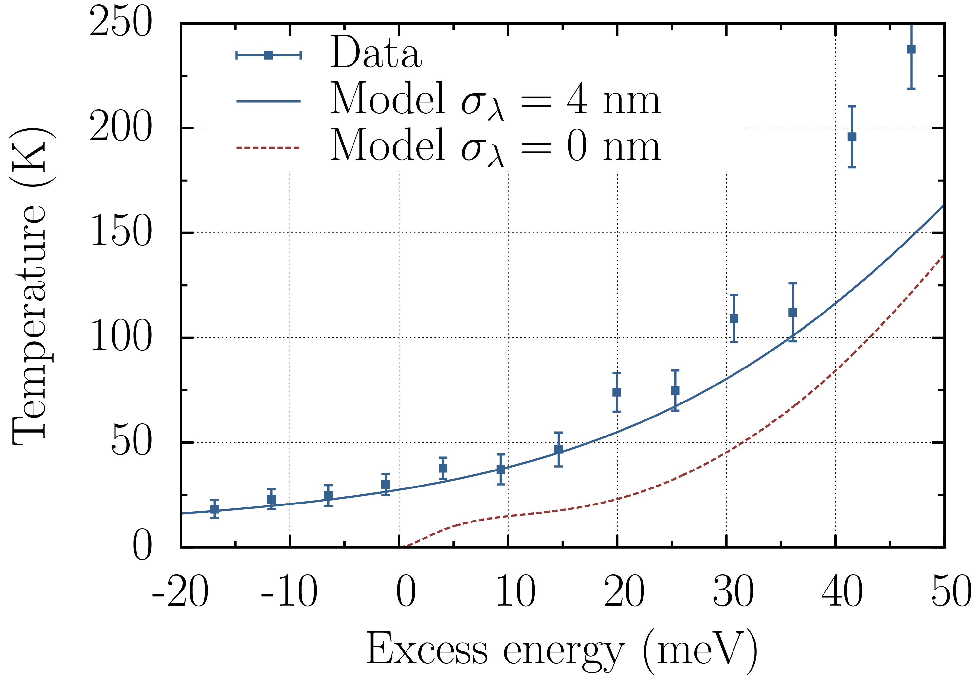
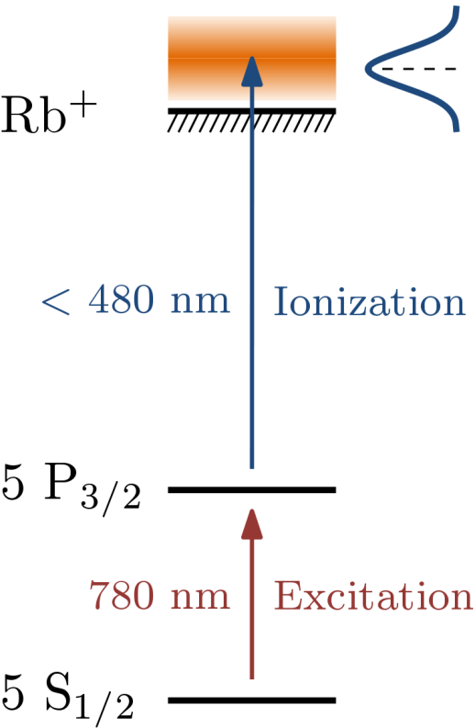
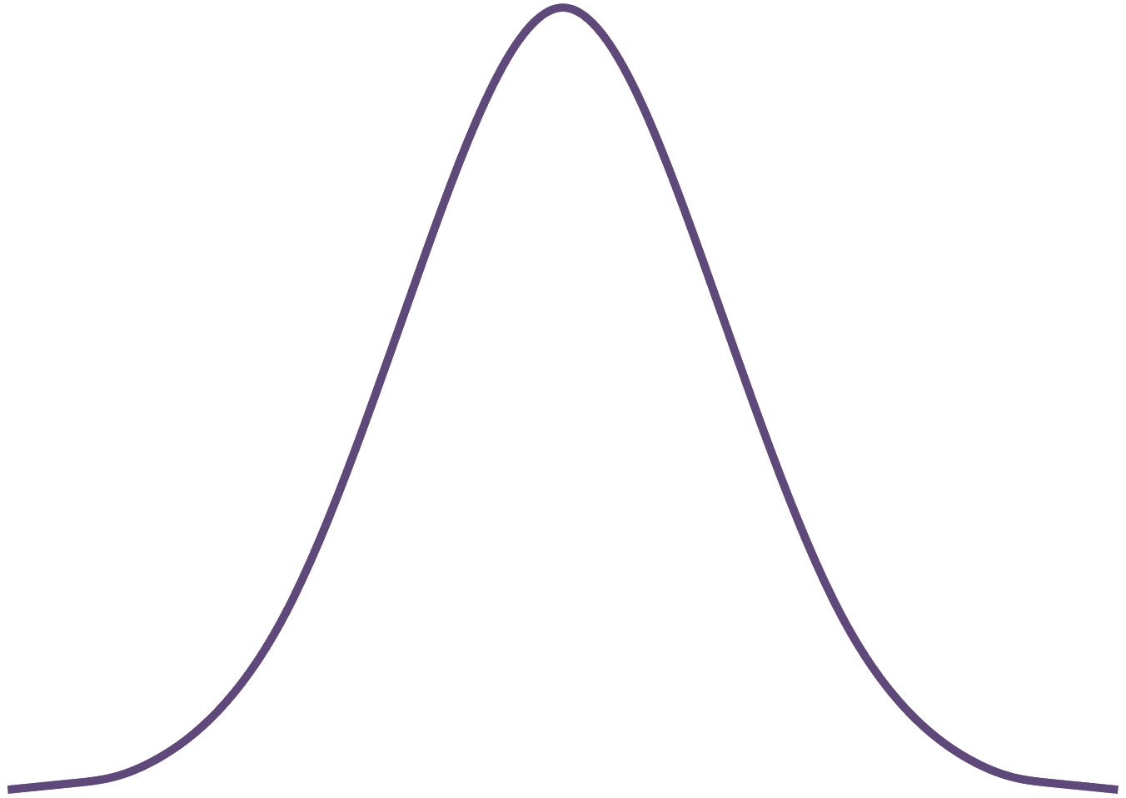
Comparison with Model
Laser profile
Engelen et al.,
Nature Comm. (2013)
Analytical model explains femtosecond data;
few 10 K electron source with fs laser!

Slide 24
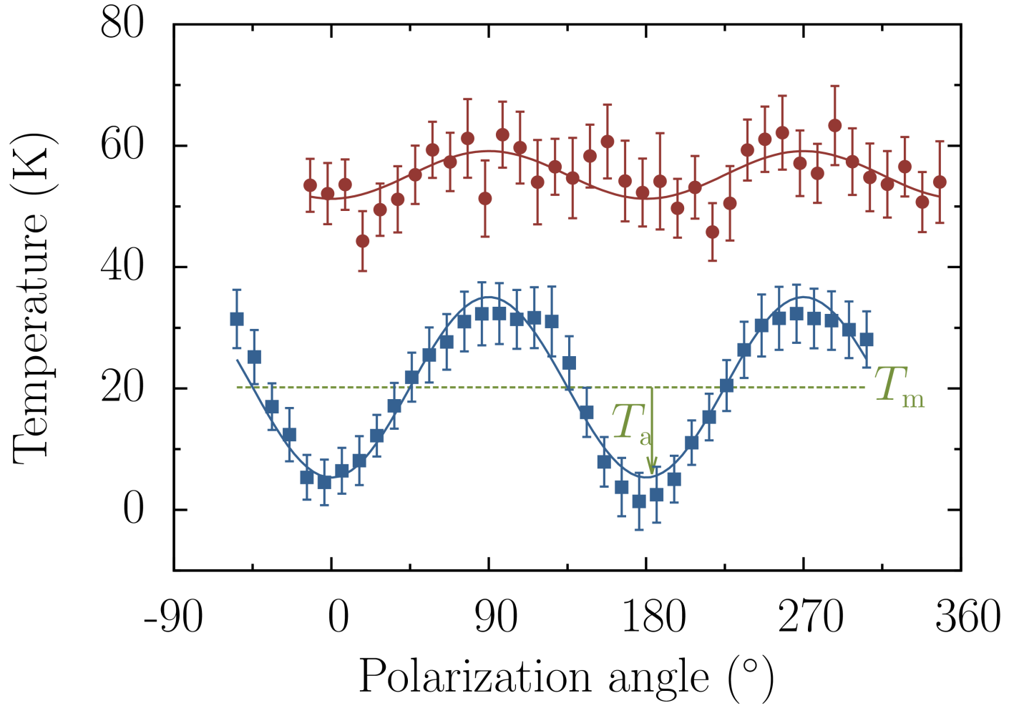
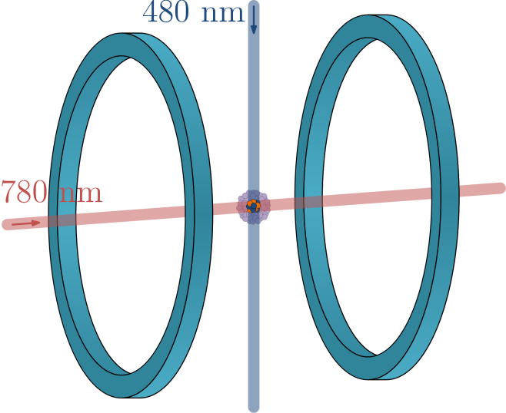
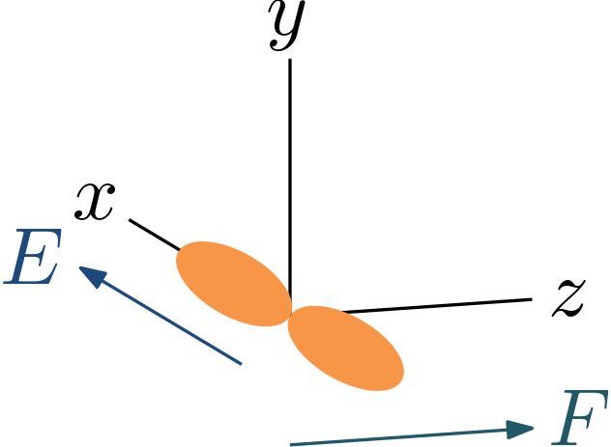
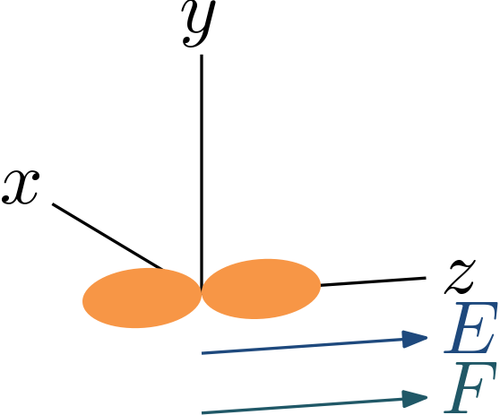
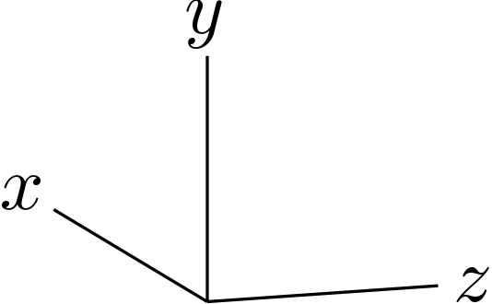
Dependence of T on Polarization
ns laser, λ = 484 nm
fs laser, λ = 481 nm
Very low T…
Engelen et al., New J. Phys. (2013)

Slide 25
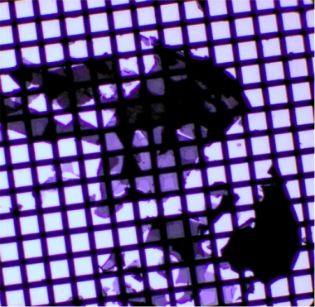
First diffraction pattern: graphite
Electron energy: 9.3 keV
Graphite crystal on 200 TEM grid

Slide 26
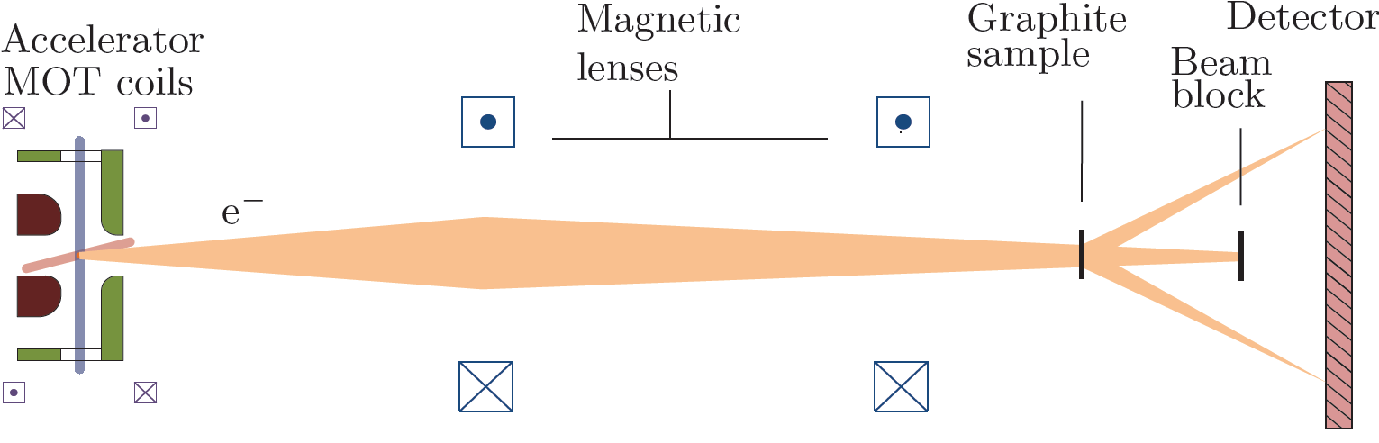
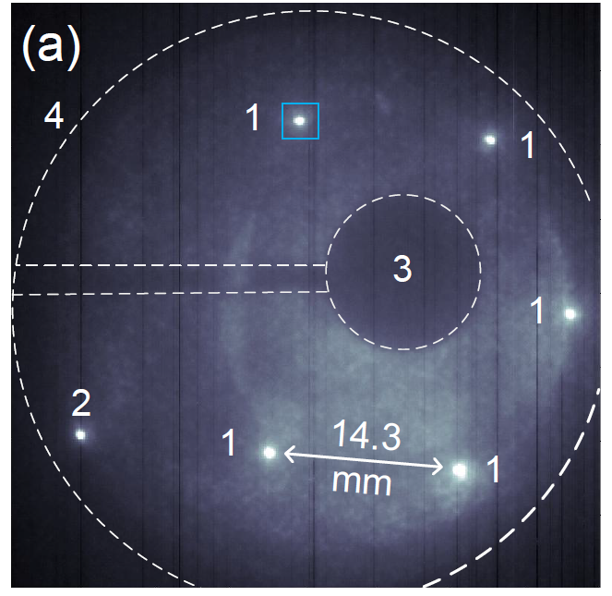
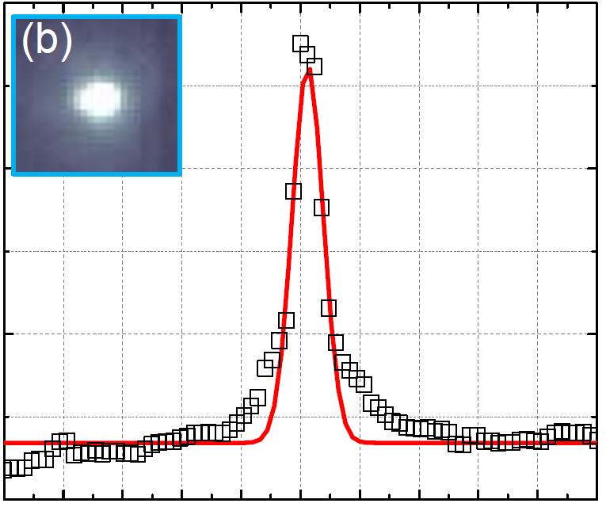
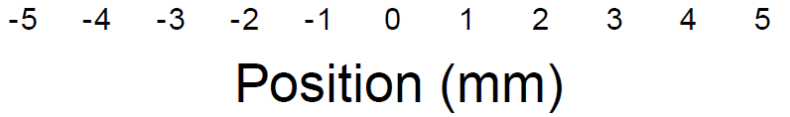
Diffraction pattern graphite
200 µm
30 µm
Van Mourik et al., to be published
Electron energy: 13.2 keV

Slide 27
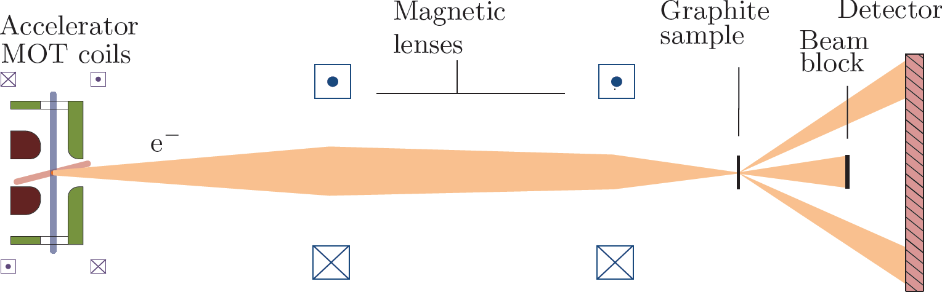
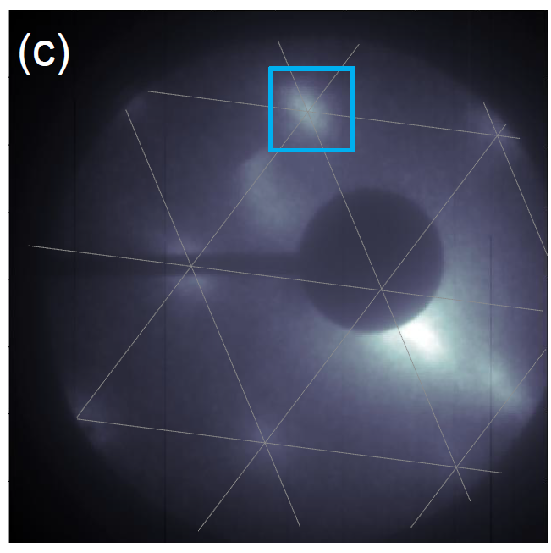
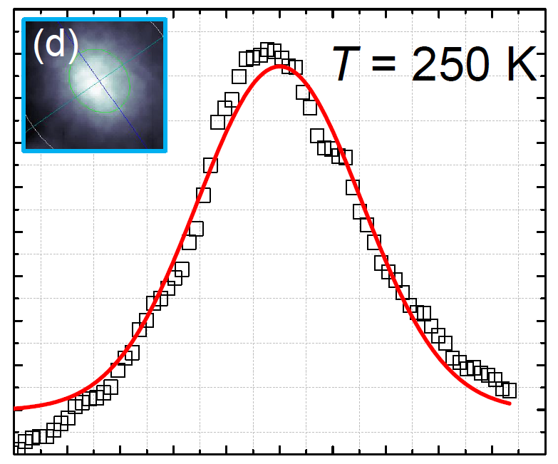
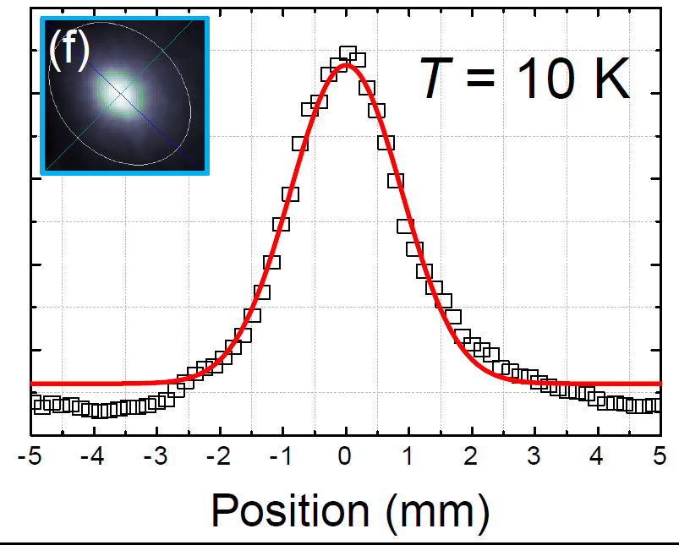
Diffraction pattern graphite
9 µm
Van Mourik et al., to be published
Electron energy: 10.8 keV

Slide 28
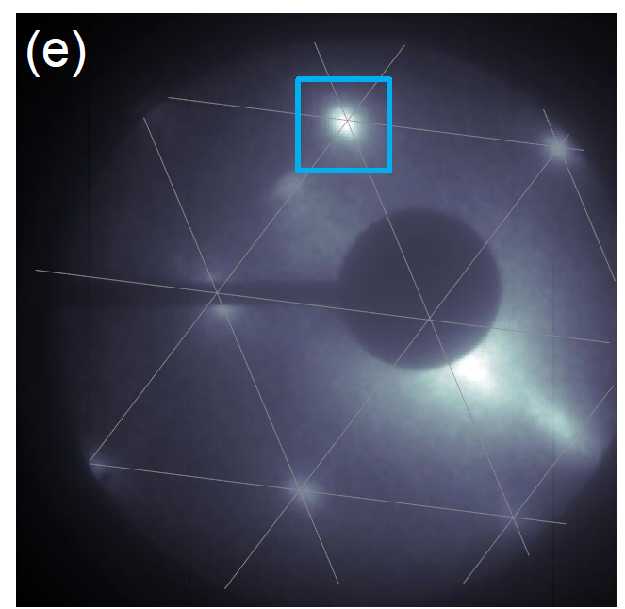
Diffraction pattern graphite
3 µm
Van Mourik et al., to be published
Electron energy: 10.8 keV

Slide 29
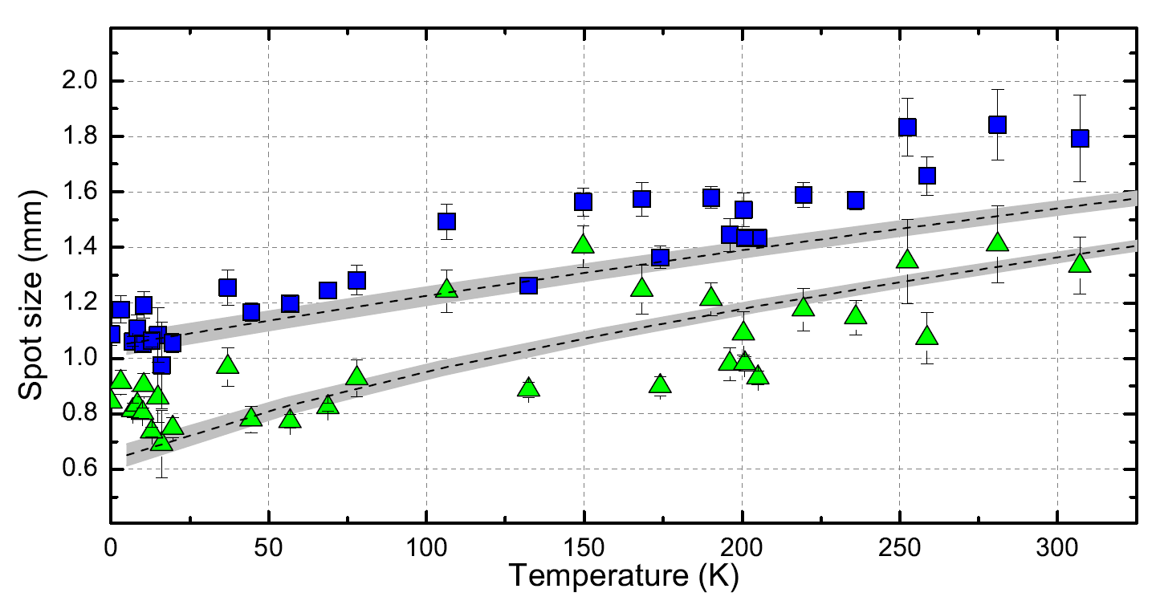

Diffraction spot size vs. temperature
Visibility diffraction pattern tunable with T (with λ and F)
behaviour as expected: GPT – no fitting parameters
Van Mourik et al., to be published

Slide 30
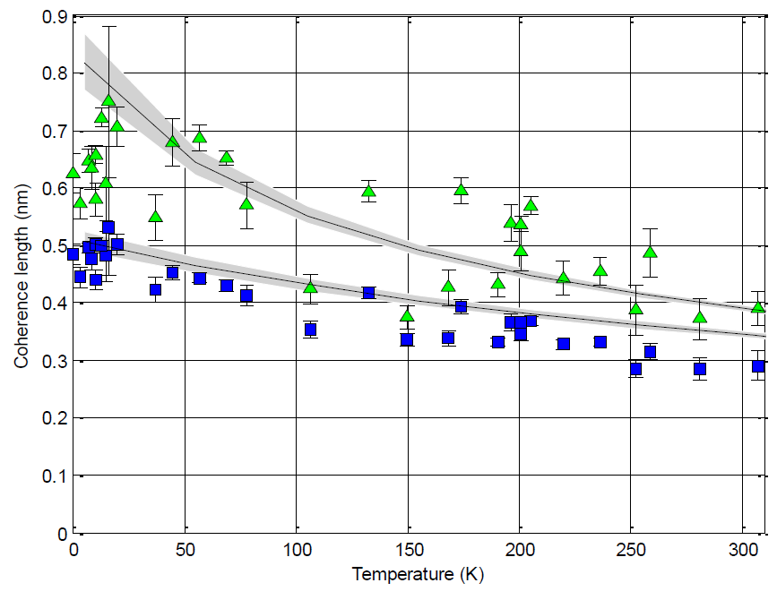
Coherence length vs. temperature
Coherence length directly from diffraction pattern
behaviour as expected – no fitting parameters
Van Mourik et al., to be published

Slide 31
Implications…
30 µm
3 µm
Source size 30 µm → spot size on sample 3 µm…

Slide 32
Implications…
1 µm
0.1 µm
Source size 1 µm → spot size on sample 100 nm…
…ultrafast nano-diffraction with 1 nm coherence length→

Slide 33
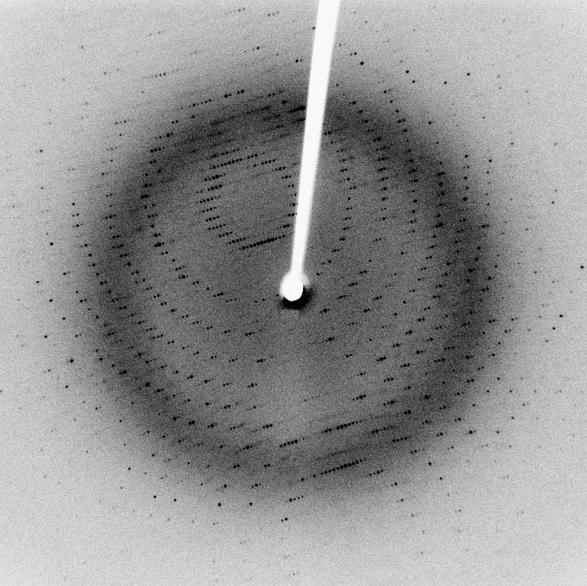
Implications…
30 µm
50 µm
Source size 30 µm & spot size on sample 50 µm…
… >10⁵ electrons per pulse with 10 nm coherence length
→ few (single?) shot UED of macromolecules

Slide 34
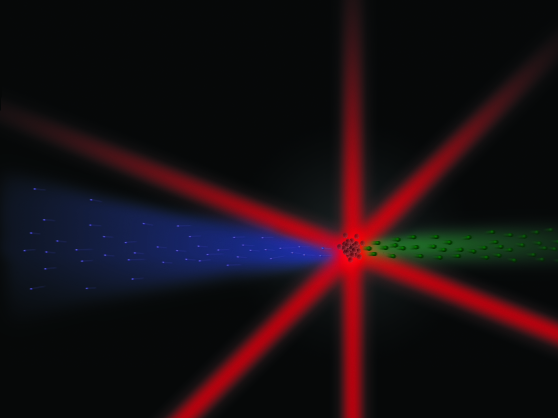
Summary
ultracold & ultrafast electron source: T ≈ 20 K & τ = few ps
temperature tunable with laser wavelength and polarization
detailed understanding photoionization process
first diffraction patterns confirm source properties
ultrafast nano-diffraction possible
UED of macromolecules possible

Slide 35







Acknowledgment
Bert Claessens – PhD 2007
Gabriel Taban – PhD 2009
Merijn Reijnders – PhD 2010
Thijs van Oudheusden – PhD 2010
Nicola Debernardi – PhD 2012
Adam Lassise – PhD 2012
Wouter Engelen – PhD 2013
Peter Pasmans – PhD
Stefano Dal Conte – postdoc
Daniel Bakker, Martin van Mourik – MSc 2013
Many other BSc and MSc students
Bas van der Geer, Marieke de Loos – Pulsar Physics
Edgar Vredenbregt – coPI
Technical support:
Louis van Moll
Jolanda van de Ven
Eddie Rietman Iman Koole
Ad & Wim Kemper
Harry van Doorn

Slide 36
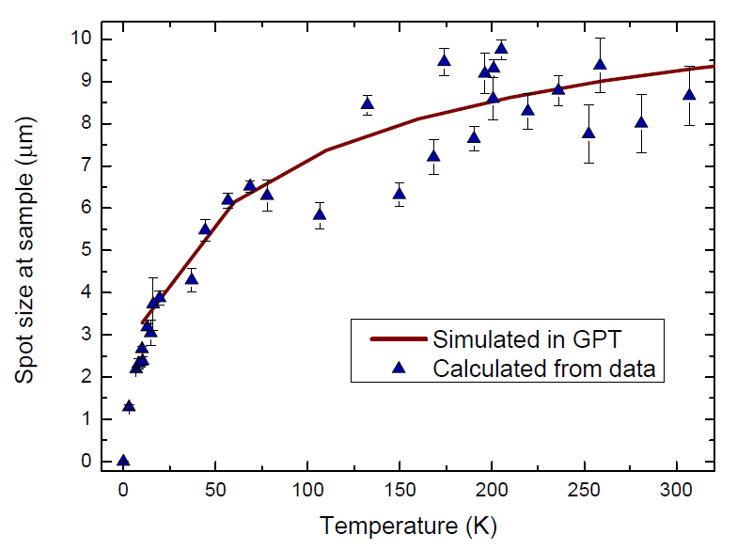
Spot size on sample vs. temperature

Slide 37
Phase space density
>10⁵ electrons per pulse with 1 nm•rad normalized emittance
→ coherent fluence ≥ 10⁻³
→ degeneracy ≥ 10⁻⁵
Coherent fluence
Degeneracy
T << 1 K possible??

