Slide 1
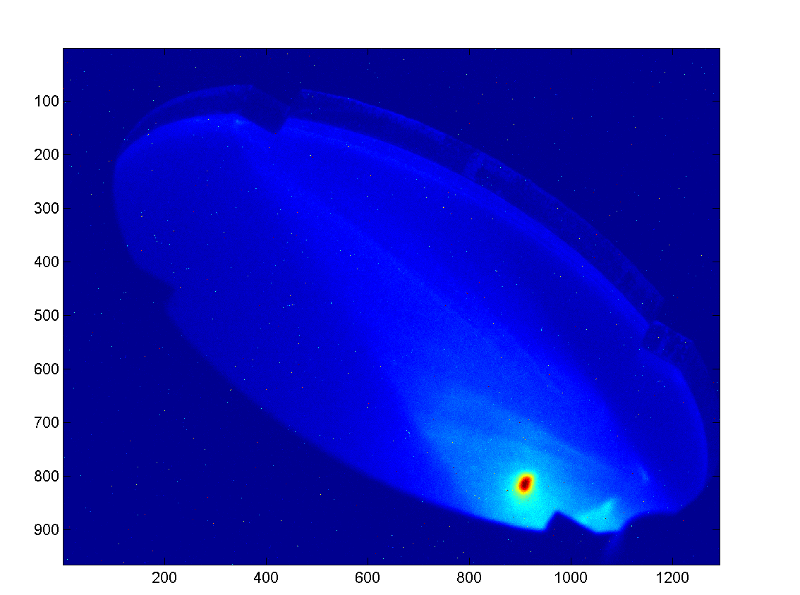
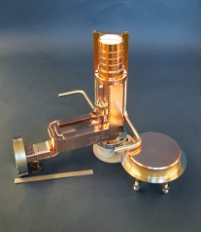
Commissioning of SLAC X-Band Photoinjector Valery Dolgashev on behalf of of Cecile Limborg-Deprey
FEIS 2013 - Femtosecond Electron Imaging and Spectroscopy
Key West, Florida,
December 9 - 12, 2013
Notes:
I’m going to present the initial performance of SLAC X-Band photoinjector

Slide 2
Acknowledgments
C.Adolphsen, T.Raubenheimer
NLCTA Team: C.Hast, D.Mc.Cormick , K.Jobe, M.Dunning , E.Hemsing, S.Weathersby, F.Fu
Faya Wang
RFARED team
A.Vlieks
Laser group: I.Makasyuk, A.Miahnahri, S.Gilevich, W.Polzin, P.Hering
Controls : Matjaz Kobal (Cosylab), M.Boyes, K.Luchini, D.Rogind
Mechanical: D.Walz, R.Rogers
Alignment: G.Gassner, H.Imfeld
Many other people (A.Benwell, B.McKee, J.Tice, bldg 33 team, Juan Cruz, C.Hudspeth, … )

Slide 3
Motivation: X-Band photoinjector A high brightness electron source
Build upon decades of DOE investment into high-gradient rf technology
Mature high gradient R&D:
practical accelerating gradient for linacs ~100MV/m (25MV/m for S-Band)
practical cathode fields in RF gun for RF gun ~200MV/m (120MV/m for S-Band)
Recent research in new materials is pushing practical surface fields toward 300 MV/m
Experience from success of LCLS and its RF photoinjector
Possible applications:
Injector for Compact, FELs (180 m long, 2fs, 20GW, 6GeV: PRST-AB,15, 030703 (2012))
Compact Inverse Compton scattering (ICS) source
Ultra-Fast Electron Diffraction
Notes:
Why an X-Band photoinjector ?
SLAC has spent 20 years in developing the X-Band bringing the technology to high maturity
with operating gradients for linacs of 100MV/m at X-Band against typically 25 MV/m at S-Band and 200MV/m in RF gun against 120 MV/m for S-Band
Then comes the success of LCLS , with its photoinjector demonstrating high brightness performances
Finally a repeated request to build more compact machines
Simulations indicate that X-Band photoinjectors would be excellent sources for Compact FELs, Compact ICS, and UED facilities

Slide 4
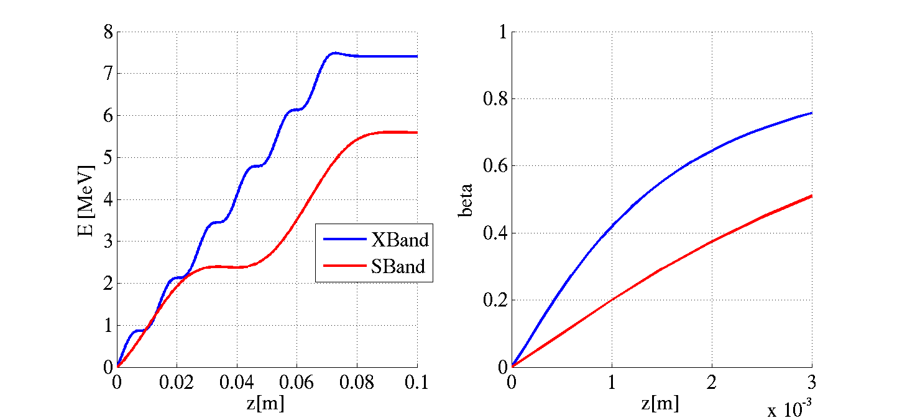
High cathode electric fields: 200 MV/n X-band vs. 120 MV/m S-band
S-band
X-band
Beta of 0.5 reached at
1 mm for X-band vs.
3 mm for S-band
Accelerating electric field over the first 3 mm

Slide 5
RF Gun Simulations (Astra) Peak brightness: 8x higher for X-Band than S-Band gun
bunch length ⇨ shorter by 3-4
from high dE_{z} / dt
emittance ⇨ smaller by up to 2
from high higher cathode fields
larger surface field allows smaller laser spot,
and hence smaller transverse emittance
 | X-Band Test Acc. Simulations (*) |  |  |  | LCLS Simulations(*) and measurements
Q [pC] | ε_{x,95%} [mm-mrad] | σ_{l} [mm] | B_{peak}= Q/σ_{l}/ε² |  | ε_{x,95%} [mm-mrad] | σ_{l} [mm] | B_{peak}= Q/σ_{l}/ε²
250 | 0.250 | 0.228 | 2.24
250 | 0.280 | 0.184 | 2.21 |  | 0.40 | 0.620 | 0.32
20 | 0.075 | 0.109 | 4.16 |  | 0.15 | 0.220 | 0.52
10 | 0.076 | 0.055 | 4.02
10 | 0.118 | 0.042 | 2.18
1 | 0.016 | 0.080 | 6.2
1 | 0.036 | 0.025 | 3.94
Notes:
We anticipate peak brightness 8x higher for our X-Band gun than for the S-Band gun from calculations
The bunch length is reduced by a factor of up 4 thanks to the high gradient and high frq.
The transverse emittance by up to 2 , to overcome the surface field when operating at smaller laser spot size
You can review the cases below where numerical optmization was done in the case of the LCLS where they match the measurements and optimization for the X-Band gun
for a 250 pC and 20 pC cases

Slide 6
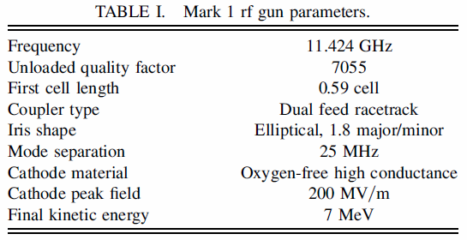
History of SLAC X-Band Guns
5.5 cell gun was developed at SLAC for compact Inverse Compton Source in collaboration with UC Davis (2001-2005) (A.E. Vlieks, et al., SLAC-PUB-11689)
“Mark0” have improved coupler (racetrack and low-magnetic fields) – from 2012 operating at SLAC X-band Test Accelerator
“Mark 1” have increased mode separation, elliptical irises, 5.6 cell - collaboration SLAC/LLNL, now at Livermore (R.Marsh et al. Phys. Rev. ST Accel. Beams 15, 102001 –2012)
Notes:
The original version was developed in collaboration with UC Davies for an inverse compton scattering project but with poor funding
An upgraded version Mark-0 was built but not tested.
The design was revisited in 2010 in collaboration with LLNL , including similar improvements as those implemented in the LCLS gun
We are presently testing the Mark-0 in our XTA test facility

Slide 7
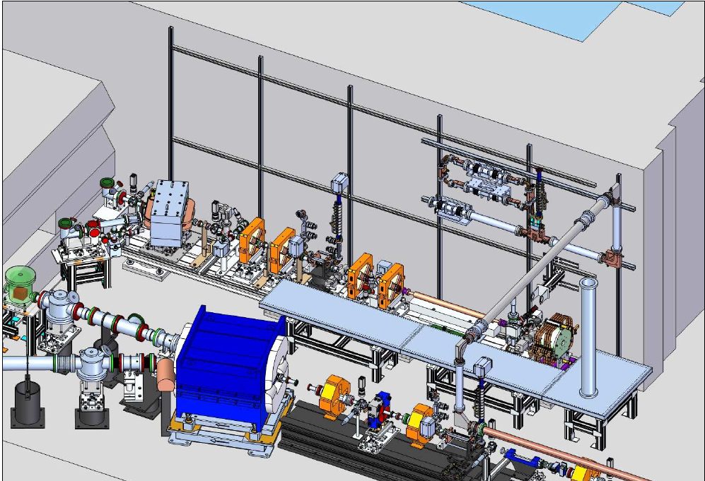
X-Band Test Area (XTA) in bunker of SLAC’s Next Linear Collider Test Accelerator
YAG/OTR
Transverse deflector
Gun + linac < 1.8m
E = 80 MeV (soon 100MeV)
6.7 m
spectrometer
Notes:
The X-Band Test Area occupies a less than 7m long space at the end of the NLCTA tunnel at SLAC
The gun is followed by a 1m long linac at the end of which we have presently 80 MeV but soon 100MeV
The last 2/3 of the beamline is used for characterizing the beam properties.

Slide 8
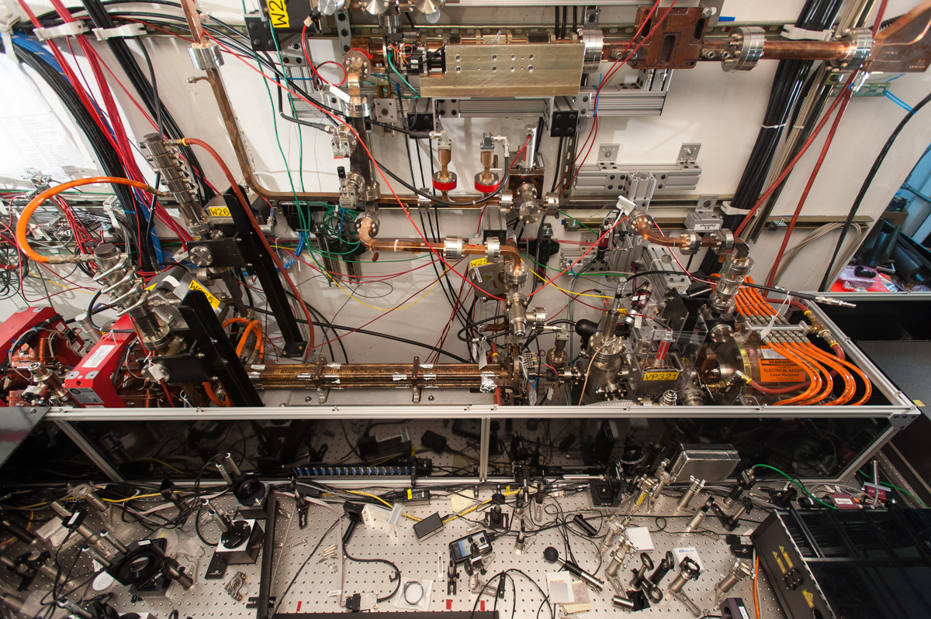
X-Band Test is operational since summer 2012
High power phase shifter
6 dB RF splitter
Linac
Gun + Solenoid
Laser Injection chamber +YAG +FC
Laser
Compressor(IR)
Tripler
Notes:
In this picture where you can appreciate the dimensions with 1in reference on the honeycomb laser table
The XTA beamline was installed in the summer of 2012.
You will notice the RF waveguide coming in here and the 6dB splitter which sends the power to the gun and the linac
The relative phase is adjusted with high power phase shifters

Slide 9
XTA rapid turn-on
1st beam July 2012, 18 months after project started
Existing X-Band RF station and waveguide
Existing NLCTA tunnel and infrastructure in place
Imported LCLS control system & applications
During 1st year
Stabilization of beam timing jitter
Laser oscillator PLL: reduced noise from 500fs (2°) to 160 fs (0.64 °)
RF feedbacks (phase, amplitude, SLED)
Recent beam-line upgrades
New, 100MV/m accelerating structure with race-track couplers
New Cavity BPMs
Notes:
The first beam was obtained 18months after the project was started. This was possible thanks to the preexisting NLCTA infrastructure, RF system, and the possibility of copying the LCLS control system
During 1st year of operation, the beam quality was suffering from shot-to-shot and slow drift preventing from tuning to small emittance
Extensive work was done to
reduced the laser oscillator phase jitter from 2 deg down to 0.6 deg
implemented RF feedbacks
We are now operating our new linac which will be capable of 100MV/m

Slide 10
Experimental Results
Energy out of rf gun ~ 7.5MeV (V_{RF,peak}~ 200MV/m)
Energy is 85 MeV at 1.8 m from source
Charge of up to 250 pC transmitted through linac
QE in low 10⁻⁵
Peak current of 150A (for 120pC)
Bunch lengths
250 fs rms at 20pC
540 fs at 150 pC
Emittance : not fully optimized yet (unstable laser mode)
~ 0.7 mm-mrad for 30 pC
~ 1.7 mm-mrad for 100 pC
Energy spread rms 3.10⁻⁴ (15 pC) , 10⁻³ (60 pC)
Energy jitter < 10⁻³
Notes:
Here is a list of our experimental results so far

Slide 11
Cathode peak field 200MV/m operated routinely
Schottky scan
Time of Flight (TOF)
Charge [a.u]
Arrival time [° X-Band]
[° X-Band]
[° X-Band]
Astra
simulations
200MV/m
also
confirmed by steering measurement
Notes:
We operate routinely cathode peak field of 200MV/m
In the left plot is a Schottky scan ie charge emitted as a function of injection laser phase
The range of 100deg is consistent with the simulations for a 200MV/m field
This is also confirmed by the TOF measured with a phase cavity and also compared to simulations
The energy out of the gun is also verified by steering measurements

Slide 12
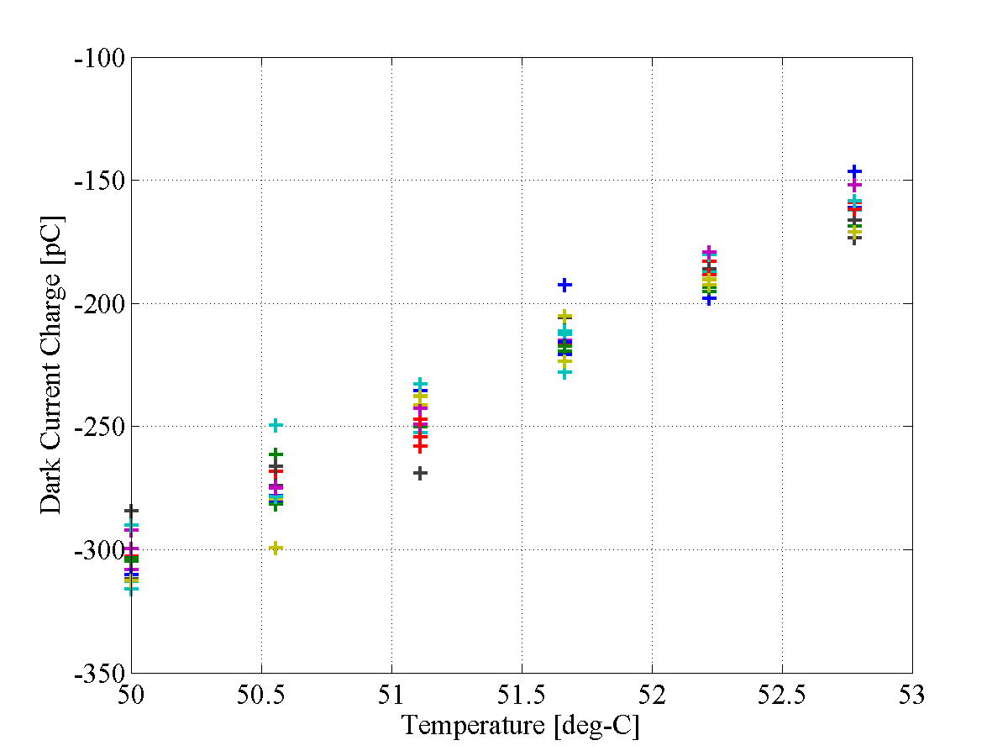
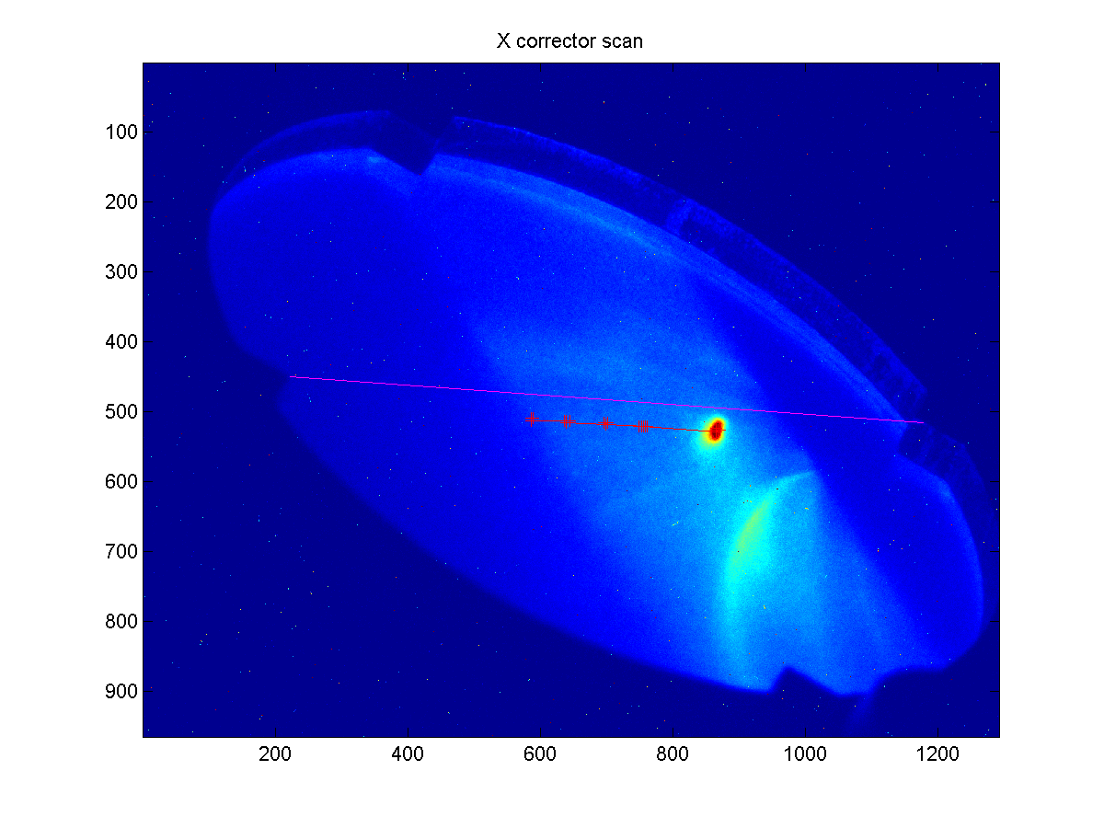
Parasitic, field emission currents
Dark currents are at acceptable level
17.5 MW in gun, 209 MV/m on the cathode
Total field-emission charge ~180pC during 160ns long RF pulse
13% Dark Current fluctuations correspond to power fluctuations at ~1% level
Photo-e beam
Dark current

Slide 13
Commissioning: Emittance measurements and optimization
ε_{y} ~ 0.7 mm-mrad
at 20 pC
ε_{x} ~ 0.9 mm-mrad
at 20 pC
But laser spot size
was too large

Slide 14
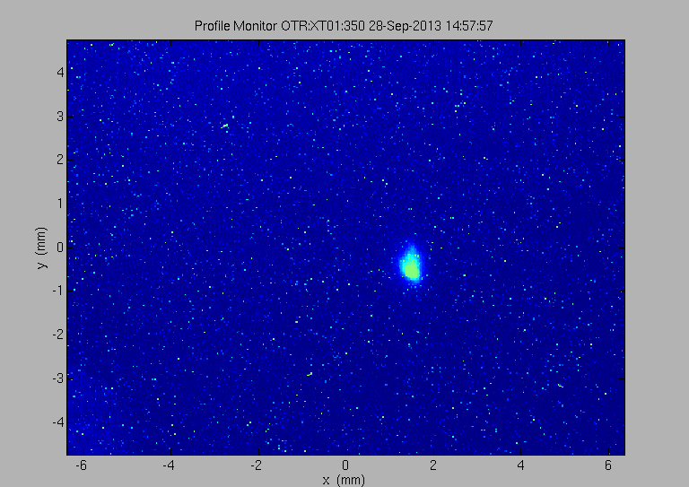
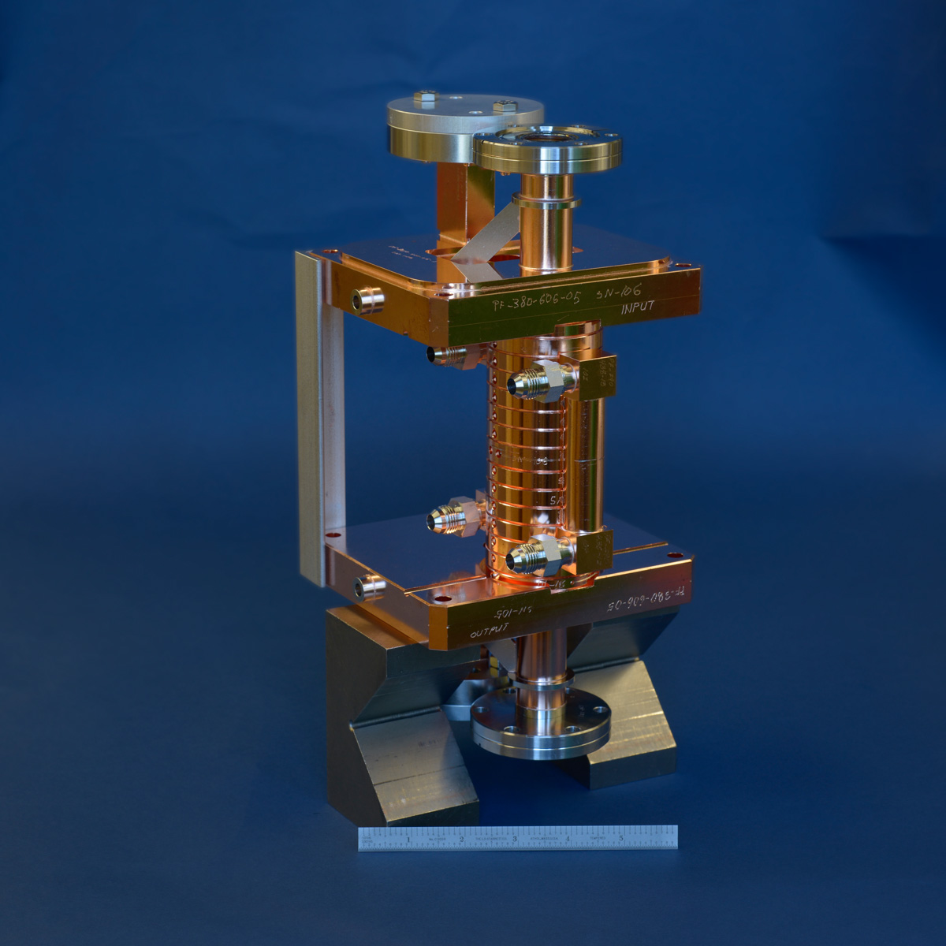
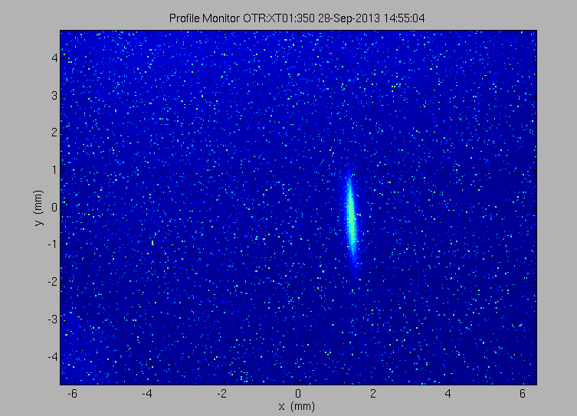
Commissioning: Bunch length measurements
X-Band transverse deflector
Deflector off
Measured bunch compression at low Q
475+/-70 fs rms at 50° (15pC)
250+/-70 fs rms at 30° (10pC)
125+/-30 fs rms at 15° (5pC)
Deflector on
Notes:
Bunch lengths were measured with an X-Band transverse deflector
Our deflector requires less than 1 MW to give tens of fs resolution
We measured compression at low Q as a function of injector phase and 500fs at 50deg, 250fs at 30 deg. and 125 fs at 15 deg.
Earlier measurement gave 250fs for 20pC
Again these are preliminary data

Slide 15
Application of X-band injector to Ultrafast Electron Diffraction
Phase 1: Single-shot time resolved measurements,
using rf deflector to streak ps electron beam after sample
Phase 2: Stroboscopic measurement using short (~30 cm) standing wave accelerating cavity for velocity bunch-length compression

Slide 16
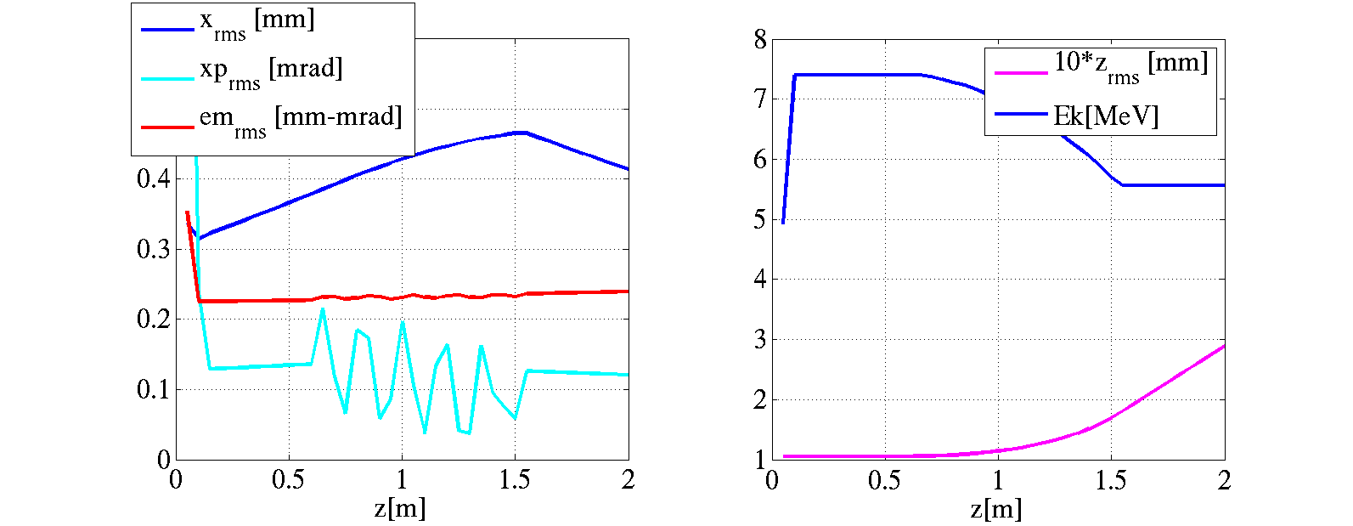
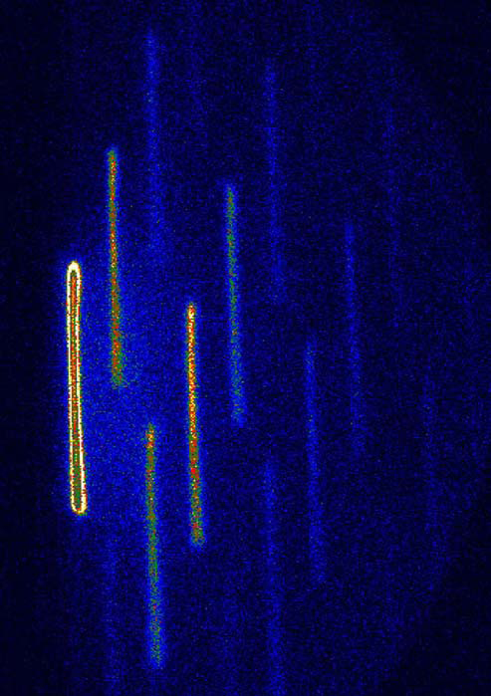
UED experiment at XTA – Phase 1
RF deflector , 200fs resolution
R.Li Review of scientific instruments 81, 036110 2010 , Tsinghua University
- Streaked long ~1ps bunch to observe sub-ps dynamics
- very high resolution X-Band transverse deflector
Gun (200MV/m)
Deceleration in 1-m-long Traveling Wave linac
E = 5.5 MeV,
σ_{θ} = 0.1 mrad
σ_{x} = 0.3 mm
β_{Tcav} ~ 8 m
Resolution ~ 4 fs
σ_{x}
ε
σ_{x'}

Slide 17
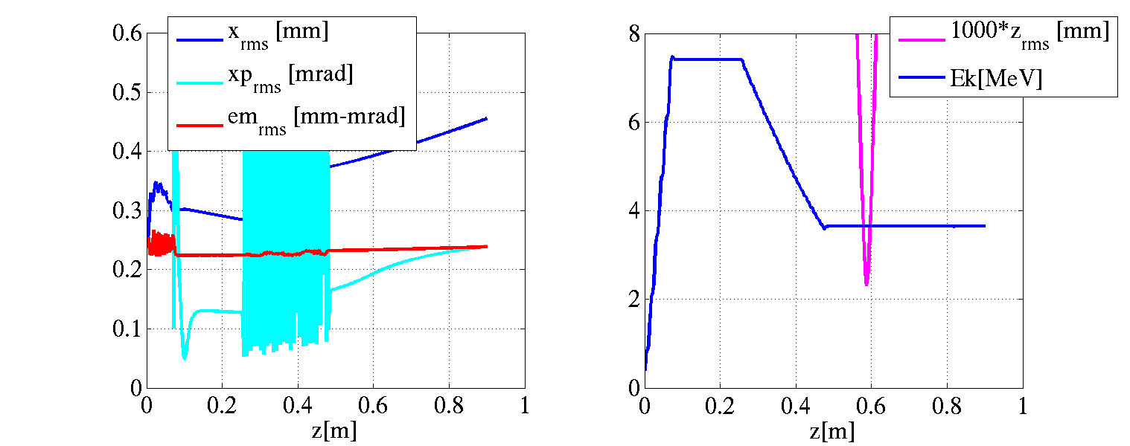
UED experiment at XTA –phase 2
Stroboscopic measurements with 7 fs-long-bunch
-install short Standing Wave accelerating to do velocity bunching
-use arrival time measurements to reconstruct timing
Early simulations at 1pC with compressor
7fs rms
s_{x}
e
s_{x'}

Slide 18
Summary
X-Band Test Area is a test-bed for multiple techniques and methods that needed to make a compact, high brightness injector
Committing is ongoing with goal of sub-micron emittances and sub-ps-long bunches
Ultrafast Electron Diffraction is one of many potential applications of this technology

