Slide 1


Single-shot Picosecond Temporal Resolution Transmission Electron Microscopy
Renkai Li and Pietro Musumeci
Department of Physics and Astronomy, UCLA
FEIS 2013 - Femtosecond Electron Imaging and Spectroscopy
Dec 9 - 12, 2013, Key West, FL, USA

Slide 2
Outline
transmission electron microscopes go ‘4D’
stroboscopic and single-shot approaches
single-shot picosecond temporal resolution MeV TEM
  higher launching field: modified rf photogun
  ultralow emittance: cigar-shape beam
  ultralow energy spread: rf curvature regulation
  novel electron optics: PMQ and μ-quads
summary and outlook

Slide 3
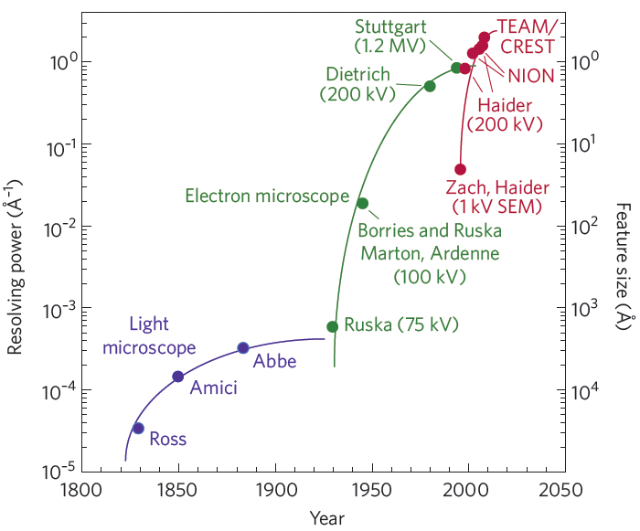
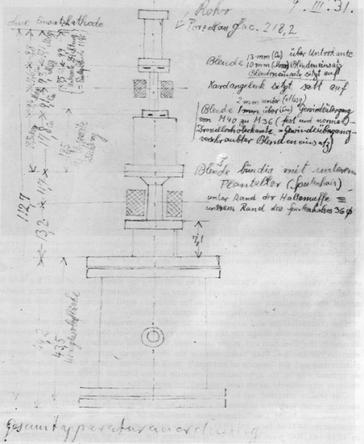
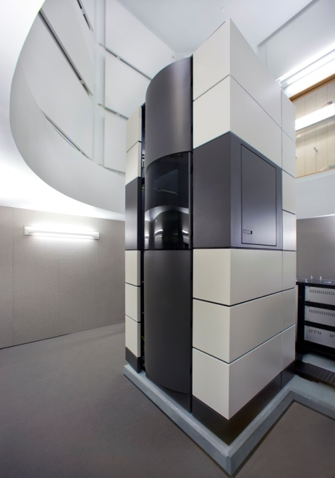
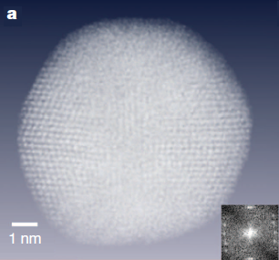
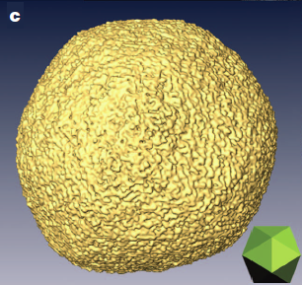
Transmission electron microscopies
primary tool for material science, chemistry, physics, biology, and industry
sub-Ångström spatial resolution with aberration correction
Ruska’s EM sketch
TEAM I at NCEM LBNL
D. A. Muller, Nat. Mater. 8, 263 (2009)
Adapted from H. H. Rose (2009)
3D electron tomography at ångström resolution
M. C. Scott, Nature 444, 483 (2012)

Slide 4
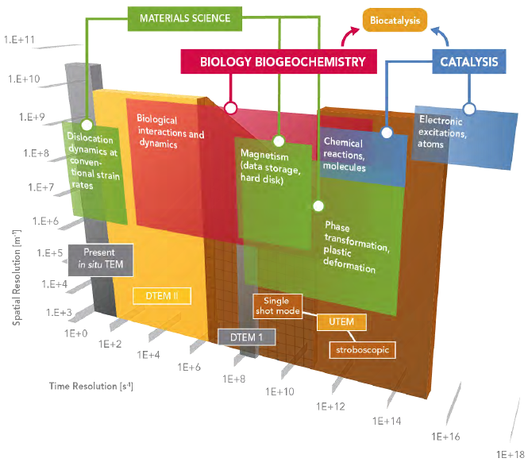

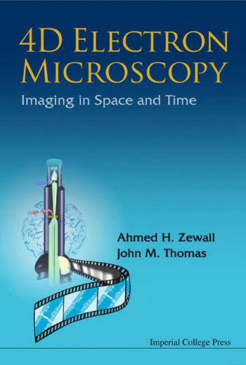

Resolution in the 4th dimension – time domain
Conventional TEMs need millisecond to second exposure time
many reasons to see structural changes in time, rather than static images
EMSL Ultrafast TEM Workshop Report, June 14-15, 2011

Slide 5
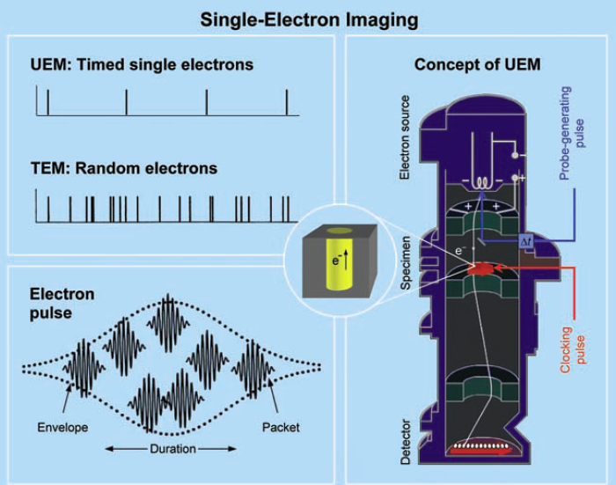
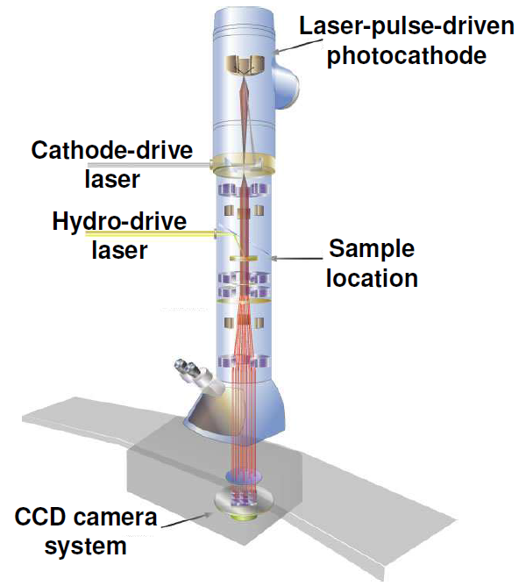
Ultrafast TEM: stroboscopic and single-shot approaches
Stroboscopic
Single-shot
N. D. Browning et al., in Handbook of Nanoscopy, 2012
A. H. Zewail, Science 328, 187 (2010)
O. Bostanjoglo, in Advan in Imag Elect Phys,121 (2002)
use photocathode in conventional 200 kV TEMs, pump-probe scheme
Stroboscopic: 1 e⁻/pulse, atomic scale resolutions
Single-shot: 10⁸ e⁻/pulse, 10 nm – 15 ns resolution

Slide 6
Single-shot UEM using photocathode rf guns
DTEM limited by beam brightness and space charge effects
  modified conventional TEM gun, low gradient of 1 MV/m
  low beam energy of 200 keV, high charge density close to sample area
Are the low gradient gun design and low beam energy the optimal solution for ultrafast imaging applications?
Photocathode rf guns
  high gradient 100 MV/m, help improve beam brightness
  high beam energy 3-5 MeV, greatly suppress space charge effects
Using the beam from photocathode rf guns, it is possible to build picosecond-temporal resolution UEMs.

Slide 7
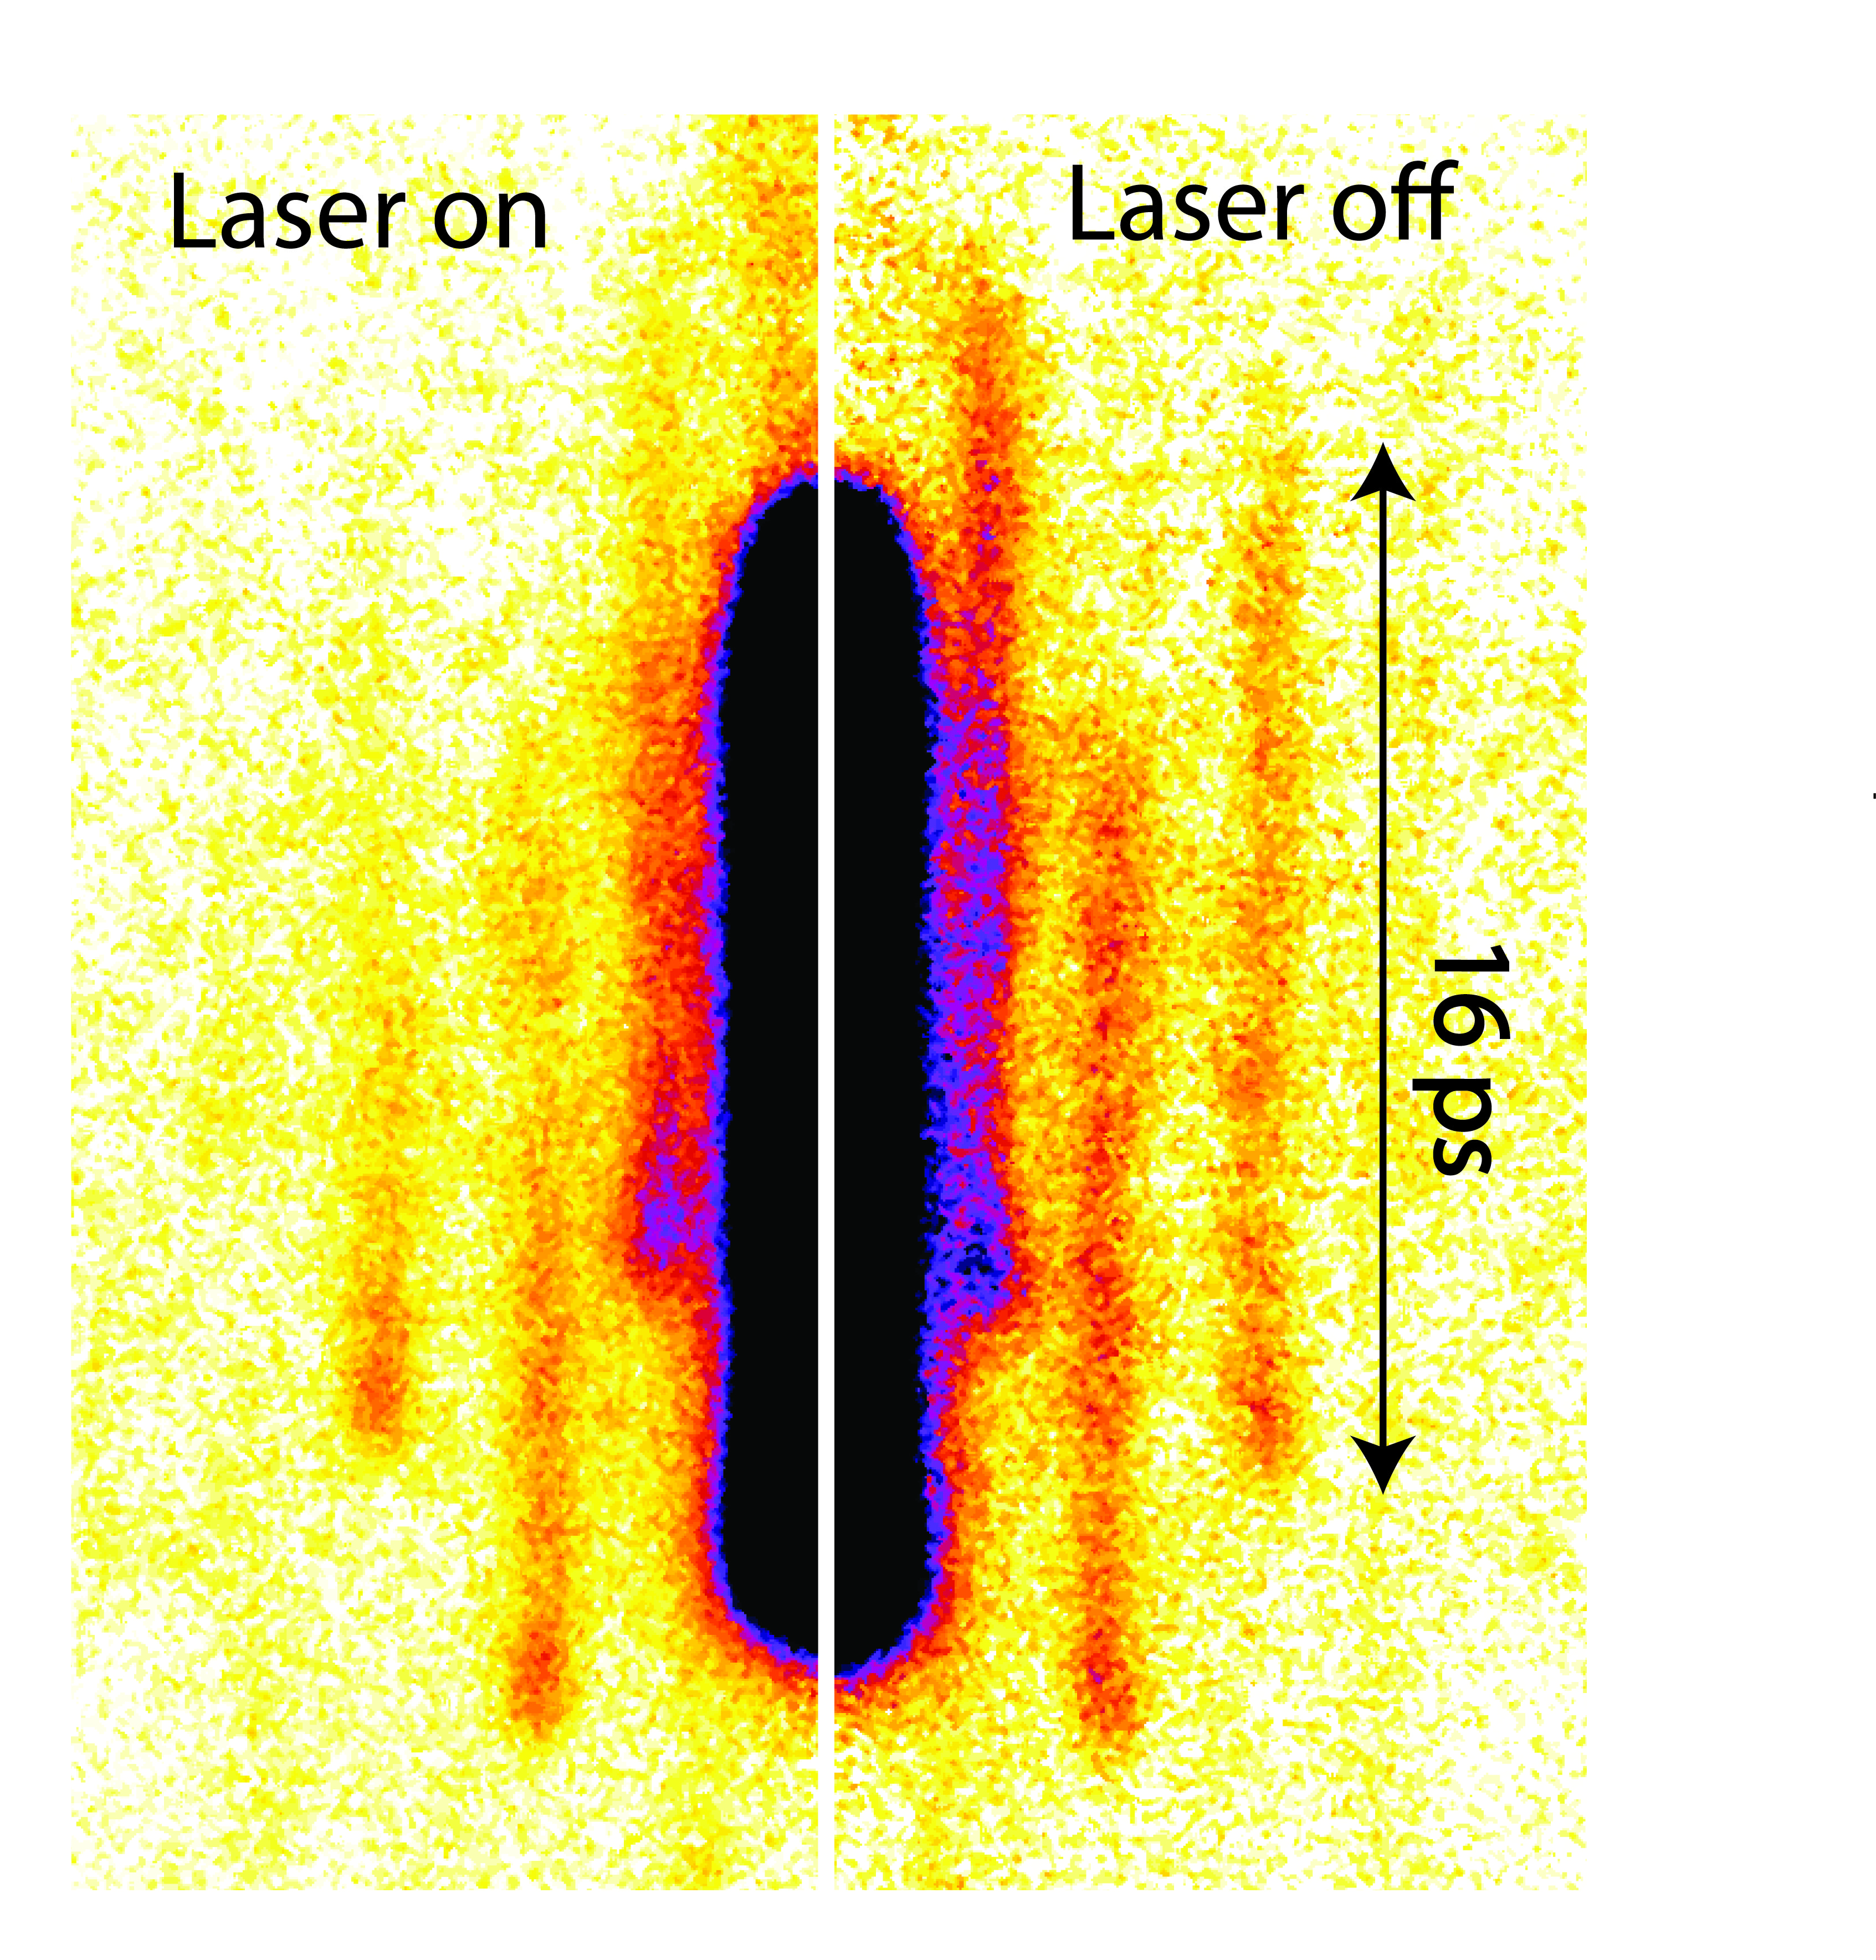
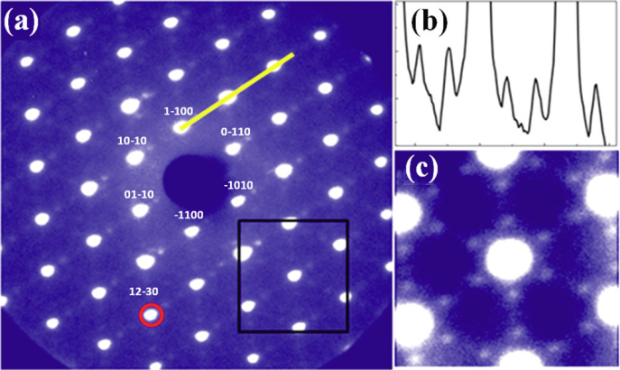
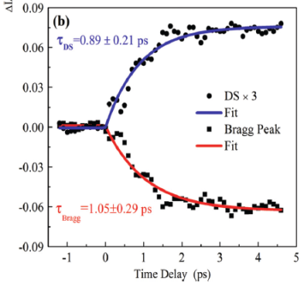

an exciting new field: UED and UEM
CDW, very high pattern quality
gold melting, streak-mode,
full history with one e- beam
(220)
(220)
(200)
(200)
P. Musumeci et al. JAP, 108, 114513 (2010)
P. F. Zhu et al. APL 103, 071914 (2013)
Courtesy of Xijie Wang
Some Recent workshops
Dec. 2012, Workshop on Ultrafast Electron Sources for Diffraction and Microscopy Applications http://pbpl.physics.ucla.edu/UESDM_2012/
Feb. 2013, Banff Meeting on Structural Dynamics http://www0.sun.ac.za/banff/
July 2013, Workshop on Femtosecond Transmission Electron Microscopy http://lumes.epfl.ch/page-93264-en.html

Slide 8
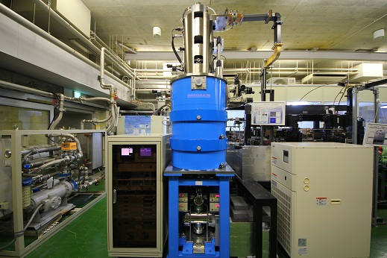
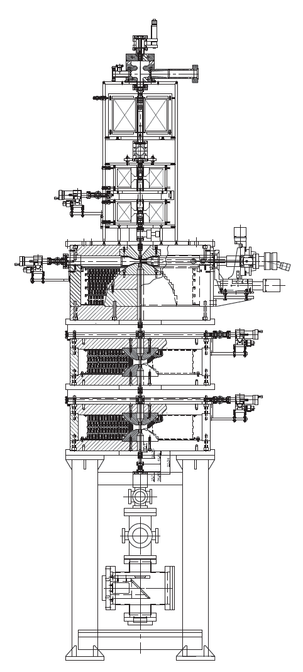
prototype rf gun based UEM at Osaka Univ.
Courtesy of Jinfeng Yang
RF gun
Femtosecond
Laser
Femtosecond
e- beam
10μm
38nm/pixel
Electron charge:
~10 fC/pulse
(10⁵ e-’s/pulse)
Measurement time:
~10 min
Sample
Au single crystal, 10 nm
x1200
~10⁸ e-’s/image
CCD
similar UEM projects in China and Germany!

Slide 9
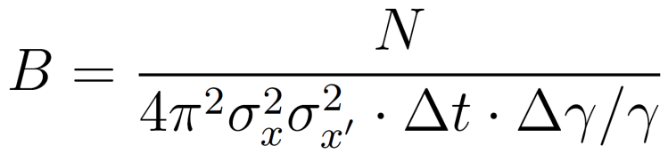
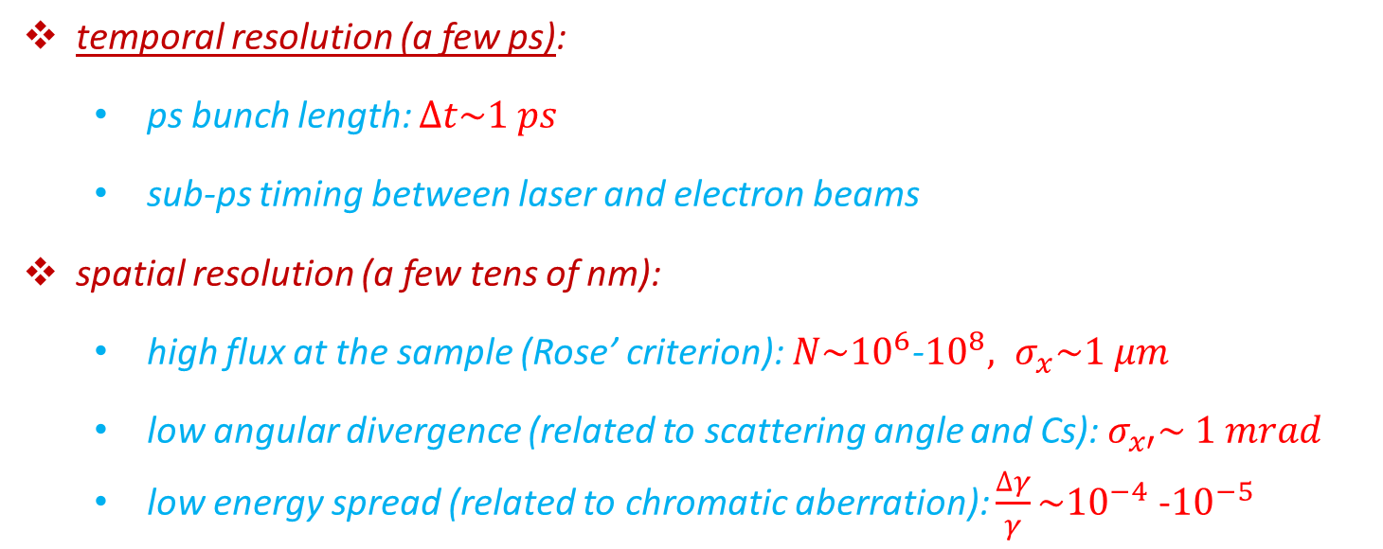

beam requirements for single-shot ps UEM
B. W. Reed et al., Microsc. Microanal. 15, 272 (2009)
temporal resolution (a few ps):
  ps bunch length: $∆t\sim 1 ps$
  sub-ps timing between laser and electron beams
spatial resolution (a few tens of nm):
  high flux at the sample (Rose’ criterion): $N\sim {10}^{6}$-${10}^{8}, σ_{x}\sim 1 μm$
  low angular divergence (related to scattering angle and Cs): $σ_{x′}\sim 1 mrad$
  low energy spread (related to chromatic aberration): $\frac{∆γ}{γ}\sim {10}^{−4}$ -${10}^{−5}$
$ε_{n}=10 nm$-$rad$

Slide 10
A few innovations for brighter MeV beams:
higher launching field in the rf photogun
cigar-aspect ratio ultralow emittance beam
ultralow energy spread using higher harmonic cavity
strong lens for MeV beams

Slide 11
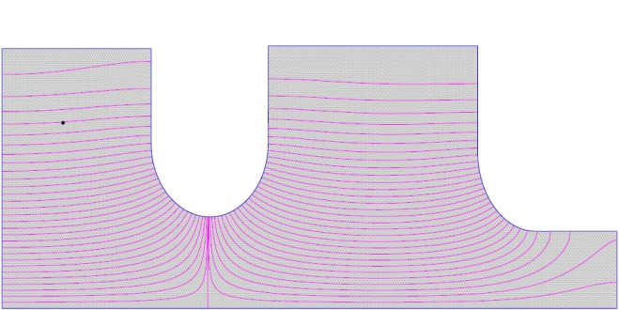
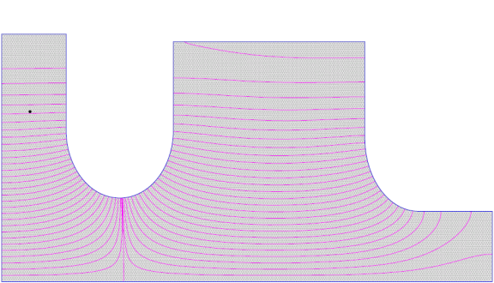
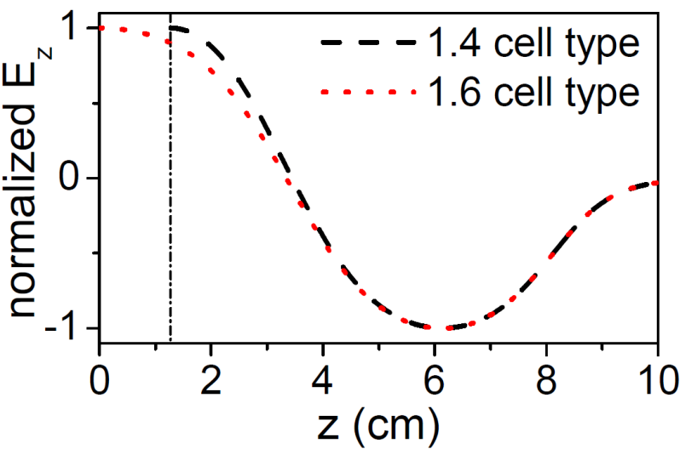
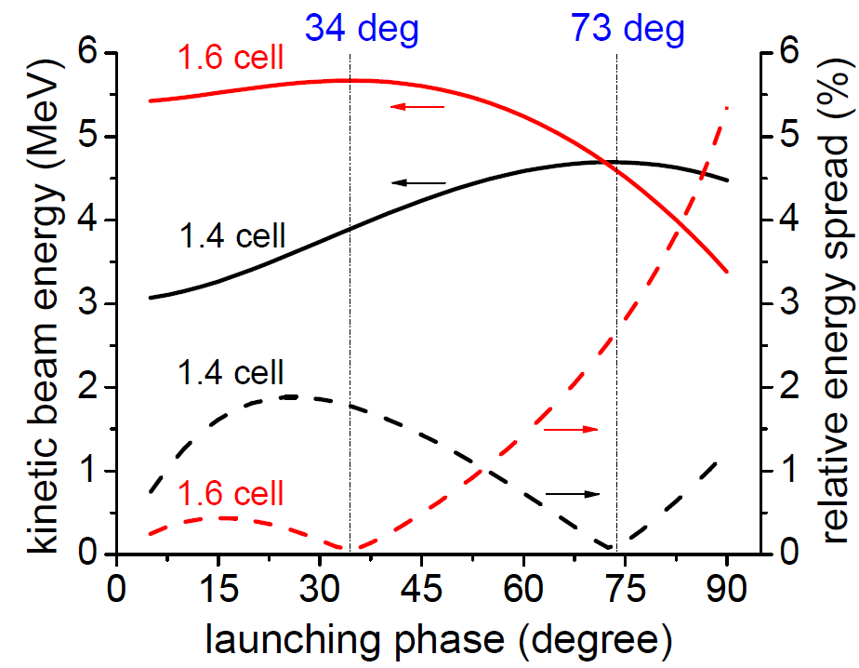
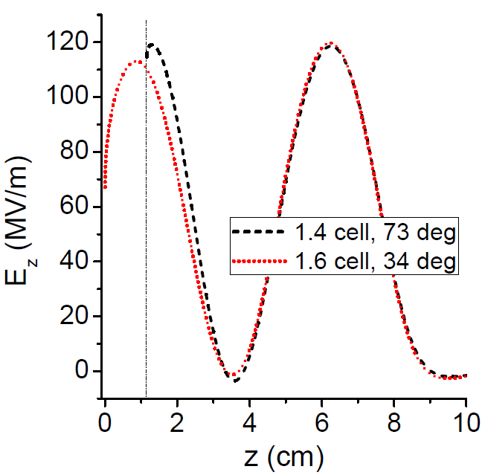
higher extraction field in the gun
traditional (1.6 cell) photocathode rf gun was optimized for high charge, high final output energy
its typical launching phase is 30˚
launching field s only half (sin30˚=0.5) of the acceleration gradient of the gun
launching filed is critical to beam brightness
so, by shortening the photocathode cell, move to higher launching phase, e.g. 70˚, (sin70˚=0.94), ×2 improvement in brightness
Shorten the photocathode cell
1.6 cell type
cathode
2 cm
1.4 cell type

Slide 12

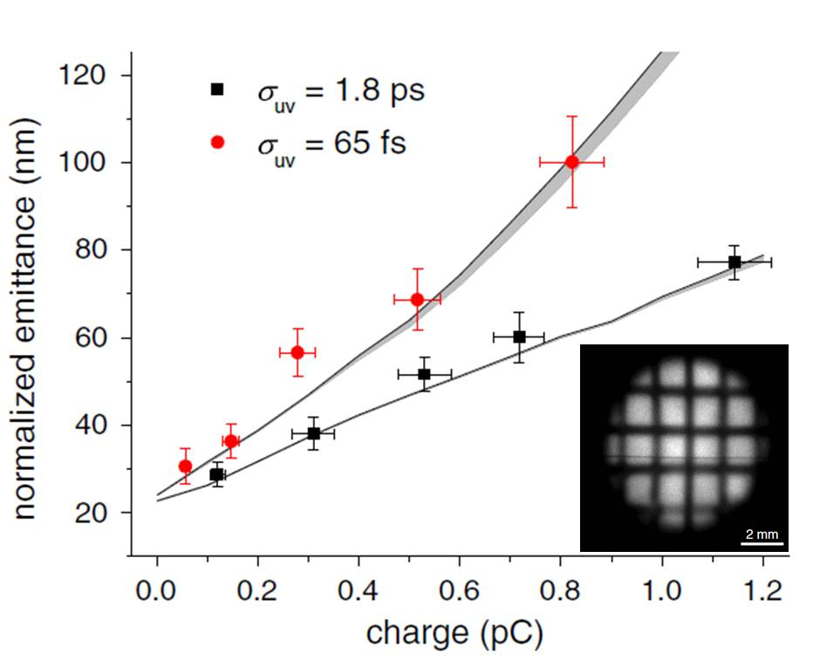
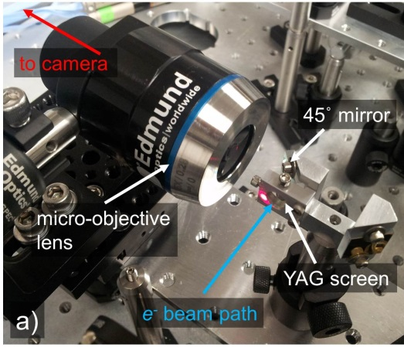
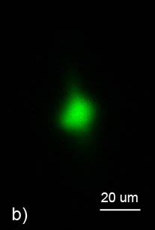
a few pC charge, ultralow emittance: Cigar-beam
  Cigar-beam: long (10 ps) and narrow (<50 μm spot size)
  the aspect-ratio can beat the ‘virtual cathode limit’ D. Filippetto et al., submitted
  very small intrinsic emittance from the cathode Claessens et al., PRL (2005)
  transverse and longitudinal dynamics are essentially decoupled
measurement of ultralow emittance and small spot size
Simulation shows we can generate 5 MeV, 2 pC charge, 2 ps rms width, <10 nm normalized emittance, <1 um rms spot size at the sample.
5 μm rms
‘grid method’ measure very low (~1 nm) geometric emittance
R. K. Li et al, PRSTAB 15, 090702 (2012)
B. Jacobson, NAPAC13, TUOBB4

Slide 13
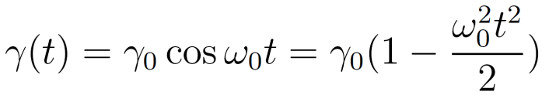
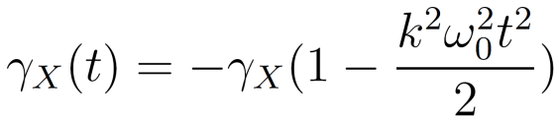

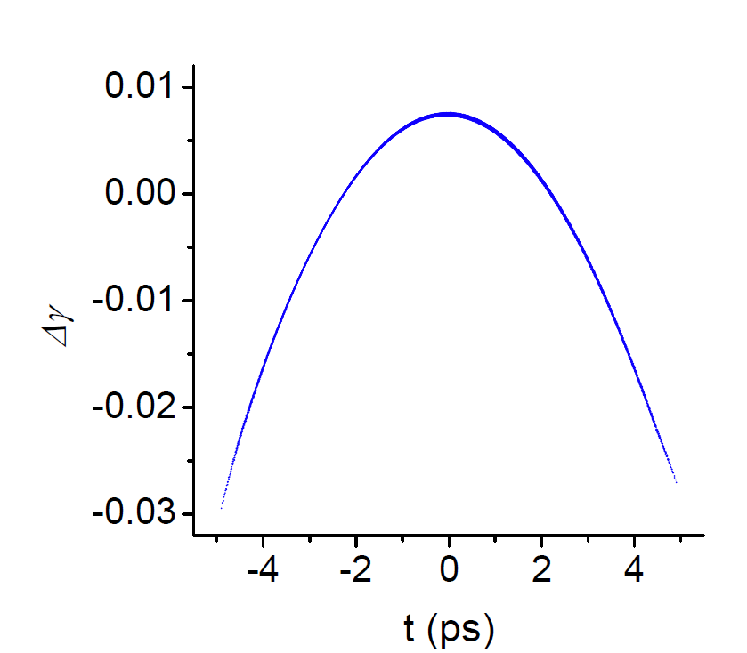
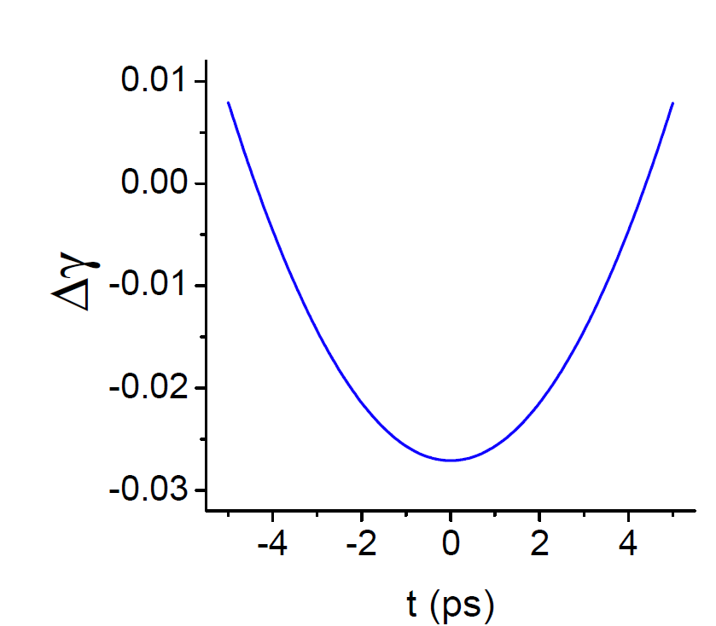
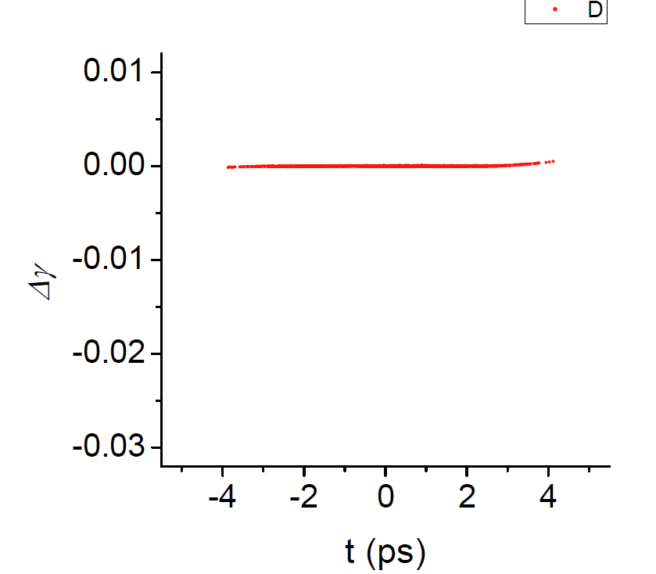
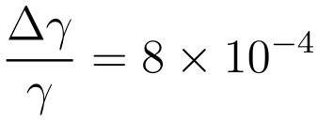
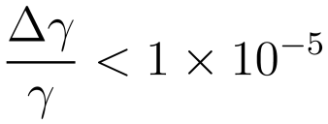

low energy spread: rf curvature regulation
beam rf curvature from rf guns
  beam energy depends on launching phase (time)
  beam energy spread dominated by the rf curvature
  slice energy spread much smaller
γ-t at S-band gun exit
deceleration in X-band cavity
final γ-t distribution
<20 eV
larger $k≡ω_{X}/ω_{0}$ works better (less deceleration, less power)
performances limited by rf amplitude and phase stabilities

Slide 14
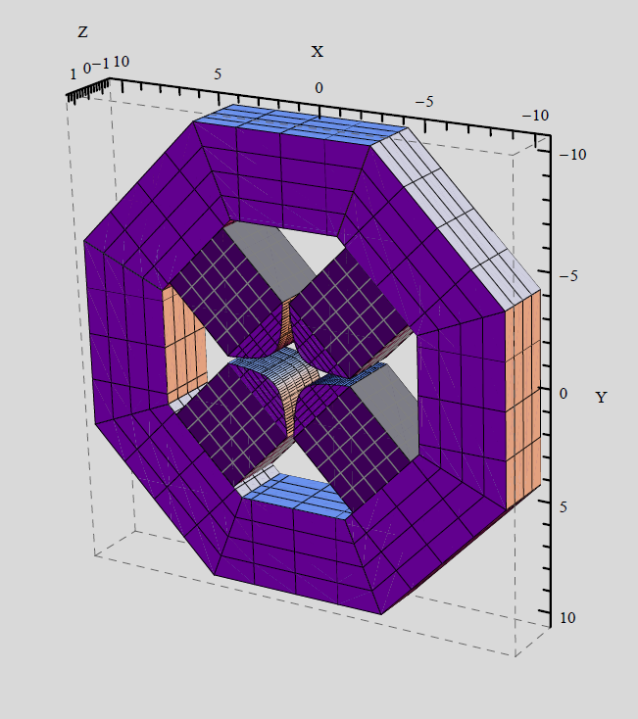
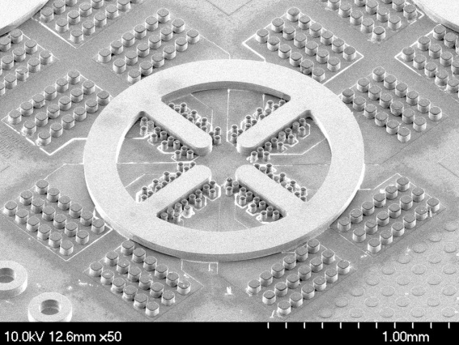
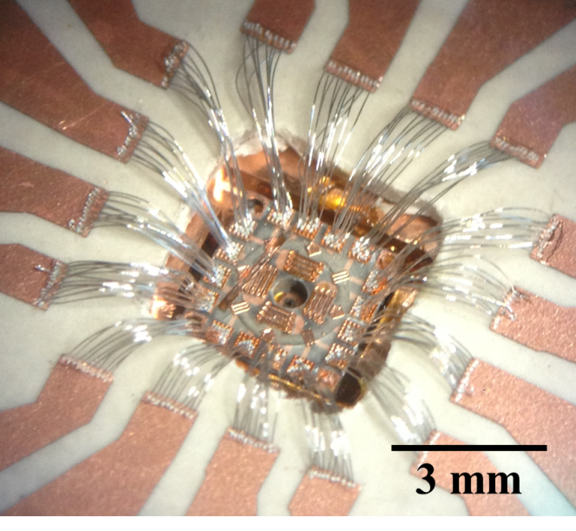
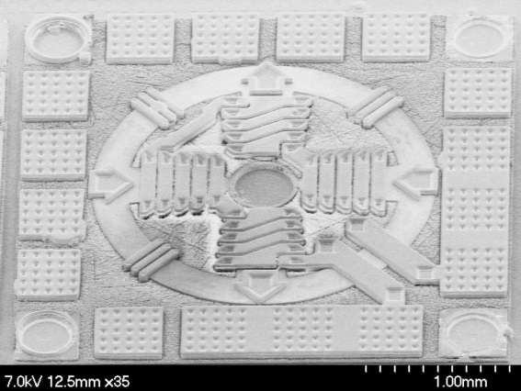
strong lenses for MeV beams
for conventional TEMs (<300 keV), solenoid lenses are used
solenoid is symmetric, but very ineffective for high energy electrons
Cs and Cc are roughly equal to the focal length
heavy and bulky NC solenoid (≤2.2 T), or SC solenoid can be used
or, using quadrupoles which are strong and compact
permanent magnet quadrupoles
nano-fabricated micro-quads
permanent magnets, B₀=1.40 T
1) Gradient up to 5000 T/m
2) tunable strength!!
Prototype recently successfully tested.
gradient G~500 T/m
1 cm
Courtesy of J. Harrison, UCLA
Theia Scientific Corp.

Slide 15
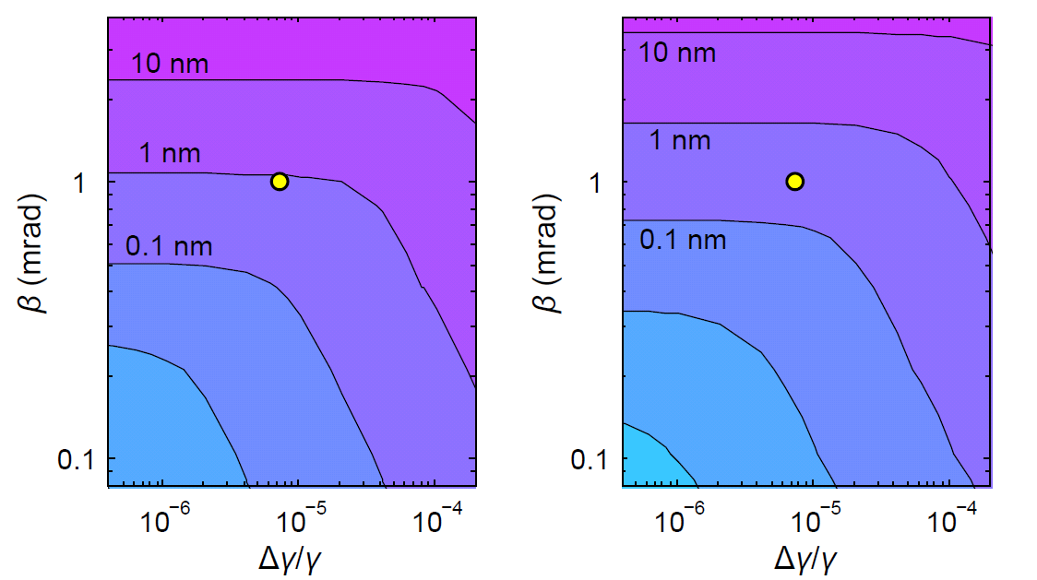
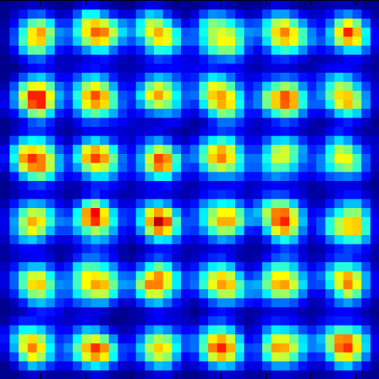
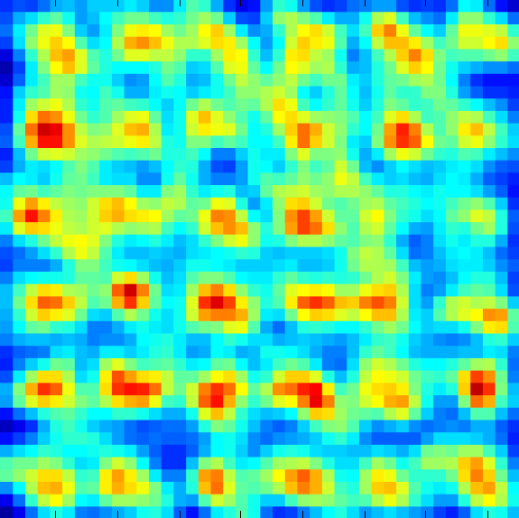
Numerical tracking of aberrations and e-e interaction
need powerful/reliable numerical tool
Incoherent imaging (contribution from wave property negligible)
Cc and Cs can be calculated analytically for hard-edge models
consistence between GPT, ELEGANT, and COSY Infinity for Cc and Cs
resolution determined not only by aberration, but also electron flux and e-e interaction
3D field map, various space charge models, stochastic scattering (O(N²) classical point-to-point or O(Nlog(N)) tree-code) all packed within GPT
shift of image plane and slight change in magnification due to e-e interaction
take full advantage of theoretical guidance and various codes developed in beam physics community
GPT tracking in 3D field maps
σ_{x} /M
σ_{y} /M
*3D field maps modelled by RADIA
×3 charge
10 nm
10 nm

Slide 16
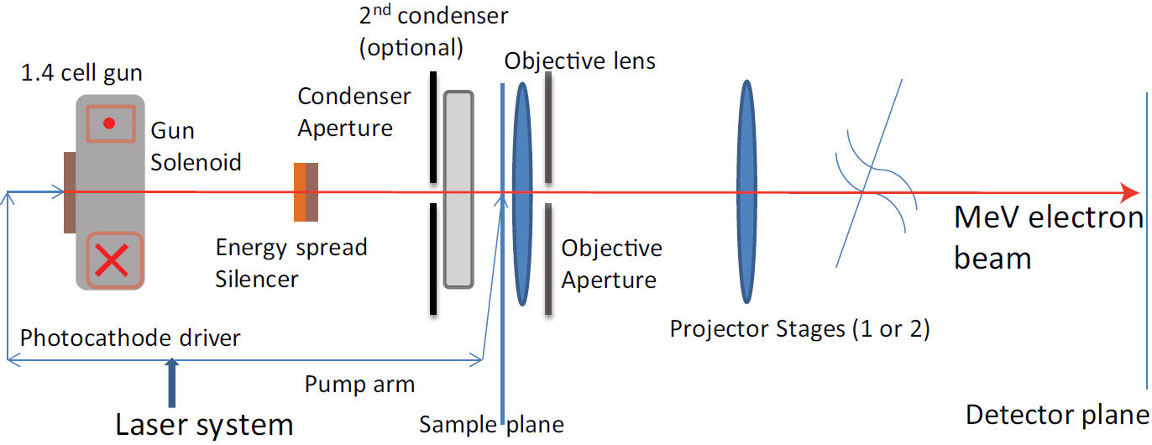
key components of a single-shot ps MeV UEM
high gradient S-band rf gun see L. Faillace HBEB Workshop 2013
cigar-shape low emittance beam (parabolic, small spot UV laser)
X-band rf regulation cavity
strong electron lens
high efficiency detection of MeV electrons R. K. Li et al., JAP 110, 074512 (2011)
rf amplitude and phase control
numerical studies of aberrations and e-e interactions

Slide 17


Acknowledgement
funding agencies: DOE-BES, DOE-HEP, JTO-ONR
UCLA Pegasus Laboratory members
P. Frigola, A. Murokh, and S. Boucher at Radiabeam
helpful discussions with M. Mecklenburg, B. W. Reed, J. C. H. Spence, W. Wan, X. J. Wang, D. Xiang, and many others

Slide 18
Summary
strong motivation, clear path towards a single-shot ps UEM
pushing existing technologies, new technologies will help
key parameters (emittance, energy stability and spread) challenging but within reach
integrate best parts, together w/ precise control and diagnosis
movie mode? Frame rate linked to rf frequency
R&D will also benefit many other beam applications (XFEL, external injection for plasma and dielectric laser-accelerators)
Thank you for your attention!

