Slide 1
Monochromatizing without filtering using dynamic fields without bunching:
A new concept for d-TEM illumination
Roland Janzen¹
1. Institut für Physik, Johannes Gutenberg Universität Mainz, Staudinger Weg 7, 55128 Mainz, Germany

Slide 2
Outline
Motivation
Dynamic fields as ‘wizards’
The cubic resonator
Circular deflection: The concept
Designing a CD based monochromator
vision: steady beam accelerator
vision: equidistant one-electron pulses
summary

Slide 3
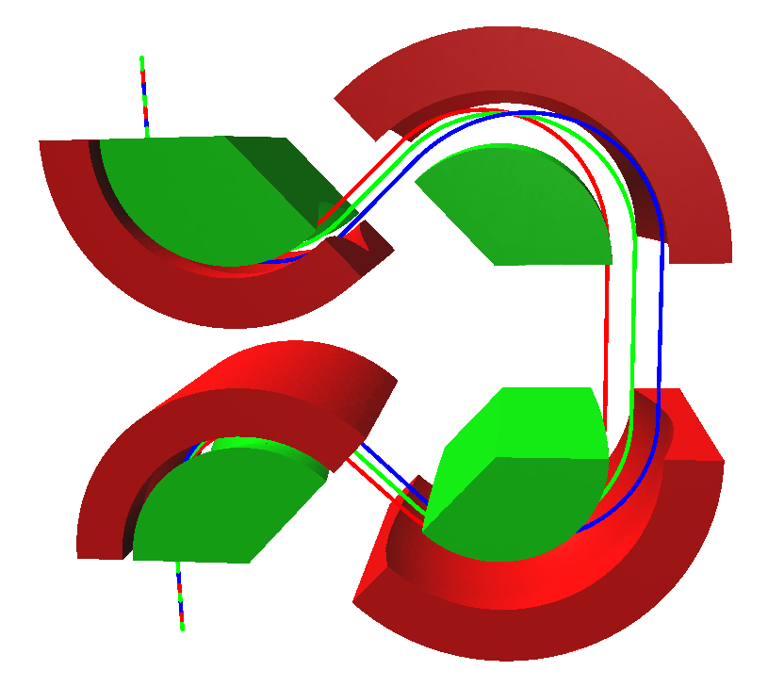
Motivation: State of the art:
Monochromators are energy filters
polychromatic
optic axis
positive
electrodes
separated
monochromatic
optic axes
z

Slide 4
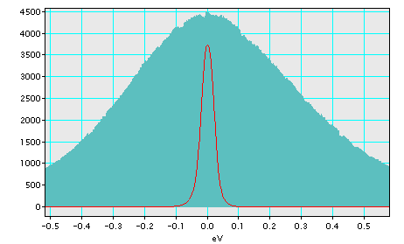
Most of the current is filtered out

Slide 5
Dynamic fields as wizards
Monochromators in the original meaning of the word:
Would affect the energy of the particles
Need dynamic fields to work
→ Investigation of the interaction of charged particles with longitudinally oszillating fields.
Example: interaction of electrons with longitudinally oszillating TE₁₀ fields at fixed entrance phase

Slide 6
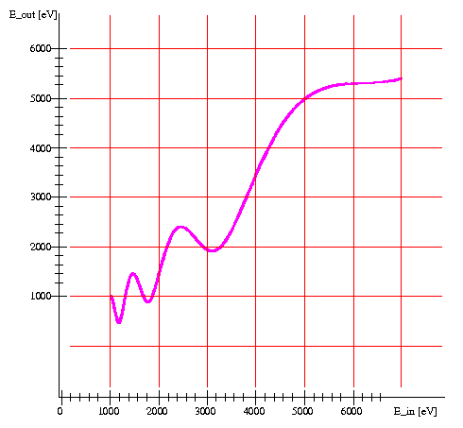
Simulation results of interaction between electrons and longitudinally oscillating waves

Slide 7
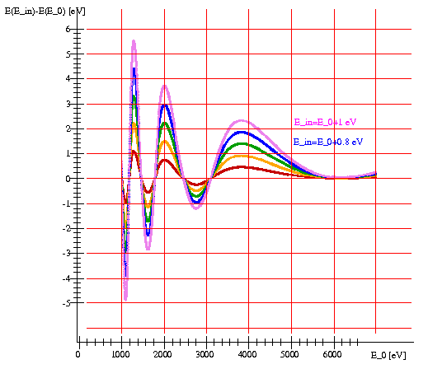
Simulation results of interaction between electrons and longitudinally oscillating waves

Slide 8
recapitulation:
Dynamic fields as wizards
Phase-locked entrance of charged particles into dynamic fields: Energy spread may be
  amplified (for energy filtering purposes)
  reduced / deleted (monochromatization)
  inverted (compensation for dispersion effects)
Broad field of applications!
But how to realize the phase-locked entrance condition?

Slide 9
Standing waves in resonator cavities:
  Optimum phase condition approximately fulfilled in narrow recuring time slice
  Bunching techniques compress continuous beam into pulses
  Suffers from Liouville’s law:
    Pulse compression by a factor K increases the energy spread by same factor
    Monochromatization power decreases with increasing pulse length

Slide 10
Liouville’s law: Example: Pulse compression
t=0
t=L/v
L

Slide 11




Liouville’s law using the example of pulse compression
t=0
t=L/v
L

Slide 12



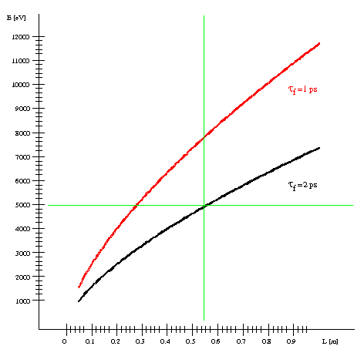

Slide 13










with
factor of compression
This is due to Liouville's law:
solving
for L and inserting into
yields:
and finally:

Slide 14
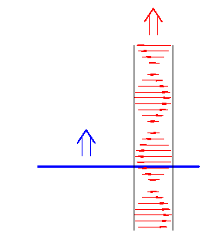
Propagating waves:
  Optimum phase condition moves with phase velocity
  Idea: move point of entrance with point of optimum phase condition!

Slide 15
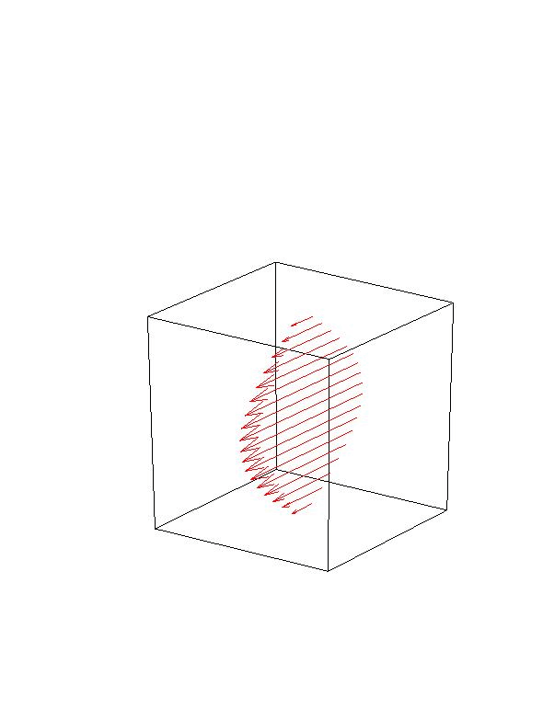
Excursion: The cubic resonator
Cubic resonator: TE₁₀-mode standing wave x-direction
z
x
y

Slide 16
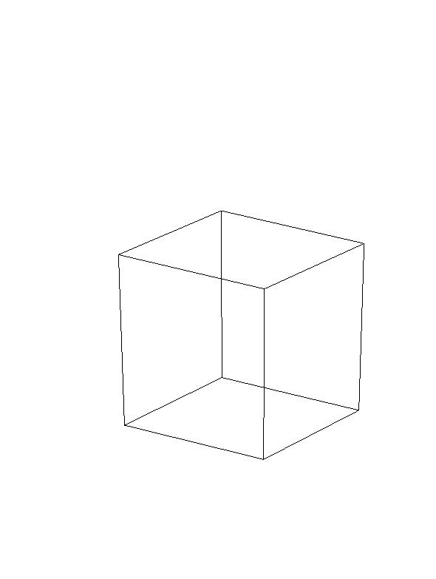
Excursion: The cubic resonator
Cubic resonator: TE₁₀-mode standing wave y-direction
z
x
y

Slide 17

Excursion: The cubic resonator
Cubic resonator: TE₁₀-mode standing waves in x- and y-direction
z
x
y

Slide 18
Excursion: The cubic resonator
Cubic resonator: TE₁₀-mode standing wave circularly polarized
z
x
y
Notes:
wellenbauch=antinode

Slide 19
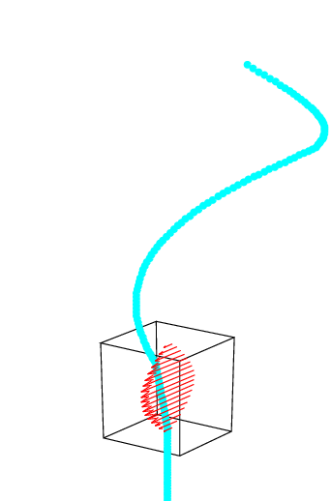
Circular deflection: the concept

Slide 20
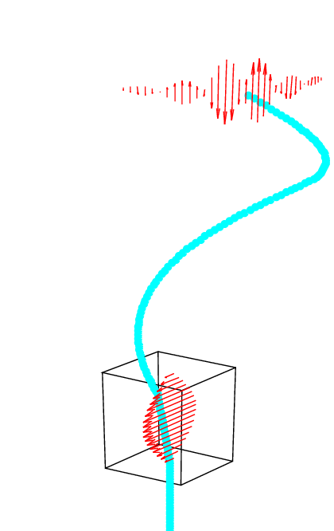
Circular deflection enables phase locked entrance into circulating wave

Slide 21
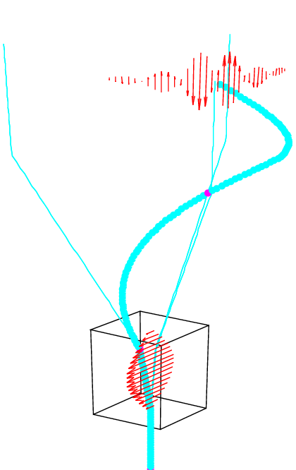
Rotating orbital
But: no azimuthal motion of the electrons!

Slide 22
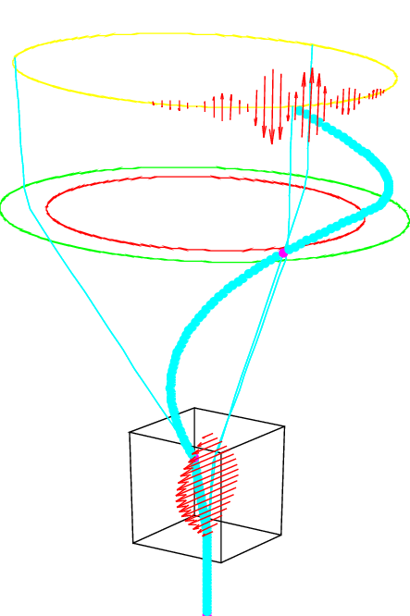
Idea: monochromator based on CD
But: electrons are off axis after monochromatization
Commonly used strategy in electron optics: mirror entire assembly
Notes:
zugehörig = corresponding

Slide 23
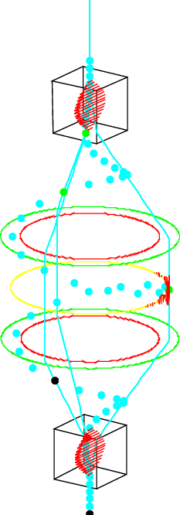
Second annular dipole or lens bends spiral orbital back to cone
Second circular deflector performs a circular ‚undo‘-deflection
Anything seems fine if amplitudes match and all waves are perfectly synchronized
Notes:
veranschaulichen = illustrate, visualize, demonstrate

Slide 24
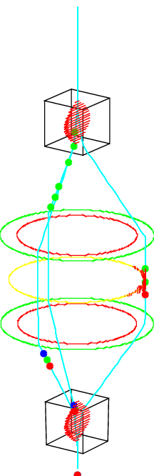
Time of flight effects:
  Formerly fast particles come early
  Formerly slow ones come late
→ angle between vector of undo deflection and direction of motion
undo defl. Vector
for ‚slows‘
direction of
motion
undo defl. Vector
for ‚fasts‘
Formerly energy spread transforms into angular spread

Slide 25
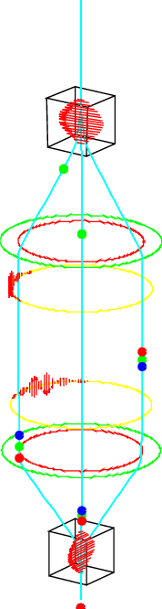
solution:
  insert another circulating wave in front of monochromator,
  performing a spread inversion
→ formerly ‚fasts‘ become ‚slows‘ and vice versa
Optimum adjustment: formerly ‚fasts‘ and formerly ‚slows‘ join at entrance of monochromating wave

Slide 26
recapitulation
New ansatz: circular deflection
  supplies time coding
  uncertainty in time (theoretically) vanishes!
  synchronizing waves yields exact phase-locked entrance conditions
t₁
azimuthal position yields
clock for time coding
t₂
Notes:
Uncertainty in time vanishes as good as synchronizing succeeds

Slide 27
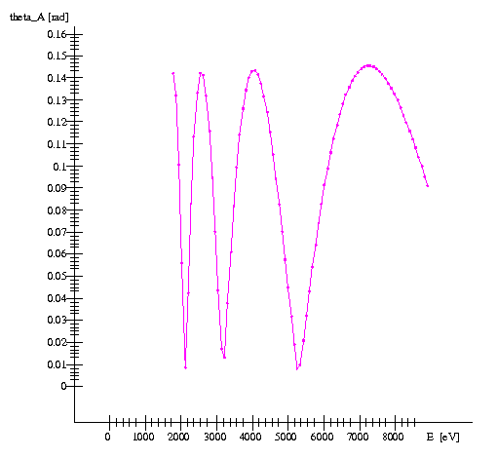
Note that CD can work without dispersion!

Slide 28
- setup for CD based monochromator
Spread inverter
M
CD
CD
K₁
K2
K₂
K₁
Spead inverter eliminates phase dispersion (TOF differences) at the end of ‘M’
M eliminates ΔE
If correctly adjusted, computer simulation shows that both, Δt and ΔE vanish behind ‘M’!

Slide 29
Vision: Steady beam accelerator

Slide 30
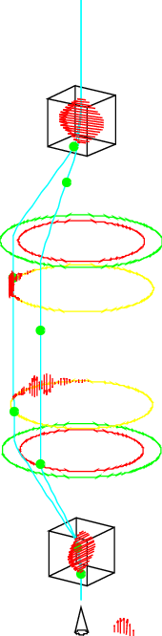
Vision: equidistant one-electron pulses
Roadmap:
  Feed a CD-based monochromator by a plasmonic field emitter
  Synchronize trigger pulse with monochromator fields

Slide 31
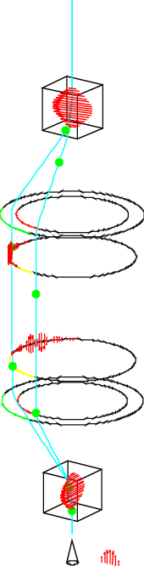
Vision: equidistant one-electron pulses
Roadmap:
  Feed a CD-based monochromator by a plasmonic field emitter
  Synchronize trigger pulse with monochromator fields
  Only sector of 2π τ/Δt of the assembly is ‚used‘
    Δt : temporal uncertainty of emission
    τ: period of oscillation
Notes:
azimuthal extent

Slide 32
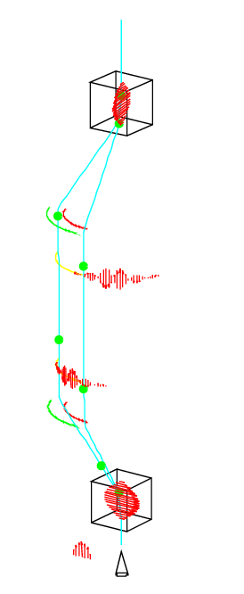
Vision: equidistant one-electron pulses

Slide 33
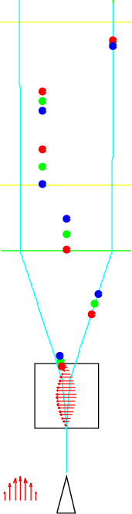
Vision: equidistant one-electron pulses
note:
electrons are separated by means of their emission (point of) time

Slide 34
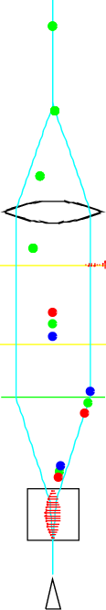
Vision: equidistant one-electron pulses
Roadmap continued:
  focus the bundle
  focal point: transversally oscillating field uses time-angle correlation to bend paths back to a new axis

Slide 35
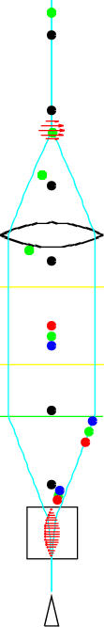
Vision: equidistant one-electron pulses
Roadmap continued:
  focus the bundle
  focal point: transversally oscillating field uses time-angle correlation to bend paths back to a new axis
  unfortunately time-phase correlation is destroyed upstream focal point

Slide 36

Vision: equidistant one-electron pulses
Roadmap continued:
  add another monochromating wave at temporal focal point
  add longitudinally oscillating field behind lens:
  time-position correlation used to
    accelerate late electrons
    decelerate early electrons
Notes:
einholen: catch up with

Slide 37
  another keen idea:
    combining field emission and circular deflection
    exciting a rotating surface plasmon polariton in the hole of the anode of a field emitter
    → energy transfer to the (field emitted) electron might be quantized
    decrease static field strength such that field emission occurs solely in (or near) the maximum of the rotating (plasmonic) field
    radial component of the plasmonic field does the circular deflection job

Slide 38
  challenges
    synchronizing all waves
    providing the necessary high field strengths
    controlling the amplitudes
    suppressing standing waves

Slide 39
  Fields
 | tolerances | inter-action strength
micro-waves | ++
Laser fields | --
 | tolerances | inter-action strength | synchro-nization | standing- wave ratio | handling | size of arrange-ment
micro-waves | ++ | ++ | -- | - | -- | --
Laser fields | -- | -- | ++ | + | ++ | ++
 | + | + | ? | ? | ? | +
    microwaves, i. g. 2.45 GHz (λ≈0.12 m):
      variation of field across cross section of beam negligible
    LASER:
      average beam diameter and λ have same order of magnitude!
      →azimuthal time coding might get uncertainty due to beam size
      → need intermediate images at any interaction zone

Slide 40
  Fields
    estimate minimum field strength required
 | tolerances | inter-action strength
micro-waves | ++
Laser fields | --
 | tolerances | inter-action strength | synchro-nization | standing- wave ratio | handling | size of arrange-ment
micro-waves | ++ | ++ | -- | - | -- | --
Laser fields | -- | -- | ++ | + | ++ | ++
 | + | + | ? | ? | ? | +
      example: circular deflection with polar angle (semi angle of cone) α:
      - assume harmonic field E:
      - solve for E:
      → required field strength increases like 1/λ with decreasing wavelength

Slide 41
  Fields
 |  |  |  | standing- wave ratio | handling | size of arrange-ment | current
micro-waves | ++ | ++ | -- | - | -- | --
Laser fields | -- | -- | ++ | + | ++ | ++
synchroni-zation
interaction
strength
tolerances

Slide 42
  Fields
    current:
    one electron pulses:
    microwaves, i. g. 2.45 GHz: 466 pA
    LASER, i. g. 700 nm:
      → even with duty cycles of 1000 plenty of current!

Slide 43
  Fields
 |  |  |  | standing- wave ratio | handling | size of arrange-ment | current
micro-waves | ++ | ++ | -- | - | -- | -- | -
Laser fields | -- | -- | ++ | + | ++ | ++ | ++
synchroni-zation
interaction
strength
tolerances

Slide 44
  Fields
 |  |  |  | standing- wave ratio | handling | size of arrange-ment | current | ΔE
micro-waves | ++ | ++ | -- | - | -- | -- | -
Laser fields | -- | -- | ++ | + | ++ | ++ | ++
synchroni-zation
interaction
strength
tolerances

Slide 45
  Fields
    monochromatization power:
    Heisenberg’s uncertainty relation:
    monochromatization process requires
    →
    example: LASER at λ=700 nm: ΔE>17 eV

Slide 46
  Fields
 |  |  |  | standing- wave ratio | handling | size of arrange-ment | current | ΔE
micro-waves | ++ | ++ | -- | - | -- | -- | - | ++
Laser fields | -- | -- | ++ | + | ++ | ++ | ++ | ---
synchroni-zation
interaction
strength
tolerances

Slide 47
  Fields
 |  |  |  | standing- wave ratio | handling | size of arrange-ment | current | ΔE
micro-waves | ++ | ++ | -- | - | -- | -- | - | ++
Laser fields | -- | -- | ++ | + | ++ | ++ | ++ | ---
tera-waes | + | + | ? | ? | ? | + | + | +
synchroni-zation
interaction
strength
tolerances

Slide 48
Summary
Dynamic fields allow for real monochromatization (plus multiple further applications)
Circular deflection opens the door to use dynamic fields without bunching
Vision: Equidistant monochromatic one particle pulses are theoretically possible

