Slide 1
Molecular Structural Dynamics Unveiled by Time-Resolved X-ray Solution Scattering
Hyotcherl Ihee
KAIST, IBS, Korea
Femtosecond Electron Imaging and Spectroscopy (FEIS) 2013
Key West, USA
2013-12-12
Notes:
Thank you for the nice introduction and invitation.
In this talk, I would like to share my experience with picosecond pump-probe x-ray solution scattering using X-ray pulses from third generation synchrotron sources.
I am delighted to be invited to give a talk in this European Conference on the Spectroscopy of Biological Molecules. This is my first time to this conference and I hope I can continue to come in the future.
I thought I could be the one who traveled the longest distance to get here. But it seems that Japanese scientists traveled a slightly longer distance and they beat me. In addition I did not lost my baggage. And some of them lost their baggage whereas I did not. So apparently I am not the one who had hardest time to come here.
As a matter of fact, I am not going to talk about spectroscopy, but diffraction, a highly complementary technique to spectroscopy in investigating molecular structural dynamics.
Crystallography and liquidography share the same ground, using the same pump-probe concept and the same experimental setup at a synchrotron beamline. The only difference is whether the sample is a single crystal or a liquid solution.
Yesterday we have heard many nice talks about time-resolved spectroscopy.
In this talk, I would like to discuss about two approaches to visualize protein structural dynamics, that is time-resolved crystallography and time-resolved liquidography.

Slide 2
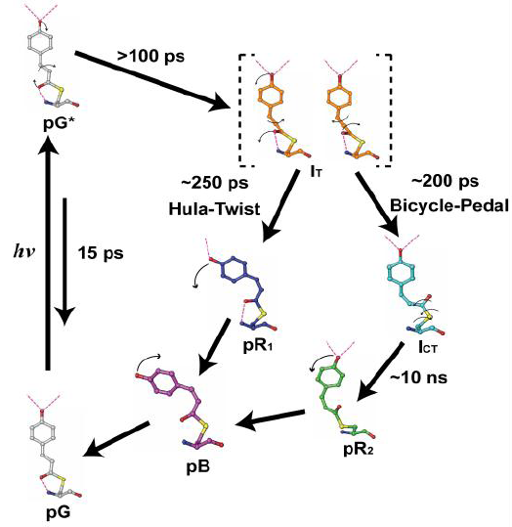
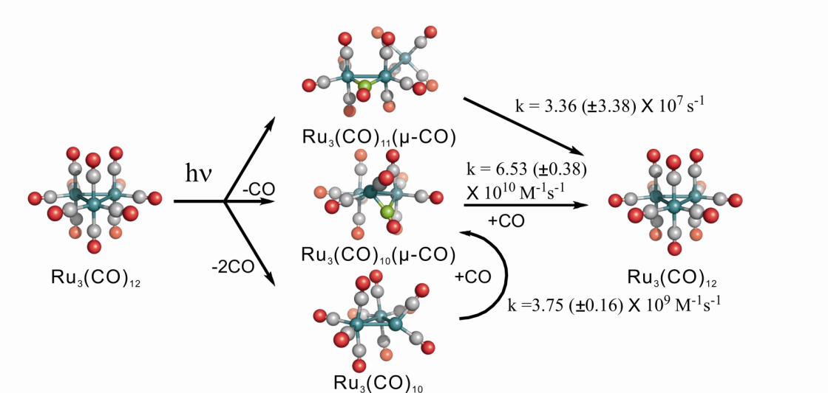
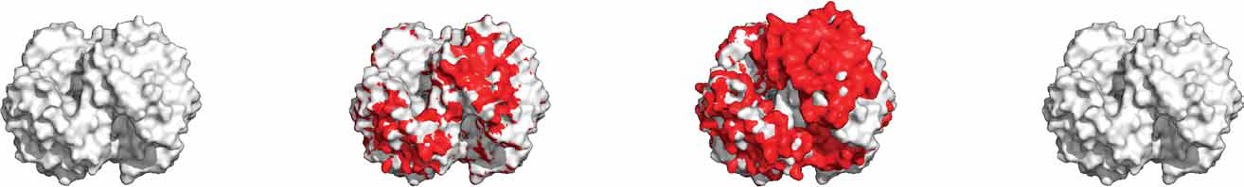
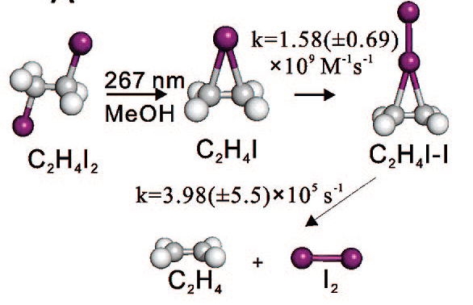
Molecular Structural Dynamics

Slide 3
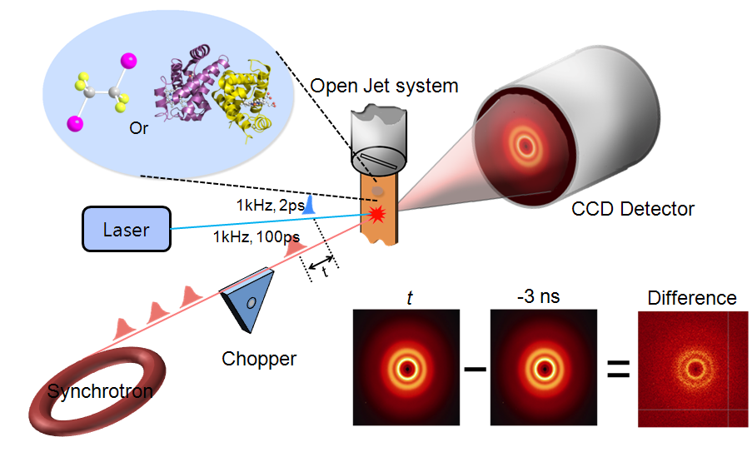
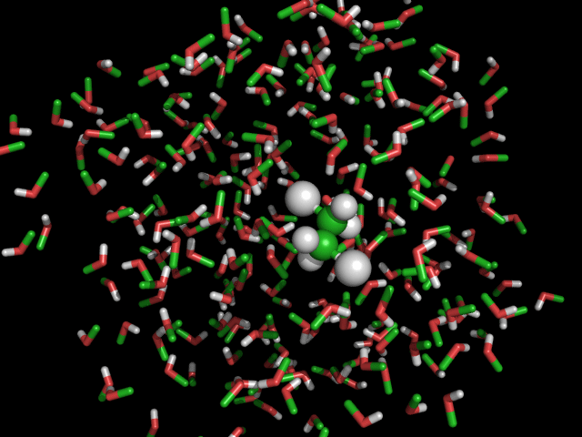
Solution-Phase Reaction Dynamics
Many reactions related with Chemistry & Biology occur in solution phase.
Time-resolved solution scattering (diffraction) to probe reaction dynamics
Notes:
For the last six years, we have used synchrotron-based time-resolved X-ray solution scattering as a tool to investigate solution-phase reactions. Initially it was not so obvious that solution scattering could be a good method to study reactions, but it turned out that indeed it was the case and our efforts in this direction have been quite fruitful. By the way, in my presentation, the scattering and diffraction are used interchangeably.

Slide 4
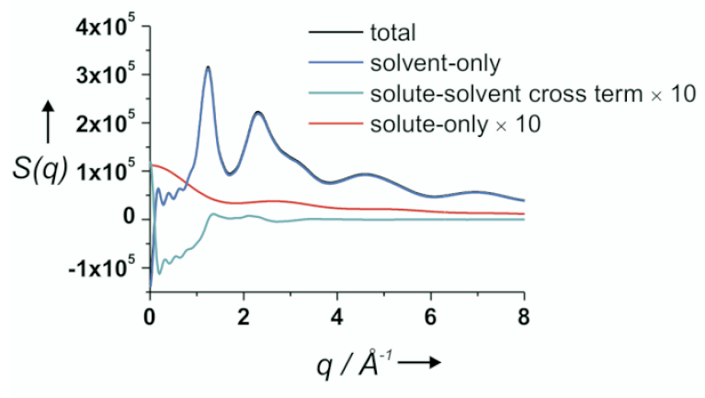
Scattering from Solutions
I₂/methanol solution
Notes:
When it comes to the scattering from a solution, which consists of the solute and solvent, we have to consider the contribution from the solute, the solvent, and the solute-solvent cross term, which is also called the cage term. At usual concentrations, the number of solute is much smaller than that of the solvent. For example, for I2 dissolved in methanol solution at a typical concentration, the total signal is almost identical to the contribution from the solvent-only term. The contribution from the solute is almost negligible, which makes things difficult when we are interested in the molecular structure of the solute.

Slide 5
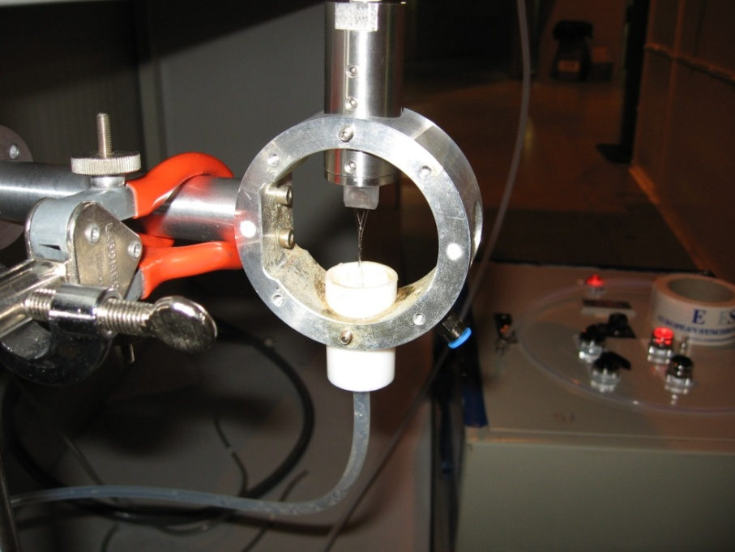
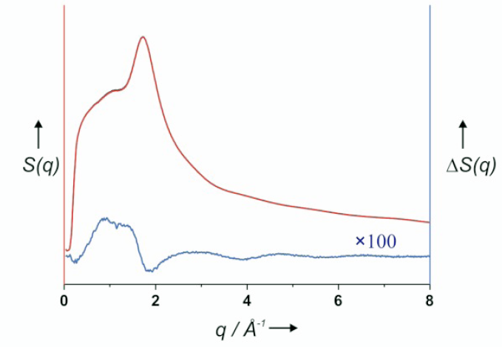
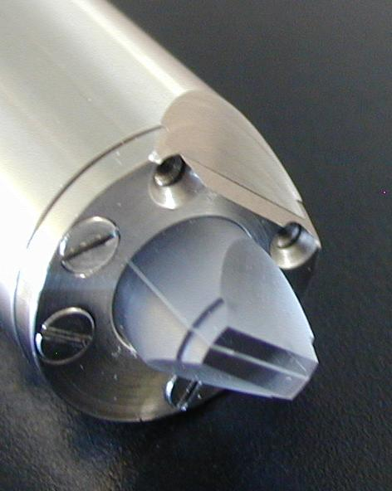
Net Signal (Difference) is even smaller
Notes:
Moreover we are interested in the “change” of the solute structure and the net signal we are after is the difference of the scattering pattern before and after the laser excitation. Typically, we collect data at a negative time delay and subtract it from the data at other time delays to produce the difference pattern. This red curve is the raw scattering intensity and the blue is the difference scattering intensity multiplied by 100. Typically the relative laser induced diffraction signal change is quite small. Delta S(q) depends on both time and scattering angle, and is typically less than 0.1 % of S(q). (10:00) We have to deal with this small signal and this is why we had to stick with synchrotron sources and could not take advantage of the currently available femtosecond x-ray sources, which simply do not provide enough X-ray photons per pulse.

Slide 6
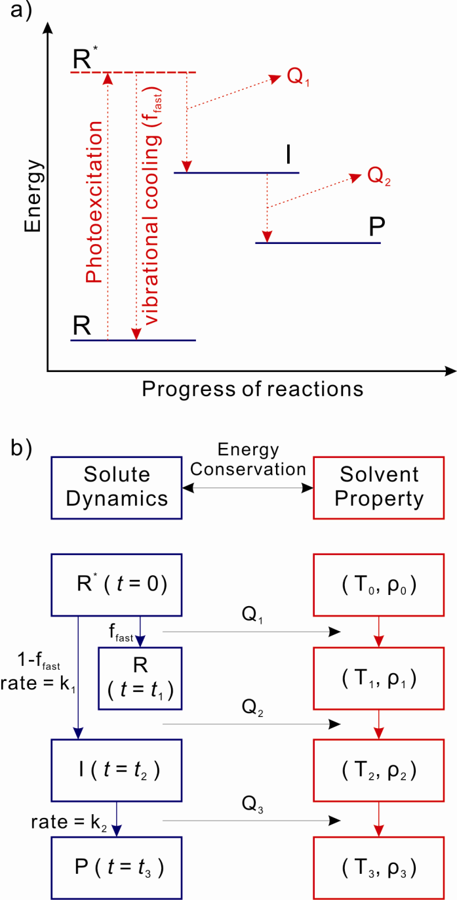
Scattering from Solutions
heat
Notes:
In addition, when the solute undergoes a reaction, the energy levels also change. Because of the energy conservation, the energy differences between states are eventually transferred to the solvent, changing the solvent temperature and density as a function of time. Thus when we analyze the data, we have to consider the solvent scattering change in response of the temperature change and density change in addition to the scattering change due to the solute reactions.

Slide 7
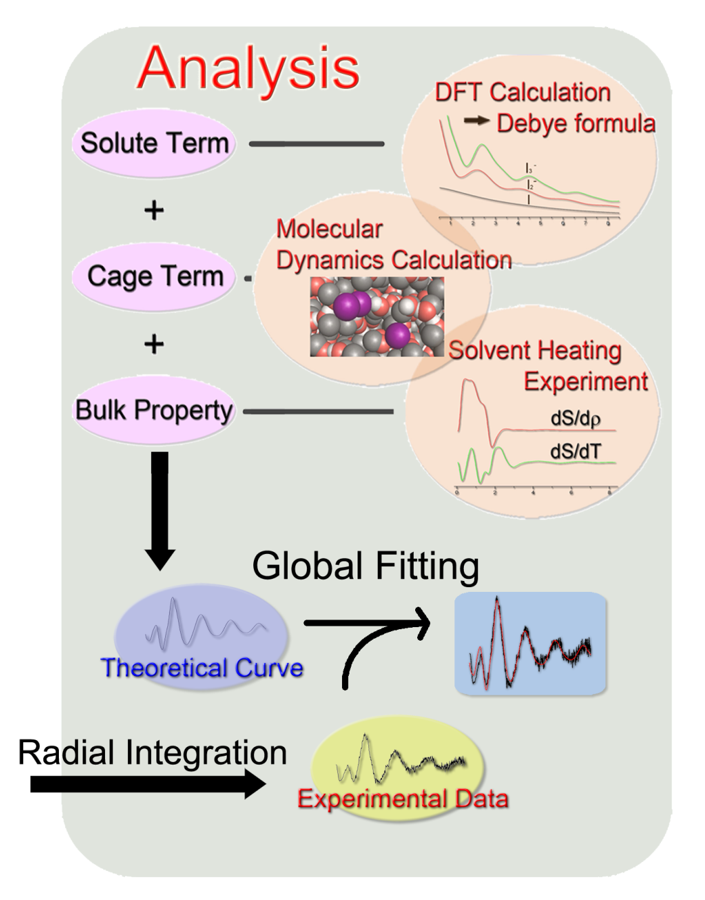
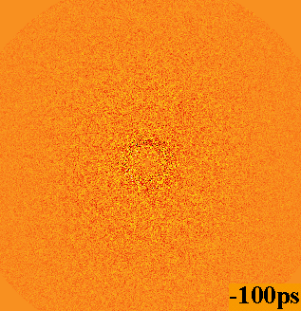
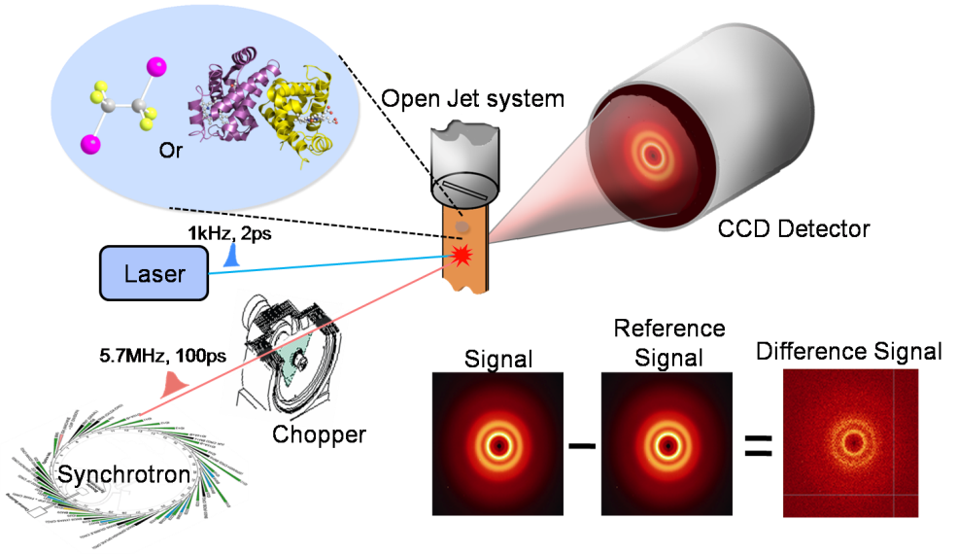
Time-Resolved X-ray Liquidography
Notes:
이렇게 얻어진 시그널은 다음과 같이 분석됩니다. 분석과정은 시그널이 반응하는 분자 자체에 의한 신호와 용매 분자들에 의한 신호, 그리고 분자-용매 간 상호작용에 의한 신호로 분리가 가능하다는 가정 하에 진행됩니다. 이들의 합으로 이론적으로 계산된 커브를 실험 커브에 맞춰나갑니다. 이때, 시간에 따른 모든 데이터를 함께 사용하는 글로벌 핏팅 방법을 이용하여 핏팅의 신뢰도를 높입니다.

Slide 8
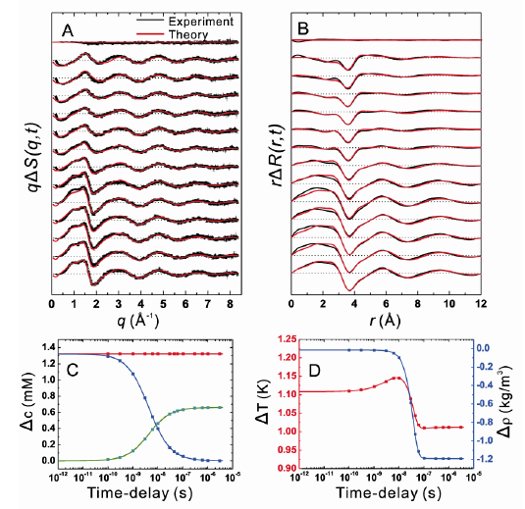
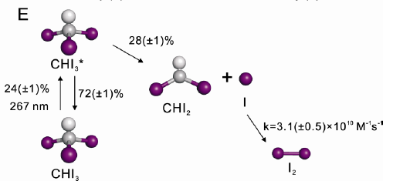

Photochemistry of CHI₃ (Iodoform) in methanol
CHI₂-CHI₂
ΔS(q,t) =
ΔS(q,t)_{solute}
+ ΔS(q,t)_{solute-solvent}
+ ΔS(q,t)_{solvent}
CHI₂-I isomer
ACIE, 47, 1047-1050 (2008)
Notes:
The first example is the photolysis of CHI3, Iodoform in methanol. Analysis of the scattering data has identified this reaction pathways. About a quarter of the initial population of iodoform is excited and about 28 percent of the excited state undergoes a carbon-iodine bond dissociation whereas the remaing 72% vibrationally relaxes to the ground state. The formed iodine atoms eventually recombine to form molecular iodine with this reaction rate. Other reaction channels such as the formation of this species via recombination of CHI2 radical, or the formation of the iodoform were not observed. More importantly the formation of this isomer was not observed.

Slide 9
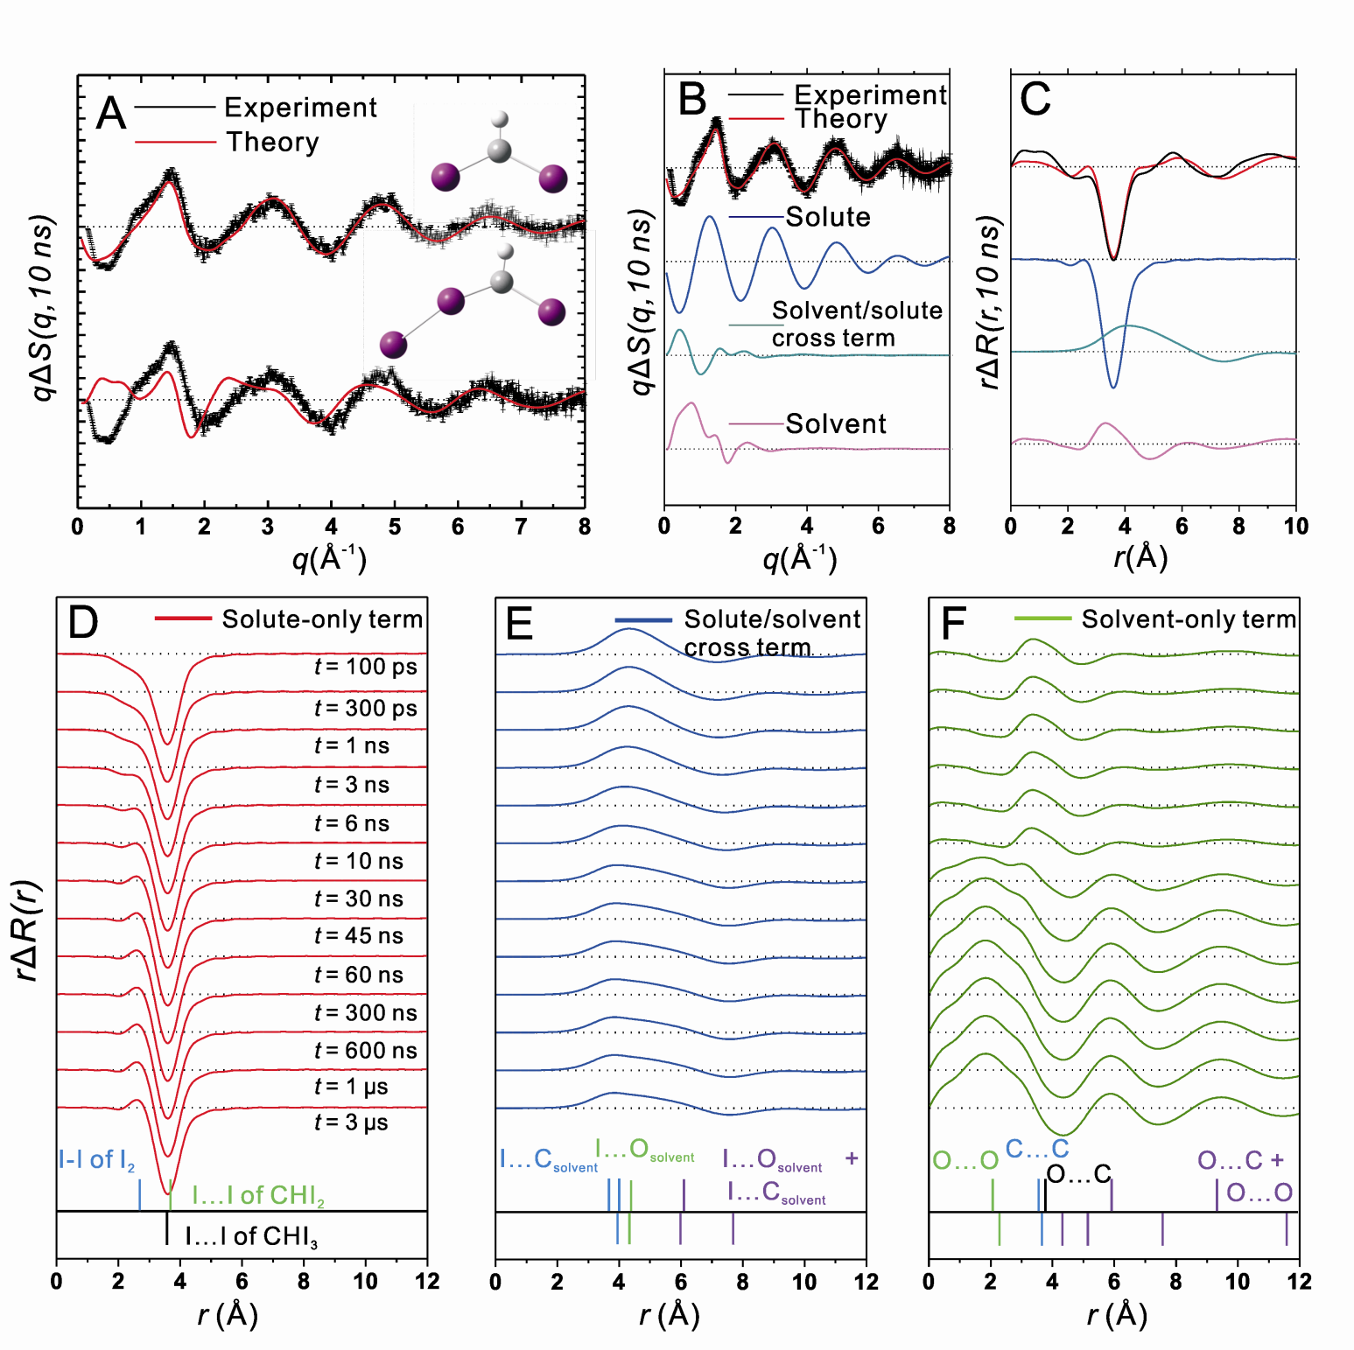
ACIE, 47, 1047-1050 (2008)

Slide 10
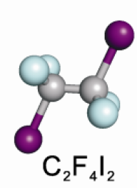
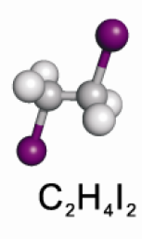
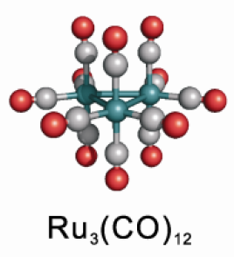
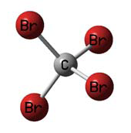
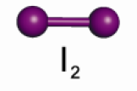
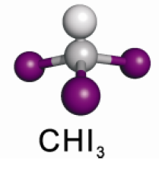
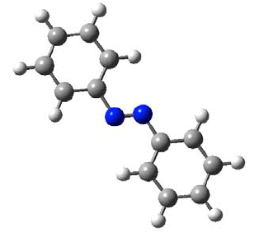


Small Molecule Gallery
JCP, 125, 174504 (2006)
JACS, 130, 5834-5835 (2008)
Science, 309, 1223-1227 (2005)
CBr₄
JPCA 1209 10451-10458 (2005)
JCP, 124, 124504 (2006)
JACS, 129, 13584-13591 (2007)
JPCA, 116, 2713-2722 (2012)
ACIE, 47, 5550-5553 (2008)
JACS, 132, 2600-2607 (2010)
JCP, 124, 034501 (2006)
JACS, 135, 3255 (2013)
ACIE, 47, 1047-1050 (2008)
HgI₂ & HgBr₂
C₁₂H₁₀N₂
(Azobenzene)
PNAS, 103, 9410-9415 (2006)
I₃⁻
PCCP, 12, 11536-11547 (2010)
PRL, 110, 165505 (2013)
Notes:
Here I list some of the solute molecules that my group has studied so far with solution scattering. I would not talk about small molecules, but I believe that the next talk by Marco Cammarata will cover some of this.

Slide 11
Structural Sensitivity

Slide 12
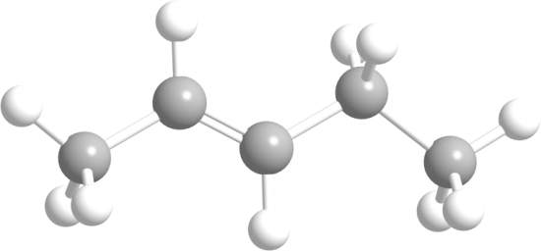
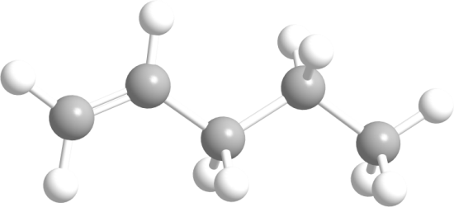
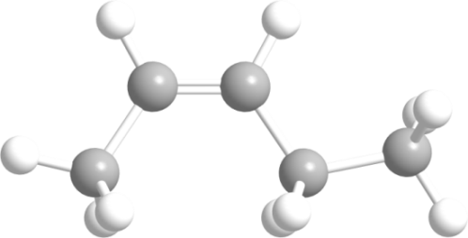
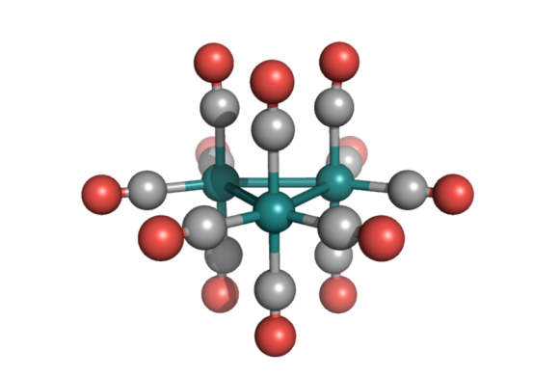
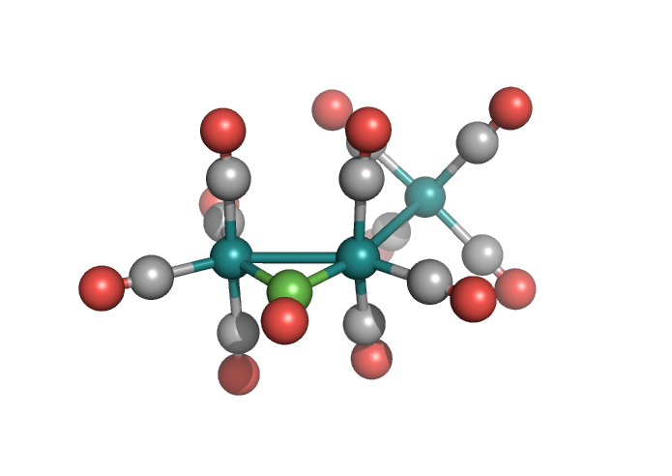
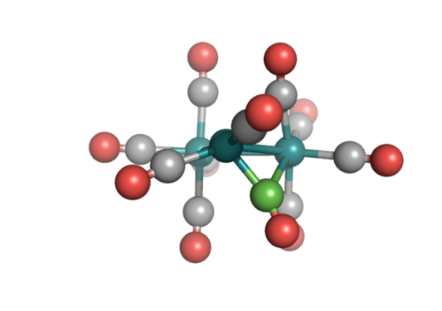
hν
Ru₃(CO)₁₂
J. L. Graff et al, JACS 101, 273 (1979)
Previous Spectroscopic Studies
E.A. Glascoe et al, Organomet. 25, 775 (2006)
Ru₃(CO)₁₁(μ-CO)
Ru₃(CO)₁₀(μ-CO)
Intermediate 1
Intermediate 2
Notes:
Here is another example where we have seen a surprise. This tri-metallic compound is a photocatalyst used to perform this kind of isomerization of unsaturated hydrocarbon. This is a famous model system that has been studied extensively with all available experimental and theoretical methods. Time-resolved infrared spectroscopy have identified two intermediates. The first intermediate has not lost any CO ligand, but one CO ligand has rearranged to bridge between two Ruthenium atoms. This symbol indicates a bridged CO whose carbon atom is shown in green for clear presentation. The other intermediate has lost one CO and has one bridging CO. Infrared detection was quite sensitive because the bridging CO gives very different vibrational frequencies than those of the terminal CO ligands. However, this leaves the possibility that other intermediates without bridging CO ligands go undetected.

Slide 13
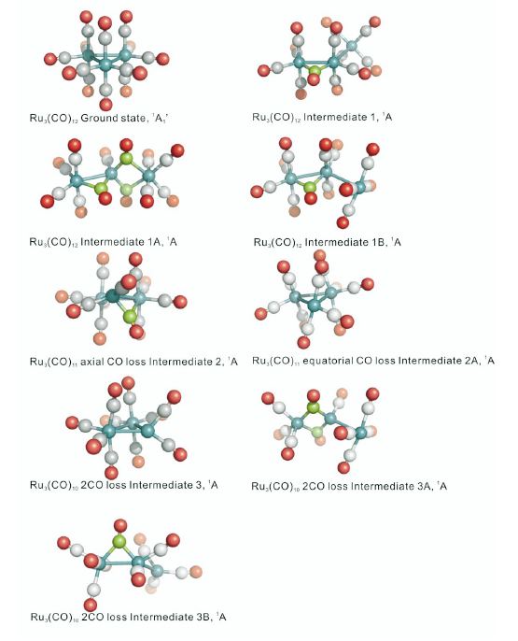
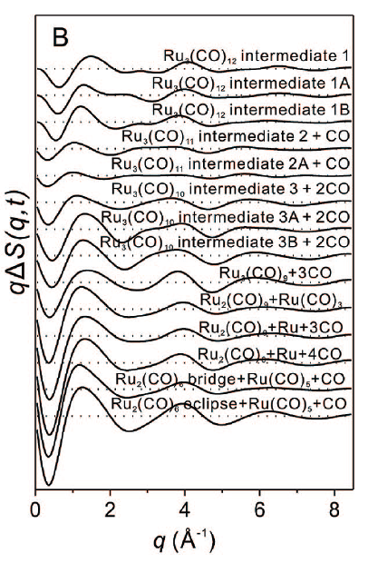
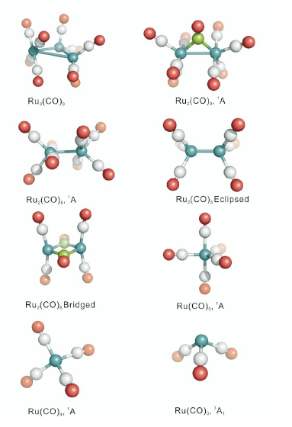
Notes:
To investigate this possibility, we considered all possible reaction intermediates and products, which give more than ten reaction channels. The scattering curves from these channels can be easily calculated as I emphasized in the beginning of my talk, and they are all different. This means that each channel gives its own characteristic scattering curve that can be used as a fingerprint of chemical species.

Slide 14
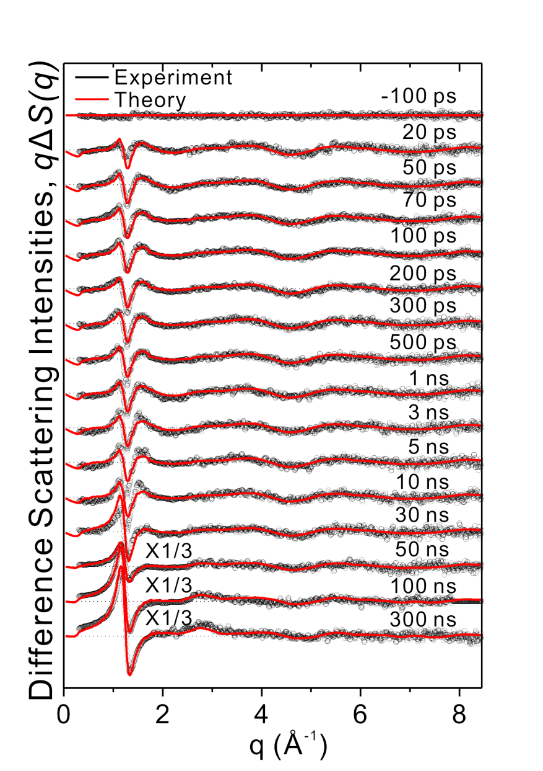
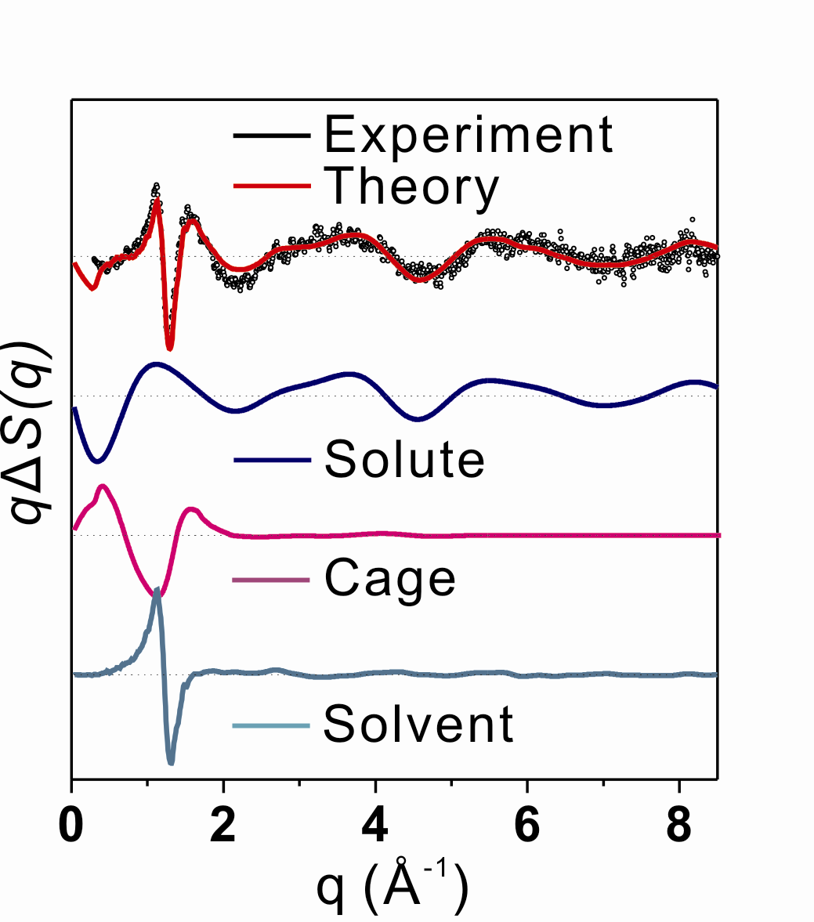
Time-resolved difference scattering intensities qΔS(q)
Angew Chemie Int Ed, 47, 5550-5553 (2008)
Δt = 100 ps

Slide 15
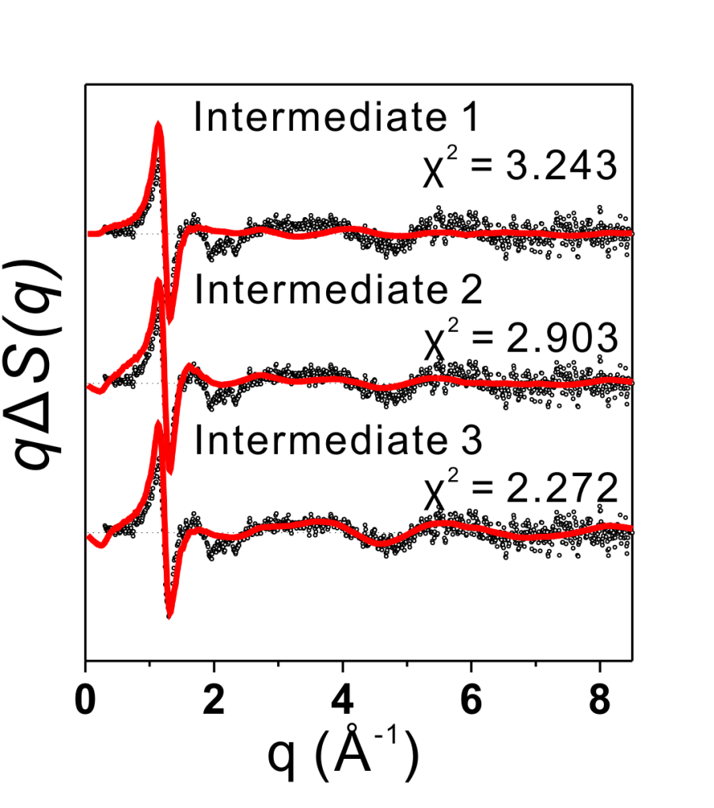

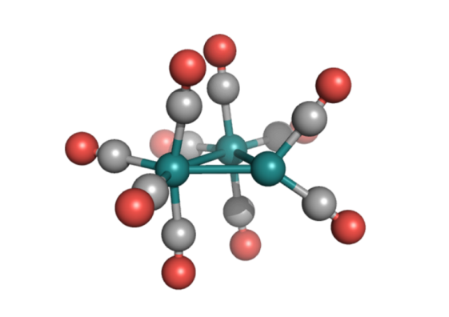
Determination of the Photoproduct
Ru₃(CO)₁₁(μ-CO)
Ru₃(CO)₁₀(μ-CO)
Δt = 30 ns
Ru₃(CO)₁₀
Notes:
Initially we attempted to fit our data, for example at the time delay of 30 ns, with the known two intermediates, but they did not give a satisfactory agreement with the data. Instead the new intermediate, which has lost two CO ligands and has no bridging CO, shows a better agreement.

Slide 16
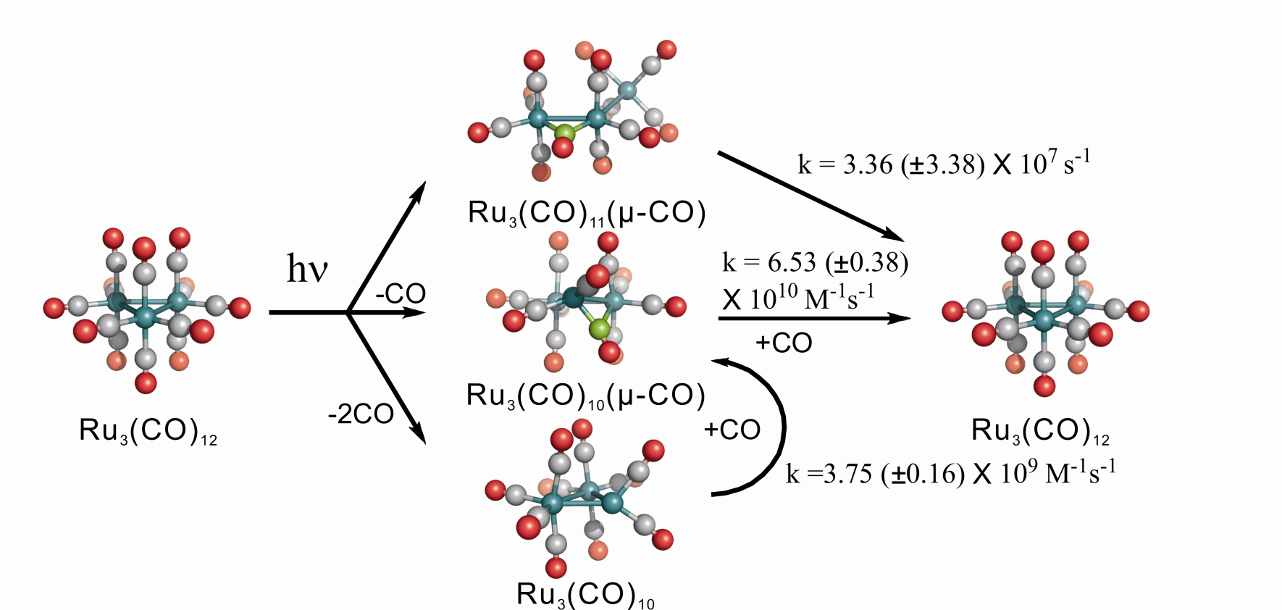
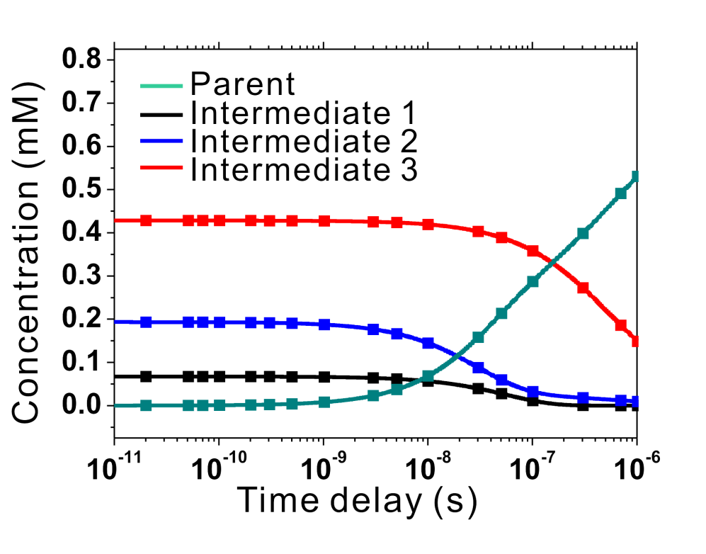
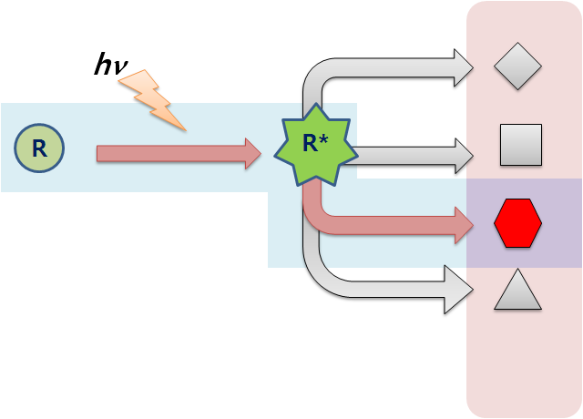
Photochemical Reaction Pathway
Notes:
So in the final analysis, we included all plausible intermediates and the result shows the following kinetics. It turned out that this new intermediate is the major intermediate. In conclusion, the infrared detection must have missed this major intermediate because this has no bridging CO ligand.

Slide 17

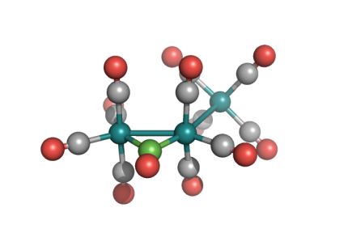
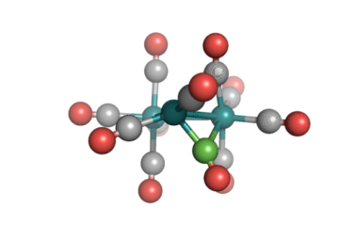
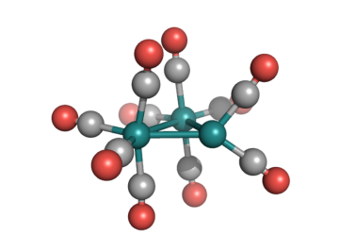
Structure Refinement
Species | Experiment (Å) | DFT (Å)
Ru₃(CO)₁₂ | Ru-Ru: 2.88 | 2.93
Intermediate I, Ru₃(CO)₁₁(μ-CO) | Ru1-Ru2: 2.86 | 2.91
 | Ru1-Ru3: 5.05 | 5.14
 | Ru2-Ru3: 3.12 | 3.17
Intermediate II, Ru₃(CO)₁₀(μ-CO) | Ru1-Ru2: 2.76 | 2.81
 | Ru1-Ru3: 2.89 | 2.94
 | Ru2-Ru3: 2.79 | 2.84
Intermediate III (Ru₃(CO)₁₀) | Ru1-Ru2: 2.66 | 2.71
 | Ru1-Ru3: 2.89 | 2.94
 | Ru2-Ru3: 2.68 | 2.73
X 0.983
Angew Chemie Int Ed, 47, 5550-5553 (2008)
Notes:
Continuing with the ruthenium complex, we tried to fit the Ru-Ru distances. To reduce the number of the fitting parameters, instead of fitting all Ru-Ru distances, we fit one scale factor that scales the starting DFT values to the final experimental values. It turned out that the DFT values have to be reduced by 2% to give a better agreement with the experiment, and this is consistent with the well-known trend that the DFT calculations overestimate the transition metal-metal bond distances.

Slide 18
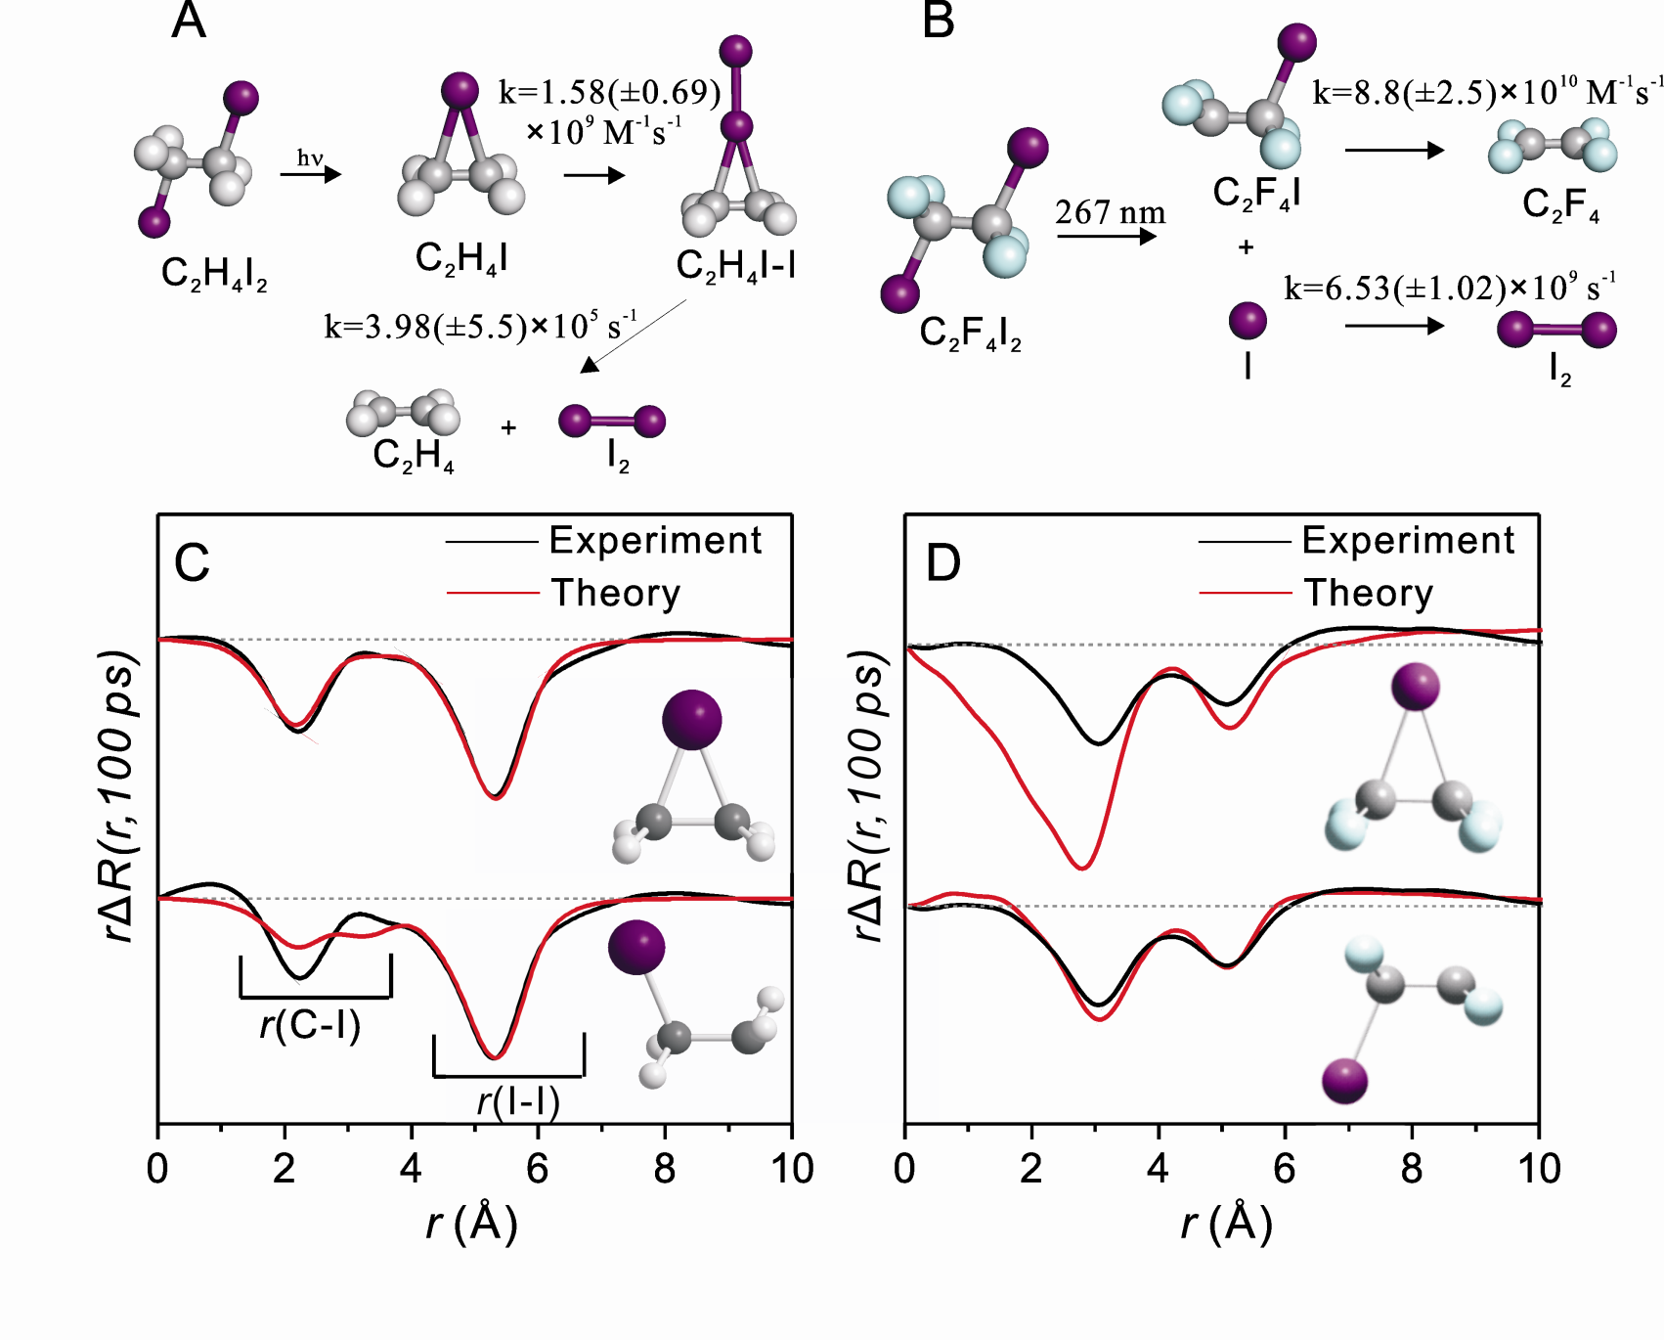
Science, 309, 1223-1227 (2005)
JACS, 130, 5834-5835 (2008)
Notes:
In this case, we studied two kinds of diiodoethanes, one is C2H4I2 and the other is its fluorinated analog, C2F4I2, where the hydrogen atoms are replaced with fluorine atoms. Although the starting structure has the same form, time-resolved solution scattering showed that the reaction pathways and the associated intermediates are completely different, underscoring the dramatic effect of the fluorination. In particular as you can see, the C2H4I radical structure is consistent with the bridged form whereas its fluorinated form is consistent with the classical open structure.

Slide 19
Dynamics in Liquid vs Gas Phase

Slide 20
Dynamics of C₂F₄I₂ in solution
Comparison with C₂F₄I₂ in gas phase (Ultrafast electron diffraction):
Contrast with C₂H₄I₂
~300 ps vs. ~23 ps
~20% vs. 55%
for C₂F₄I → C₂F₄ + I
C₂F₄I₂
C₂F₄I + I
C₂F₄ + 2I
C₂F₄ + I₂
JACS, 130, 5834-5835 (2008)
Notes:
The first example is the photodissociation of C2F4I2, which has been already mentioned. In fact this molecule is one of early examples studied by gas phase time-resolved electron diffraction.

Slide 21
for C₂F₄I → C₂F₄ + I
Gas Phase
Solution Phase
Time-Resolved X-ray Solution Scattering
Time Scale: ~300 ps
Fraction: 20%
Ultrafast electron diffraction
Time Scale: ~23 ps
Fraction: 55%
C₂F₄I + I
C₂F₄ + 2I
C₂F₄I₂
Notes:
For the secondary dissociation of C2F4I into C2F4 and I, the electron diffraction showed that the time scale is about 23 picoseconds and about 55% of the radicals undergoes this dissociation. In contrast, in the solution phase, both the time constant and the fraction change significantly, clearly visualizing the effect of the solvent taking away the available energy of the intermediate.

Slide 22
Structural Dynamics of HgI₂
In the gas phase, both HgI+I and Hg + 2I are observed.
vibrational
cooling
HgI₂
HgI
I
Hg
I₂
Notes:
In the case of photodissociation of HgI2 in methanol, although this molecule is simple, it can have four candidate reaction channels.

Slide 23
Structural Dynamics of HgI₂
100 ps
Experimental
Experimental
Theory
Theory
t = 100 ps
Residuals
HgI₂→HgI+I
t = 300 ps
t = 1 ns
t = 3 ns
HgI₂→Hg+2I
t = 10 ns
Difference diffraction intensity, qΔS(q)
Difference radial intensity, rΔS(r)
Difference Diffraction Intensity, qΔS(q)
t = 30 ns
HgI₂→Hg+I₂
t = 50 ns
t = 300 ns
HgI₂→HgI-I
t = 1 μs
q (Å⁻¹)
r (Å)
q (Å⁻¹)
PNAS, 103, 9410-9415 (2006)
Notes:
We could identify the reaction pathway. Our data show that only the two-body dissociation into HgI + I is observed by scattering.

Slide 24
Gas Phase
Solution Phase
Photolysis of HgI₂ at 267 nm
Photolysis of HgI₂ at 267 nm
Femtosecond Mass spectrometry
Time-Resolved X-ray Solution Scattering
Notes:
This is in contrast with the gas phase reaction where both the two-body and three-body dissociations were reported. Again the comparison visualizes that the solvent must have played an important role.

Slide 25
Solvent-Dependent Dynamics

Slide 26
C₂H₄I₂ in Cyclohexane
50 ps
50 ps
100 p s
100 p s
300 ps
300 ps
1 ns
1 ns
3 ns
3 ns
10 ns
10 ns
30 ns
30 ns
70 ns
70 ns
100 ns
100 ns

Slide 27
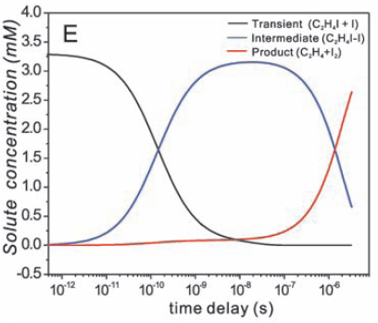
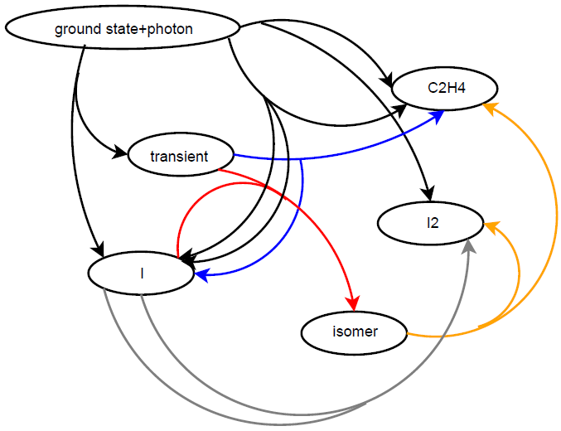
Comparison of Population Kinetics of C₂H₄I₂ Photolysis
Cyclohexane
Methanol
C₂H₄I₂
Rate constant | Cyclohexane | Methanol
C₂H₄I + I → C₂H₄I-I | 8.61 | 9.2
C₂H₄I → C₂H₄ + I | 8.83 | 7.6
C₂H₄I-I → C₂H₄ + I₂ | 6.74 | 5.6
I + I → I₂ | 6.41 | 7.8
f_{excited} | 0.167 | 0.162
f_{rapidly cooled} | 0.438 | 0.65
C₂H₄
C₂H₄I
I₂
I
C₂H₄I-I

Slide 28
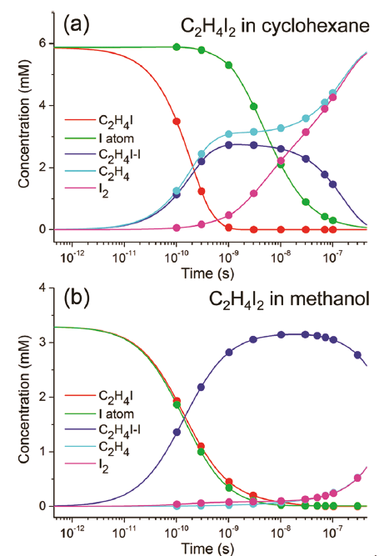
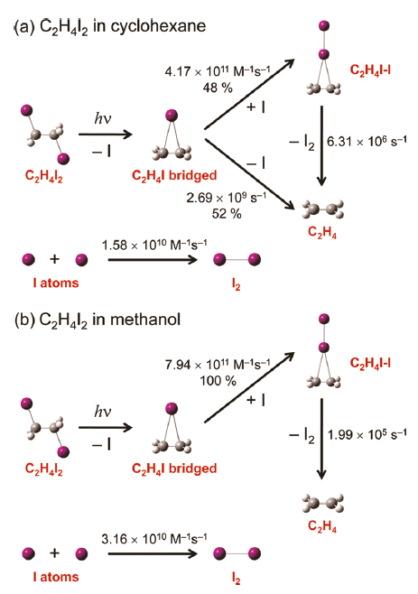
Comparison of Population Kinetics of C₂H₄I₂ Photolysis

Slide 29
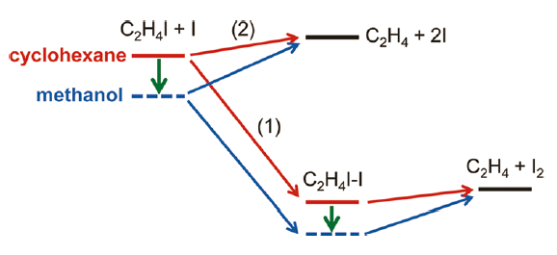
Comparison of Population Kinetics of C₂H₄I₂ Photolysis

Slide 30
Water breaks the symmetry of I₃⁻ (triiodide ion)
Notes:
So far we have focused on identifying the structure of intermediates. In this example, our interest was in the structure of the reactant, I3- triiodide ion. In the gas phase, it is linear symmetric. In other words, this I-I distance is the same as the other I-I distance. How about in solutions? Do we see any effects of solvents? As I explained earlier, because the solute concentration is very small (in this case about 1 mM), the scattering signal is overwhelmed by the contribution from the solvent and thus it is very difficult to refine the structure of the solute. If we induce photolysis of this ion and obtain the difference curve, then all the contributions that does not change are subtracted out in the difference curve, thereby increasing the sensitivity to the structure of the solute.

Slide 31
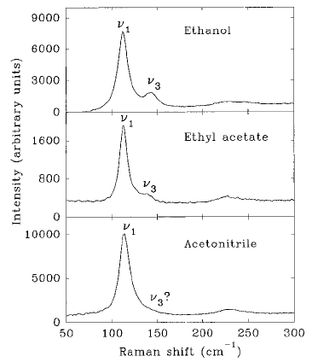

Symmetry breaking of I₃⁻ ion
Experiments (Raman & Anisotropy)
  Asymmetric - Bent
Thomas Kuhne and Peter Vohringer,
J. Phys. Chem. A 102, 4177 (1998)
E. Johnson and A. B. Myers,
J. Phys. Chem. 100, 7778 (1996)
Notes:
물에 의한 solute 분자의 구조 변화가 극명하게 드러나는 유명한 example로 I3-이온의 symmetry breaking 현상이 있습니다. 일반적인 상황에서 I3-분자는 linear symmetric한 구조를 가지고 있는데, hydrogen-bonding이 가능한 solvent조건에서는 이 구조가 크게 달라질 수 있다는 것이 제안되었습니다. 1996년에 raman study에서 raman inactive한 모드가 관찰되어 asymmetic한 구조를 가질 가능성이 제기되었고, TR-anisotropy결과에서는 비정상적으로 빠른 rotational diffusion속도로부터 bent한 구조가 제안되었습니다. 하지만 이런 보고들은 모두 간접적인 실험 결과로 부터 유추한 것들이고 용액상에서 I3-구조의 틀어짐을 직접 관찰하지는 못했습니다.

Slide 32

Fitting parameters
Notes:
분석을 위해 각 데이터 별로 여섯개의 핏팅 파라메터가 사용되었습니다. 네 개의 bondlength와 scaling factor, 그리고 온도 변화 텀을 사용했습니다.

Slide 33
Refined structure (in water)
PRL, 110, 165505 (2013)
Asymmetric and bent structure
If one average distance was used, the broad feature in the experimental curve cannot be matched.
Notes:
최종적으로 얻은 최적의 fit으로 부터 각각의 bondlength들을 결정할 수 있었고, 이를 통해 I3-의 구조를 reconstruct할 수 있었습니다. 예상했던 대로 물에서는 크게 aymmetric bent한 구조를, 메탄올에서는 약간 asymmetric한 구조를, 아세토나이트릴에서는 symmetric한 구조를 얻었습니다. 이러한 관측을 통해 물에 의한 symmetry breaking현상을 직접적으로 밝혀 낼 수 있었습니다.

Slide 34

Refined structure (in acetonitrile)
PRL, 110, 165505 (2013)
Symmetric and linear structure
If two unequal distances were used, the theoretical curve becomes broader.
Notes:
최종적으로 얻은 최적의 fit으로 부터 각각의 bondlength들을 결정할 수 있었고, 이를 통해 I3-의 구조를 reconstruct할 수 있었습니다. 예상했던 대로 물에서는 크게 aymmetric bent한 구조를, 메탄올에서는 약간 asymmetric한 구조를, 아세토나이트릴에서는 symmetric한 구조를 얻었습니다. 이러한 관측을 통해 물에 의한 symmetry breaking현상을 직접적으로 밝혀 낼 수 있었습니다.

Slide 35
Solvent induced symmetry breaking
of triiodide (I₃⁻) ion
2 -OH
Strong solute-solvent
interaction
Δr ~ 0.4 Å
1 -OH
Δr ~ 0.1 Å
0 -OH
Weak solute-solvent
interaction
Δr < 0.03 Å
PRL, 110, 165505 (2013)
Notes:
Here are shown the final fit results for the data with three different solvents. We could refine all the I-I bond distances. It turned out that water can induce the difference as much as 0.3 angstroms. Even methanol can induce the symmetry breaking although its extent is smaller than water. We can conclude that protic solvents such as methanol and water induce symmetry breaking whereas aprotic solvents such as acetonitril does not.

Slide 36

Quantum calculation with explicit water molecules: Origin of symmetry breaking
Asymmetric-bent structure is well reproduced.
Strong solute-solvent interaction is the driving force.

Slide 37

EXAFS study
?
Broadening was attributed to high DW factor, not to the symmetry breaking.
EXAFS has low sensitivity at longer distances.
Sakane et. al. J. Synchrotron Radiat. 8, 674 (2001)
Notes:
최종적으로 얻은 최적의 fit으로 부터 각각의 bondlength들을 결정할 수 있었고, 이를 통해 I3-의 구조를 reconstruct할 수 있었습니다. 예상했던 대로 물에서는 크게 aymmetric bent한 구조를, 메탄올에서는 약간 asymmetric한 구조를, 아세토나이트릴에서는 symmetric한 구조를 얻었습니다. 이러한 관측을 통해 물에 의한 symmetry breaking현상을 직접적으로 밝혀 낼 수 있었습니다.

Slide 38
Origin of broadening effect
Higher DW factor was used to fit the peak around 3.16 Å.
Peak around 6.13 Å became too broad.
Broad feature does not arise from high DW factor but from two unequal bond lengths.
Notes:
최종적으로 얻은 최적의 fit으로 부터 각각의 bondlength들을 결정할 수 있었고, 이를 통해 I3-의 구조를 reconstruct할 수 있었습니다. 예상했던 대로 물에서는 크게 aymmetric bent한 구조를, 메탄올에서는 약간 asymmetric한 구조를, 아세토나이트릴에서는 symmetric한 구조를 얻었습니다. 이러한 관측을 통해 물에 의한 symmetry breaking현상을 직접적으로 밝혀 낼 수 있었습니다.

Slide 39
Pushing the Time-Resolution

Slide 40
Photochemistry of I₂ in CCl4
J. Am. Chem. Soc., 135, 3255 (2013)

Slide 41
J. Am. Chem. Soc., 135, 3255 (2013)

Slide 42
J. Am. Chem. Soc., 135, 3255 (2013)

Slide 43
J. Am. Chem. Soc., 135, 3255 (2013)

Slide 44
Macromolecules

Slide 45

Time-Resolved X-ray Solution Scattering to study Protein Structural Dynamics
Protein in Solution
Larger Size
Lower Concentration
Notes:
This is an example of a typical small molecule and this is that of a typical protein molecule. When we apply TRXL to proteins, we have to deal with a much larger size and a generally lower concentration than that of small molecules.

Slide 46




SAXS
Size & Shape
WAXS
3D Structural Information on Folds
Notes:
This is a typical scattering pattern from a protein solution, which can be converted to a one-dimensional scattering intensity curve.
The small angle region, which is often called SAXS region, contains information about the size and shape. The scattering intensity in wider angles have more detailed information such as the folds of the alpha helix and beta sheets. Please note that the intensity is shown in log scales. As you can see, the SAXS intensity is huge compared with the WAXS intensity and this is why in most applications only SAXS region has been utilized.

Slide 47


Time-Resolved WAXS (TR-WAXS)
Nature Methods, 5, 881-887 (2008) (COVER in the October issue)
Notes:
This slide shows a schematic of the experimental setup. We put a protein solution in a capillary and apply the typical laser-pump and X-ray-probe scheme. The scattering patterns are collected as a function of time delay of the X-ray pulse relative to the laser pulse.

Slide 48






Protein Gallery
Myoglobin (Mb)
Dimeric Hemoglobin (HbI)
Hemoglobin (Hb)
Nature Methods, 5, 881-887 (2008)
J. Am. Chem. Soc., 134, 7001-7008 (2012)
J. Phys. Chem. B, 113, 13131-13133 (2009)
Nature Methods, 5, 881-887 (2008)
ChemComm, 47, 289-291 (2011)
J. Phys. Chem. Lett., 2, 350-356 (2011)
Photoactive Yellow Protein (PYP)
Cytochrome C (CytC)
J. Am. Chem. Soc., 134, 3145-3153 (2012)
Bacteriorhodopsin (bR)
J. Am. Chem. Soc., 133, 9395-9404 (2011)
Nature Methods, 5, 881-887 (2008)
Notes:
This shows a list of various model proteins studied by TRXL and for the rest of my talk I will show you the results for heme proteins.

Slide 49
Homodimeric Hemoglobin (HbI)

Slide 50

Protein Structural Dynamics Perturbed by Mutation
J. Am. Chem. Soc., 134, 7001-7008 (2012)
Wild Type
F97Y

Slide 51
Protein Structural Dynamics Perturbed by Mutation
J. Am. Chem. Soc., 134, 7001-7008 (2012)

Slide 52
Pump-Probe Time-Resolved X-ray Diffraction (Scattering)
Kinetic Information
Number of Intermediates
Rate Coefficients
Structural Information
Structure of Intermediates

Slide 53
J. Am. Chem. Soc., 134, 7001-7008 (2012)

Slide 54
Structural Refinement
J. Am. Chem. Soc., 134, 7001-7008 (2012)

Slide 55
Structural Dynamics of HbI
J. Am. Chem. Soc., 134, 7001-7008 (2012)

Slide 56
Structural Dynamics of HbI
J. Am. Chem. Soc., 134, 7001-7008 (2012)

Slide 57

Protein Folding of Cytochrome-c
17.8 μs
56.2 μs
100 μs
316 μs
1 ms
ΔS (q, t)
3.16 ms
CO-ligand Photolysis
10 ms
UCO (unfolded)
→ N (folded) + CO
31.6 ms
100 ms
UCO @ pH 7 GdnHCl 4M
folding process by photodissociation
200 ms
400 ms
q (Å⁻¹)
Notes:
TWK] All data is come from bubbling experiment. The bubbling experiment is the same as original refolding experiment except for bubbling CO-Cyt c solution with nitrogen for 10 min. It is possible that the concentration of carbon monoxide in the bubbling case is a little bit lower than the original case. [Actually, in the original case I have a trouble related with extracting intermediate structure. Therefore, in this presentation I’ll show you the bubbling data in that the intermediate structures are normally extracted.]

Slide 58
Principal Component Analysis
17.8 μs
— U – UCO
— I – UCO
— N – UCO
56.2 μs
U
N
I
100 μs
ΔS (q, t)
Population
316 μs
1 ms
ΔS (q, t)
3.16 ms
10 ms
q (Å⁻¹)
Time delay (s)
31.6 ms
100 ms
200 ms
hν
U
I
N
UCO
400 ms
340 μs
7.2 ms
q (Å⁻¹)

Slide 59



Folding Structural dynamics
— U
— I
— N
P(r)
r (Å)
hν
U
I
N
UCO
340 μs
7.2 ms
U (20 Å)
I (19 Å)
N (13 Å)
Notes:
TWK] This slide shows the structural dynamics involving reconstructed structures, radial distribution functions (RDFs) and static SAXS data about CO-Cytc. (Left up figure) The third species-associated curve is well matched with the theoretical difference between the static curves from folded (Rg: 13.7 ang) and unfolded structure (Rg : 21 ang) generated by MD simulation. That is, the unfolded CO-Cyt c having 21 angstrom with respect to radius of gyration is converted to native folded state after CO-ligand photolysis. (Left bottom figure) In fact, the static SAXS curve shows 21 ang with respect to Rg about CO-Cyt c. (Right figure) Final extracted structures from species-associated curves.

Slide 60
Anisotropic Scattering
J. Phys. Chem. Lett. 5, 350-356 (2011)

Slide 61
Anisotropic Scattering
J. Phys. Chem. Lett. 5, 350-356 (2011)

Slide 62

Anisotropic Scattering
J. Phys. Chem. Lett. 5, 350-356 (2011)

Slide 63

Anisotropic Scattering
J. Phys. Chem. Lett. 5, 350-356 (2011)

Slide 64
Summary
TR X-ray Solution Scattering Resolves Structural Dynamics: Solvent-dependent molecular structures of short-lived intermediates and their structural dynamics, and solute-solvent interplay can be visualized by Time-Resolved X-ray Diffraction in Solution for various small molecules.
“Ultrafast X-ray scattering: structural dynamics from diatomic to protein molecules", Ihee, Wulff, Kim, Adachi, Int. Rev. Phys. Chem (2010) 29, 453-520.
"Visualizing Solution-Phase Reaction Dynamics with Time-Resolved X-ray Liquidography", Hyotcherl Ihee, Acc. Chem. Res. (2009) 42, 356.
“Spatiotemporal Kinetics in Solution Studied by Time-Resolved X-ray Liquidography (Solution Scattering)", Kim, Lee, Wulff, Kong, Ihee, ChemPhysChem (2009) 10, 1958. Cover in September Issue.
Notes:
In this talk, I presented several examples where time-resolved solution scattering revealed structural dynamics in solutions. Molecular structures of intermediates and their spatiotemporal kinetics can be tracked for small molecules and proteins. Throughout my talk, I have tried to emphasize that time-resolved solution scattering is a versatile tool to investigate the reactions, complementary to spectroscopy. Many parts of my talk can be found in a recently published review article in Accounts of Chemical Research. (32:00)

Slide 65
Acknowledgement
Group Members
Jae Hyuk Lee (KAIST)
Kyung Hwan Kim (KAIST)
Jeongho Kim (KAIST)
Yang Ouk Jung (KAIST)
Youngmin Kim (KAIST)
Srinivasan Muniyappan (KAIST)
Prabhakar Ganesan (KAIST)
Cheol Hee Yang (KAIST)
Sunhong Jun (KAIST)
Hosung Ki (KAIST)
Tae Wu Kim (KAIST)
Jong Goo Kim (KAIST)
Key Young Oang (KAIST)
Kamatchi Thamilselvan (KAIST)
Annie Preethi Jamesmaxwel (KAIST)
Rajiv Gandhi (KAIST)
Collaborators
Shin-ichi Adachi (KEK)
Shunsuke Nozawa (KEK)
Tokushi Sato (KEK)
Takahiro Sato (RIKEN)
Makina Yabashi (RIKEN)
Changyong Song (RIKEN)
Tetsuya Ishikawa (RIKEN)
Marco Cammarata (ESRF, SLAC)
David Fritz (SALC)
Henrik Lemke (SALC)
Robert Henning (U Chicago)
Irina Kosheleva (U Chicago)
Vukica Srajer (U Chicago)
Michael Wulff (ESRF)
Qingyu Kong (SOLEIL)
Savo Bratos (UPMC)
Shin-ya Koshihara (TIT)
Group Alumni
Joonghan Kim (KAIST)
Jangbae Kim (KAIST)
Sena Ahn (KAIST)
Youhong Lee (KAIST)
Heejung Kim (KAIST)
Jungkweon Choi (KAIST)
Tae Kyu Kim (PNU)
Financial Support
National Creative Research Initiatives (Center for Time-Resolved Diffraction) of MEST/NRF
Notes:
I would like to start by acknowledging the people involved in the work that I am going to present, collaborators and my group members.
Especially I would like to thank Michael Wulff at ESRF and his current and former members at the beamline. The funding has been generously provided by Korean government under national creative research initiatives, one of the biggest grants available for individual researchers in Korea.

Slide 66

Thank you for your attention

