Slide 2
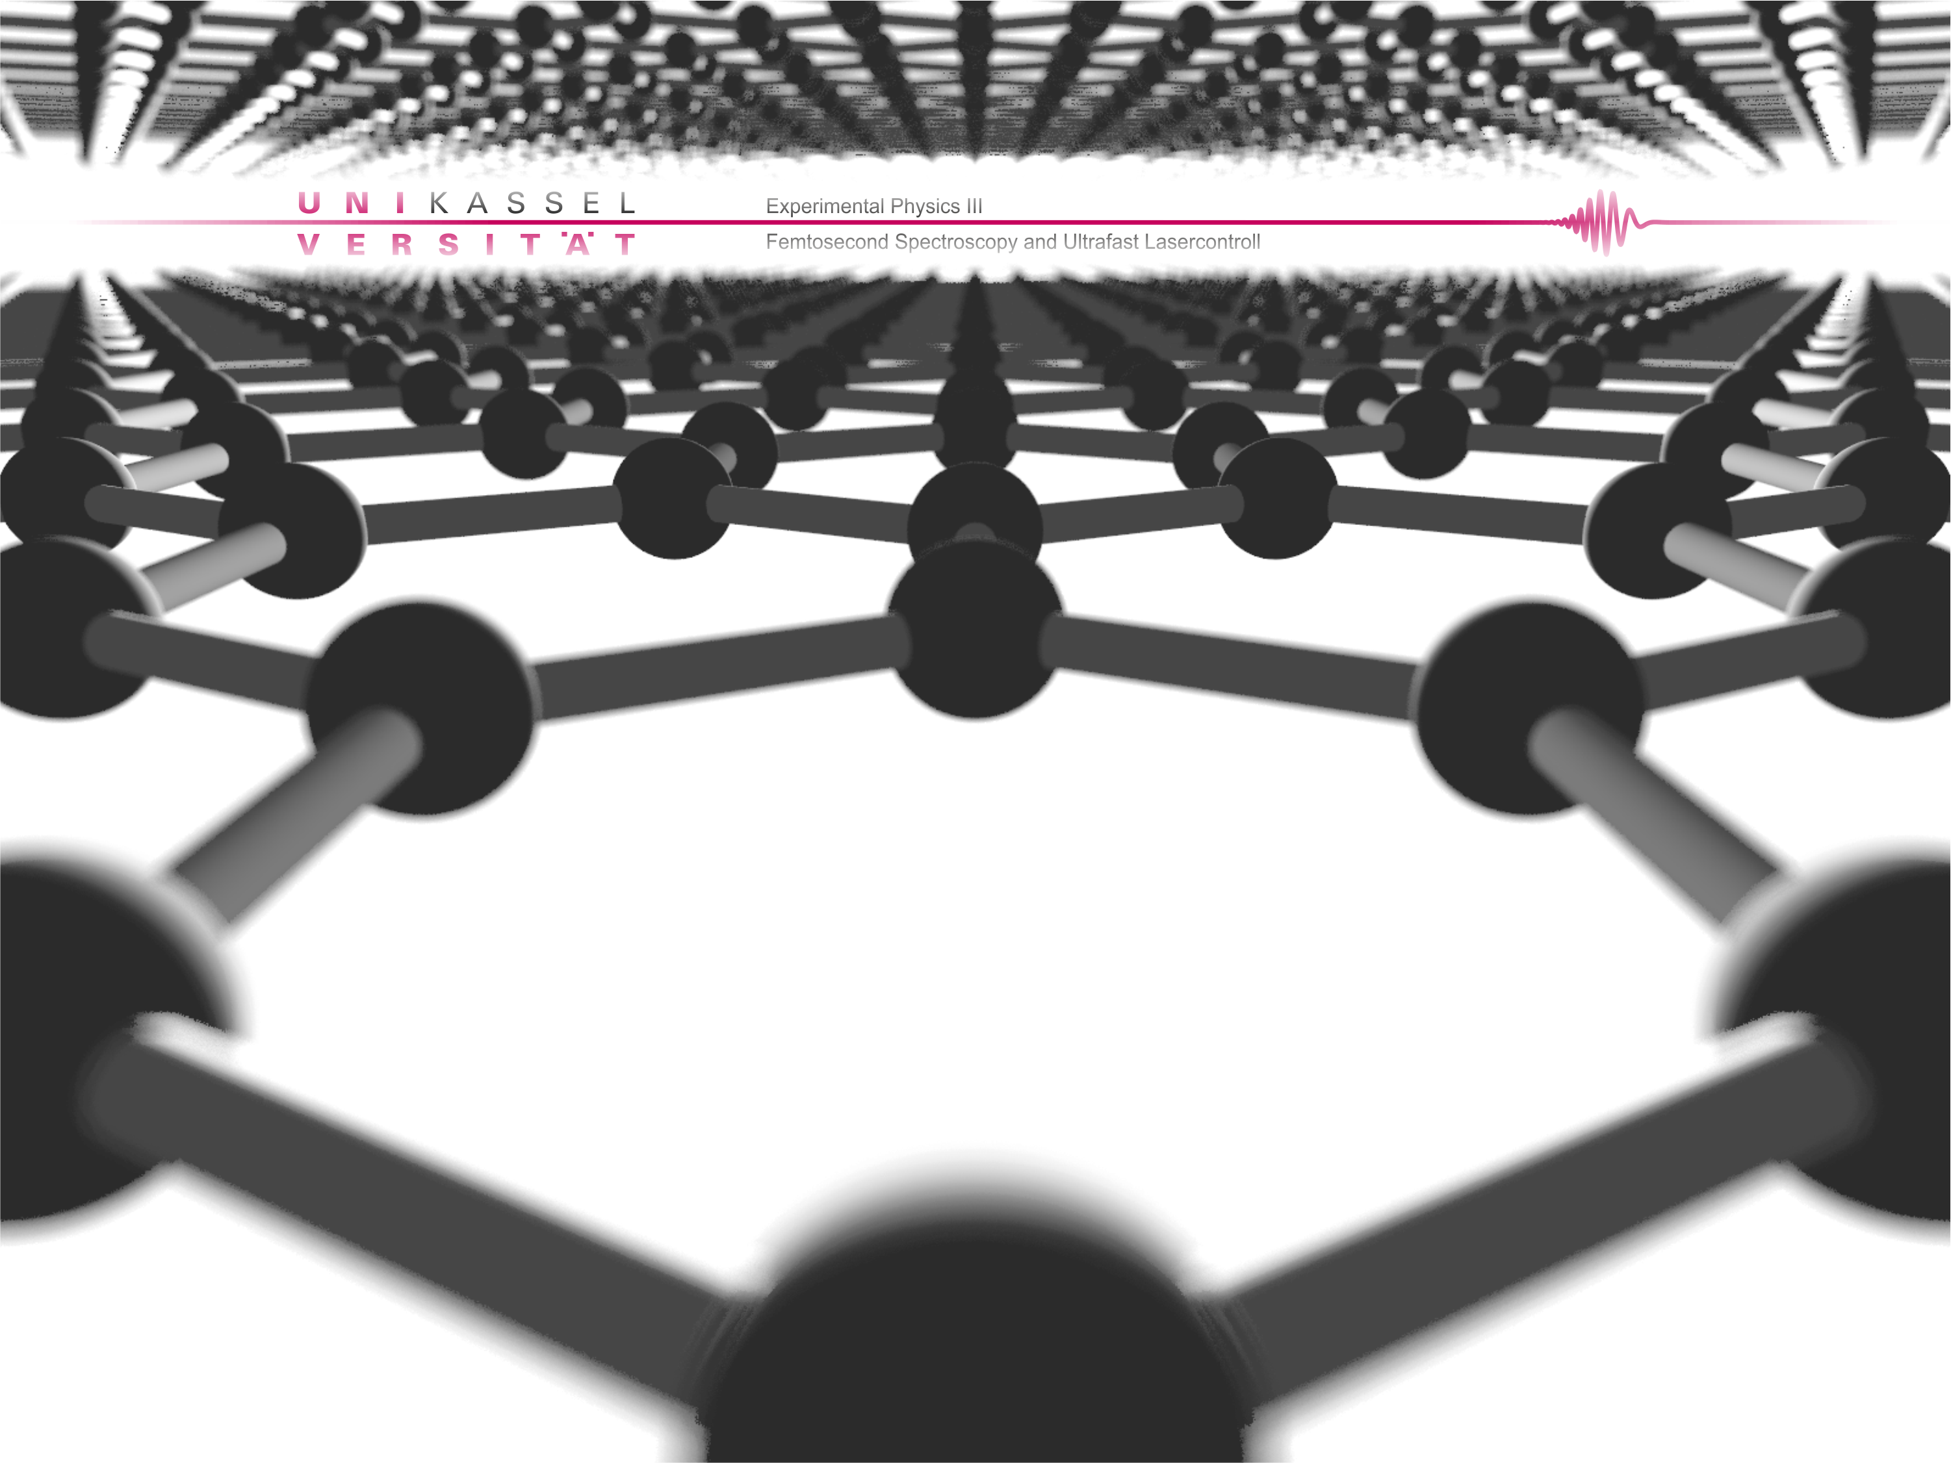
temporal pulse
characterization
UED setup and
spatial resolution
lattice dynamics
in graphite
outline

Slide 3
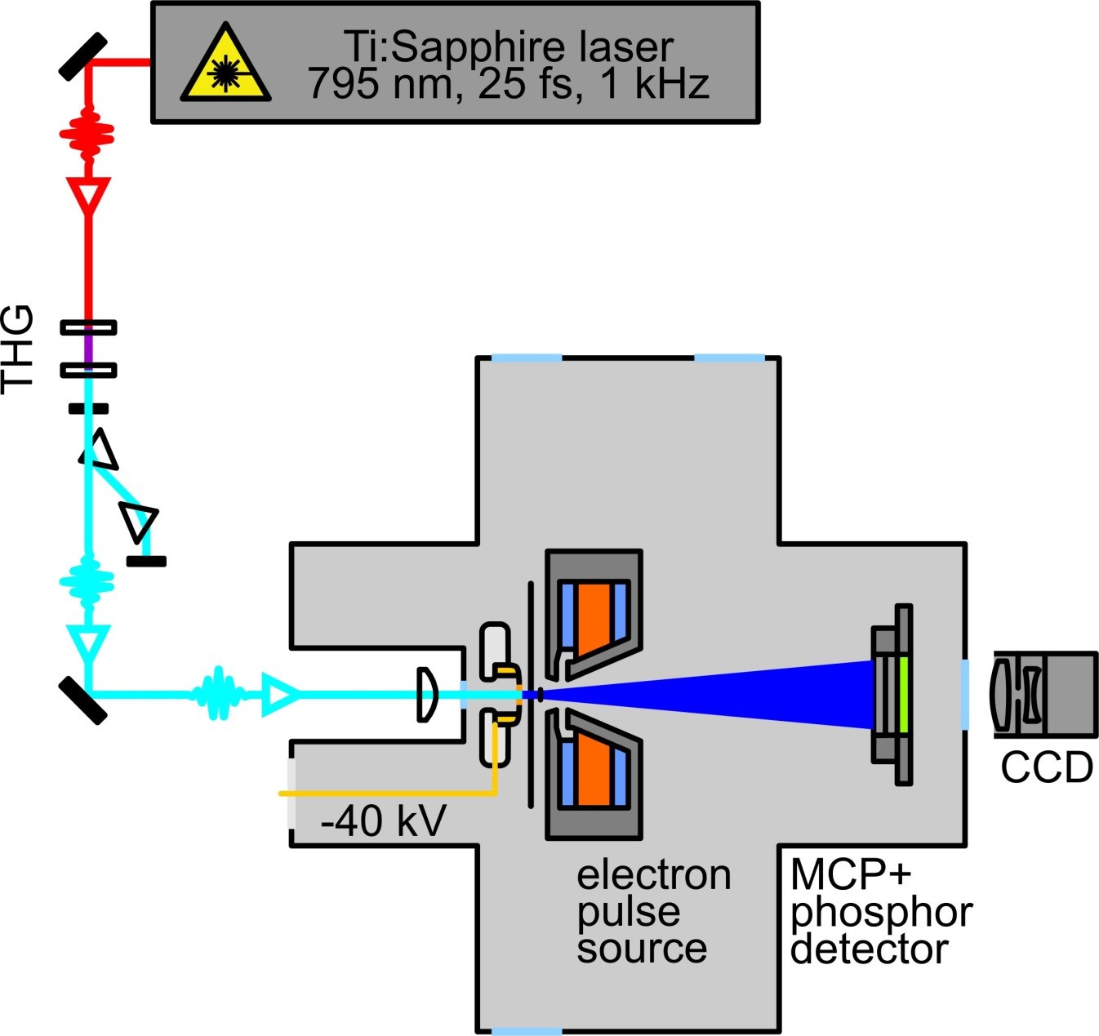
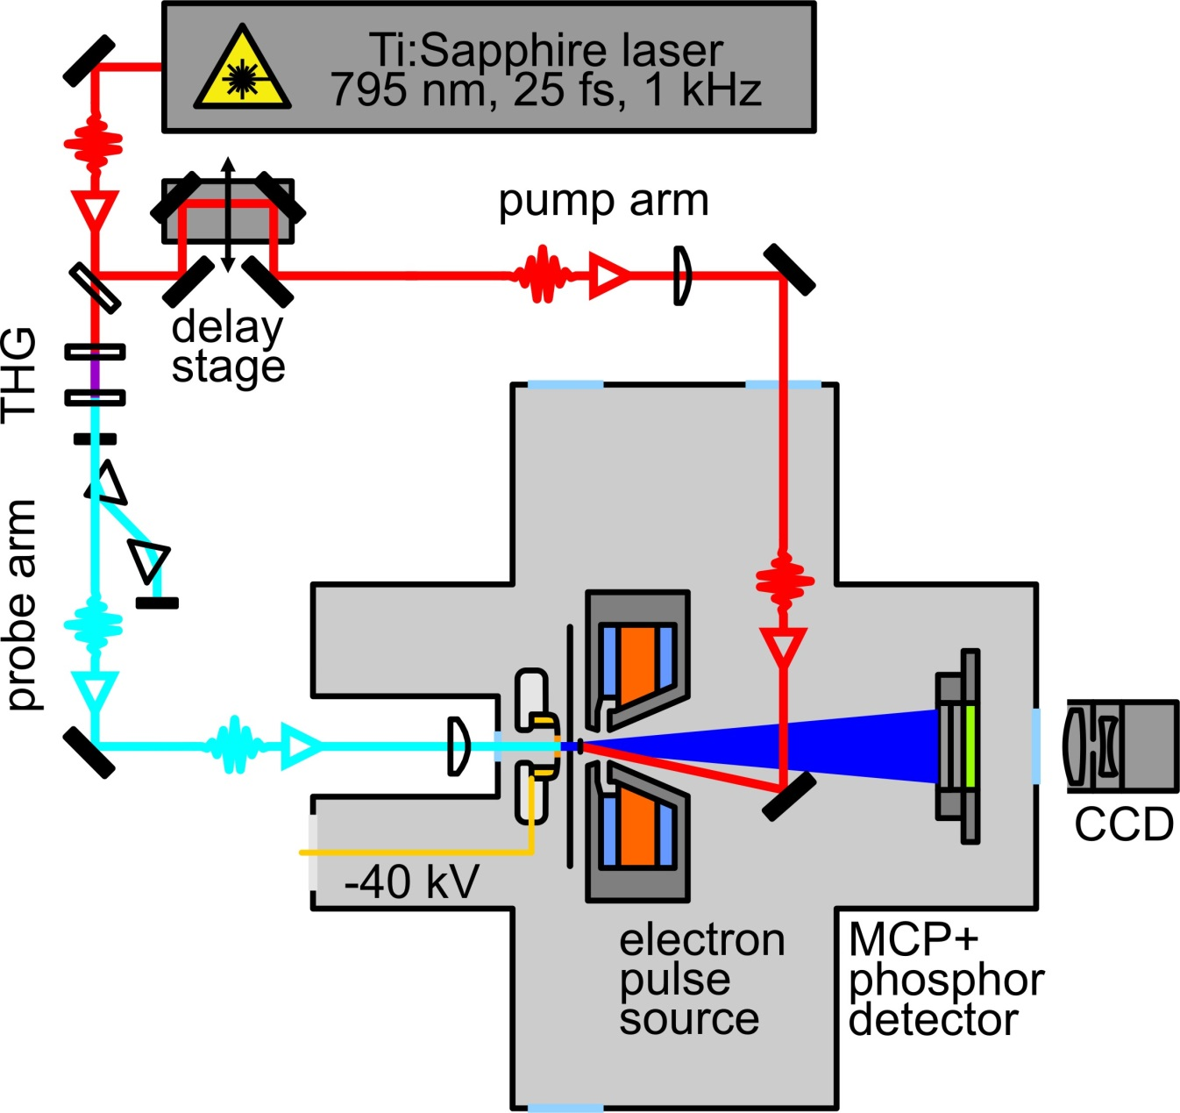
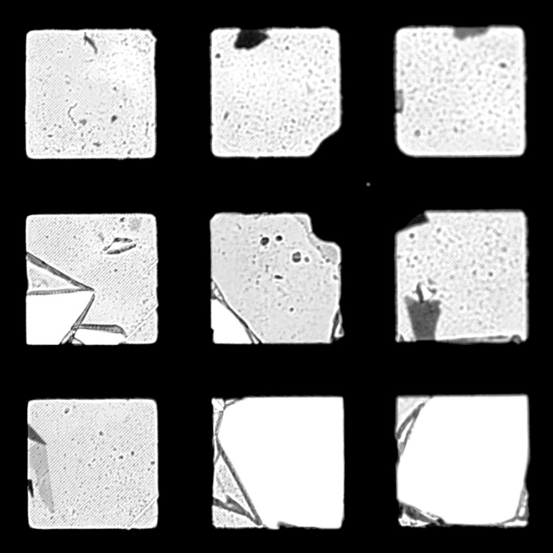
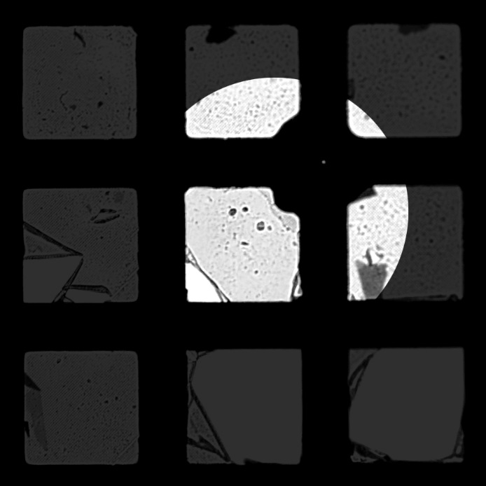
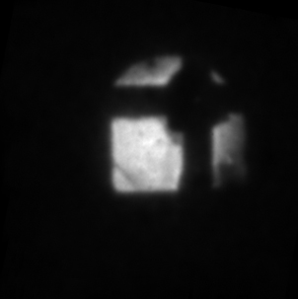
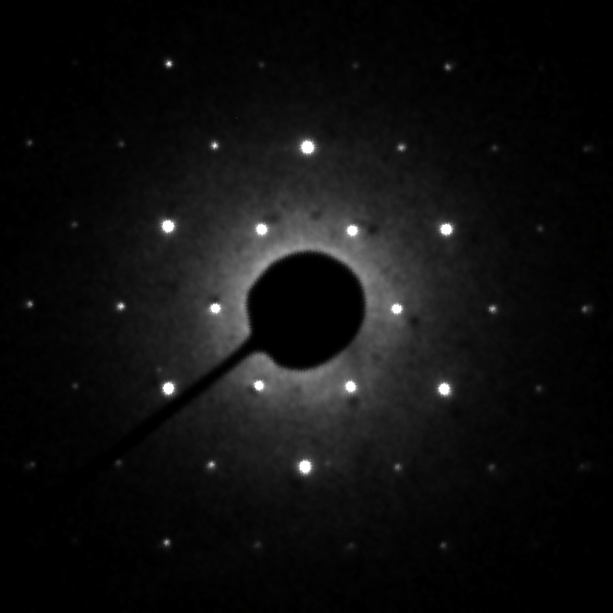
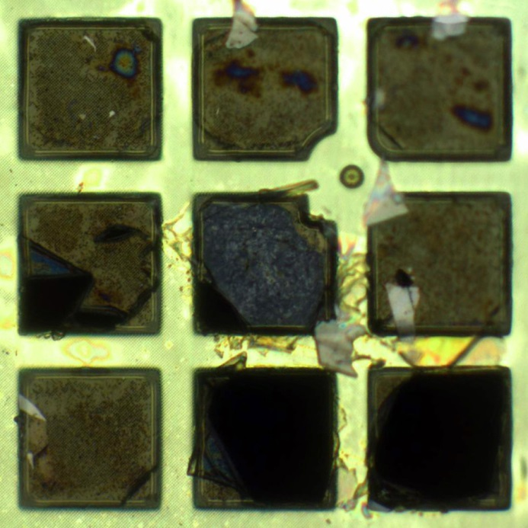
3 nm thin freestanding
single crystalline graphite
preparation with micro-mechanical exfoliation and transfer on Quantifoil® gold TEM-grid
100 µm
40 keV electron
transmission image
main parameter:
acc. voltage: 40 kV
acc. field: 11.4 kV/mm
pulse radius: ~ 75 µm
source radius: 2 µm - 30 µm
40 keV electron
diffraction pattern
optical white light
microscope image
in reflection
optical white light
microscope image
in transmission
J. C. Meyer et al.,
Appl. Phys. Lett. 92, 123110 (2008)
electron diffraction setup
Notes:
setup overview

Slide 4
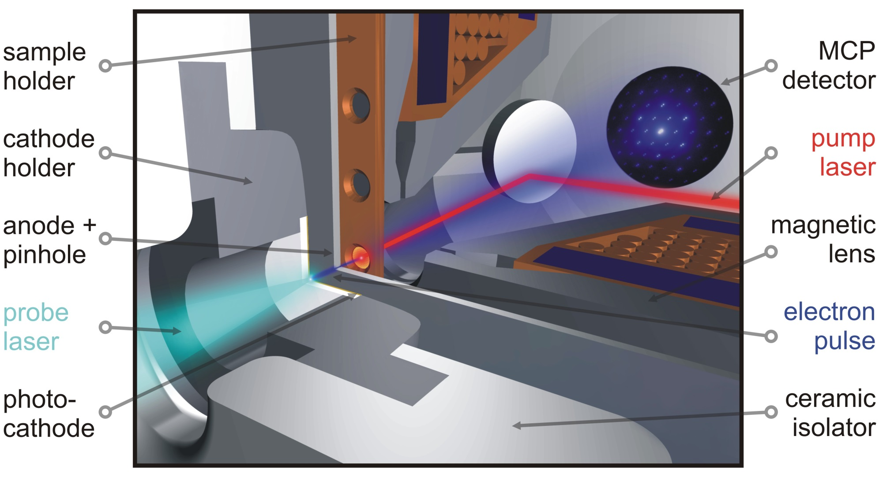
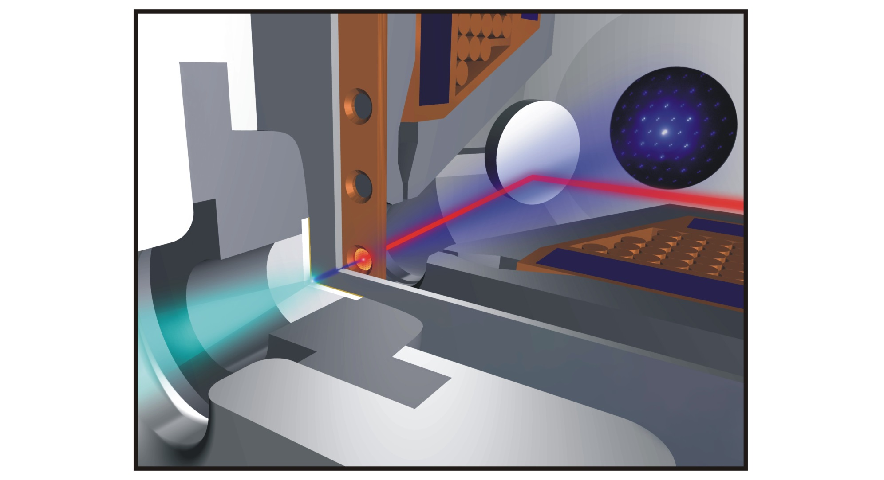
electron pulse source
8.5 mm cathode-sample distance
electron diffraction setup
Notes:
source in detail
DONT FORGET DETAIL DISCRIPTION!

Slide 5
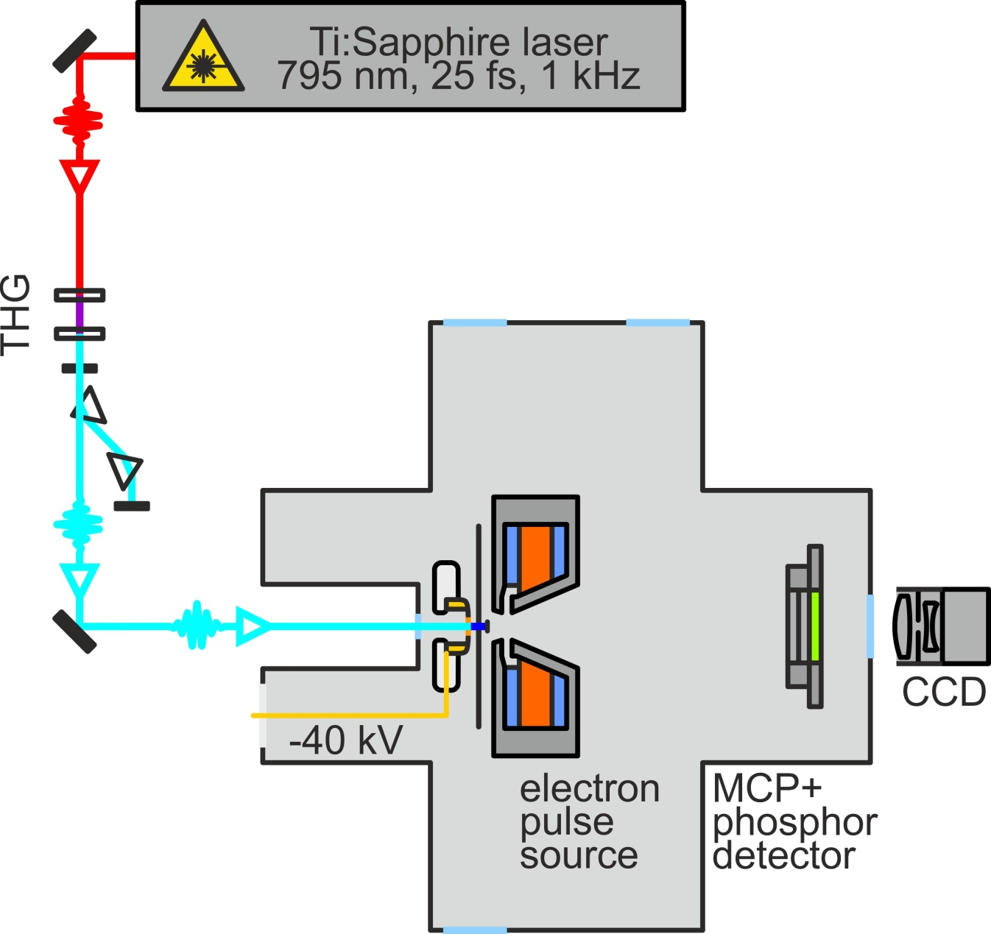
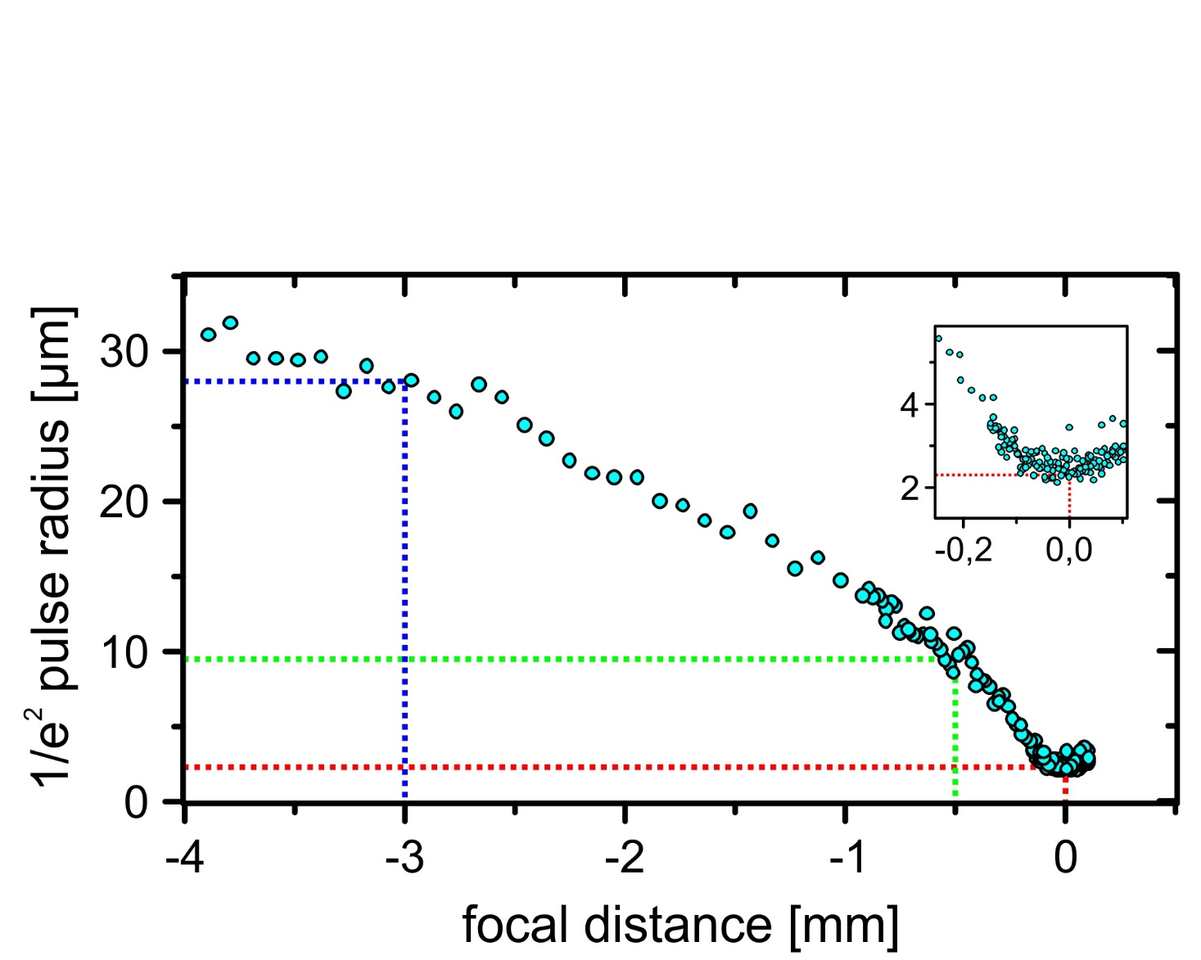
Characterization
spatial resolution
electron source size
↔ transerve coherence length
THG pulse beam size
knife edge method
28.0 µm
9.5 µm
2.3 µm
spatial resolution studies

Slide 6
spatial resolution
electron source size
↔ transerve coherence length
spatial resolution studies

Slide 7
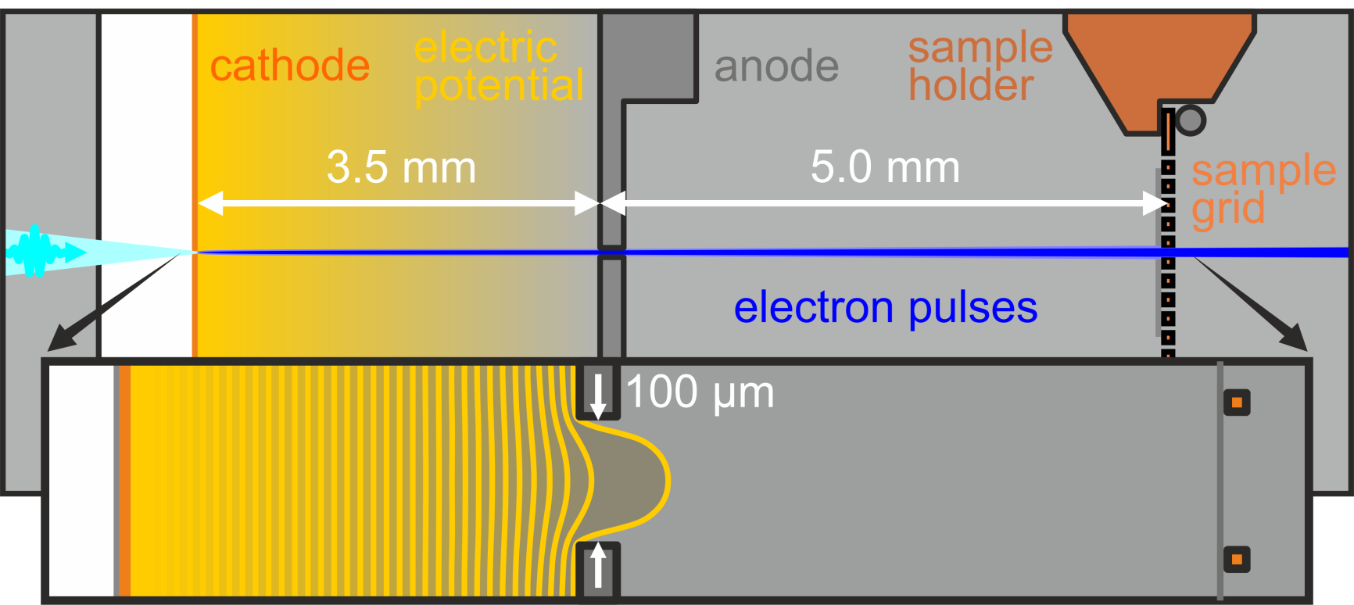
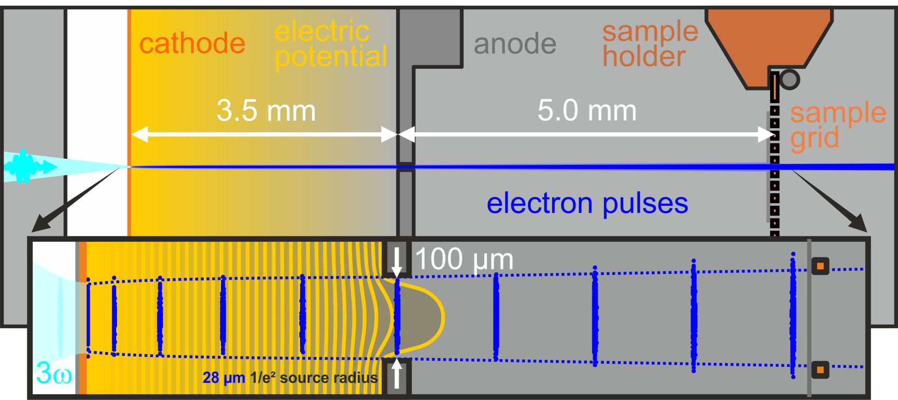
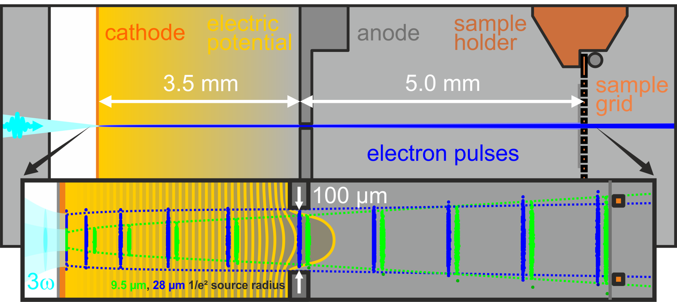
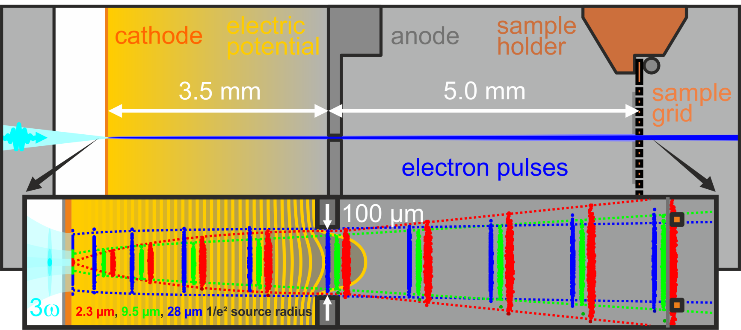
Experimental Physics III
Femtosecond Spectroscopy and Ultrafast Laser Control
spatial resolution
electron source size
↔ transerve coherence length
spatial resolution studies

Slide 8
source image expansion
w₀ = 2.3 µm
w₀ = 9.5 µm
w₀ = 28.0 µm
measured
w_{s} = 85 µm
w_{s} = 52 µm
w_{s} = 49 µm
transerve coherence length from simulation via emittance:
first approximation for transerve coherence length:
$$_{s}=\frac{ħ}{m c} \frac{σ_{s}}{ε_{s}} , ε_{s}=\frac{1}{m c} \sqrt{\left\langle r^{2}\right\rangle \left\langle {p_{r}^{}}^{2}\right\rangle −{\left\langle r{ p}_{r}^{}\right\rangle }^{2}}$$
$$_{s}={ ξ}_{0} \frac{w_{s}}{w_{0}} , { ξ}_{0}=0.6 nm$$
simulated
ξ_{s} = 3.3 nm
ξ_{s} = 20.4 nm
ξ_{s} = 4.0 nm
ξ_{s} = 22.2 nm
ξ_{s} = 1.1 nm
ξ_{s} = 1.5 nm
spatial resolution studies

Slide 9
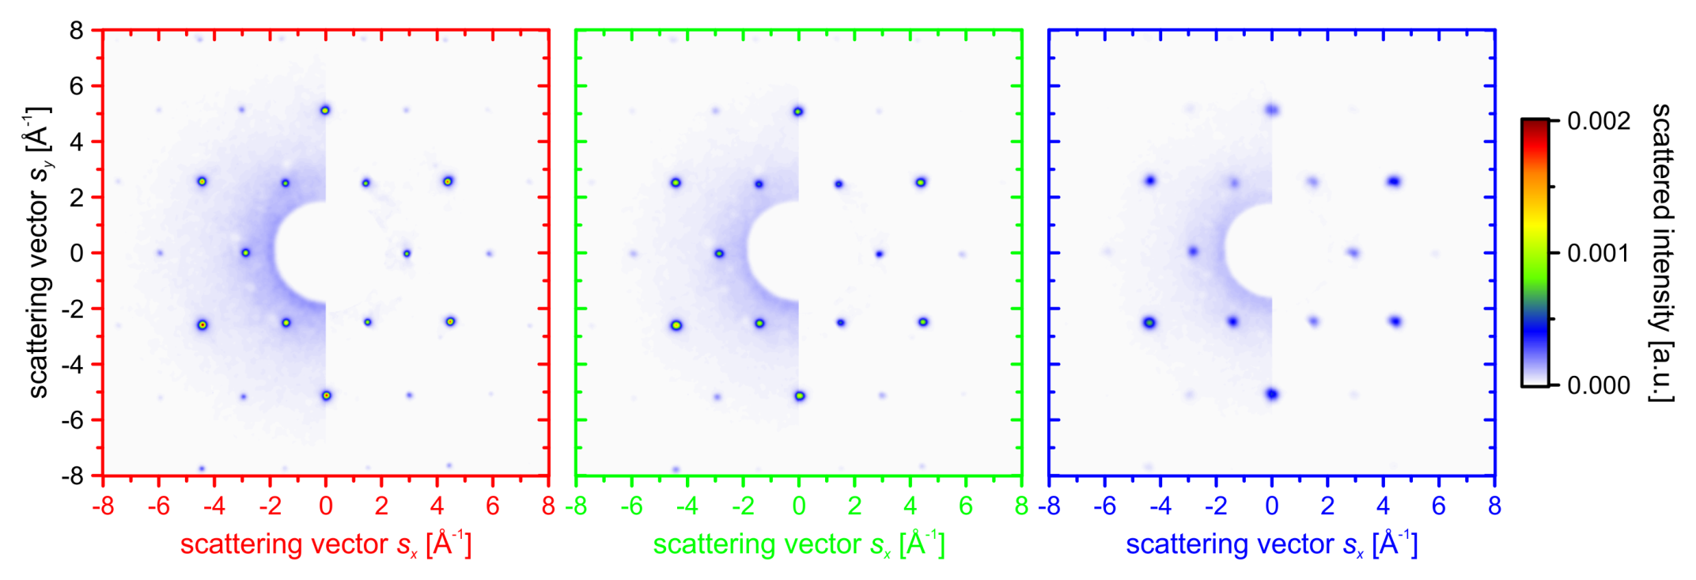
electron sample diffraction
2.3 µm
9.5 µm
28 µm
spatial resolution studies

Slide 10
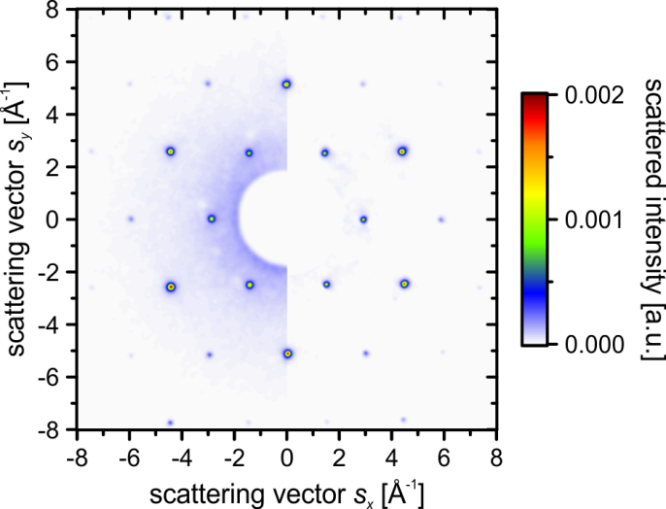
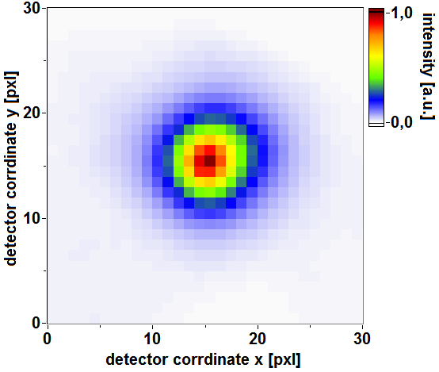
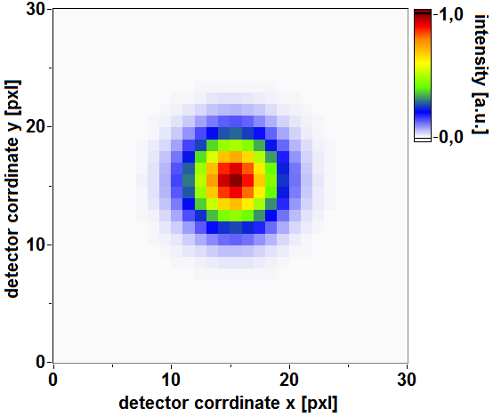
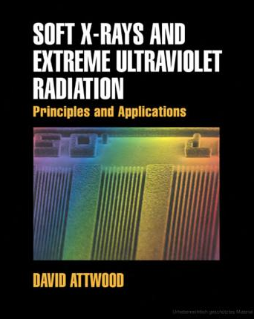
transvere coherence from diffraction data
Bragg peak
2D-Gaussian fit
van Cittert-Zernike theorem for a Gaussian source
and 88% optical coherence criterium give:
$$=\frac{2}{σ}$$
$$σ$$
$I_{DP}\left(k\right)$
, with standard deviation of
spatial resolution studies

Slide 11
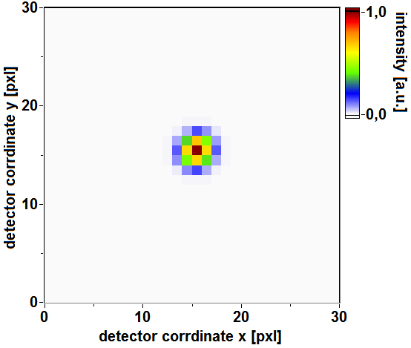
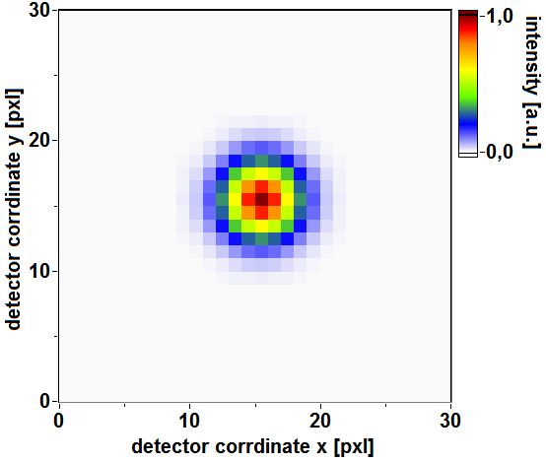
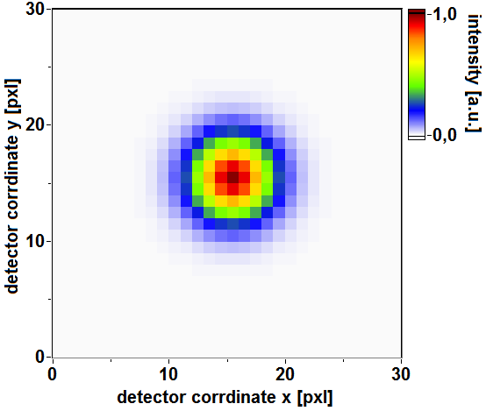
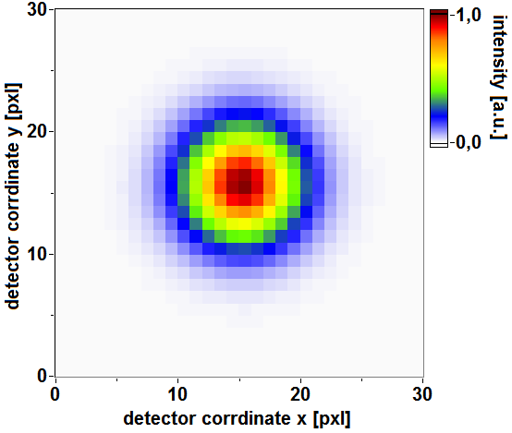
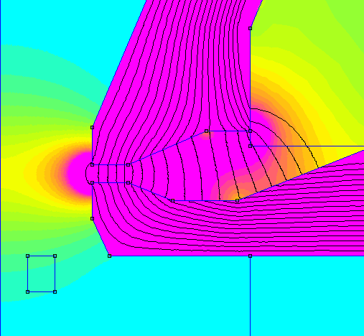
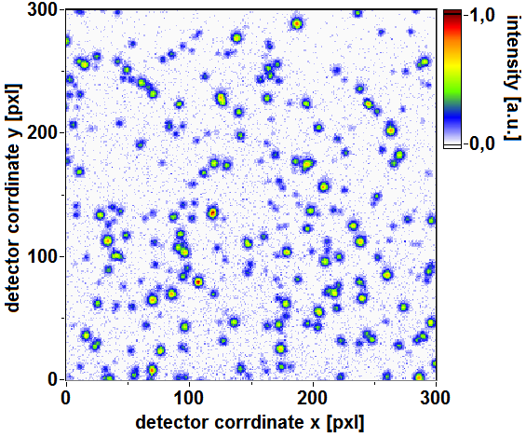
transvere coherence from diffraction data
measured Bragg peak width is a convolution result:
mag. lens aberration
deconv. Bragg peak
detector PSF
$$=$$
mag. lens aberration
single events
detector PSF
deconv. Bragg peak
$$⊗$$
$$⊗$$
spatial resolution studies

Slide 12
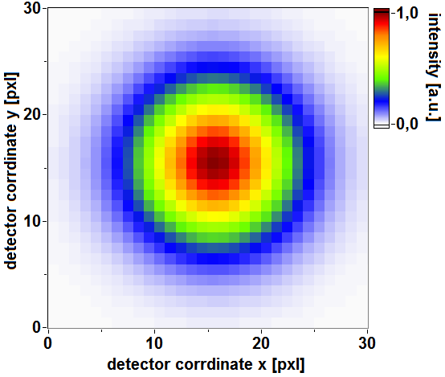
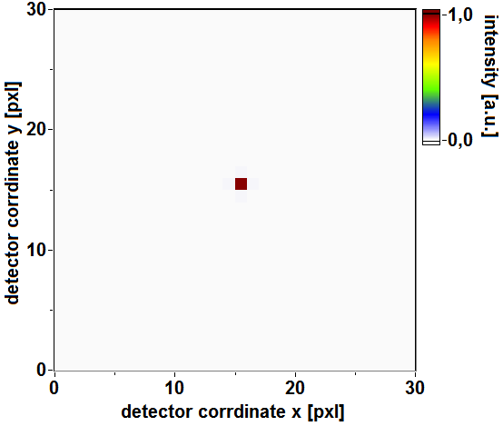
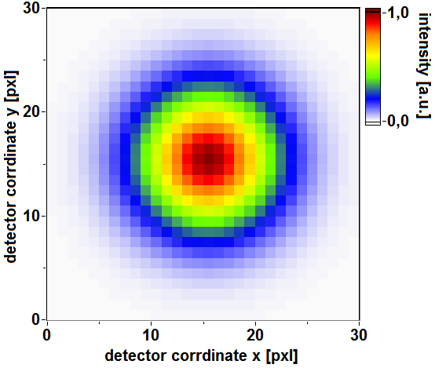
transvere coherence from diffraction data
w₀ = 2.3 µm
w₀ = 9.5 µm
w₀ = 28.0 µm
2D Gaussian fit
deconvoluted
ξ_{i} = 22.7 nm
ξ_{i} = 2.8 nm
ξ_{i} = 1.6 nm
spatial resolution studies

Slide 13
temporal pulse
characterization
UED setup and
spatial resolution
lattice dynamics
in graphite

Slide 14
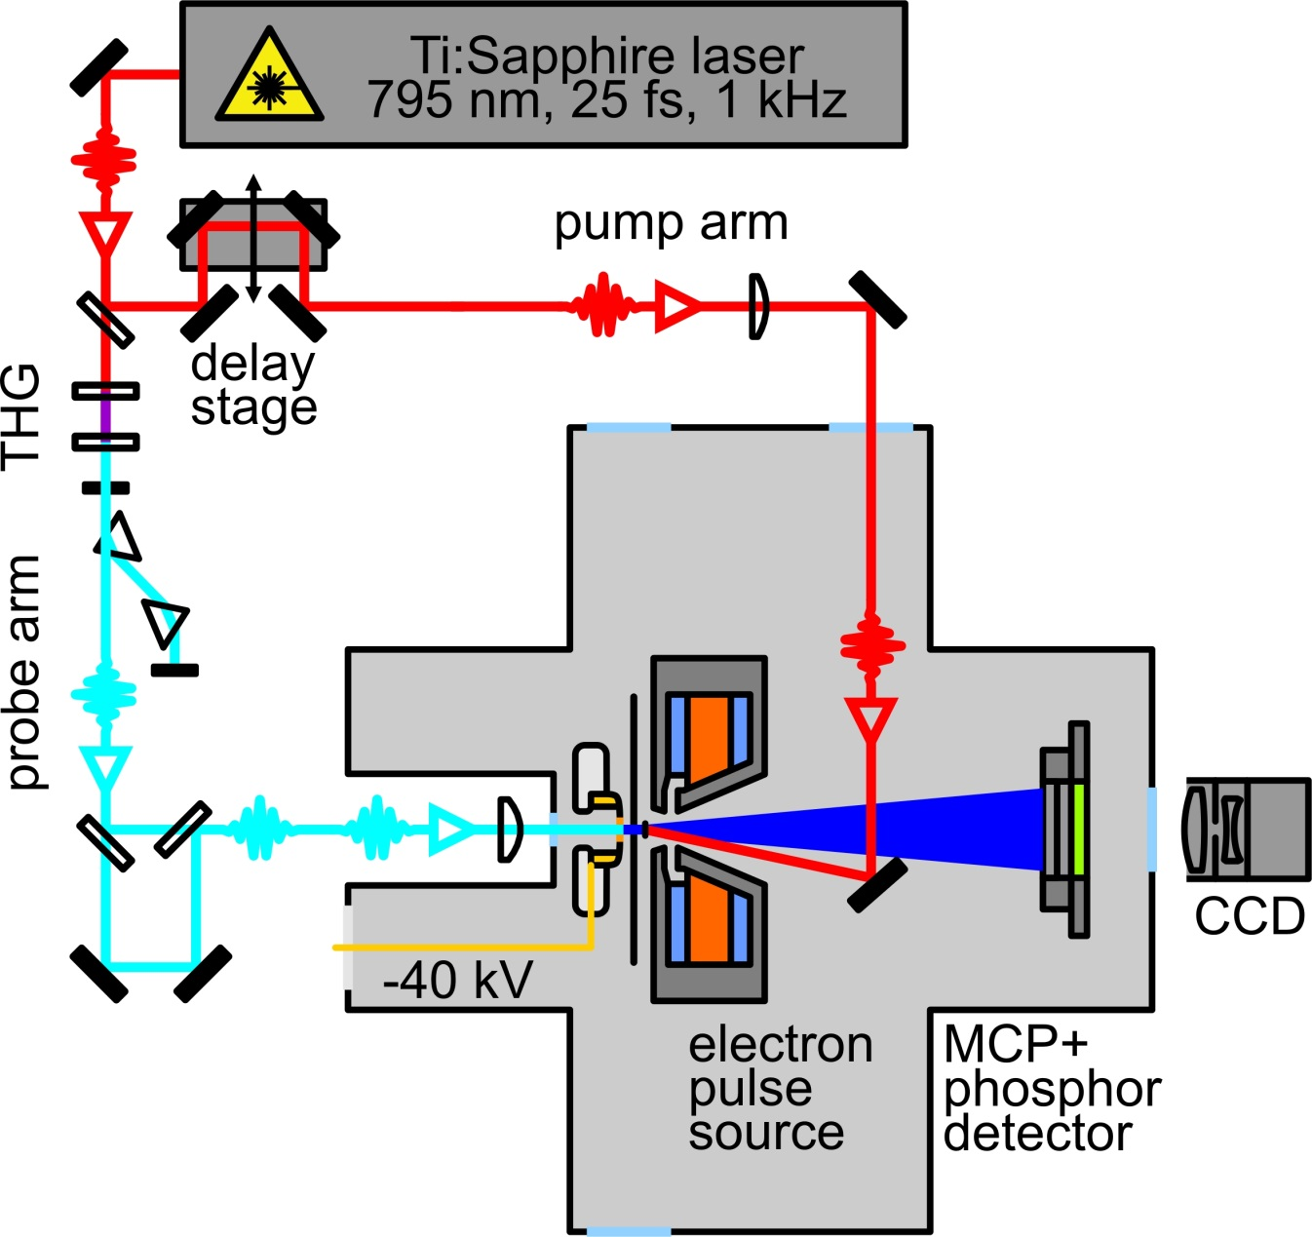
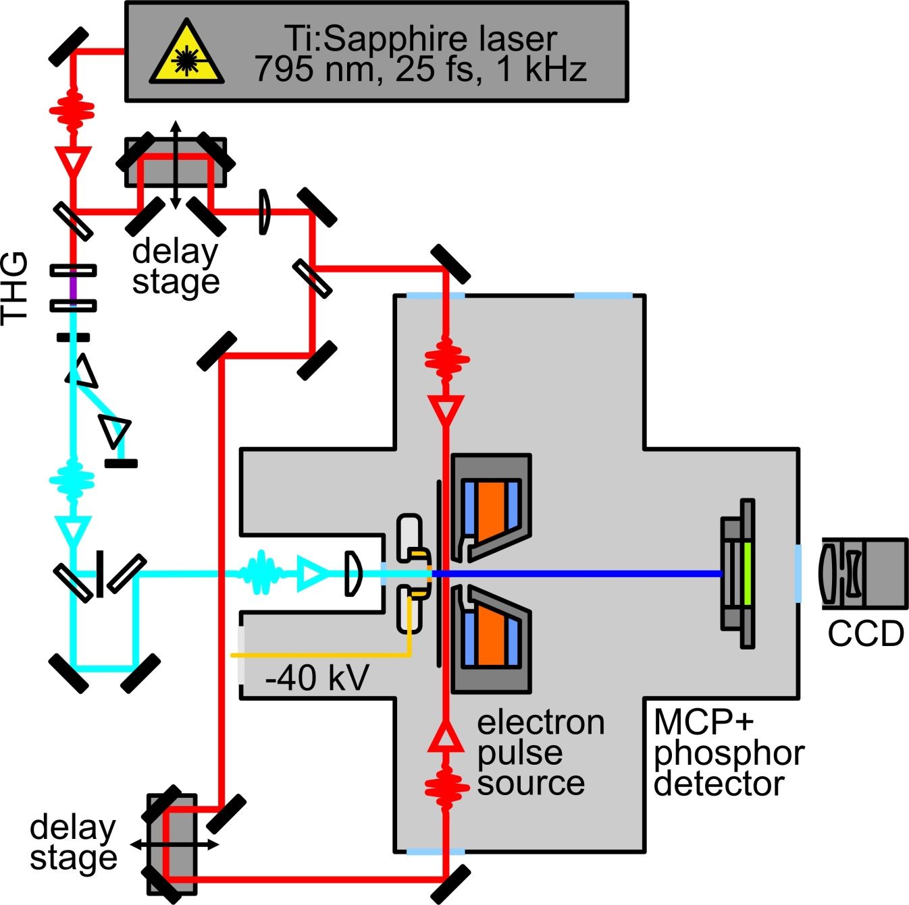
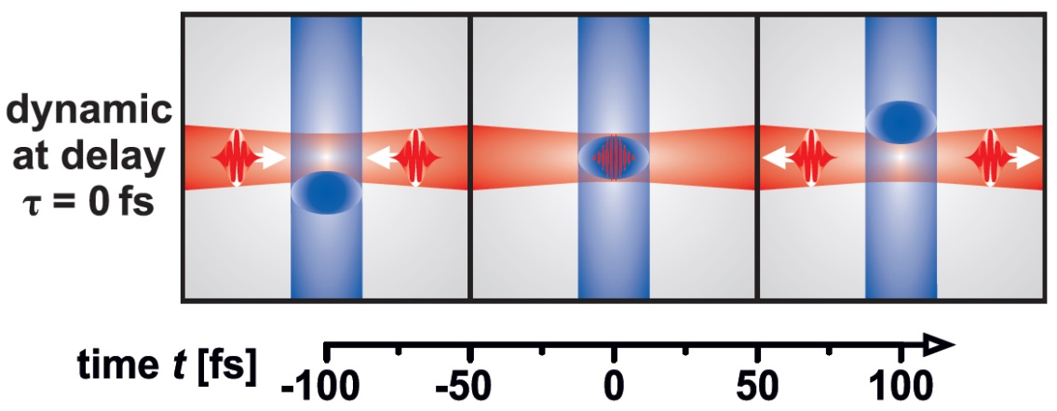
grating enhanced
ponderomotive scattering
temporal resolution
experimental parameters:
energy per pulse: ~ 100 µJ
lens focal length: 300 mm
1/e² focal radius: 33 µm
R. J. D. Miller and coworkers,
Optics Express 16, 3334 (2008)
temporal resolution studies

Slide 15
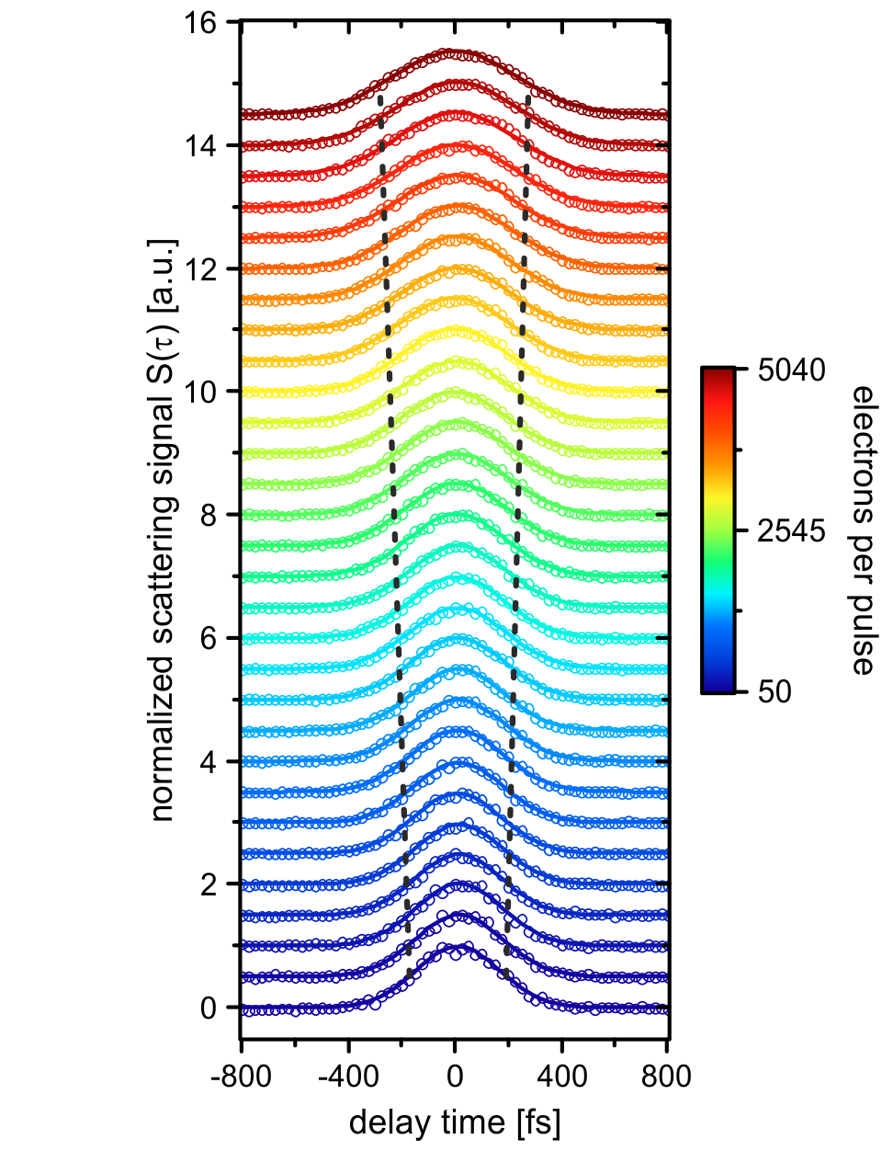
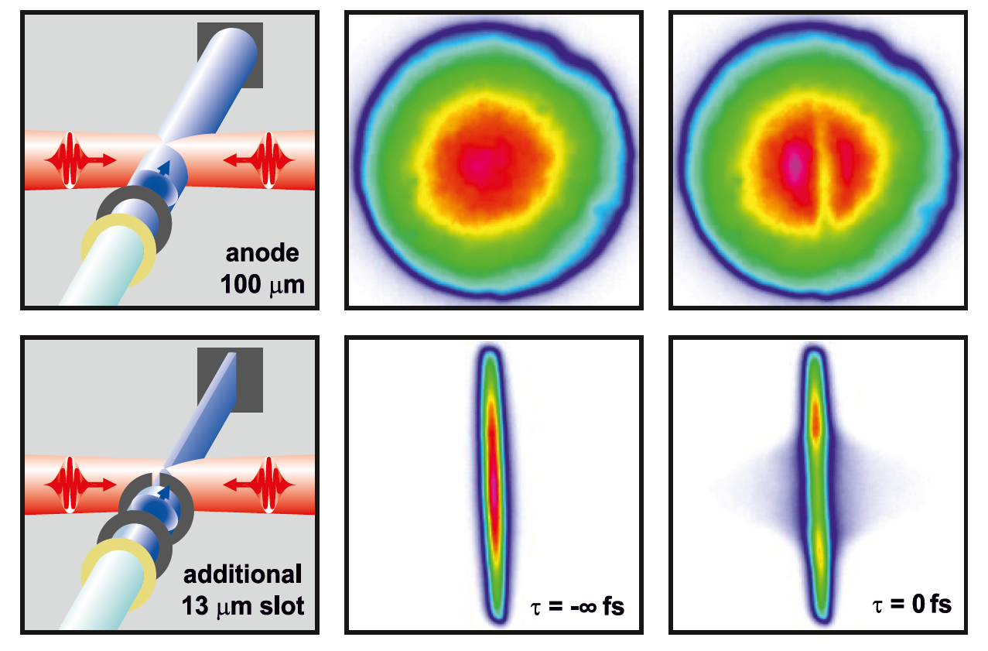
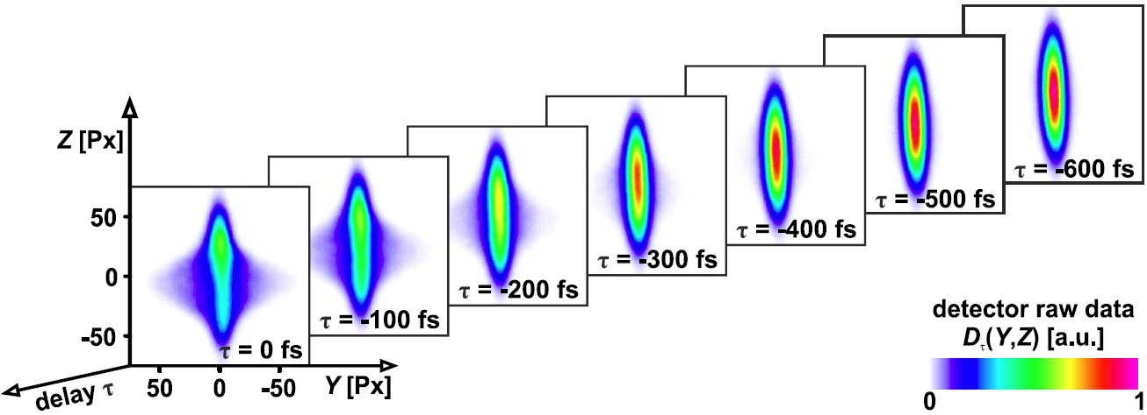
grating enhanced
ponderomotive scattering
experimental parameters:
energy per pulse: ~ 100 µJ
lens focal length: 300 mm
1/e² focal radius: 33 µm
$$S\left(τ\right)=\int{\left|Y\right| D_{τ}\left(Y,Z\right) dYdZ}$$
$$σ_{e}=\sqrt{σ_{S\left(τ\right)}^{2}−{{\left(\frac{σ_{f}}{v_{e}}\right)}^{2}−σ}_{l}^{2}}$$
temporal resolution studies

Slide 16
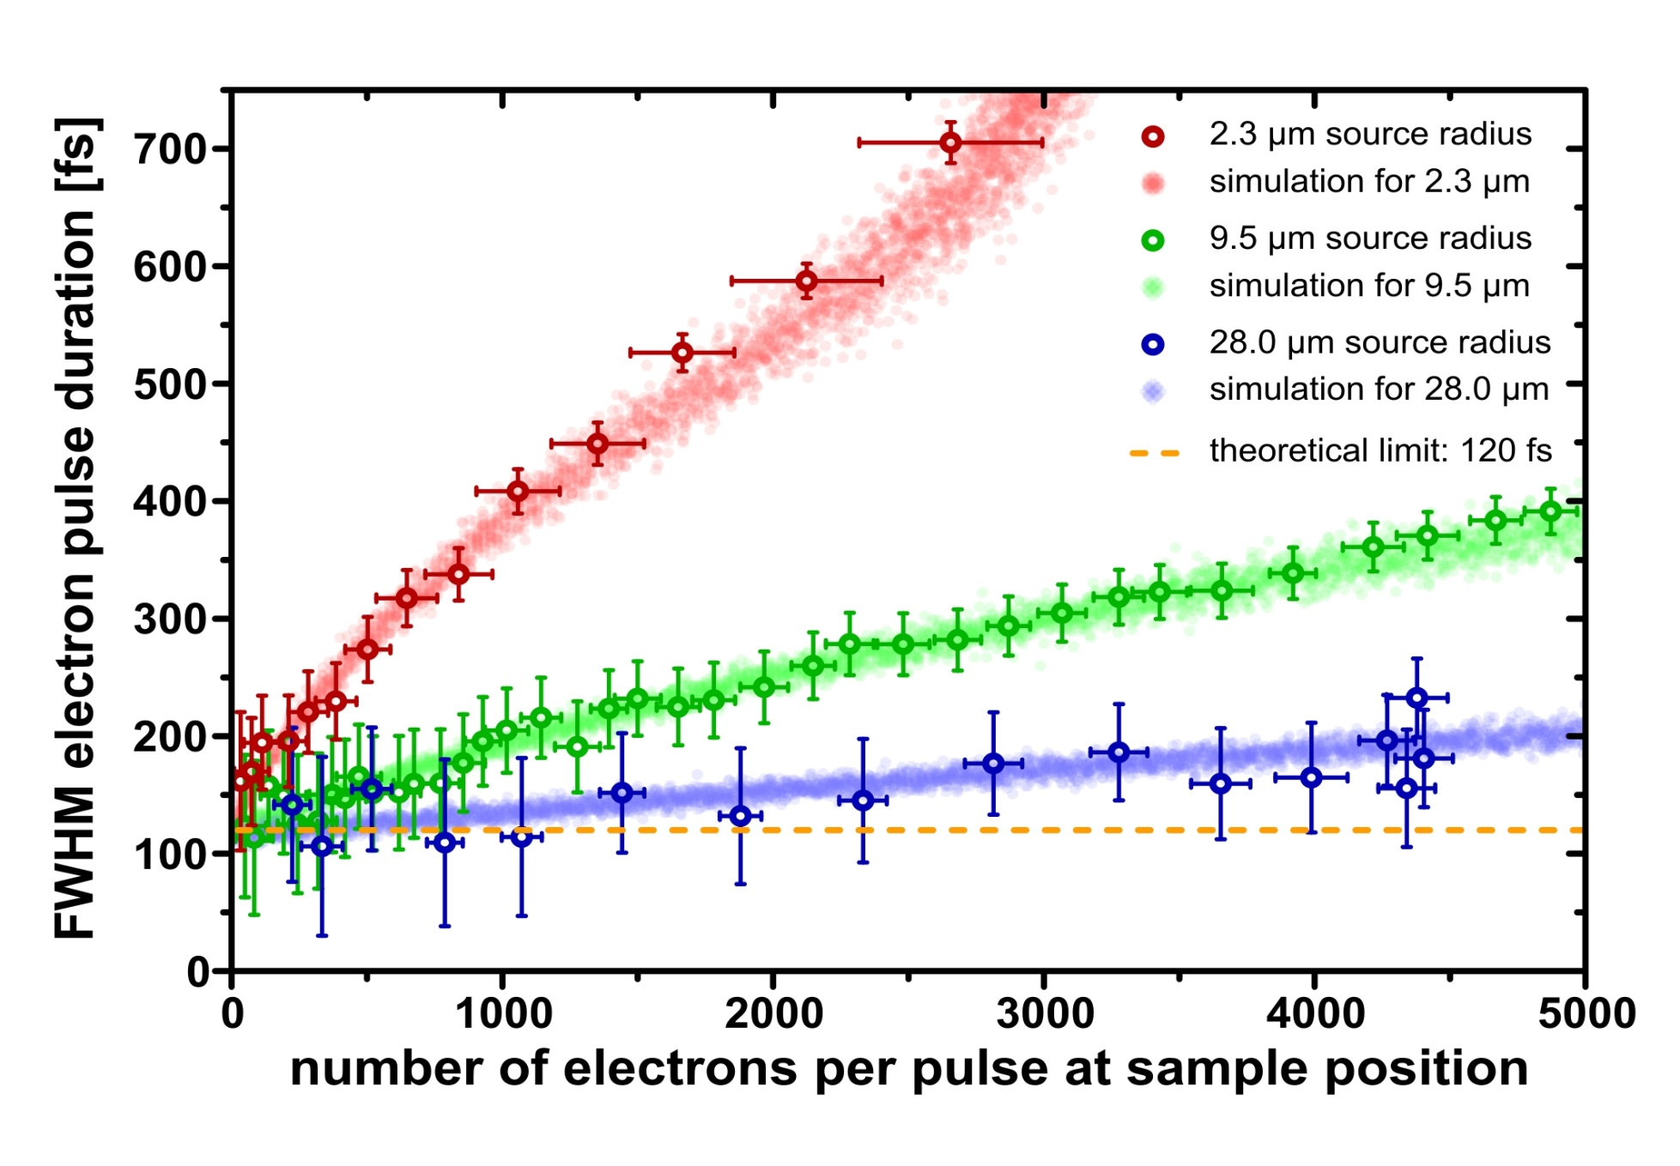
electron pulse duration at sample position
2.3 µm
9.5 µm
28.0 µm
temporal resolution studies

Slide 17
temporal pulse
characterization
UED setup and
spatial resolution
lattice dynamics
in graphite

Slide 18
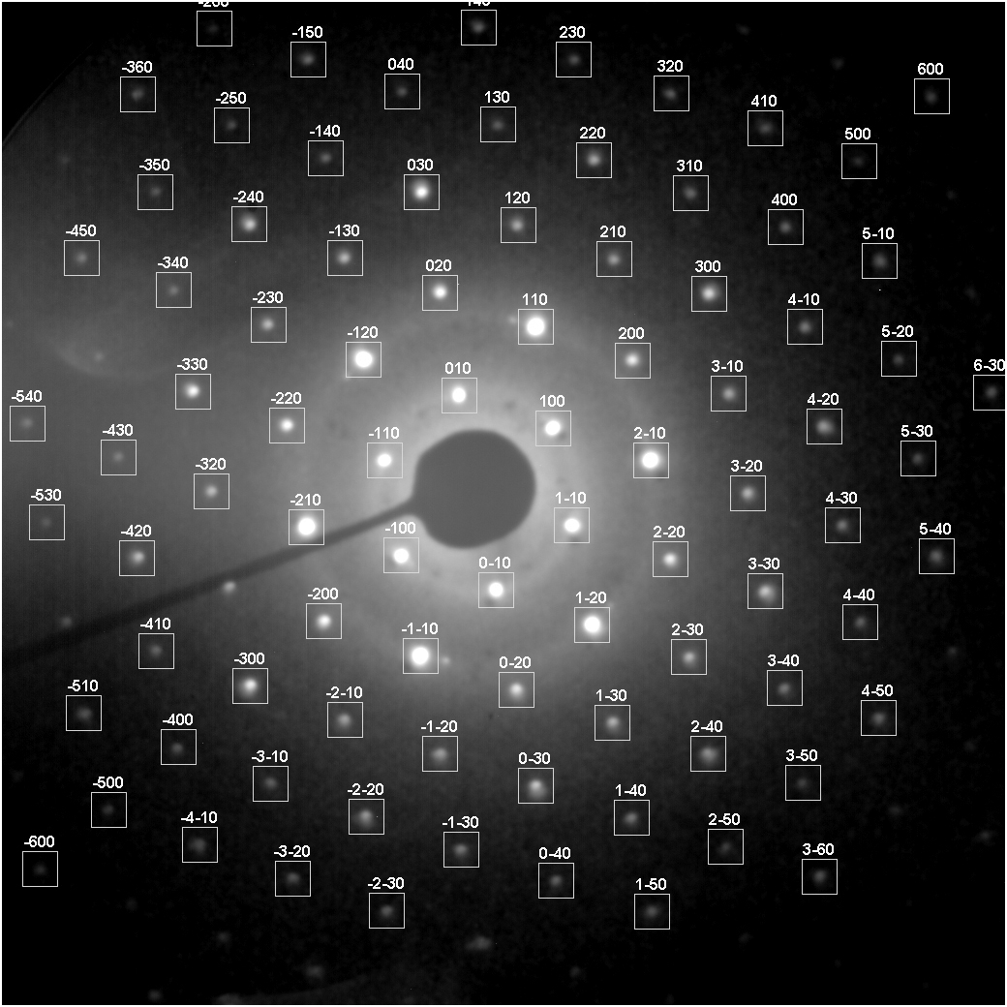
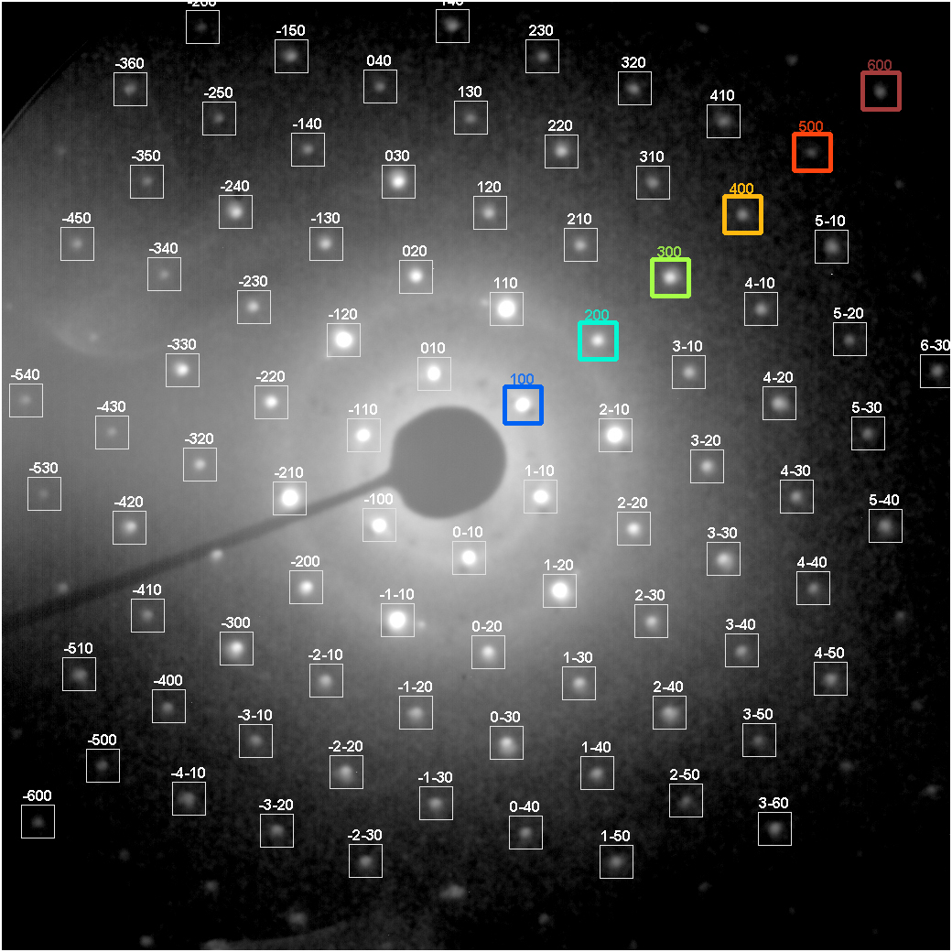
lattice dynamics in graphite
Notes:
setup overview

Slide 19
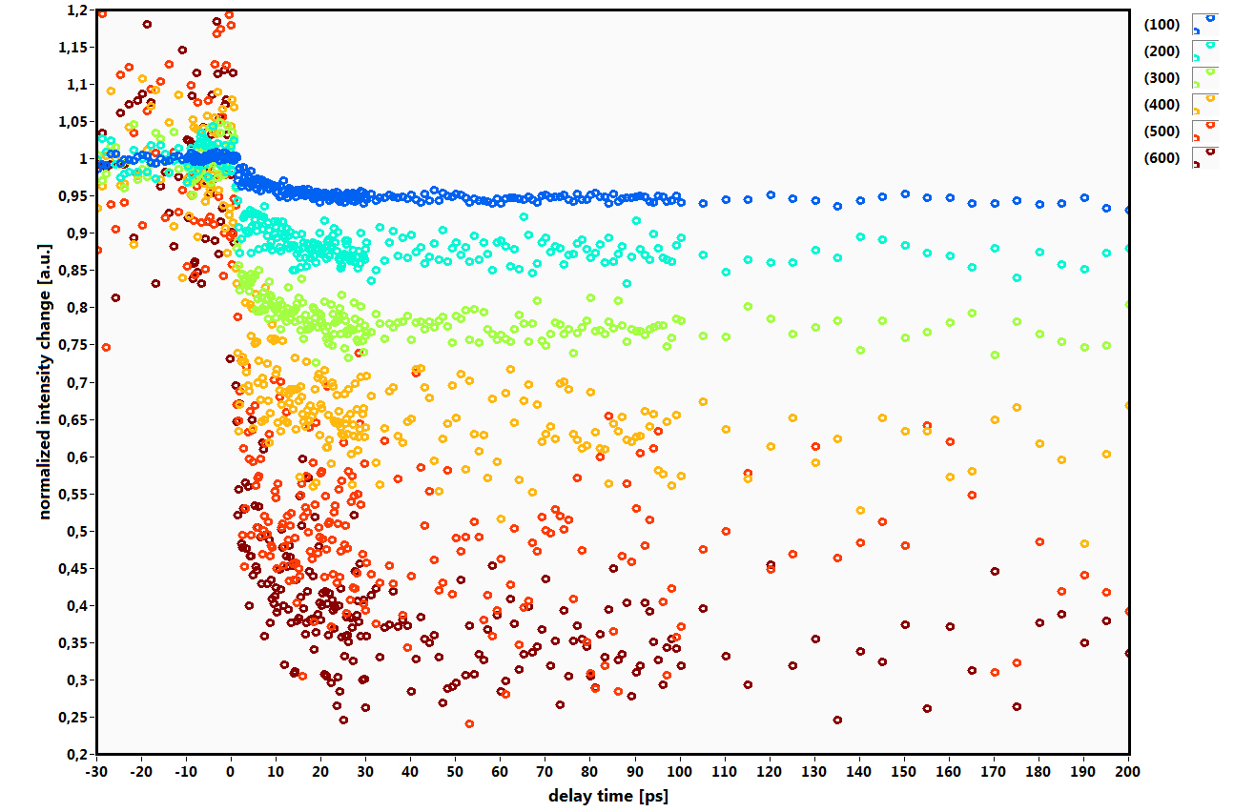
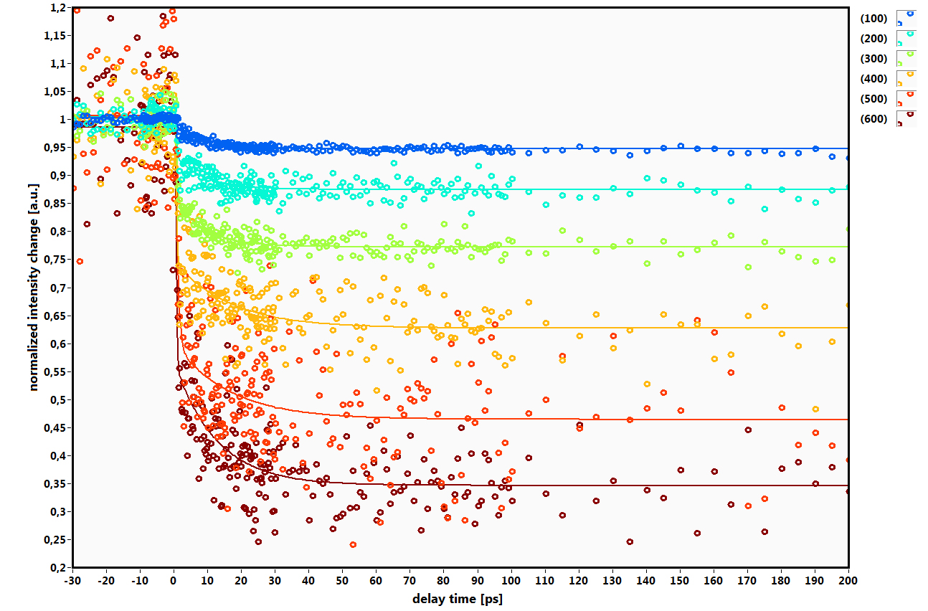
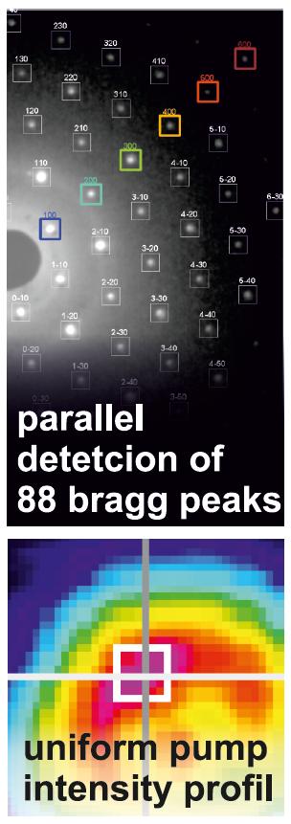
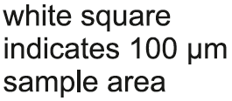
lattice heating dynamics
lattice dynamics in graphite

Slide 20
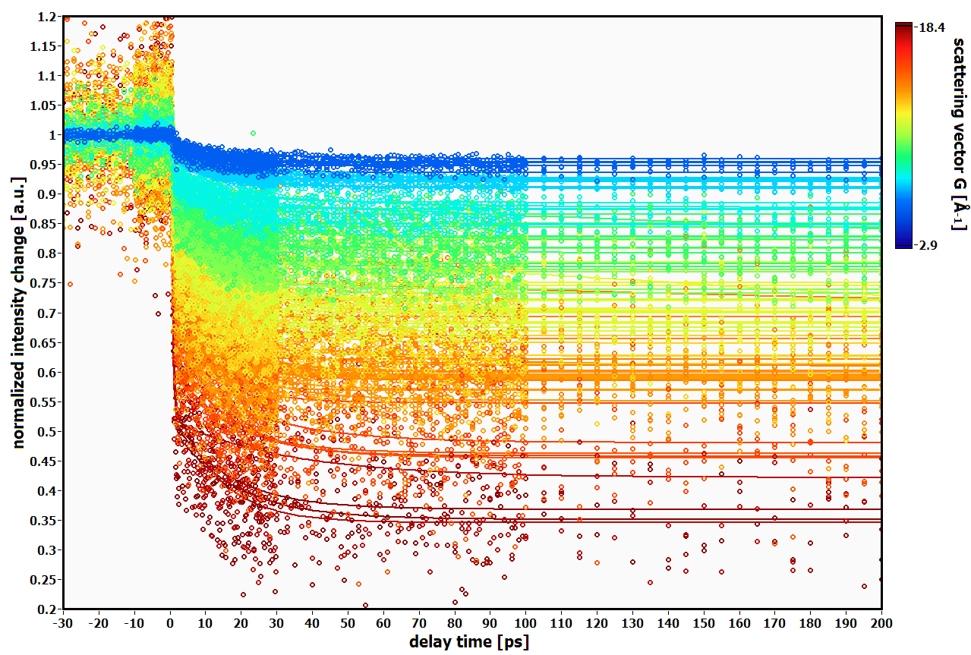
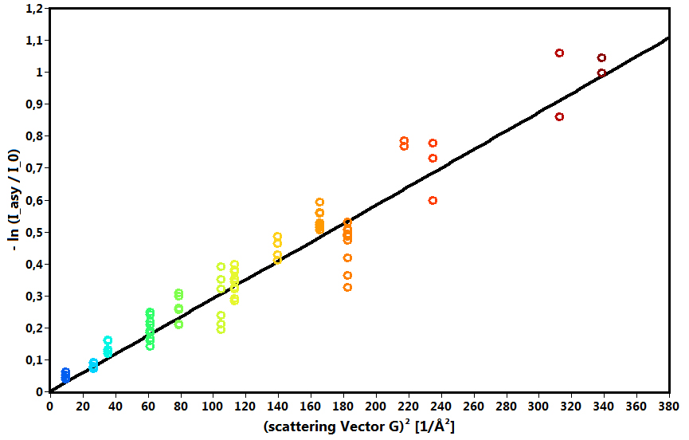
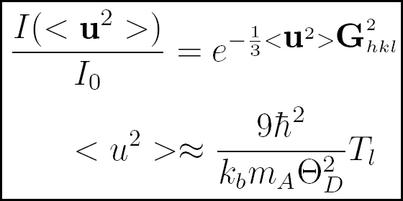
Debye-Waller effect
final lattice temparture from intensity drop: 1227 K
theoretical final temperature (laser fluence 6.7 mJ/cm²): 1135 K
lattice dynamics in graphite

Slide 21
ultrafast lattice dynamics
lattice dynamics in graphite

Slide 22
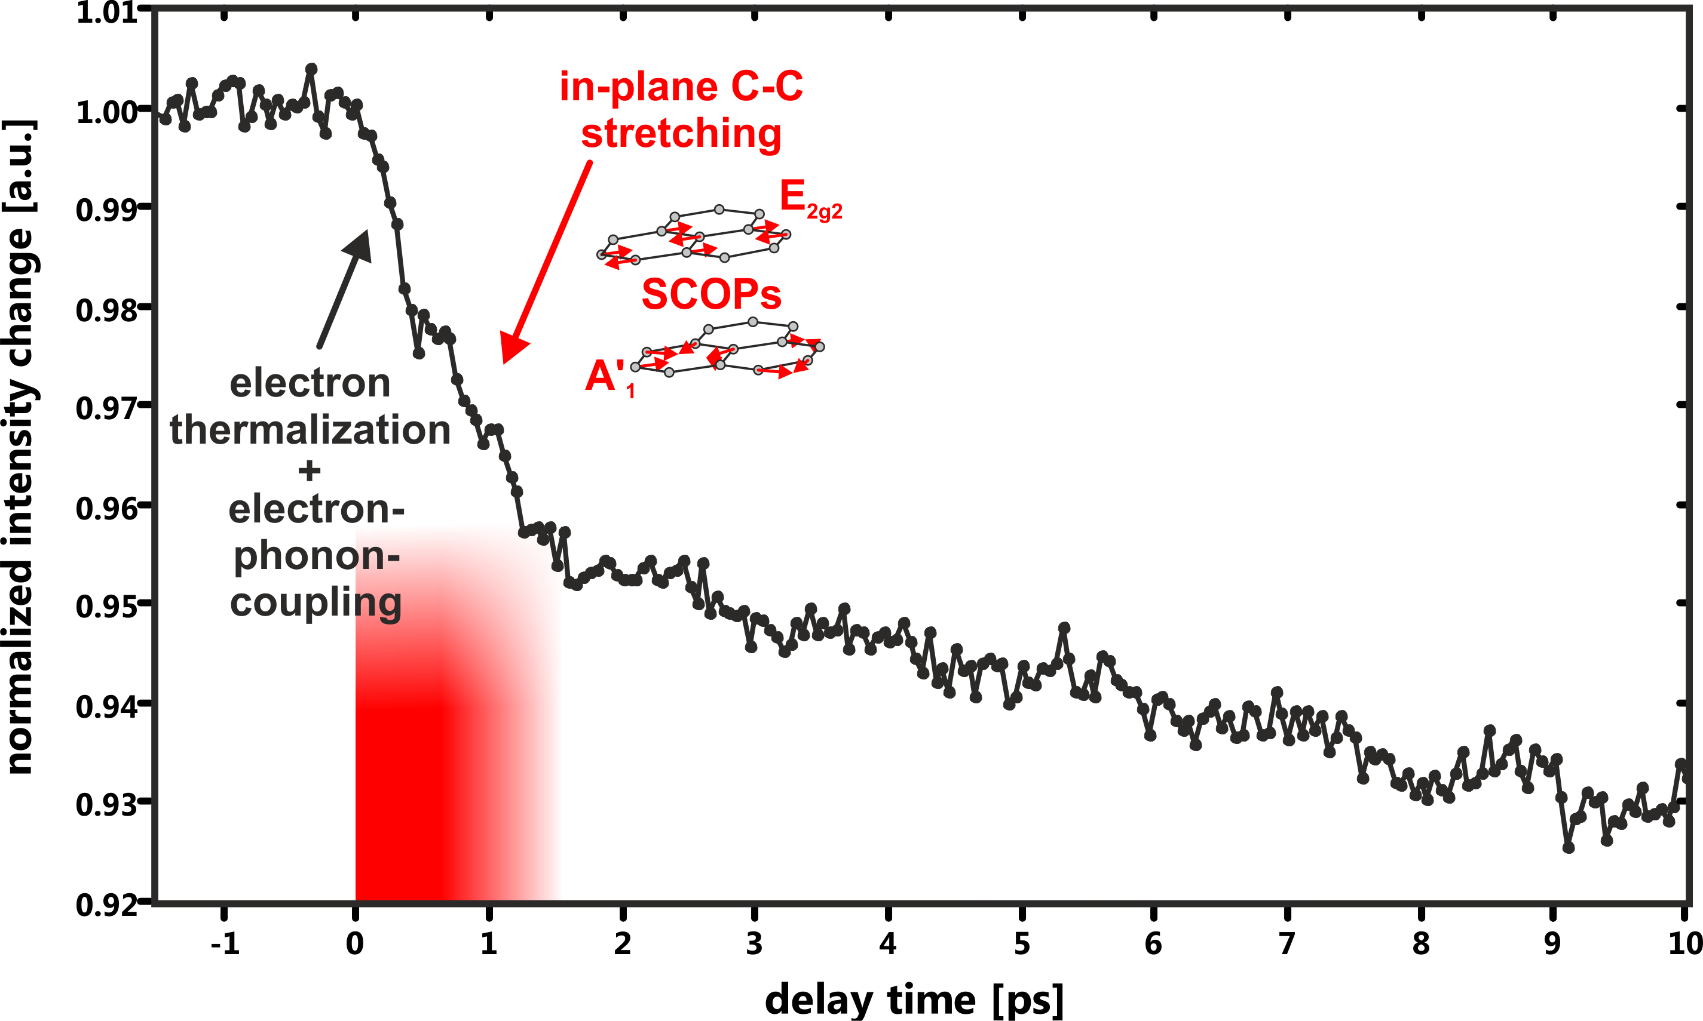
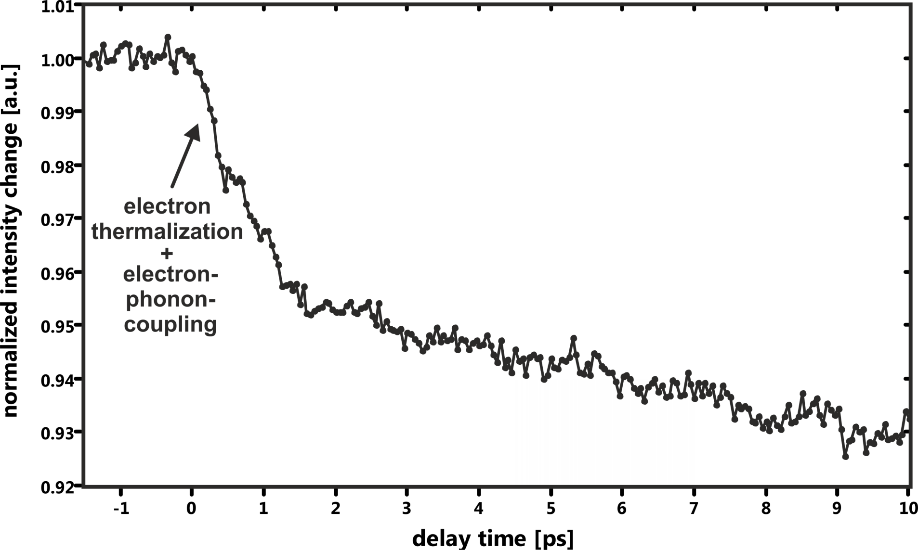
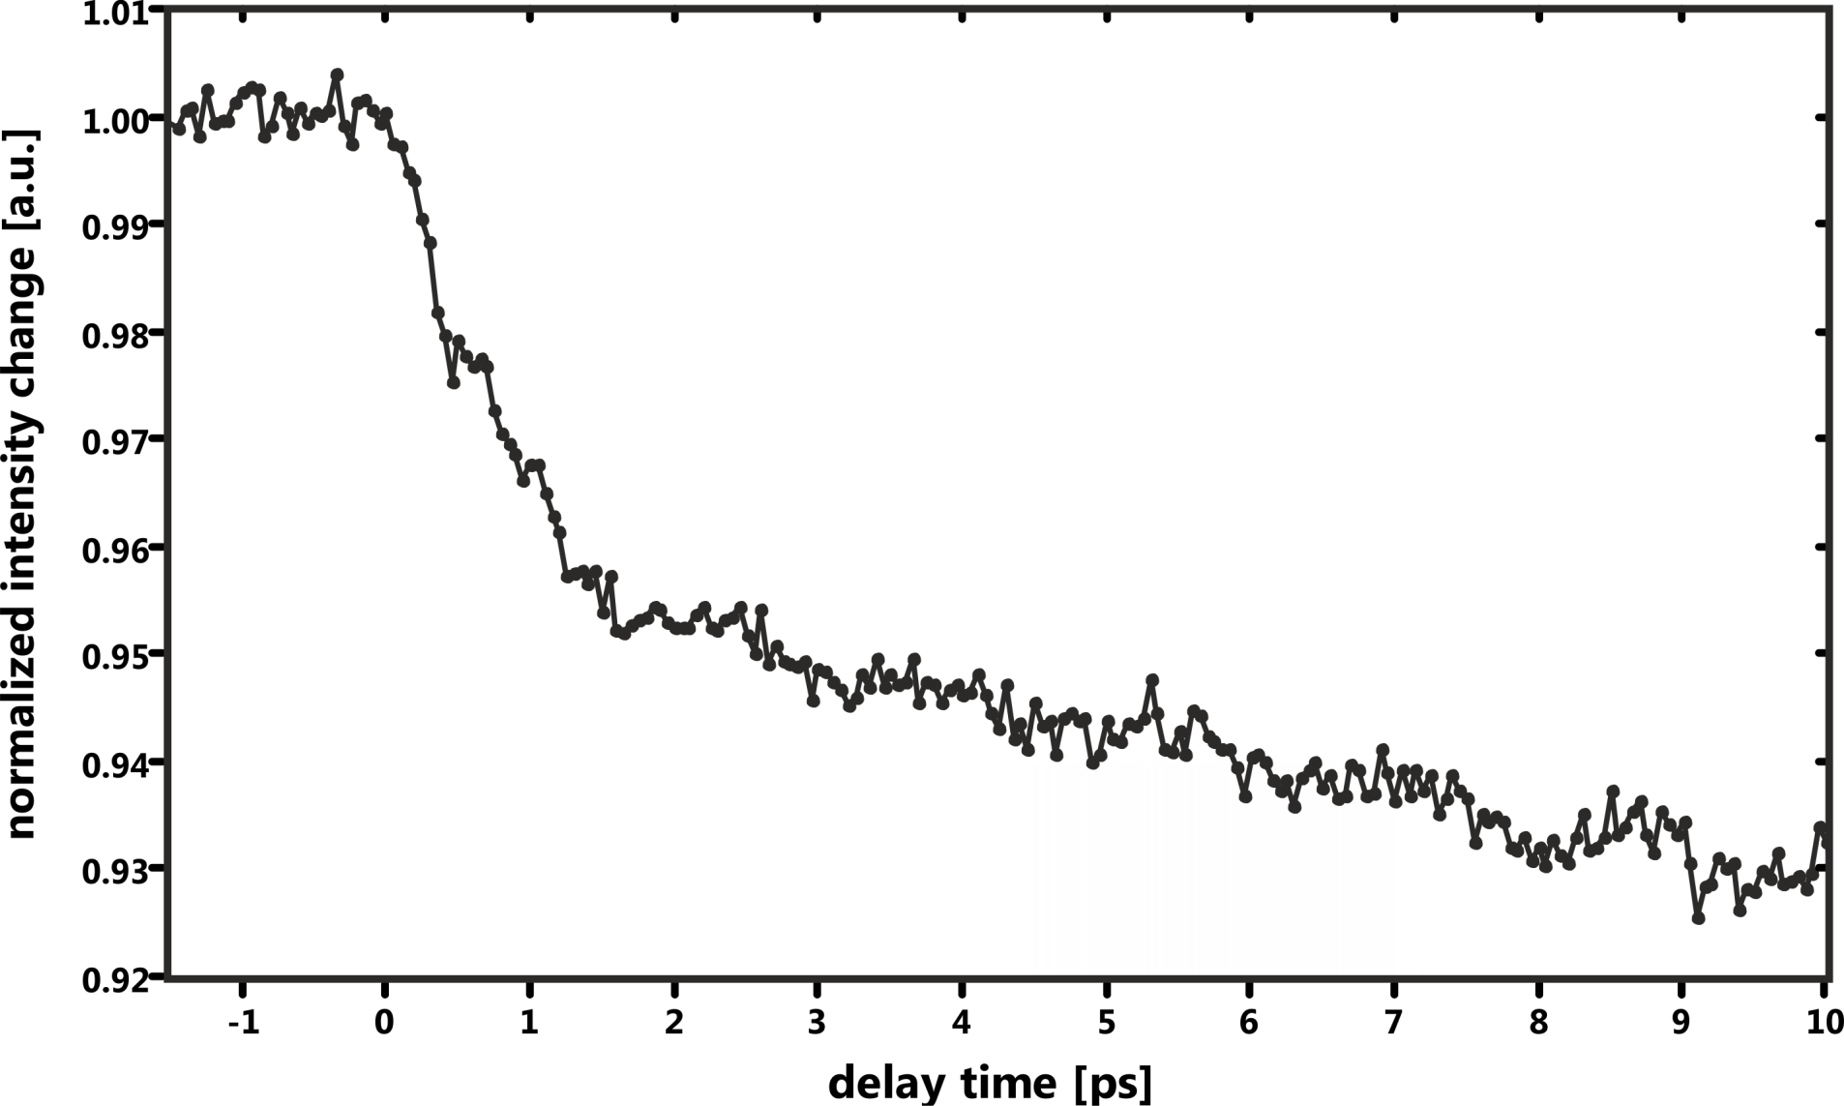
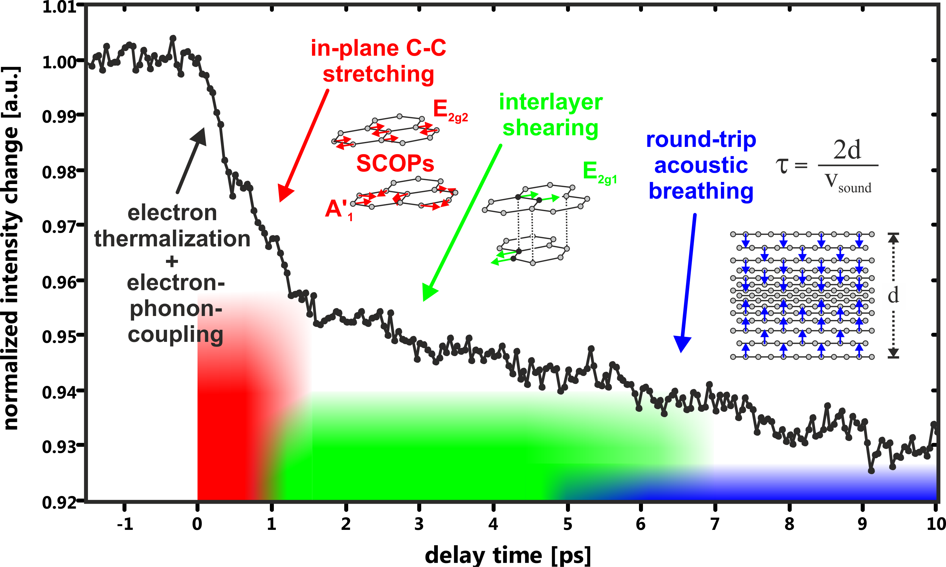
phonon decay channels
?
lattice dynamics in graphite

Slide 23
coherenct acoustic phonons
lattice dynamics in graphite

Slide 24
coherenct acoustic phonons
lattice dynamics in graphite

Slide 25
coherenct acoustic phonons
lattice dynamics in graphite

Slide 26
setup and
spatial resolution
temporal pulse
characterization
lattice dynamics
in graphite
summary

Slide 27
Prof. Dr. Thomas Baumert
Dr. Arne Senftleben
Petra Kasper
Ute Meier-Dietrich
Cristian Sarpe
Silvio Morgenstern
Marlene Adrian
Xaver Holzapfel
Vanessa Sporleder
Hendrike Braun
Nadine Götte
Tillmann Kalas
Jens Köhler
Christian Lux
Jutta Mildner
Stefanie Züllighoven
Dirk Otto
Bastian Zielinski
Dominik Pengel
Thomas Winkler
Philipp Hillmann
Thanks to the group…

Slide 28
…and thank you very much
for your kind attention !

