Slide 1
Laser / RF Timing (Engineering of Femtosecond Timing Systems)
Josef Frisch
SLAC

Slide 2
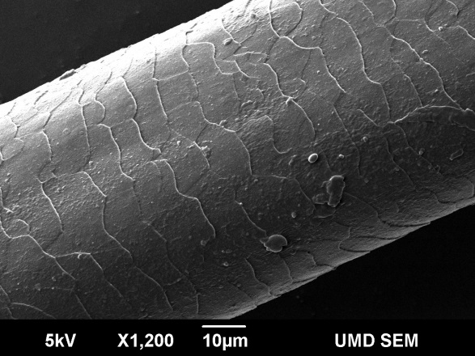
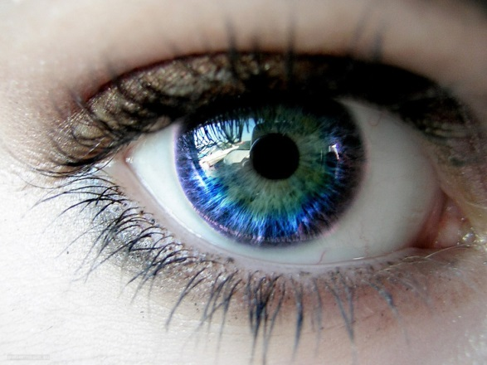
Femtoseconds
70fs
½ human hair
at C
Bryan Bandli, Scanning Electron Microscopy Laboratory, University of Minnesota
0.1 second
5000 Years
70 femtoseconds
Eye blink
1 Meter of typical engineering material will change length by 30fs/°C

Slide 3
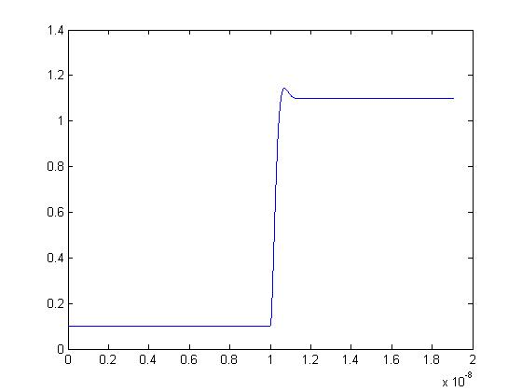
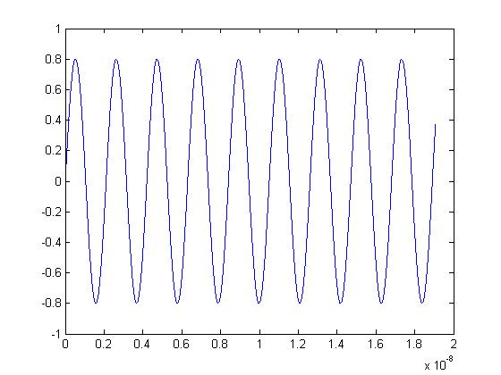
Measuring Femtoseconds - Narrow Band Clocks
Conventional electronic triggers only good to ~1ps.
Use repetitive clock to average timing measurements on millisecond timescales to allow X1000 improvement using GHz clocks

Slide 4
Why use RF?
Thermal noise (at room temperature) is -174dBm in a 1Hz bandwidth
In a 1 KHz bandwidth, thermal noise is -144dBm or 4 Attowatts
A 1 mW , 1KHz bandwidth, 10dB noise figure system would have a signal to noise of 134dBm, corresponding to an amplitude signal to noise of 2x10⁻⁷. For a 1GHz system this is a timing noise of 30 attoseconds
Noise is rarely the only limit for measuring timing
Generally there is a trade-off between noise and linearity.
RF hardware is robust and relatively inexpensive.

Slide 5
RF Linearity
Amplitude to phase conversion is a major source of timing drift and noise
Typical phase detection frequencies are ~2GHz (ω=10GHz), so 100fs represents only 10⁻³ Radian
Very difficult to measure AM-> PM due to the lack of a method to produce amplitude variation without associated phase variation.
AM->PM is a form of nonlinearity, so it is possible to make an estimate by measuring other nonlinear terms (amplitude nonlinearity).
Linearity typically specified at IP3. (Third Order Intercept point): hypothetical power were the 3rd order nonlinear terms equal the linear terms.
Nonlinear terms scale (in dB) as 3X input power, so nonlinear contribution goes as 2X input.
20dB below the IP3 point is -40db nonlinearity, or 1% amplitude

Slide 6
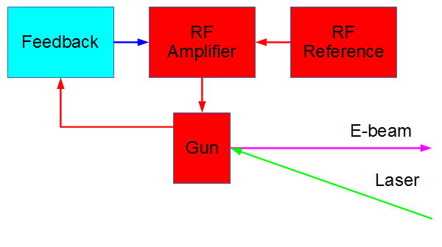
Accelerator Timing – RF Gun
RF time set by phase measurement using gun pick-off
Feedback can be pulse to pulse or continuous
Photo-emission typically off crest
Energy spread produces compression
For LCLS gun, beam time is equally controlled by laser and RF timing
Beam time is not completely determined by laser time
For a gun with no compression, locking isn’t needed!

Slide 7
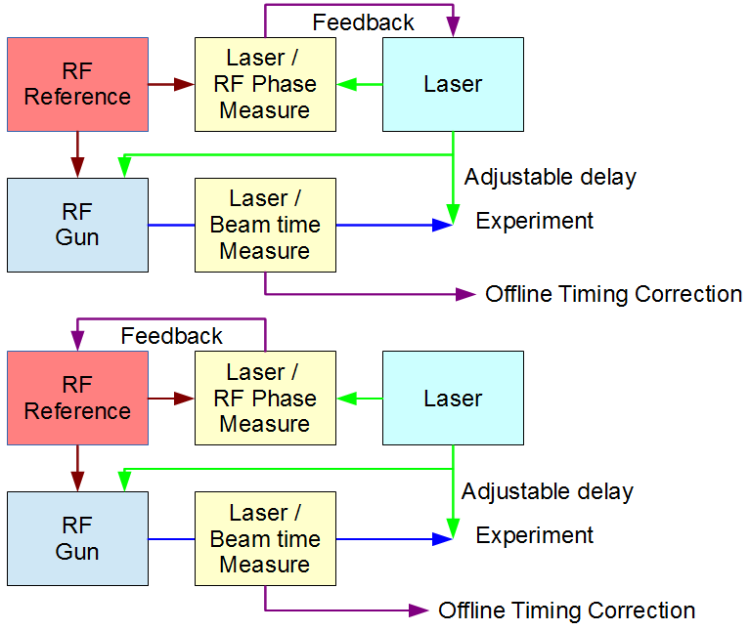
Choice depends on relative phase noise and modulation bandwidth of the laser and RF source.
For Ti:Sapphire lasers the phase noise is typically higher than for RF sources and usually the laser is locked to the RF master oscillator.

Slide 8
Laser Locking Systems
Most rely on locking the ~100MHz mode-locked laser oscillator to a reference signal
Commercial laser -> RF locking systems available at the ~100s of fs noise level
Can to better with custom systems
Ti:Sapphire lasers are the most commonly used, but fiber lasers have lower timing noise and are gaining popularity.
Significant variation in the unlocked noise of different laser oscillators – directly impacts locked performance

Slide 9
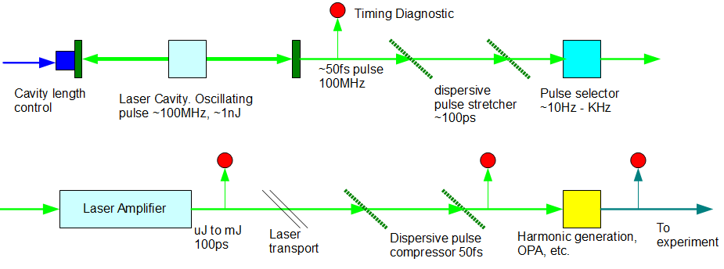
Laser Systems
Mode locked laser frequency -> phase determined by optical cavity length
Optical cavity length usually controlled with piezo-electric mirror
Pulses are stretched before amplification to avoid peak power damage
Stretching / amplification / compression can add significant jitter.

Slide 10
Phase Detection
Generally the most challenging part of the laser locking system
Laser diodes produce short (~100ps) pulses at fairly low rate (~100MHz)
Use bandpass filters to ring the signal into a near continuous RF tone
Filtering is worse for signal to noise, but better for linearity!
Resulting power can be very low (<microwatt), but still enough above thermal noise to do 10s of femtosecond phase detection.
Use a mixer to compare the phase with the reference system

Slide 11
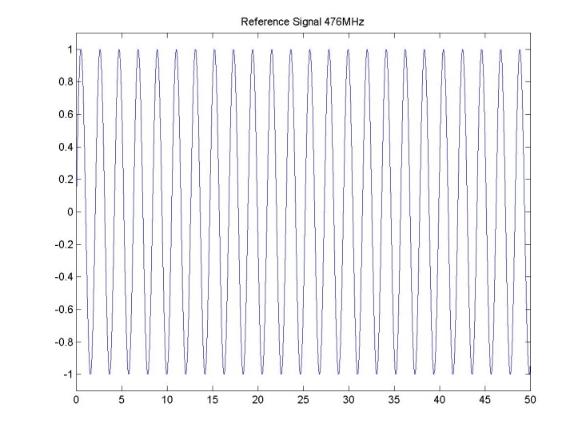
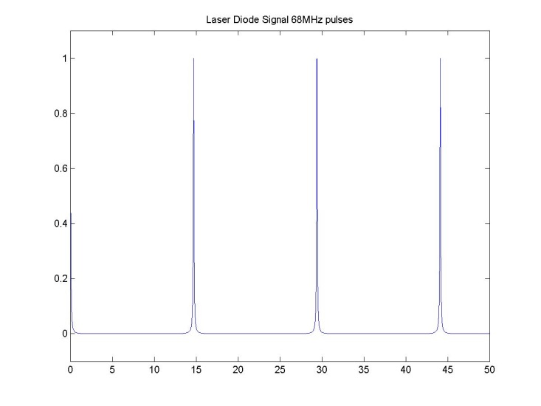
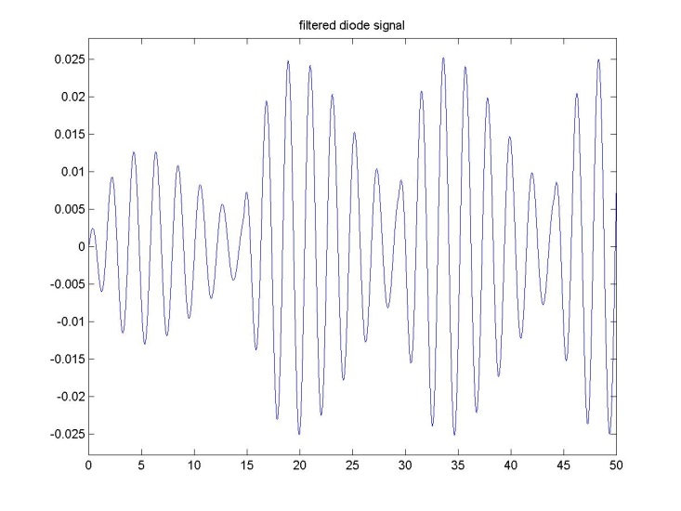
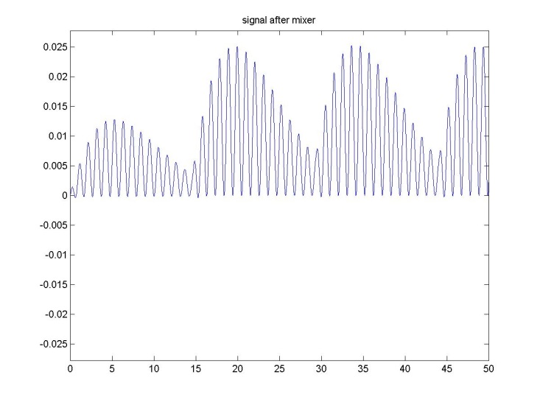
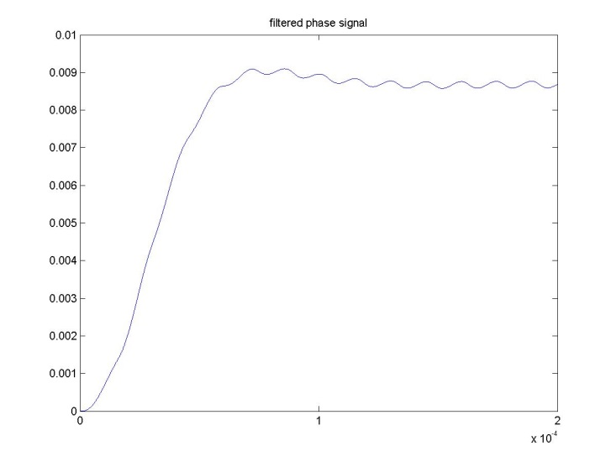
Photodiode Phase Detection Signals
Reference
Laser diode out
Filtered laser diode
Matlab calculation with 68MHz laser frequency and 476MHz locking frequency
Mixer output
LP filter output

Slide 12
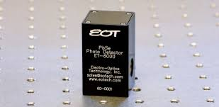
Photodiode Error Sources
Amplitude -> phase conversion
10GHz diodes typically biased at 5V
If peak output voltage becomes comparable to the bias, the capacitance of the diode can change and cause a phase shift
Remember that we are looking at timing shifts on the order of <1/1000 of the diode pulse width.
Position sensitivity
Typical 10GHz photodiode (ET-4000) has a 40micron diameter – corresponds to about 500fs for signals to cross the diode!
Improved diodes: High linearity fiber coupled diodes available.
Looks like an overall improvement
Needs care to have long term stable coupling to single mode optical fiber
Available from Discovery Semiconductor. (IP3 > 40dBm!)

Slide 13
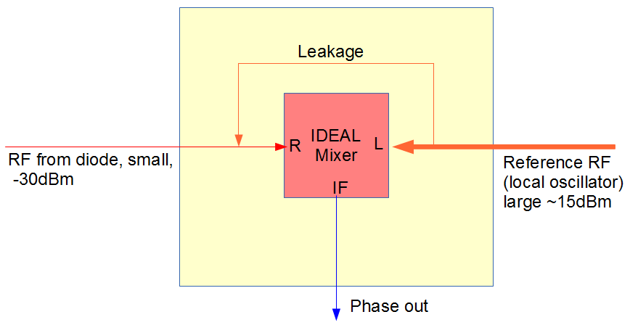
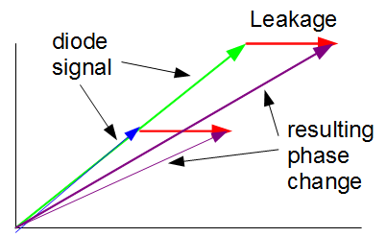
Mixer LO Leakage Errors
A small amount (~-30dB coupling) of the high power LO reference will leak into the low power RF input
This causes a shift in phase of the input RF signal from the diode that depends on the amplitude of the RF signals
Since LO is usually stable, can make feedback setpoint to be the offset from the LO.
Can improve by using high gain amplifiers on the diode signal, BUT
IP3 limits in the mixer andhigh gain systems can have cross talk from other signals

Slide 14
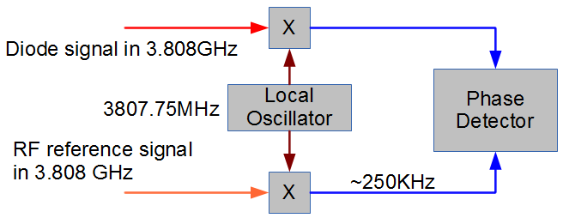
Heterodyne System
Mix to an intermediate frequency rather than DC (frequencies from SLAC system)
Low frequency phase detection much easier:
Can easily digitize and calculate relative phase in software
Can use low frequency mixer or analog multiplier with much better performance than RF mixer
Signal levels small until RF mixer, then put gain at low frequency where cross talk is less significant.
Technique used in radio receivers (R. Fessenden , 1901 (!!!))

Slide 15
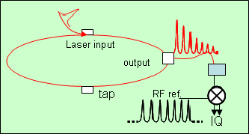
Multiplying the Laser Rate
Potential to significantly improve noise / linearity of diode detection systems
Adds some optical system complexity
M. Csatari Divall1 et al.

Slide 16
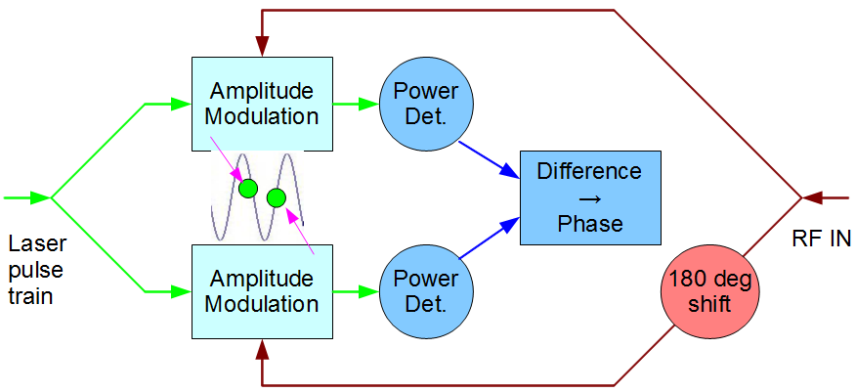
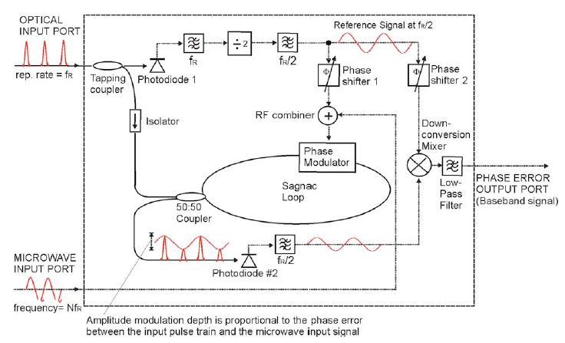
Electro-optical phase detection
Electro-optical modulator “multiplies” RF signal X optical signal – acts like a mixer
Commercial devices available to very high bandwidth (~50GHz)
Optical signal detection is low frequency, can use large diodes that can tolerate high signal levels -> good signal / noise / nonlinearity
Techniques to correct for amplitude drift and fiber length changes
Concept: differential measurement immune to RF amplitude and opitcal power drifts
Sagnac interferometer uses single phase modulator and fiber loop to cancel fiber length drifts, and detector offset drifts.

Slide 17
Diode detector vs electro-optical phase detection
Similar detection frequencies – 10s of GHz
Photodiode
Signal limited by diode non-linearity
Bandpass filter reduces signal
RF noise limits to ~1fs in 10Khz bandwidth
Sensitive to laser amplitude fluctuations
Electro-optical
Signal limited by max power in fiber (~100pJ)
Shot noise limits theoretical resolution to ~0.1fS in 10KHz bandwidth
Sensitive to laser wavelength changes
In practice other system effects are usually the limit well before you reach 1fs.

Slide 18
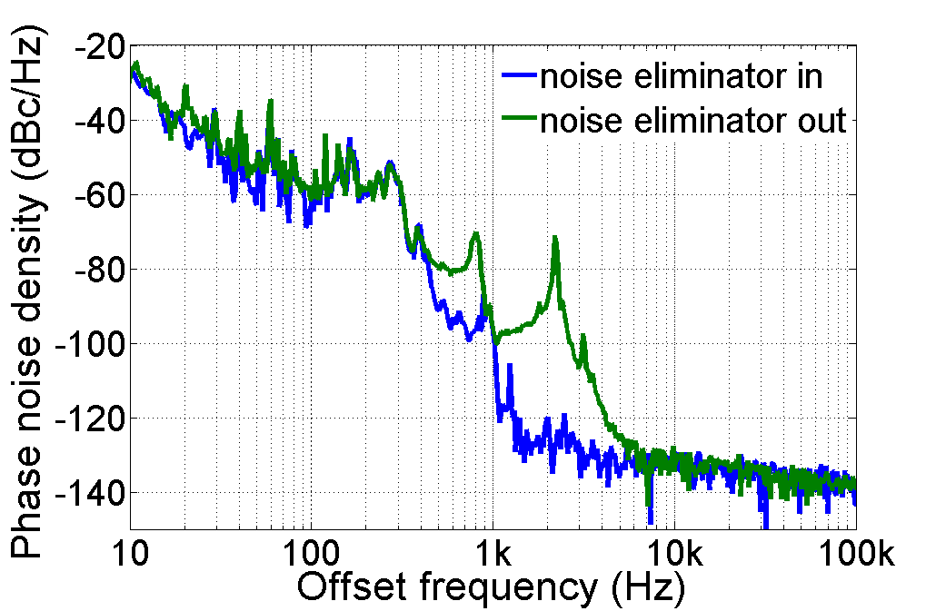
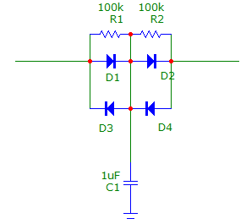
Laser Phase Control
Laser cavity length controlled by piezo-electric driven mirror in most commercial femtosecond lasers.
Typical resonance of 10s of KHz sets upper bandwidth limit for feedback – feedback usually rolled-off at few-10 KHz
Need high current, low noise drive amplifier
Beware of noise sources – found that in Coherent Vitara lasers the largest noise source was the driver for the low bandwidth piezo “starter” mirror
Fixed with diode circuit to block noise:
Don’t miss the simple stuff!!!

Slide 19
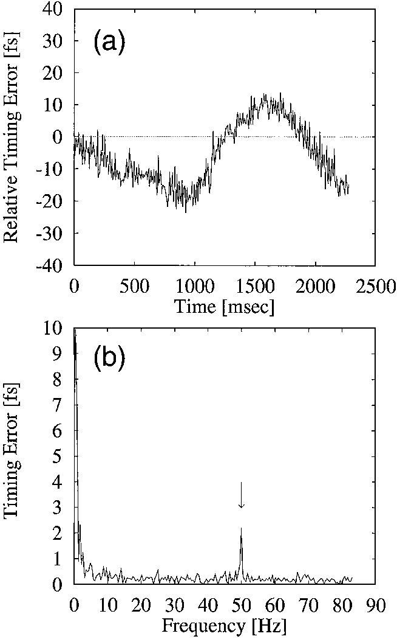
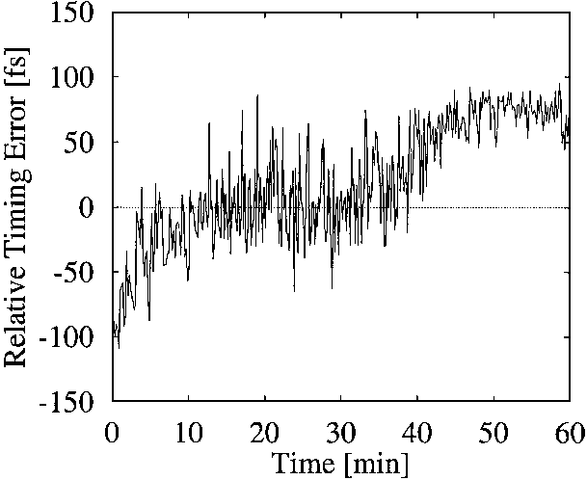
Laser Amplifier and Transport
In installed systems the laser amplifier / transport chain appears to add substantial jitter:
SLAC / MEC: oscillator / FEL jitter < 100fs, but measured optical to X-ray jitter >150fs
PSI: Oscillator jitter < 30fs, amplified pulse jitter >150fs (Divall Marta et al)
100s of fs increased jitter seen at Max Plank
Short term jitter relative to mode-locked laser ~10fs
T Mirua, et al December 15, 2000 / Vol. 25, No. 24 / OPTICS LETTERS 1795
Long term drift 100fs/hour

Slide 20
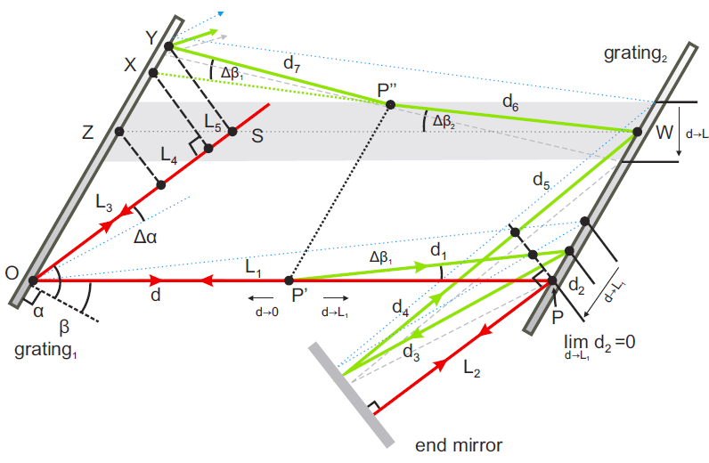
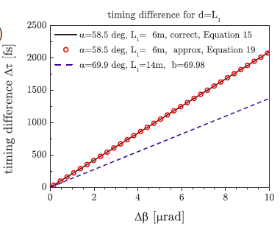
Compressor / Expander
Steering due to air currents in compressor can cause ~100fs/microradian timing shifts.
Experimental and theoretical investigation of timing jitter inside a stretcher-compressor setup. Sandro Klingebiel, et al, 13 February 2012 / Vol. 20, No. 4 / OPTICS EXPRESS 3443

Slide 21
Timing Corrections
Amplifier / transport chain:
Can use an optical cross-correlator to compare the mode-locked laser time with the output of the amplified system
E-beam arrival time monitors
Resonant cavities – demonstrated at SLAC to 7fs RMS (at 150PC), 20fs RMS at 20pC
Electro-optical arrival time monitors – Demonstrated at DESY to 3fs RMS at 300pc.
Transverse cavity deflectors – timing resolution limited by RF system noise ~30fs, work at low charges.
Can be used for offline correction of experiment data

Slide 22
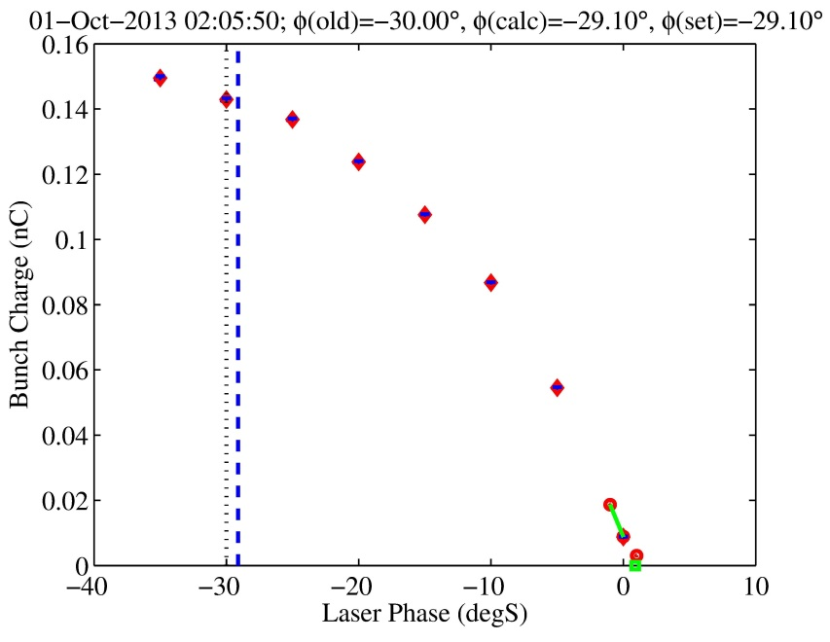
“Physics” Timing
For RF guns, the charge depends on the relative phase of the RF fields and the laser
If QE is stable, you could feedback laser time on photocathode current!
Can move to zero-current phase (Schottky edge) to find “zero” time in a few seconds (done at LCLS)
The experimental chamber will need to provide a way to find zero-time.
Separate “experiment” setup or possibly from the main experiment.
The time between finding T0 will determine the long term drift requirements

Slide 23
Comments
Below 100fs things become more difficult, 10fs is fairly heroic.
Laser locking systems can be complex and expensive – especially on the scale of electron diffraction experiments
Don’t build a more complex system that you need
Most straightforward approach is to lock the laser oscillator to the accelerator RF reference using photodiodes
Can use beam arrival time monitors and cross-correlators to correct experiment data offline.
Added costs and complexity
Where possible use physics measurements to directly measure timing.
Many sub-systems, concentrate on the ones that limit performance, not the most interesting ones: Timing is a tool, not an experiment

