Slide 1



Exact theoretical description of pump-probe experiments in charge-density-wave insulators
J. K. Freericks
Georgetown University
In collaboration with Tom Devereaux, Yizhi Ge, H. R. Krishnamurthy, Amy Liu, and Wen Shen
J. K. Freericks, Georgetown University, FEIS 2013 workshop

Slide 2
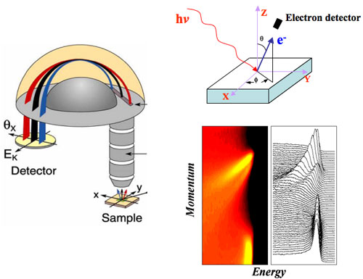
Modern angle resolved photoelectron spectroscopy
Continuous beam ARPES only measures information about the occupied states in equilibrium.
(Images from Z.-X. Shen’s group)
J. K. Freericks, Georgetown University, FEIS 2013 workshop

Slide 3
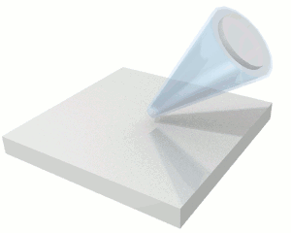
Time-resolved pump/probe photoelectron spectroscopy
Pump the system into an excited nonequilibrium state with an intense pulse of light.
Probe with a short pulse of light energetic enough to photo-emit electrons.
Schematic of a TR-PES experiment
(from Z.-X. Shen’s group)
J. K. Freericks, Georgetown University, FEIS 2013 workshop

Slide 4
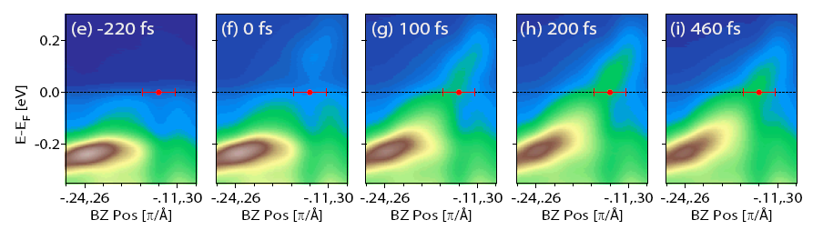
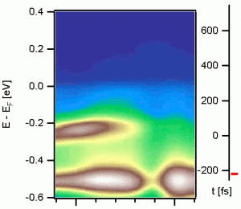
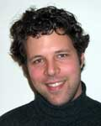
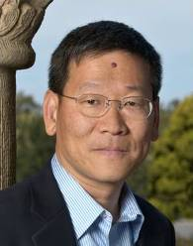
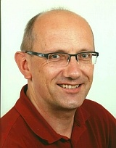

TR-PES on TbTe₃
Experimental results by Schmitt et al. Science 321, 1649 (2008)
J. K. Freericks, Georgetown University, FEIS 2013 workshop

Slide 5
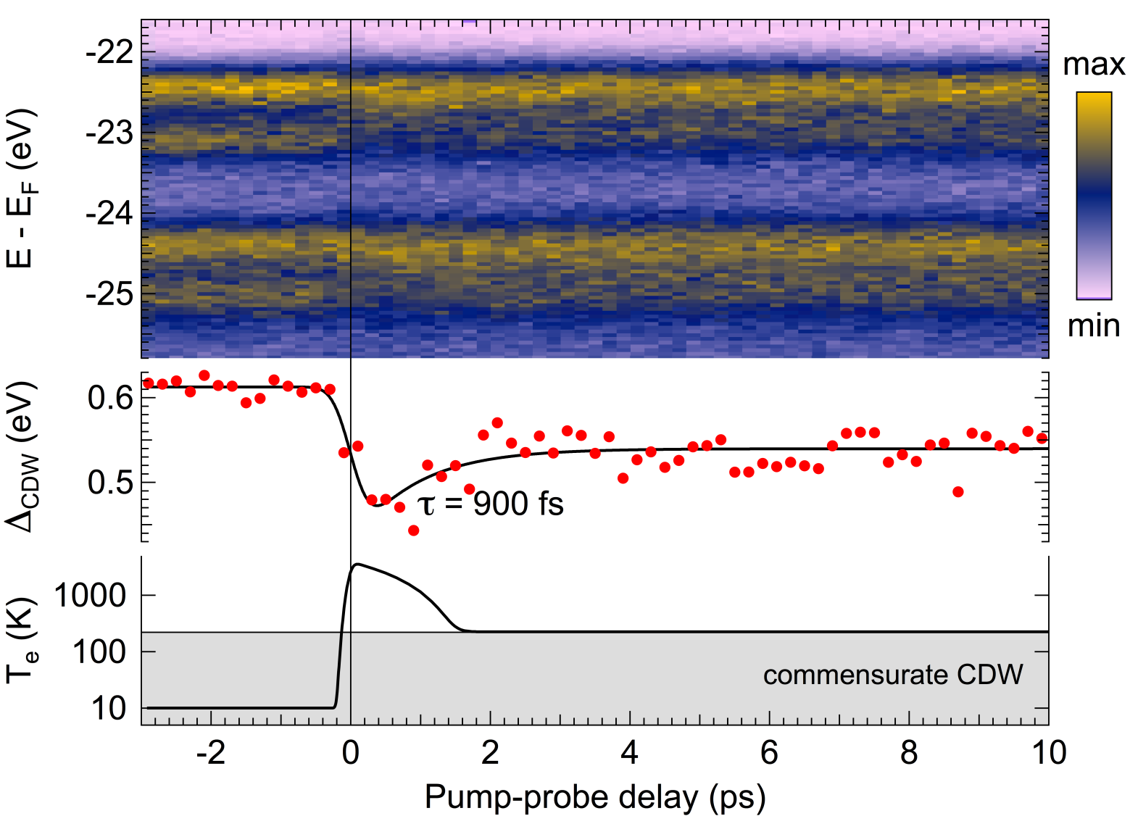
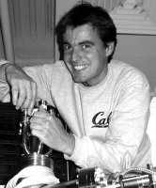
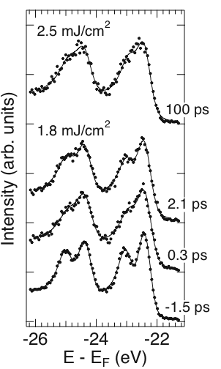
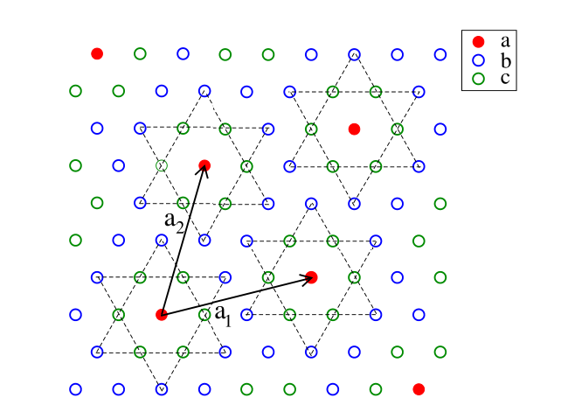
Ultrafast melting of a CDW (TaS₂)
Expt by Rossnagel’s group
PRL 105, 187401 (2010).
J. K. Freericks, Georgetown University, FEIS 2013 workshop

Slide 6
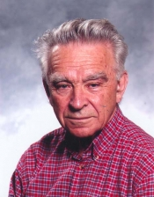
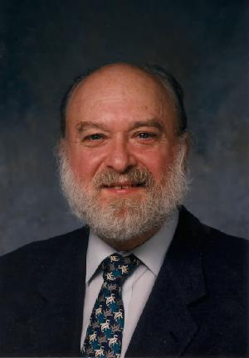
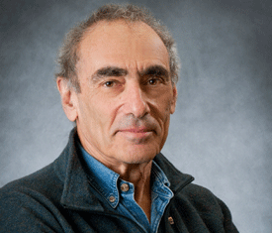
Ultrafast theory
Work with quantities on the Keldysh-Kadanoff-Baym contour. Exact solutions possible with dmft and other methods. Here, the system is noninteracting, so solvable.
Calculations become expensive!
J. K. Freericks, Georgetown University, FEIS 2013 workshop

Slide 7
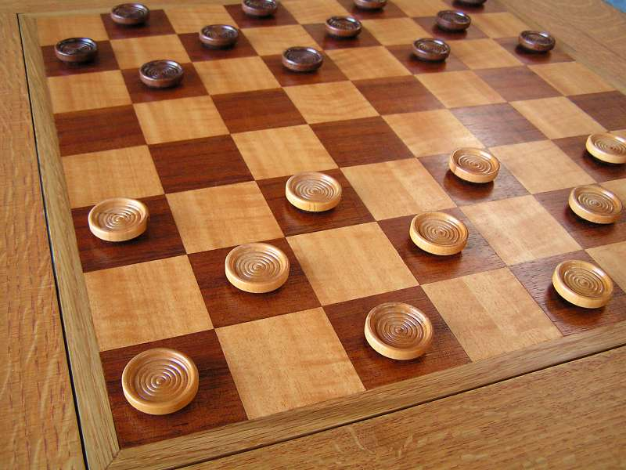
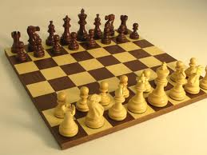
Simplest Model of a CDW insulator
J. K. Freericks, Georgetown University, FEIS 2013 workshop

Slide 8
Peierl’s substitution and the Hilbert transform
The band structure is a sum of cosines on a hypercubic lattice:
which becomes the sum of two “band energies” when the field lies in the diagonal direction after the Peierl’s substitution.
These band energies have a joint Gaussian density of states, so a summation over the Brillouin zone can be replaced by a two-dimensional Gaussian-weighted integral (in infinite dimensions).
Full gap
Gap reforms
J. K. Freericks, Georgetown University, FEIS 2013 workshop

Slide 9

Hamiltonian for the CDW
k is coupled to k+Q
Get two bands
Note: instantaneous bandstructure is independent of time!
J. K. Freericks, Georgetown University, FEIS 2013 workshop

Slide 10
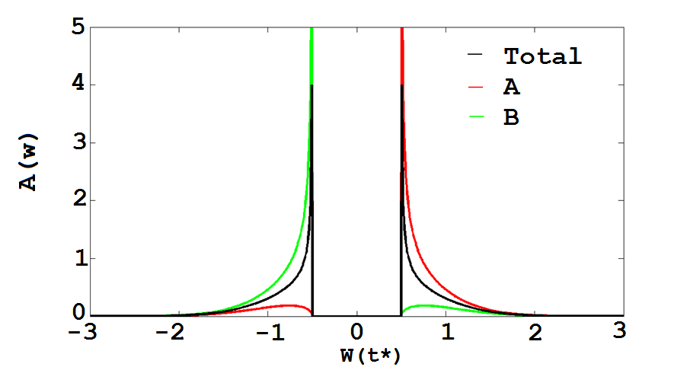


Equilibrium Features: local DOS
U=1
Full gap
Gap reforms
J. K. Freericks, Georgetown University, FEIS 2013 workshop

Slide 11
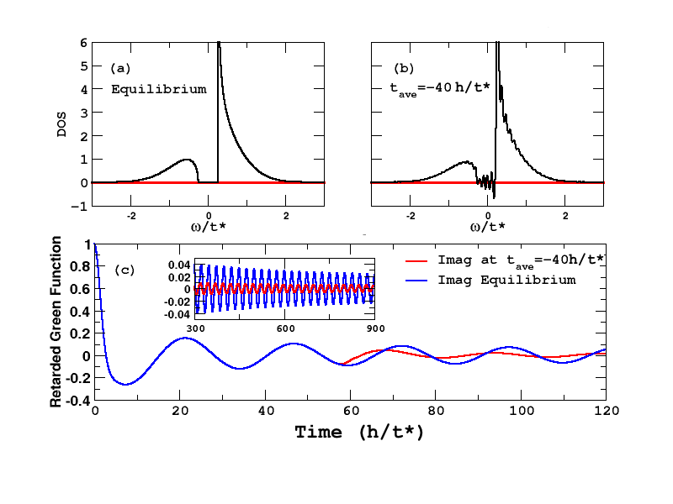
Long tails of the retarded Green’s function
J. K. Freericks, Georgetown University, FEIS 2013 workshop

Slide 12
Time resolved photoemission
J. K. Freericks, Georgetown University, FEIS 2013 workshop

Slide 13
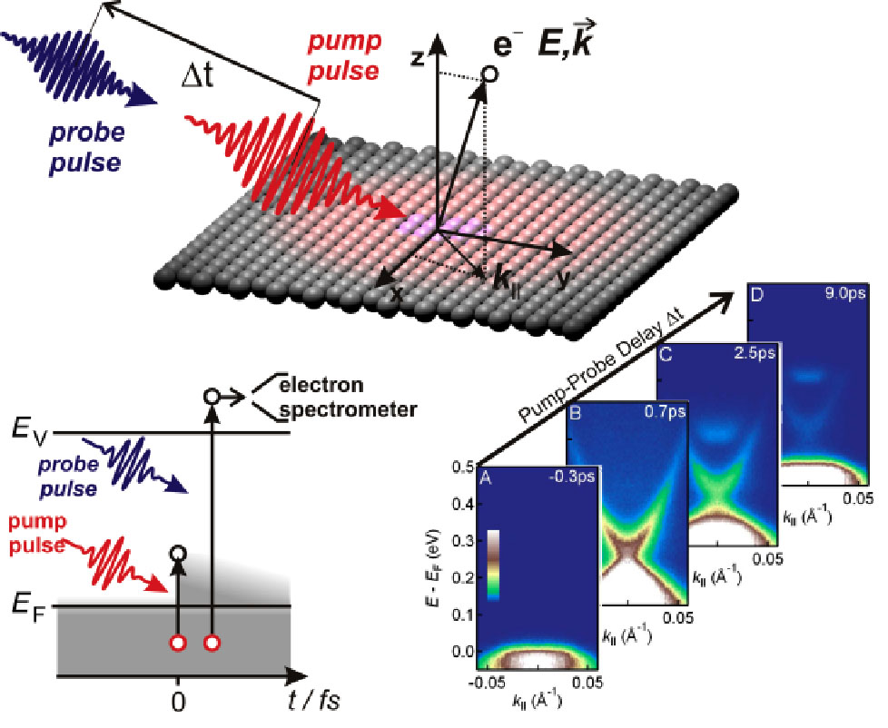
Time-resolved angle-resolved photoemission spectroscopy (tr-ARPES)
Image source: FHI Berlin
J. K. Freericks, Georgetown University, FEIS 2013 workshop

Slide 14
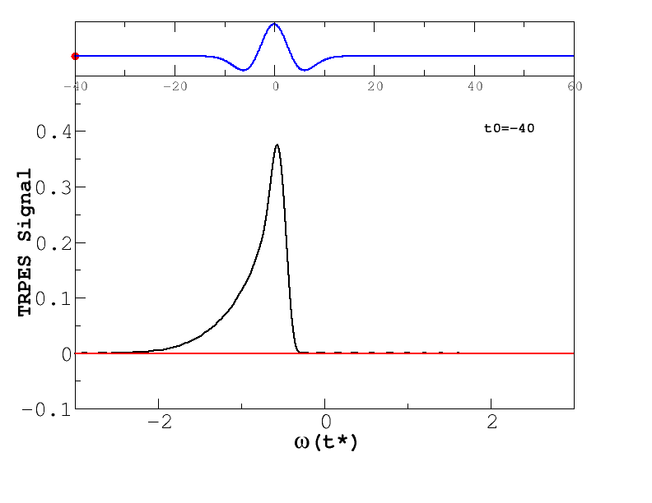
TR-PES for different field amplitudes
E0=0.75
E0=5
Time resolved photoemission signal for A(t)=-E₀exp(-t² /25)t
with probe width =14
J. K. Freericks, Georgetown University, FEIS 2013 workshop

Slide 15
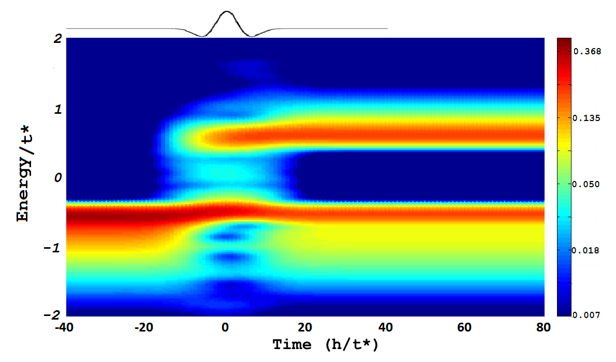
False color plot of TR-PES
E0=5
Full gap
Gap collapse
Gap reforms
All in the presence of cdw order
J. K. Freericks, Georgetown University, FEIS 2013 workshop

Slide 16
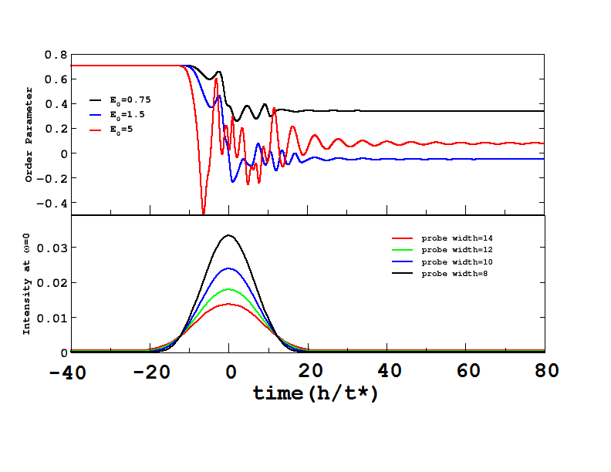
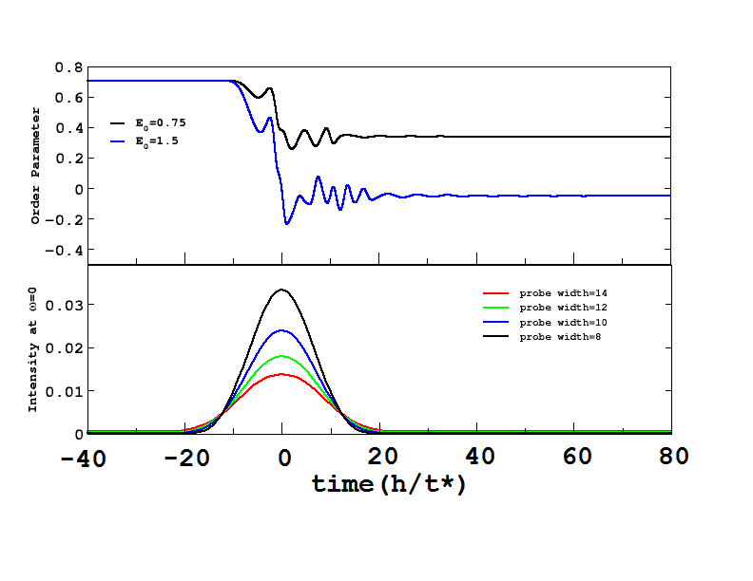
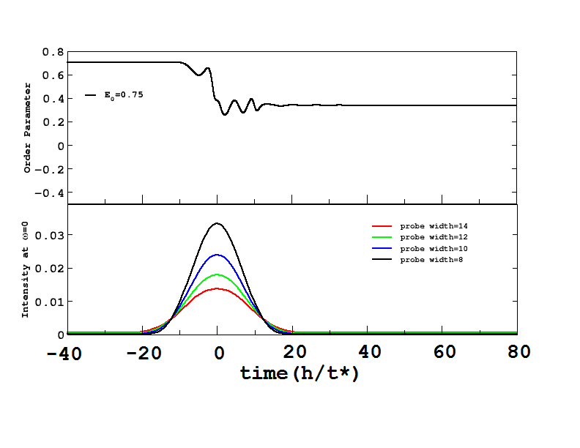
Transient order parameters
Full gap
Gap reforms
CDW electric order and gap are partially decoupled in this ultrafast process.
J. K. Freericks, Georgetown University, FEIS 2013 workshop

Slide 17
Using charge density wave systems to study the excitation process from a pump
Full gap
Gap reforms
J. K. Freericks, Georgetown University, FEIS 2013 workshop

Slide 18
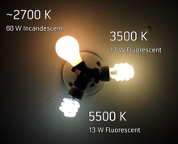


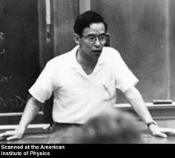
Planck-Einstein Quanta
Planck and Einstein introduced the idea of the photon carrying energy given by E=ħω
The Kubo-Greenwood linear response formalism confirms this with the strength of the response proportional to the amplitude and the Planck-Einstein relation determining the energy available for excitation
Full gap
Gap reforms
J. K. Freericks, Georgetown University, FEIS 2013 workshop

Slide 19
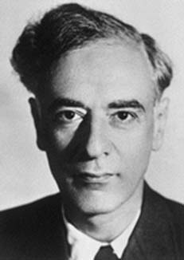
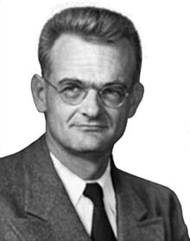
But for large fields the amplitude of the excitation is important
Landau and Zener showed that tunneling from one band to another depends exponentially on the rate that the gap region is crossed. Since this rate is proportional to the amplitude of an effective driving field, it is the amplitude, not the frequency of the excitation that governs the excitation.
Full gap
Gap reforms
As the amplitude increases to a large enough value, the excitation becomes classically allowed.
J. K. Freericks, Georgetown University, FEIS 2013 workshop

Slide 20
Pumped drive drive low frequency
J. K. Freericks, Georgetown University, FEIS 2013 workshop

Slide 21
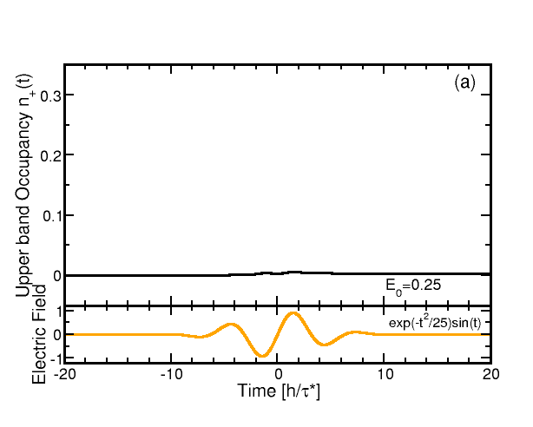
Occupancy of the upper band vs time
J. K. Freericks, Georgetown University, FEIS 2013 workshop

Slide 22
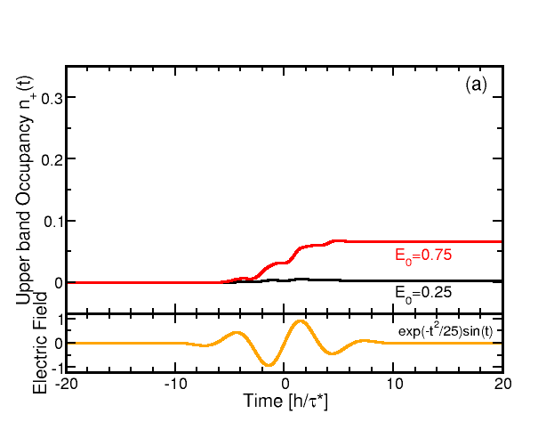
Occupancy of the upper band vs time
J. K. Freericks, Georgetown University, FEIS 2013 workshop

Slide 23
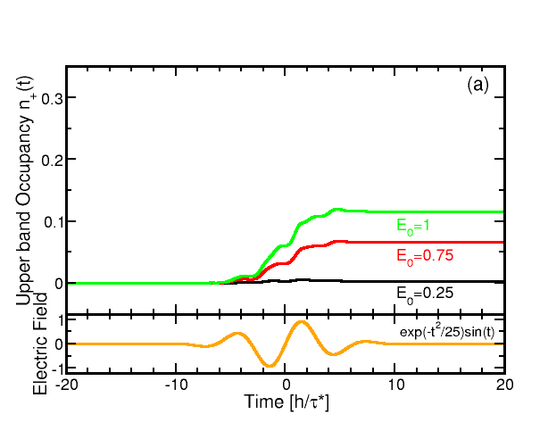
Occupancy of the upper band vs time
J. K. Freericks, Georgetown University, FEIS 2013 workshop

Slide 24
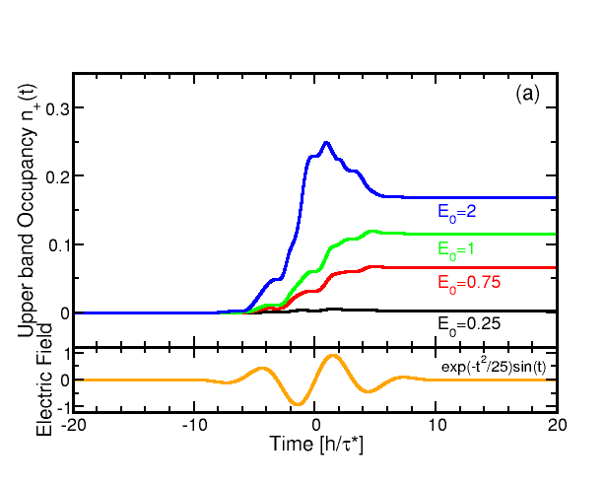
Occupancy of the upper band vs time
J. K. Freericks, Georgetown University, FEIS 2013 workshop

Slide 25
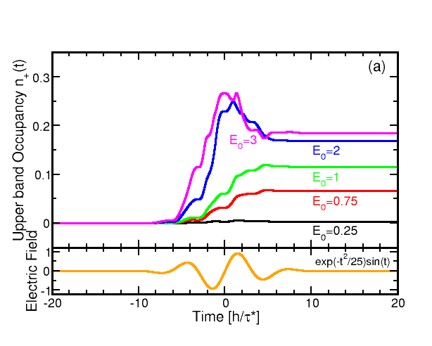
Occupancy of the upper band vs time
J. K. Freericks, Georgetown University, FEIS 2013 workshop

Slide 26
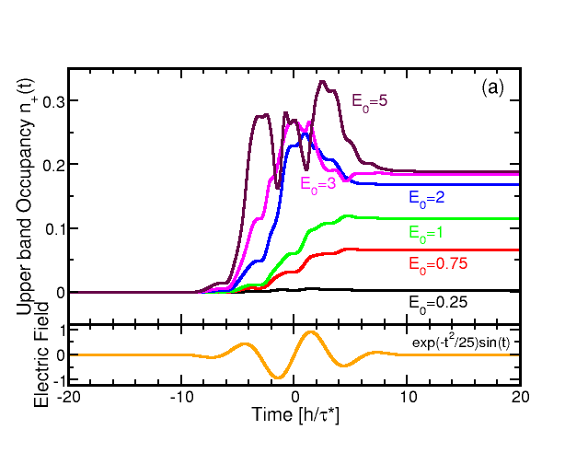
Occupancy of the upper band vs time
J. K. Freericks, Georgetown University, FEIS 2013 workshop

Slide 27
Occupancy of the upper band vs time
Note deexcitation regime
J. K. Freericks, Georgetown University, FEIS 2013 workshop

Slide 28
Pumped drive drive high frequency
J. K. Freericks, Georgetown University, FEIS 2013 workshop

Slide 29
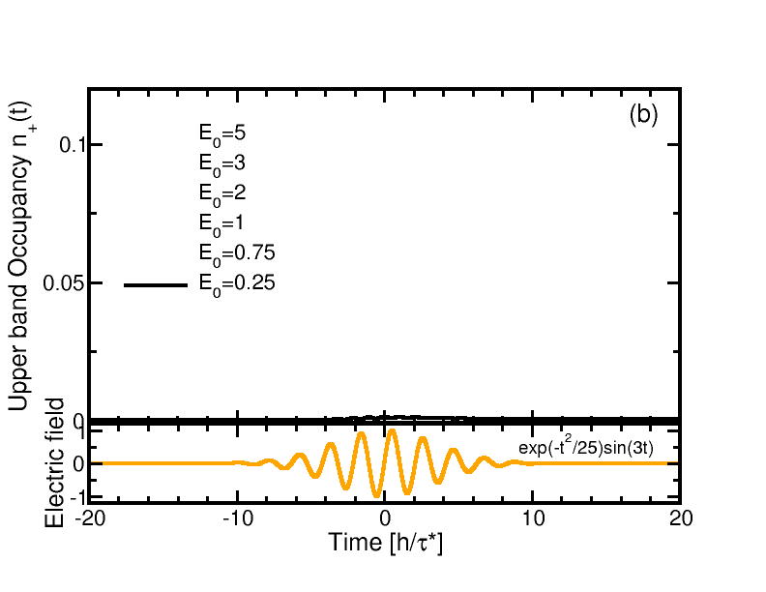
Occupancy of the upper band vs time
J. K. Freericks, Georgetown University, FEIS 2013 workshop

Slide 30
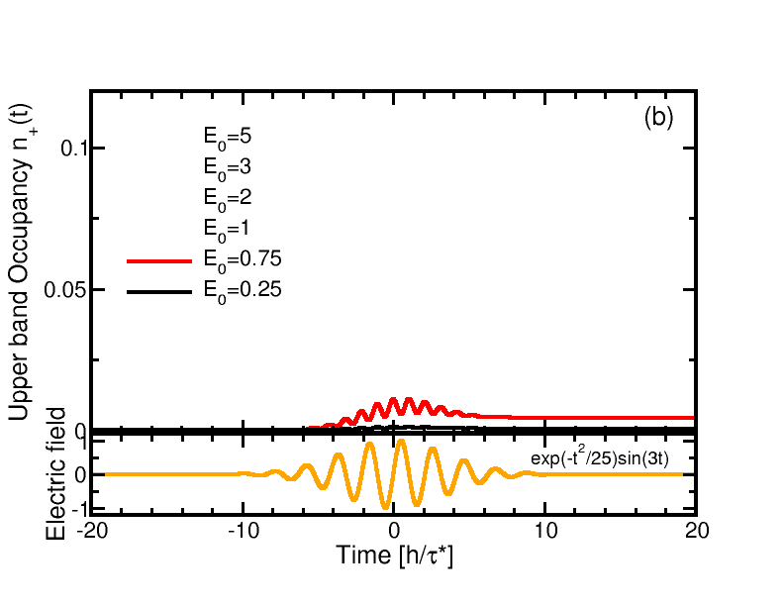
Occupancy of the upper band vs time
J. K. Freericks, Georgetown University, FEIS 2013 workshop

Slide 31
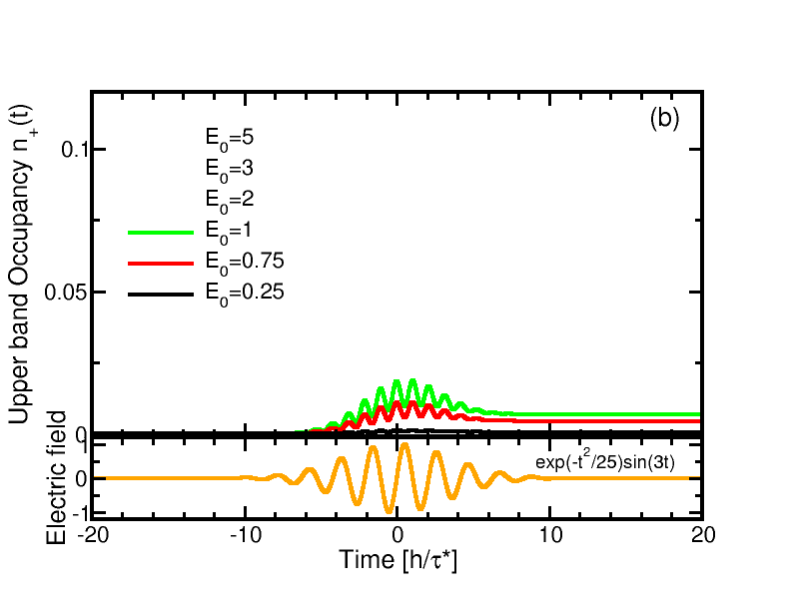
Occupancy of the upper band vs time
J. K. Freericks, Georgetown University, FEIS 2013 workshop

Slide 32
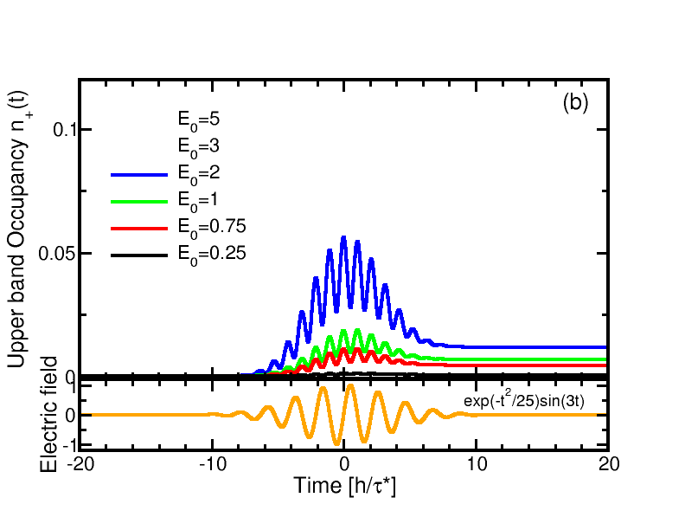
Occupancy of the upper band vs time
J. K. Freericks, Georgetown University, FEIS 2013 workshop

Slide 33
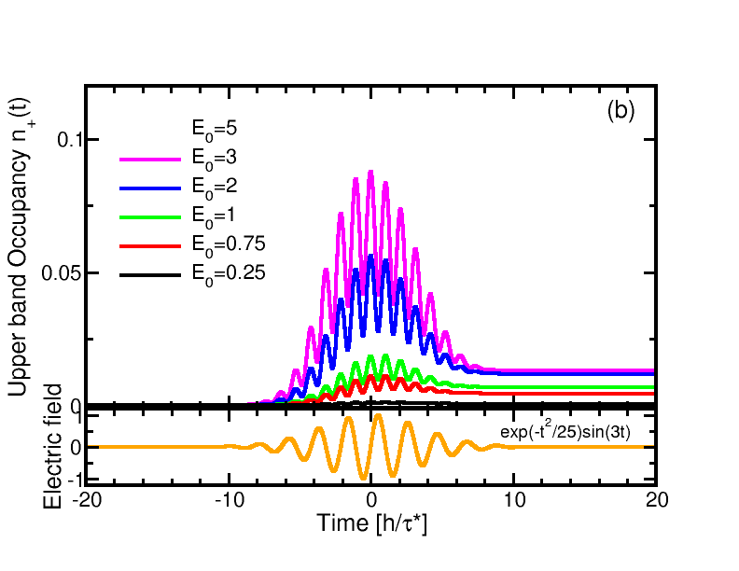
Occupancy of the upper band vs time
J. K. Freericks, Georgetown University, FEIS 2013 workshop

Slide 34
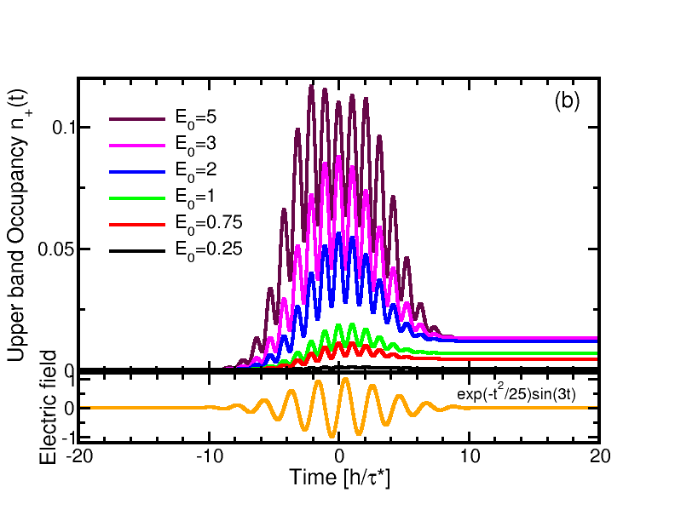
Occupancy of the upper band vs time
J. K. Freericks, Georgetown University, FEIS 2013 workshop

Slide 35
Occupancy of the upper band vs time
Deexcitation much stronger here
J. K. Freericks, Georgetown University, FEIS 2013 workshop

Slide 36
Pumped drive excited state spectroscopy
J. K. Freericks, Georgetown University, FEIS 2013 workshop

Slide 37
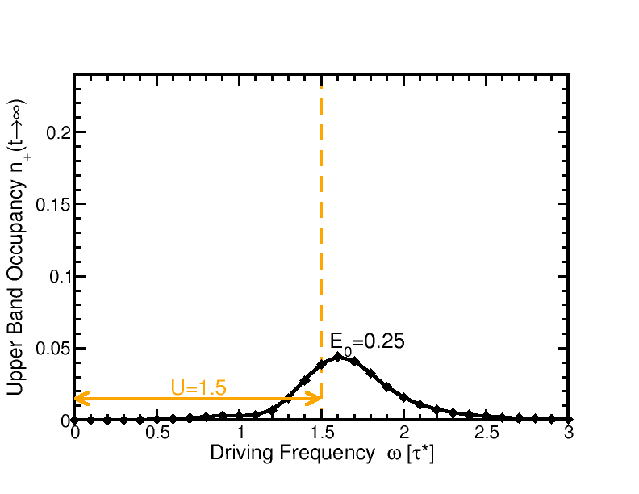
Spectroscopy of n₊(t) for different amplitude fields
J. K. Freericks, Georgetown University, FEIS 2013 workshop

Slide 38
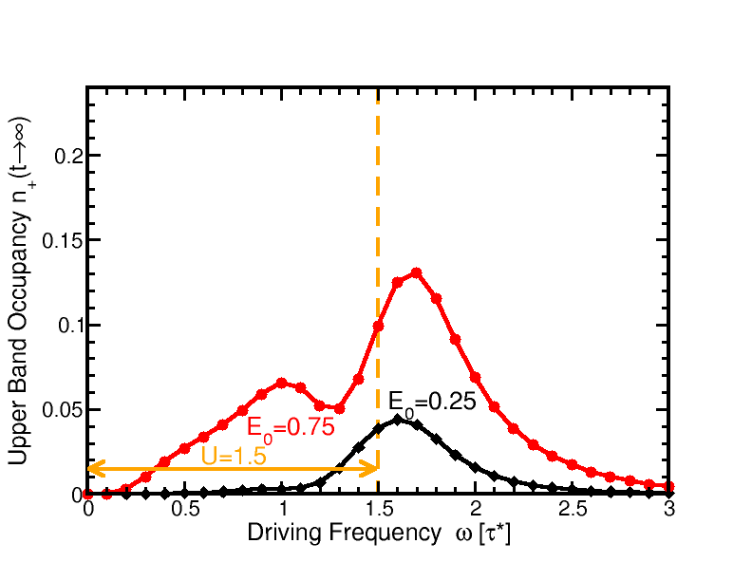
Spectroscopy of n₊(t) for different amplitude fields
J. K. Freericks, Georgetown University, FEIS 2013 workshop

Slide 39
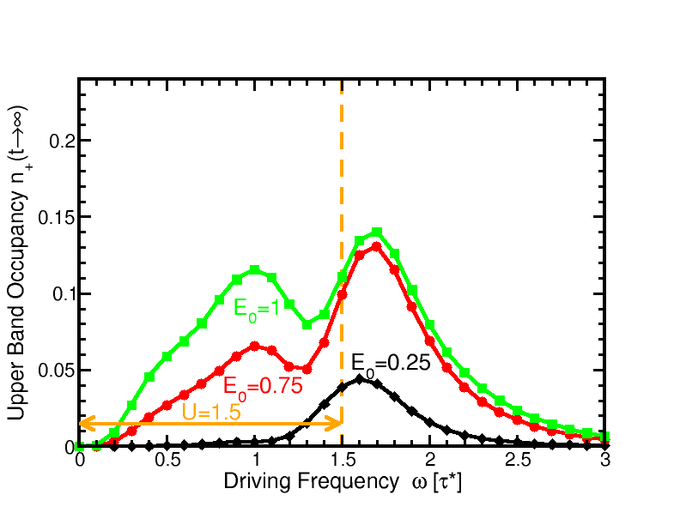
Spectroscopy of n₊(t) for different amplitude fields
J. K. Freericks, Georgetown University, FEIS 2013 workshop

Slide 40
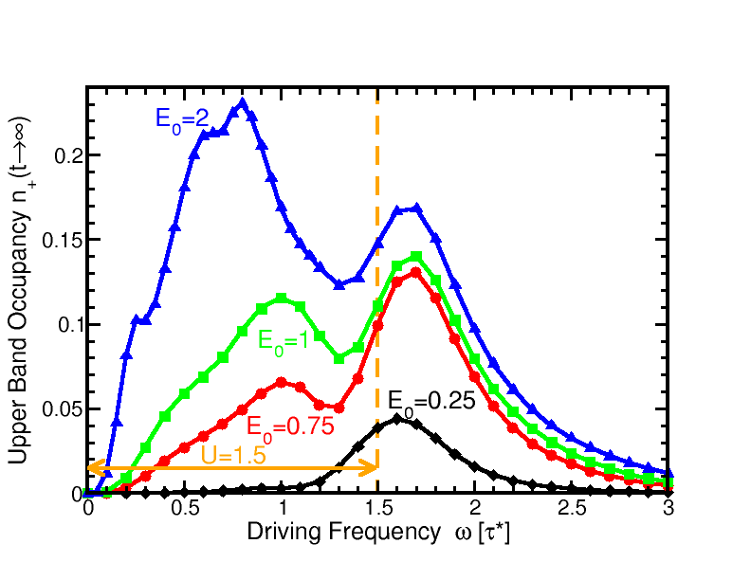
Spectroscopy of n₊(t) for different amplitude fields
J. K. Freericks, Georgetown University, FEIS 2013 workshop

Slide 41
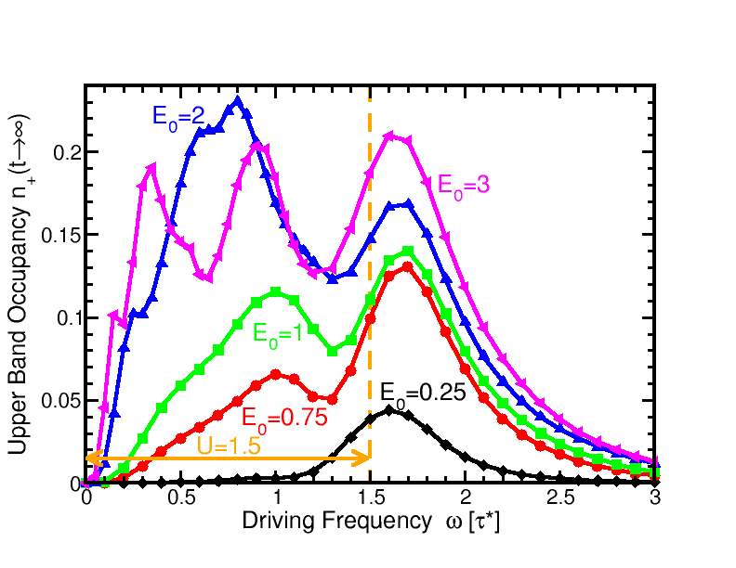
Spectroscopy of n₊(t) for different amplitude fields
J. K. Freericks, Georgetown University, FEIS 2013 workshop

Slide 42
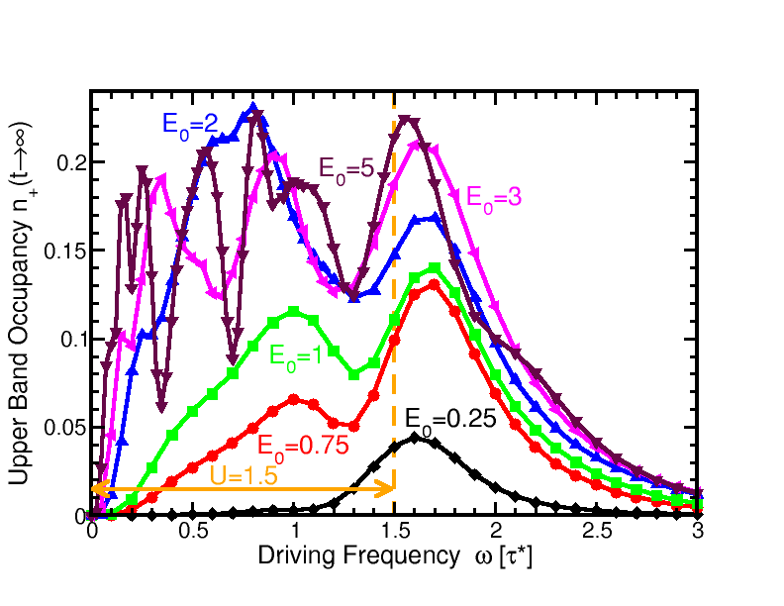
Spectroscopy of n₊(t) for different amplitude fields
J. K. Freericks, Georgetown University, FEIS 2013 workshop

Slide 43
Spectroscopy of n₊(t) for different amplitude fields
Quantum oscillations survive
J. K. Freericks, Georgetown University, FEIS 2013 workshop

Slide 44
Conclusions
Showed the simplest example of time-resolved photoemission in a CDW system which shares many of the behaviors seen in experiment, including a decoupling of the electronic gap from the CDW order parameter.
Showed results for a novel experiment in quantum excitation which makes a transition from Planck-Einstein quanta to multiphoton processes, to amplitude driven excitation to complex quantum oscillations.
J. K. Freericks, Georgetown University, FEIS 2013 workshop

Slide 45
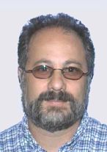
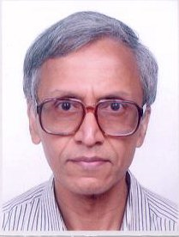

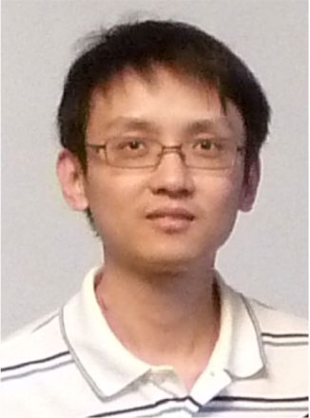

Acknowledgements
Thanks to
Tom Devereaux, Hulikal Krishnamurthy, Amy Liu Yizhi Ge Wen Shen
Funding from
J. K. Freericks, Georgetown University, FEIS 2013 workshop

