Slide 1
The APEX photo-gun:
an high brightness MHz repetition rate source
D. Filippetto
LBNL
FEIS, Key West, Florida, 2013

Slide 2
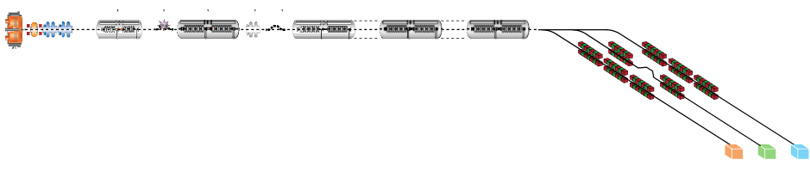

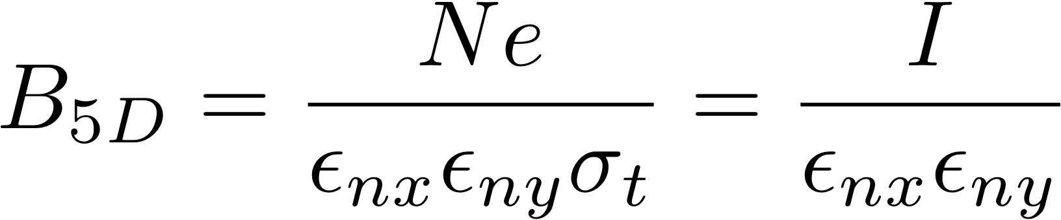
The original APEX driver: MHz FEL
Beam manipulation and conditioning
Laser systems,
timing & synchronization
High-brightness,
1 MHz rep-rate electron gun
High-brightness,
1 MHz rep-rate electron gun

Slide 3
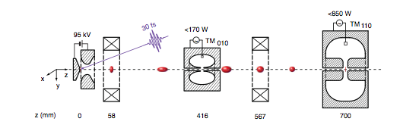
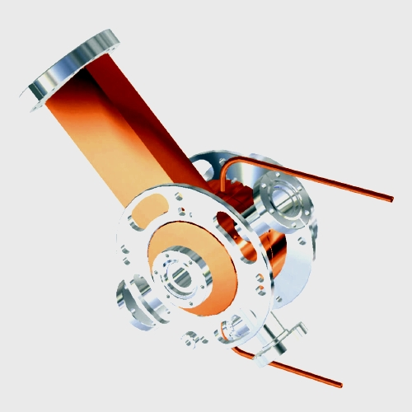
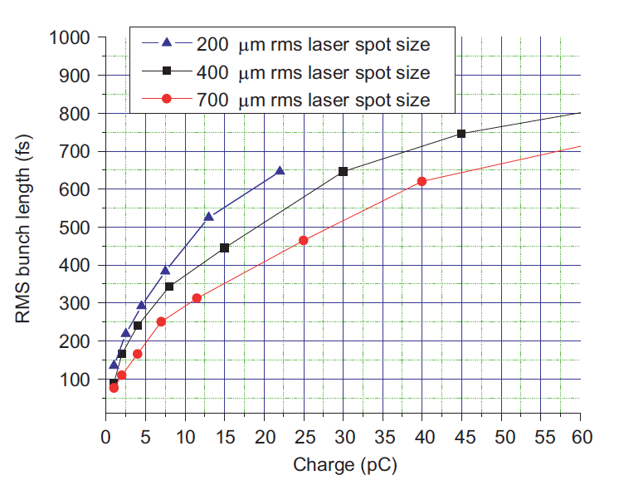
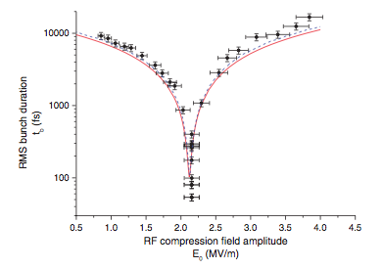
Beam Brightness
Requirements of small emittance and high current are (almost) independent
  Beam emittance is defined at the extraction
  The current can be increased by compression downstream the cathode
1.6 cell RF gun, 3GHz, BNL/UCLA/SLAC design
T. Van Oudheusden et al. Phys. Rev. Lett.
105, 264801, (2010)
P. Musumeci et al., Ultramicroscopy 108 (2008) 1450–1453
Transverse deflecting
RF cavities
Dipole Magnets
t
σ_{E}
σ_{E}
τ
τ
φ = 0
φ = π
E > E > E
L_{C} < L_{C} < L_{C}
Collimator

Slide 4
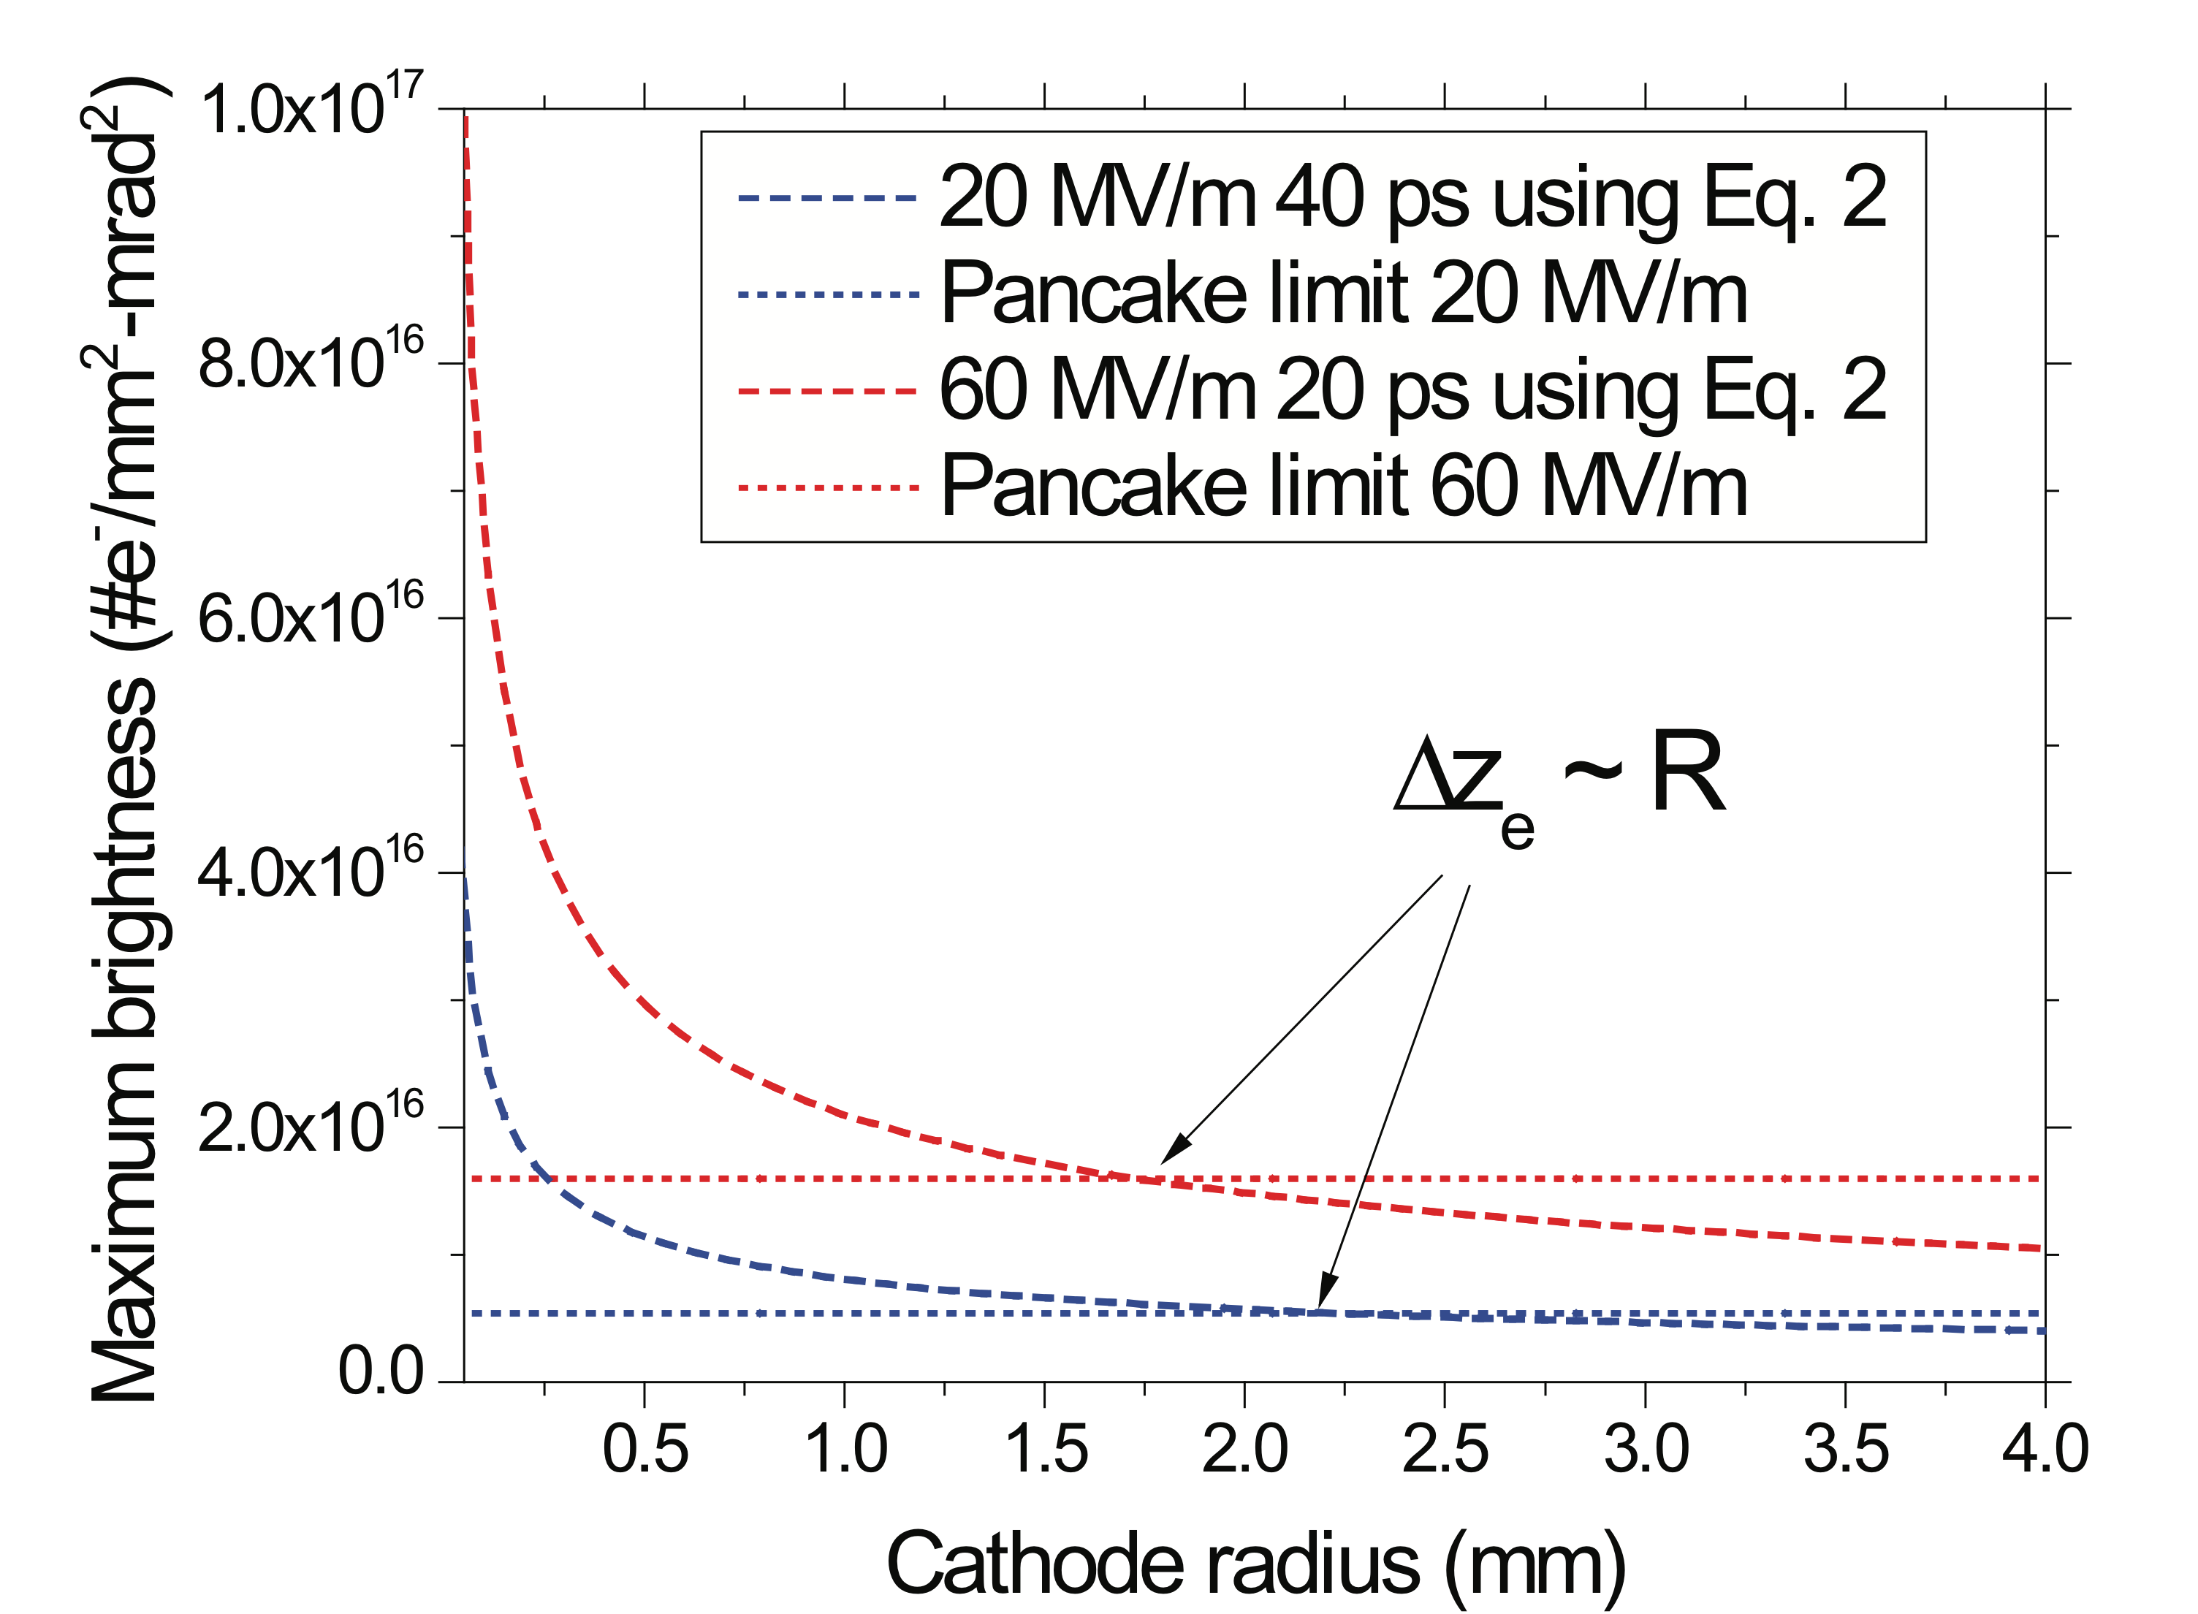



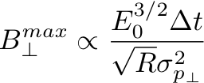
High repetition rate Vs Brightness
The 4D brightness becomes the most important source parameter. It determines
  The spatial resolution
  the beam focusability
“Pancake”
“Cigar”
I. Bazarov et al., PRL 102, 104801 (2009)
D. Filippetto et al., submitted to PRSTAB
High fields
High rf frequency
High fields
small aspect ratio (R/L)
For high repetition rate use VHF instead of GHz:
wider time acceptance, still high fields
Much lower surface power density
DC-like beam dynamics (no long. Aberrations )

Slide 5
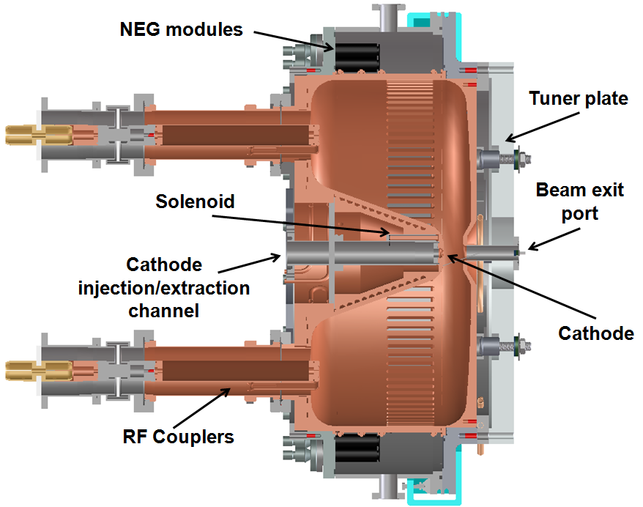
The LBNL VHF Gun
Frequency | 186 MHz
Operation mode | CW
Gap voltage | Up to 800 kV
Field at the cathode | > 20 MV/m
Q₀ (ideal copper) | 30887
Shunt impedance | 6.5 MΩ
RF Power | 100 kW
Stored energy | 2.3 J
Peak surface field | 24.1 MV/m
Peak wall power density | 25.0 W/cm²
Accelerating gap | 4 cm
Diameter/Length | 69.4/35.0 cm
base pressure | ~ 10⁻¹¹ Torr
K. Baptiste, et al, NIM A 599, 9 (2009)
Idea started from the lack of sources that would be capable of driving an MHz FEL
Relies on a mature and robust technology, to reach the required reliability for a user facility
Compared to DC sources: higher accelerating fields, relativistic beams, rep. rate limited by f_{rf}
Compared to rf-guns (LCLS): 15 times longer rf wavelength, CW operations , lower acc. fields

Slide 6
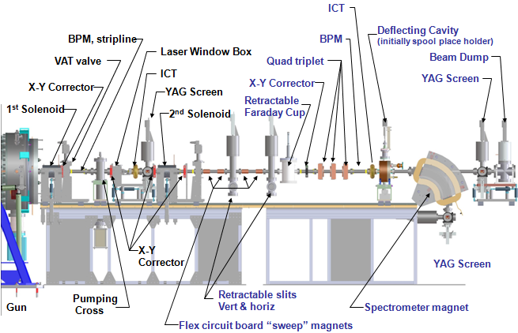
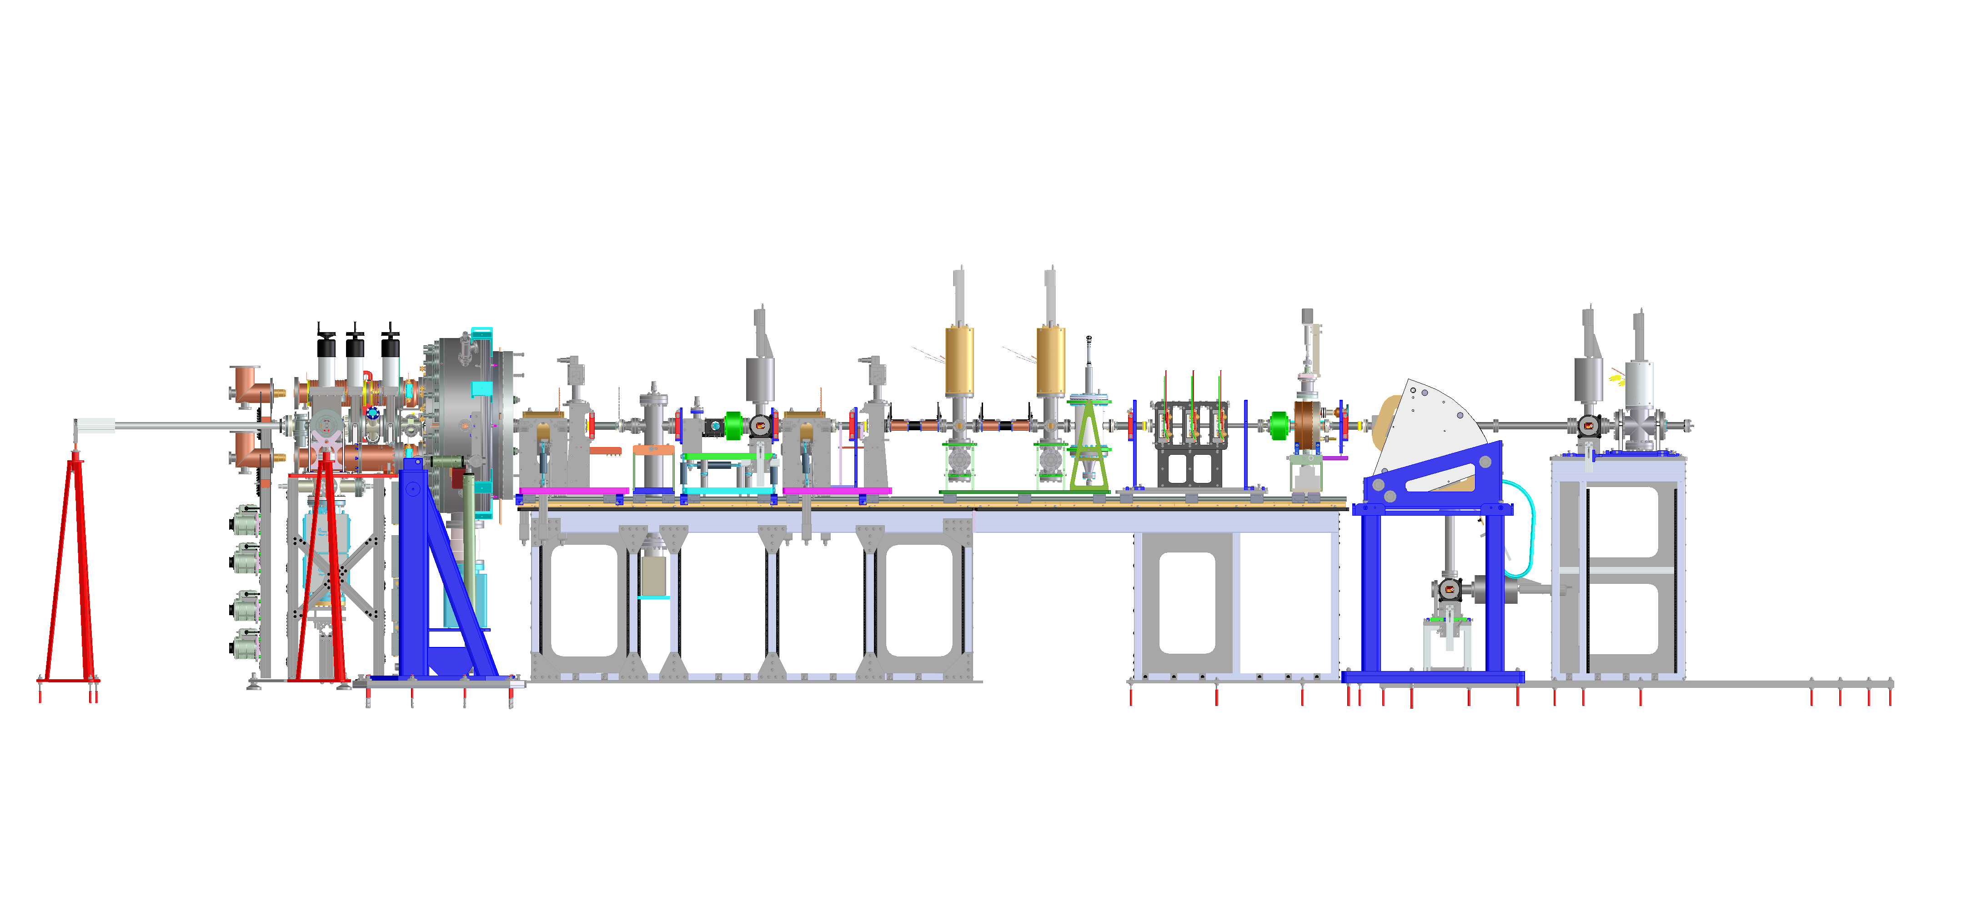
The APEX beamline
Quadrupole triplet and rf deflecting cavity
will be installed in the next 2 months.
Rf Buncher currently under design
load lock
4 m

Slide 7
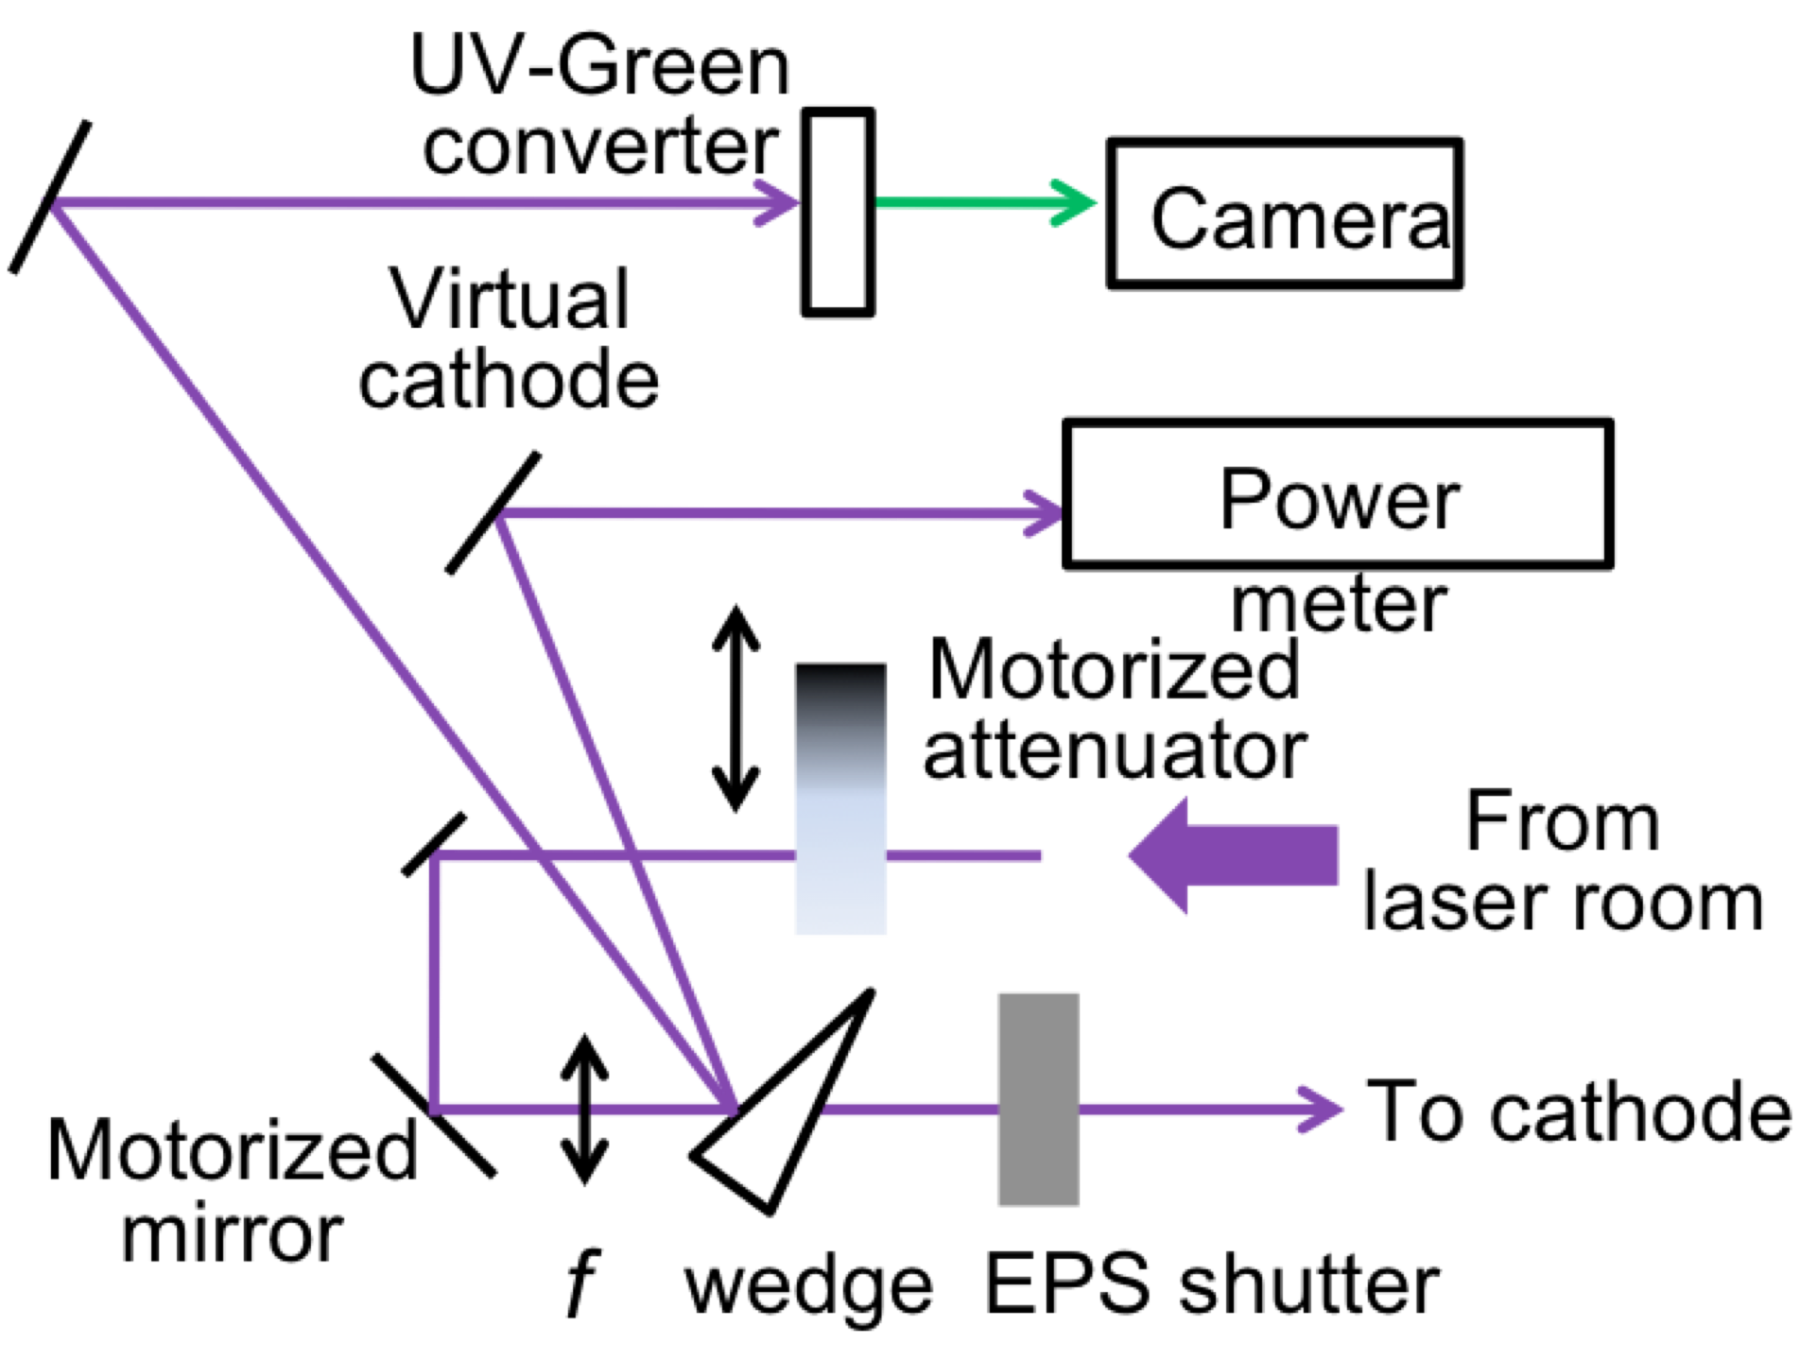
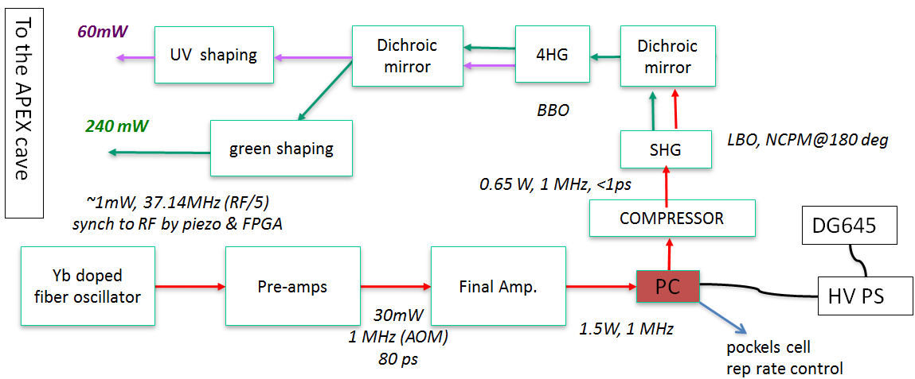
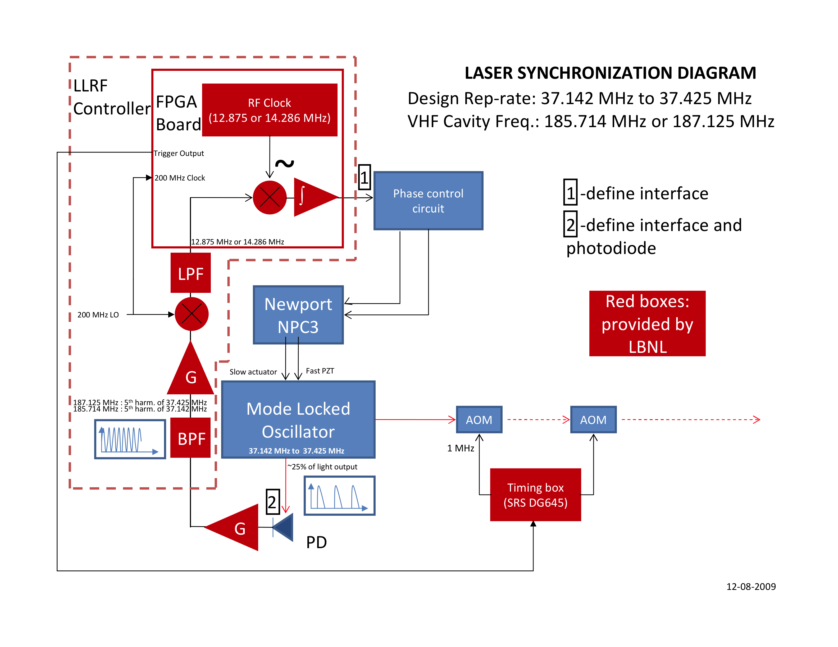
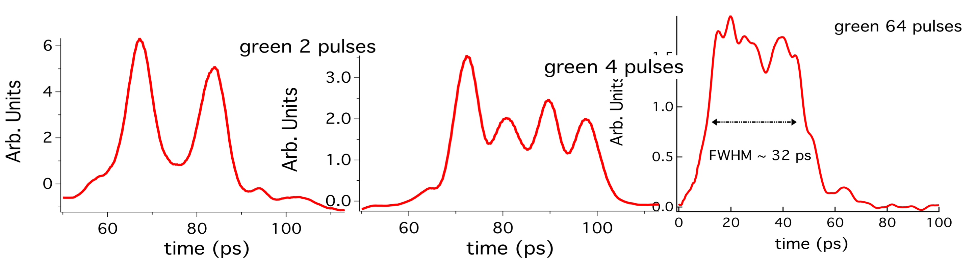
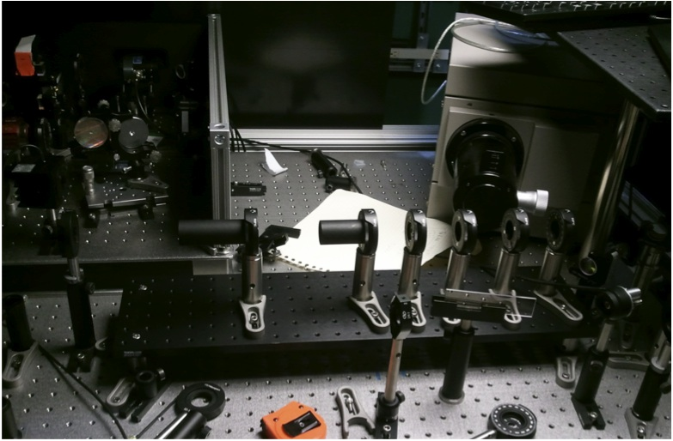
The photocathode laser system
LLNL/UCB/LBNL
streak camera in
synchroscan mode

Slide 8
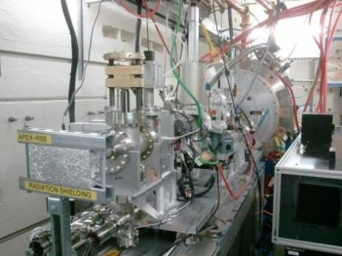
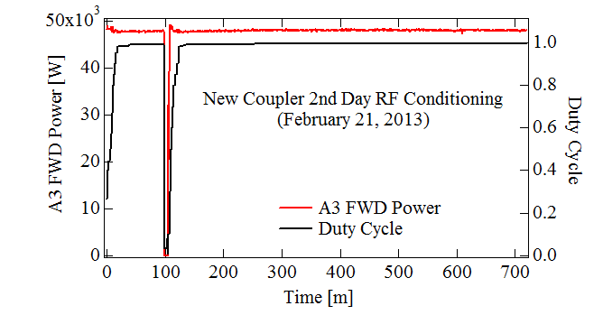
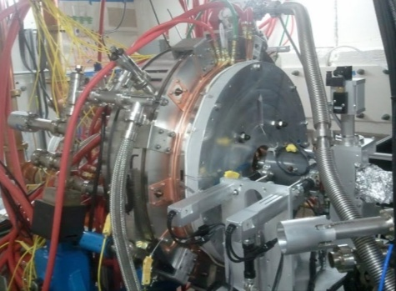
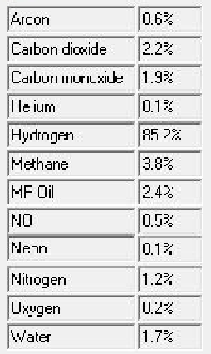
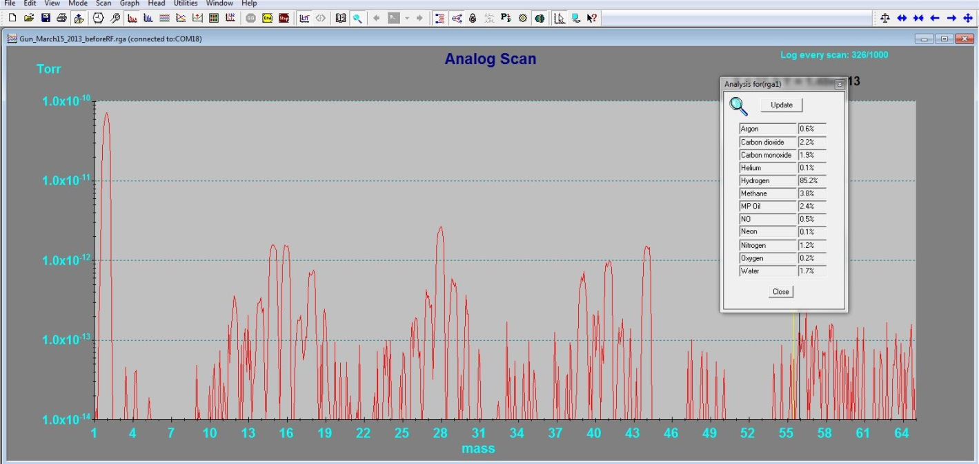
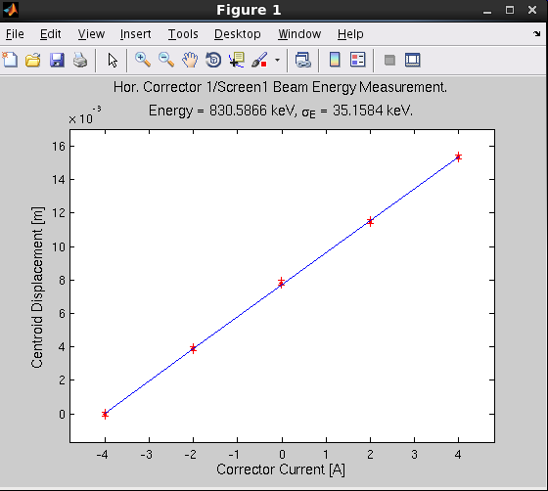
Gun performances
Not a fault.
(accessing the BTF)
RF ON:
P_{TOT} ~ 9 10⁻¹⁰ Torr
H₂O, CO and CO₂ still at 10⁻¹²
E = 830 (35) keV
21.5 MV/m

Slide 9
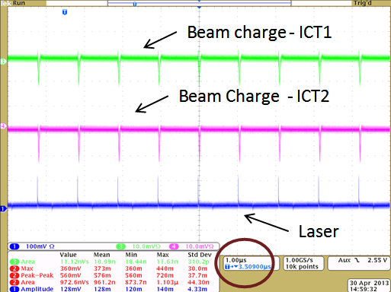
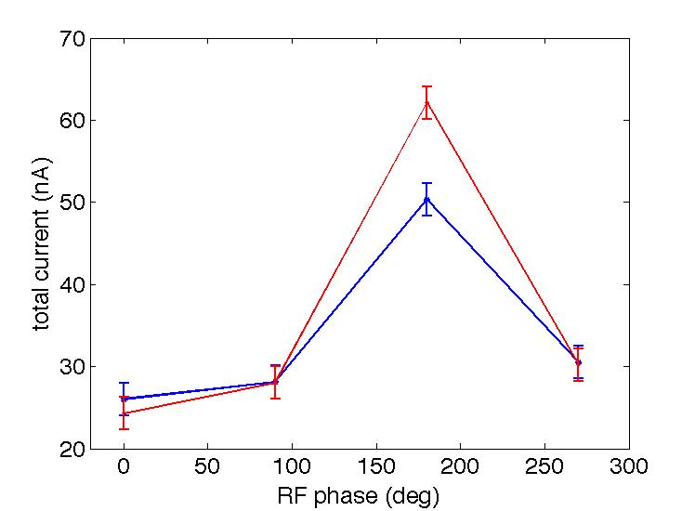
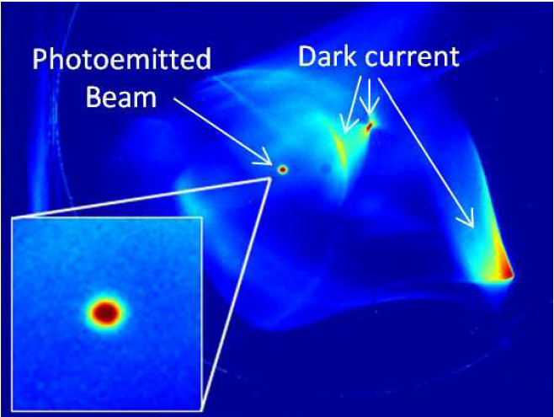
Low charge measurements
high SNR:
Increased dynamic range by
Integrating the signal of a MHz
Beam.
Charge, beam size and emittance
of 10 fC beam can be measured
Laser ON
σ=80 μm
Laser OFF

Slide 10
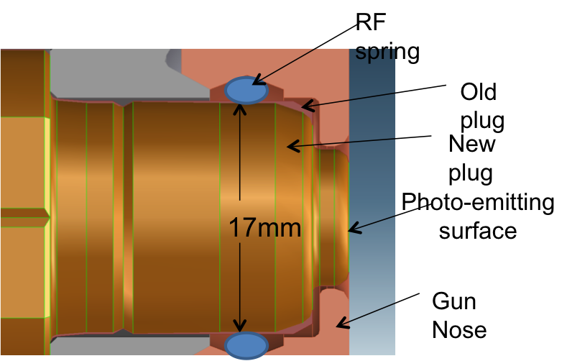
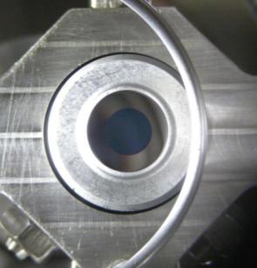
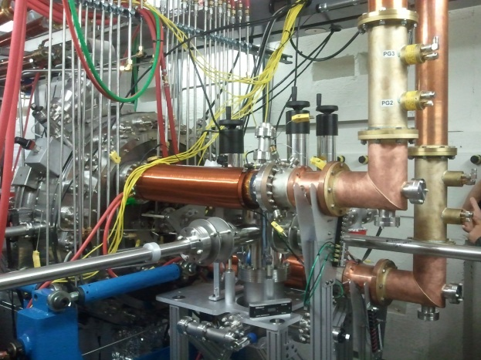
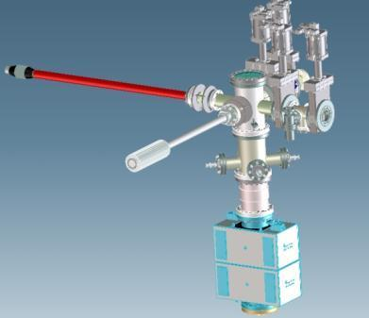
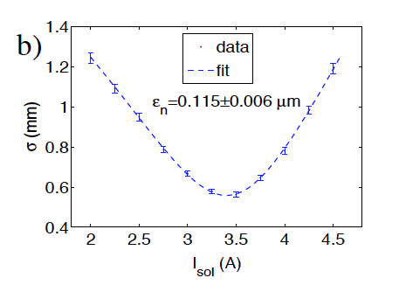
Photocathodes
PEA Cesium Telluride Cs₂Te
- high QE > 1%
photo-emits in the UV
robust
- for 1 MHz reprate, 1 nC, ~ 10 W 1060nm required
PEA CsK₂Sb, (H. Padmore’s group LBNL)
- reactive; requires ~ 10⁻¹⁰ Torr pressure
high QE > 1%
emits in the green light
- for nC, 1 MHz reprate, ~ 1 W of IR required
LBNL
measurements
NEA Semiconductors: GaAs/GaAsP
- Requires ultrahigh vacuum 10⁻¹¹ Torr pressure
2-3 times lower thermal emittance due to electron relaxationin the conduction band
Longer response time (tens of ps)
Easy cathode replacement + 6D diagnostic= test bench for cathode Brigthness
Nanopatterned cathodes developed at LBNL, nanotips …

Slide 11
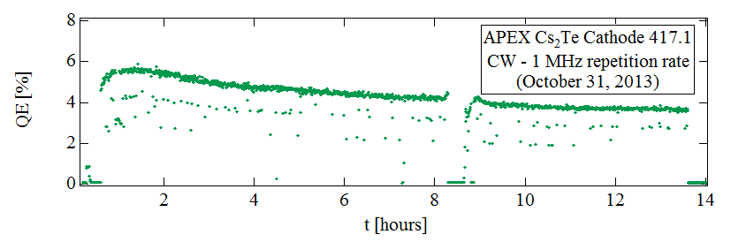
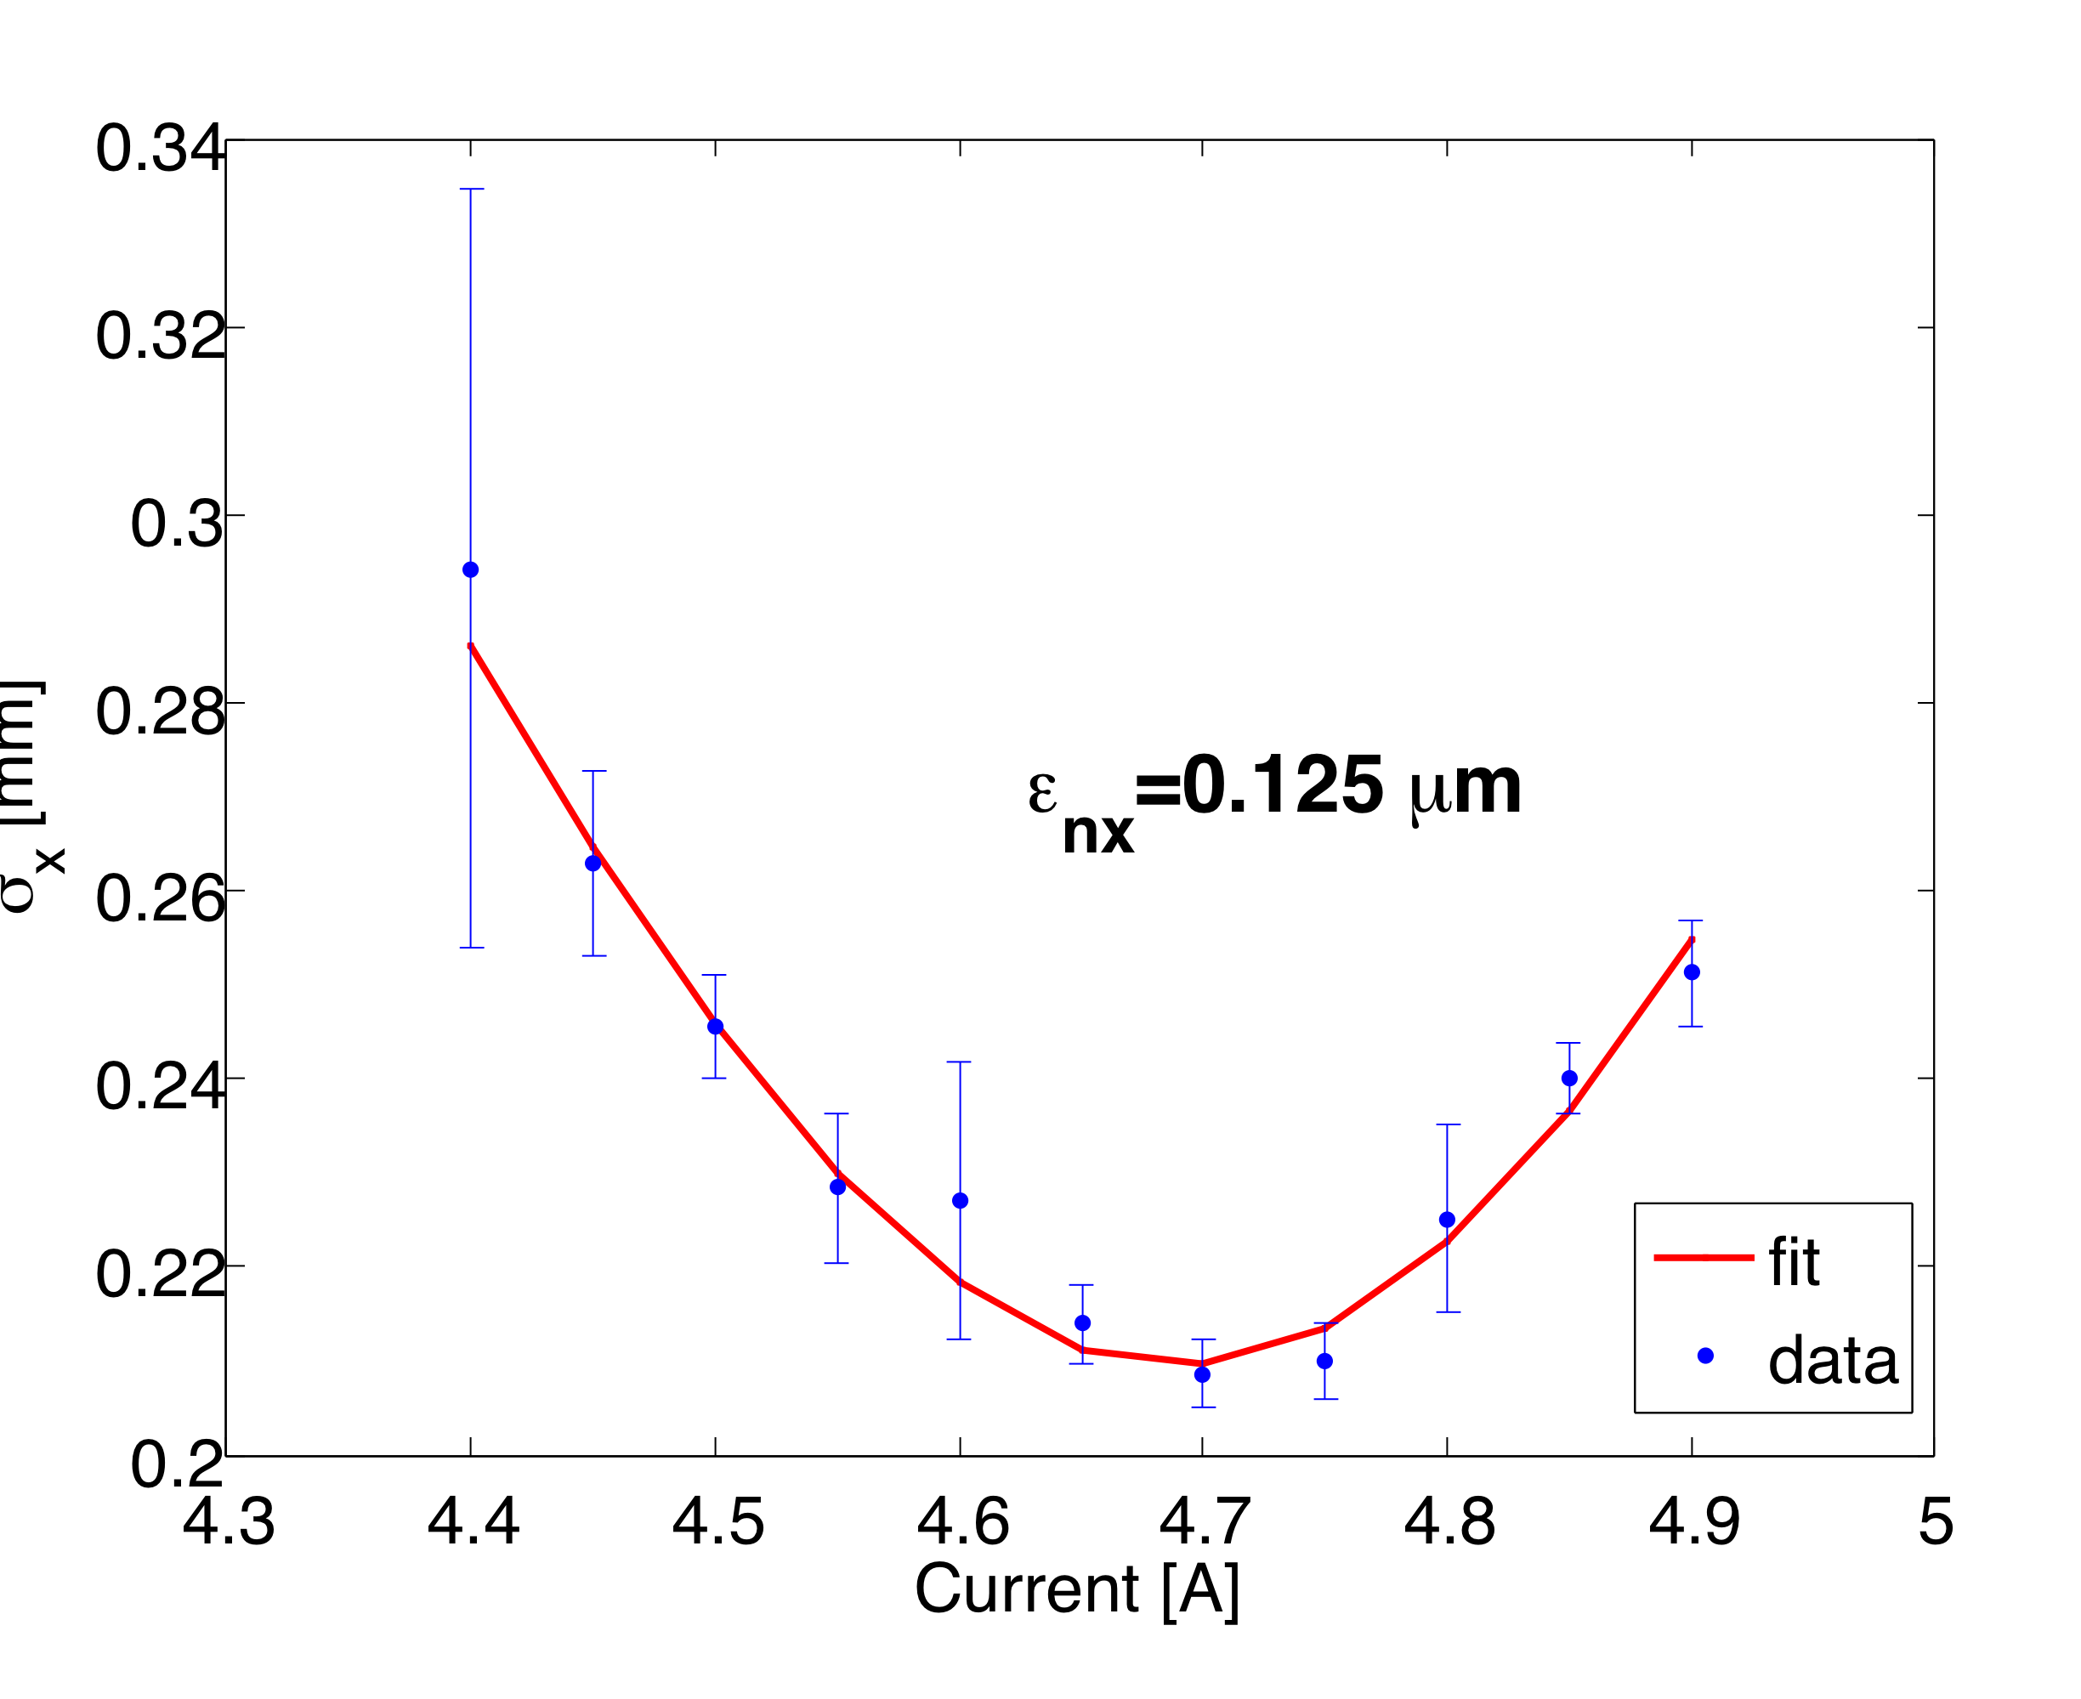
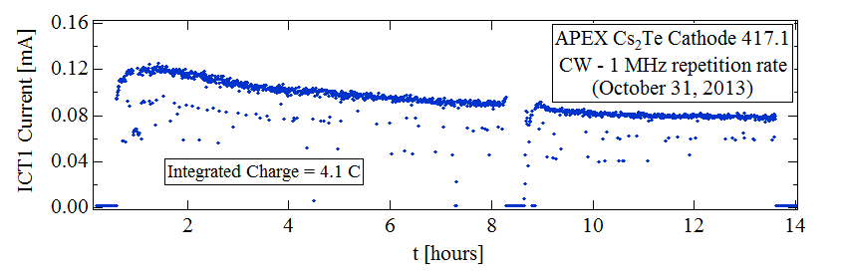
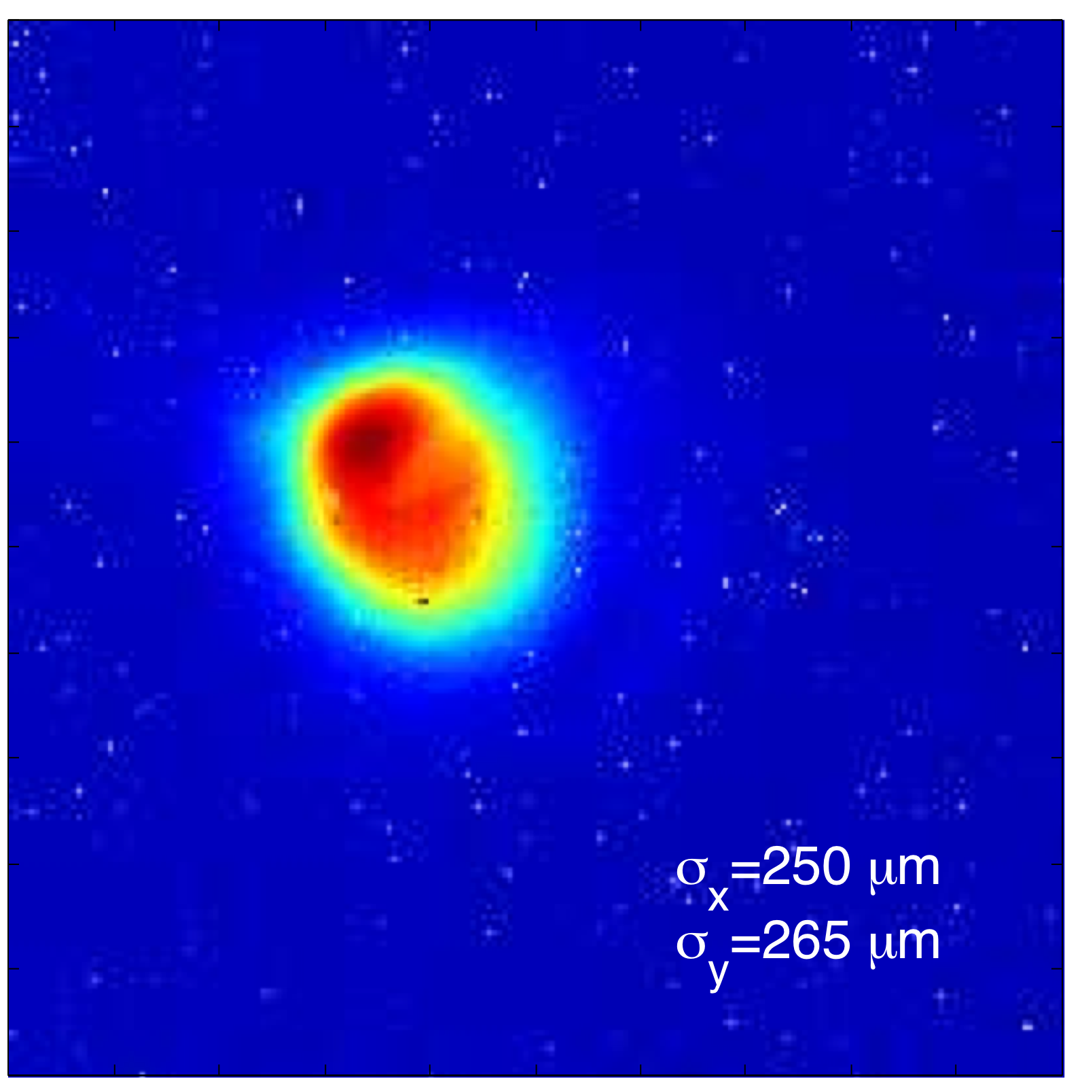
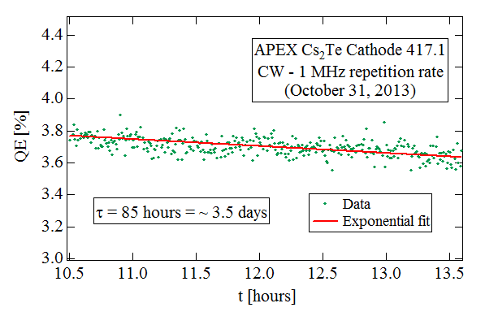
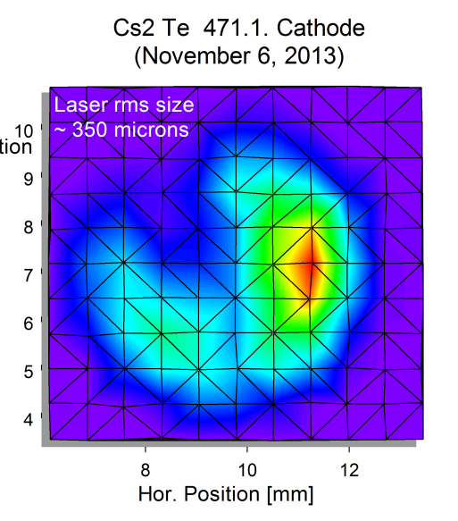
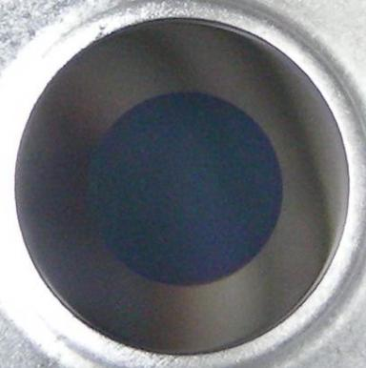
Cathode physics: Cs₂Te
0.6 μm/mm RMS
Cathode
YAG Screen 1
Laser at the cahode
Solenoid
900 fC
After 50 C
Before
11

Slide 12
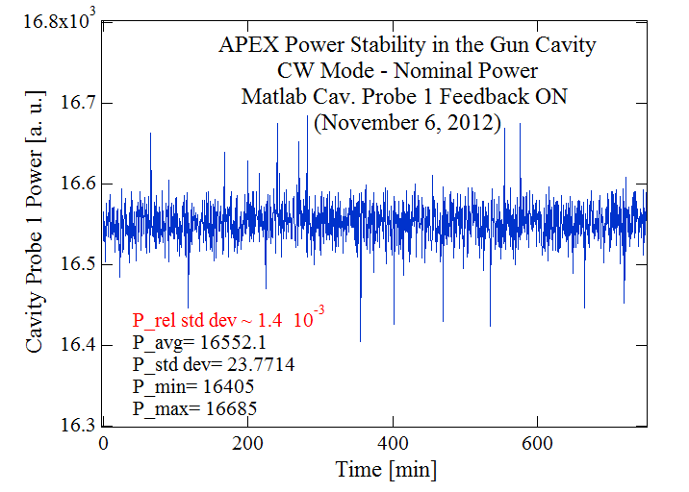
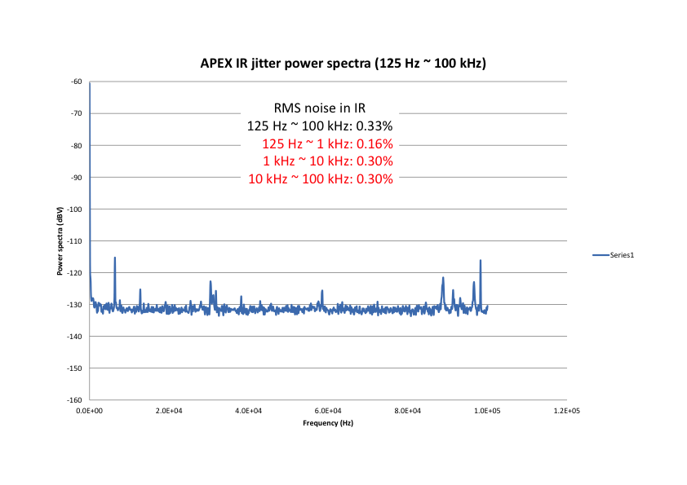
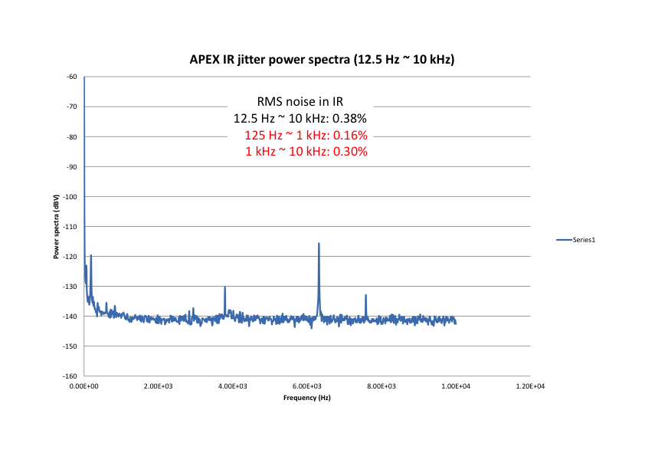
Jitter studies
Source jitters can dominate the measurement resolution. Ex. Time:
CW operations allow for continuous sampling
Wider bandwidth, faster feedbacks possible
System noise can in principle be corrected up to ½ the repetition rate
Energy, pointing and time jitters can be greatly reduced by feedback loops
Important jitters to characterize and control include:
Laser-rf time jitter
Laser energy fluctuations
Laser pointing stability at the cathode
Field amplitude fluctuations in the gun (& buncher)
Field phase jitters in the gun (& buncher)
Cavity field fluctuations
In open loop
Power spectrum of laser energy noise

Slide 13
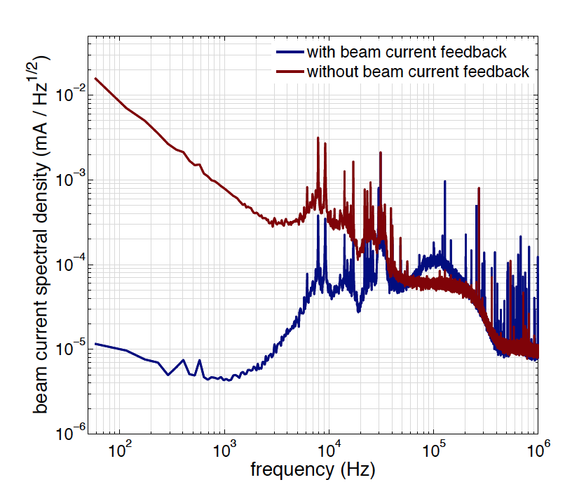
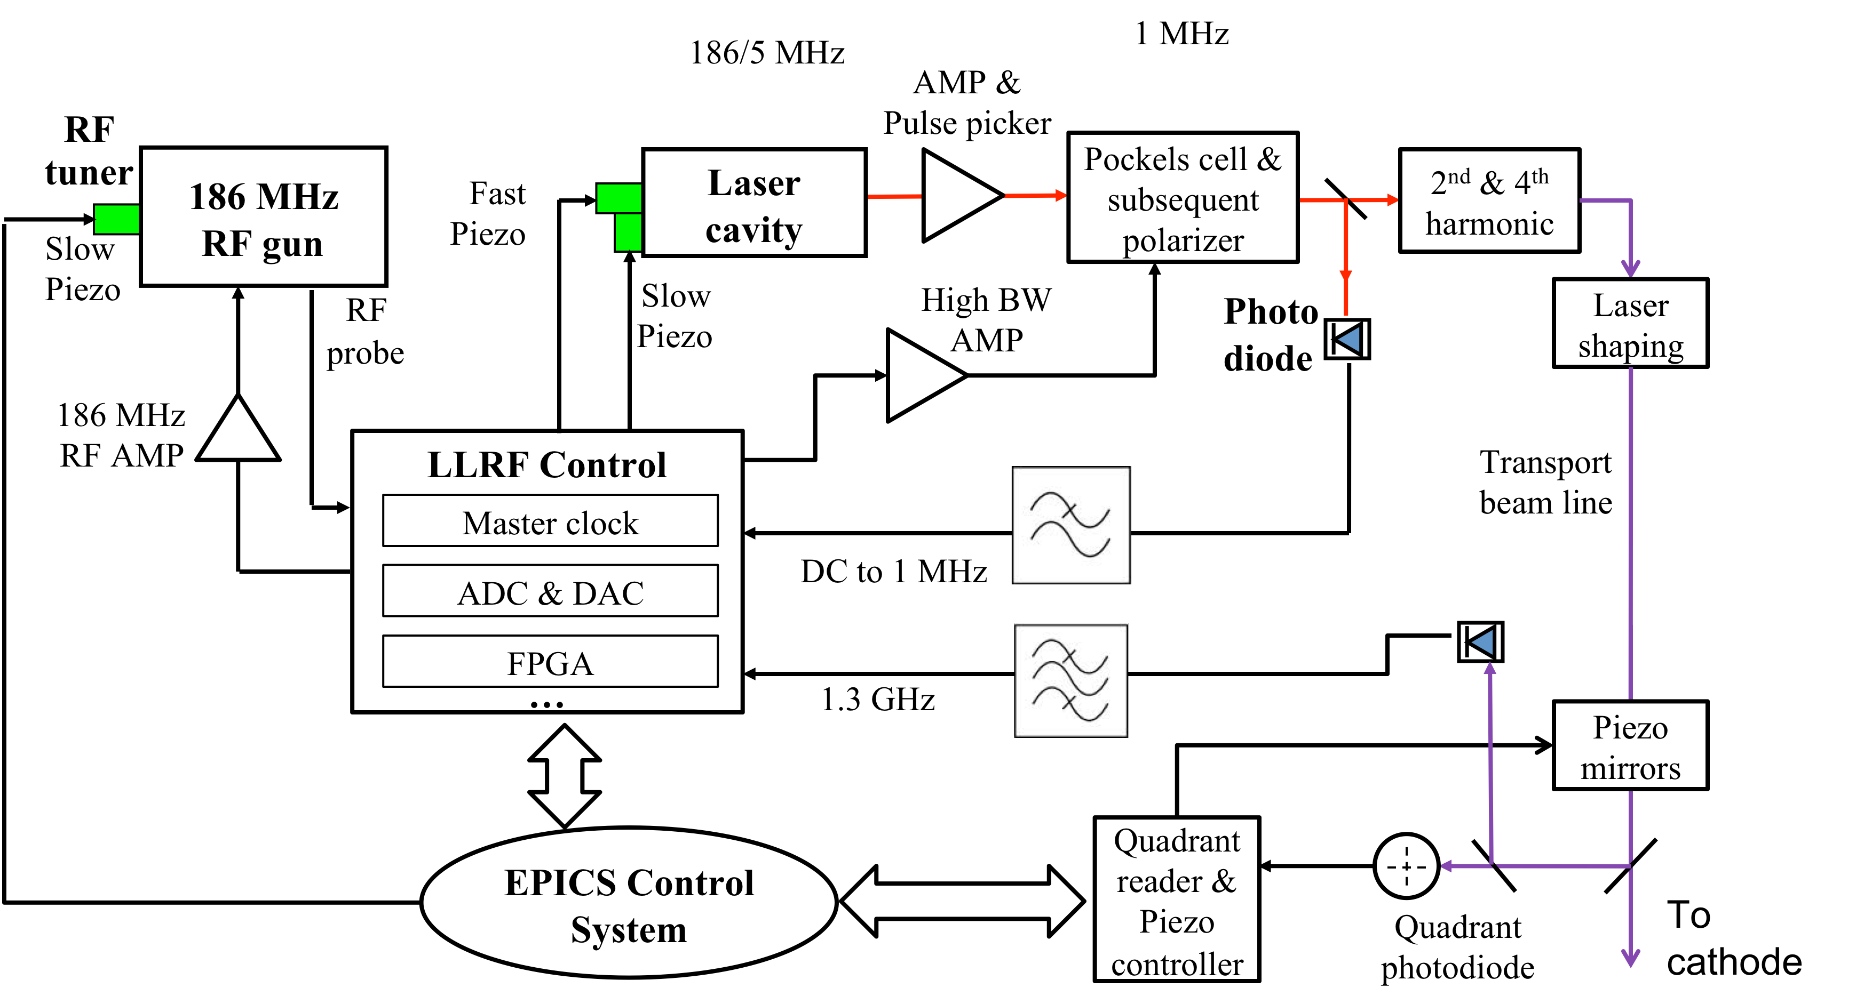
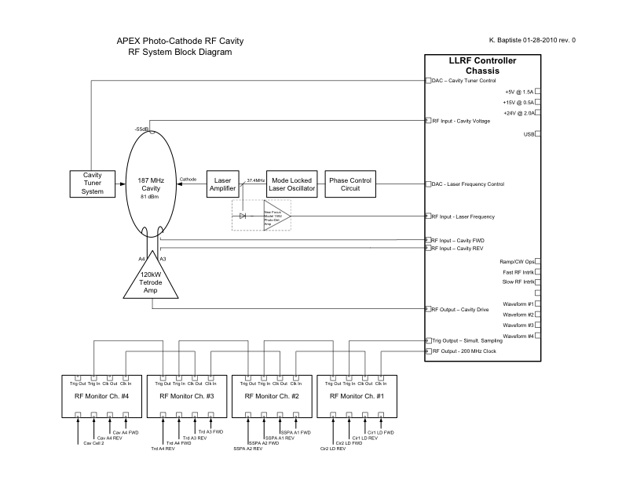
APEX Synchronization Plan
Goals:
Laser-to-rf time jitter < 100 fs
Rf amplitude fluctuations < 10⁻⁴
Beam pointing at the cathode < 10 μm
Charge fluctuations < 0.5%
F. Loehl, IPAC2011
Energy
time
position

Slide 14
UED @ APEX
Up to 186 MHz repetition rate.
Relativistic beams (up to 1 MeV)
Potentially very low noise system, avoid time stamping
High dynamic range diagnostic for probe charact.
Very high average flux:
      10¹² e-/s with 100 fs resolution and 20 nm emittance
      10¹⁵ e-/s with ps resolution and 100 nm emittance
      Shorter pulses, lower emittance possible by collimation

Slide 15
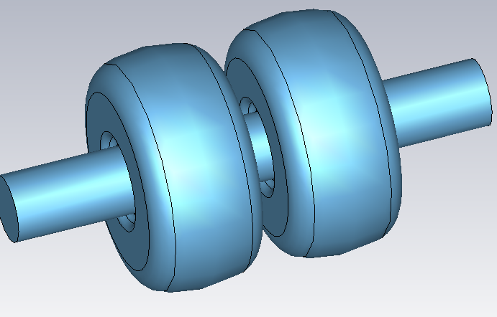



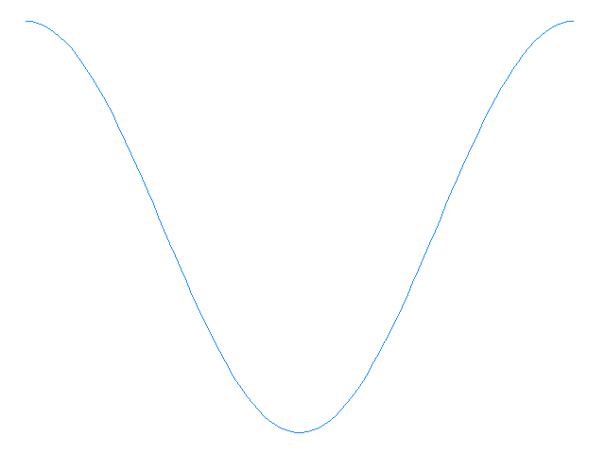

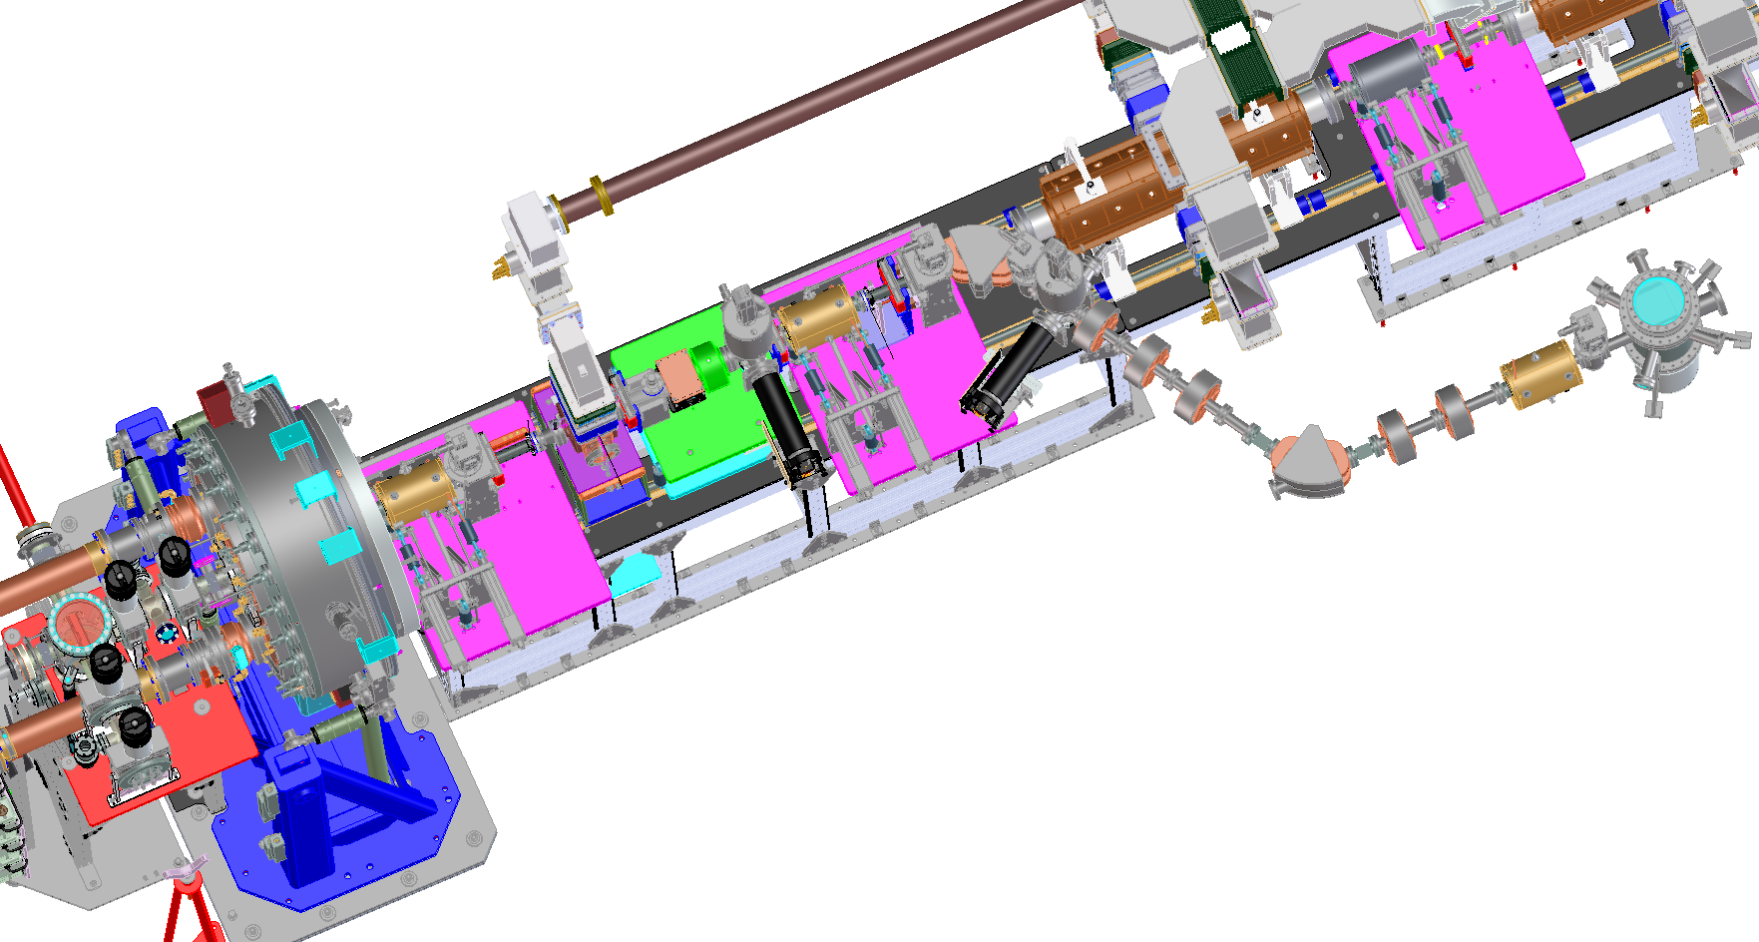
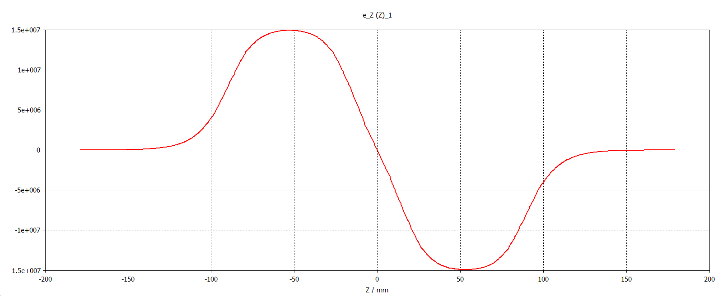
UED beamline design:
Further compression
R₅₆≠0
Energy filtering
Chirp
E
E
E
x
t
t
E
t

Slide 16
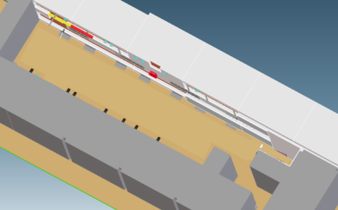
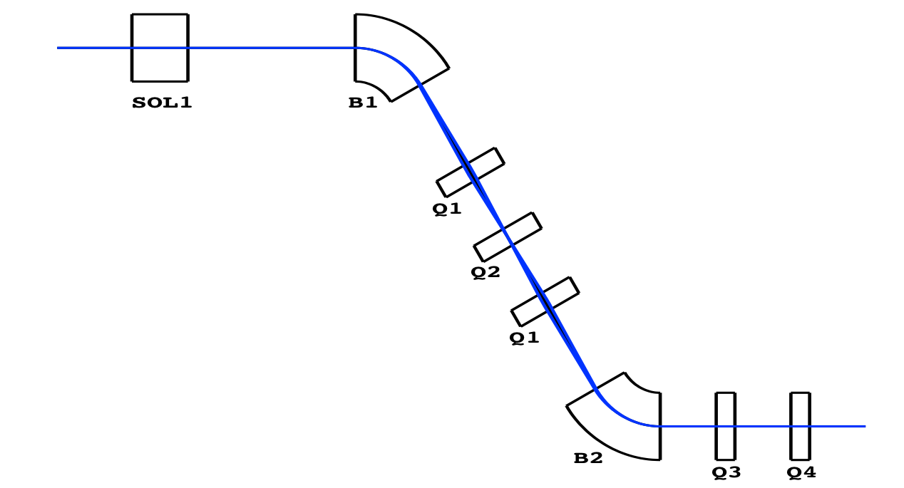
UED e- optics design
3 m
Constrains:
Avoid interference with acc. cavity rf waveguides (60 deg angle)
Fit in 1m width (65’’ overall)
Achromatic optics (R_{16,}R_{26,} =0)
Large R₁₆ at the energy collimator for time shaping,
Non zero R₅₆ to be used for beam compression in conjunction with the buncher cavity
Sol 1 makes an image at the aperture plane
Beam size kept small along the beamline (avoid non linearities), and round at the exit before last sol
15 m
Optimization with COSY:
lbend := 0.209 m
bfield := -0.192 E-01 T
length2 := 0.448 m
width := 1.0141 m
total_length := 1.366 m
kq1 := 167.448 1/m^2
kq2 := -210.204 1/m^2
kq3 := 11.944 1/m^2
kq4 := 149.947 1/m^2
R₁₆=0.149 m
W. Wan

Slide 17
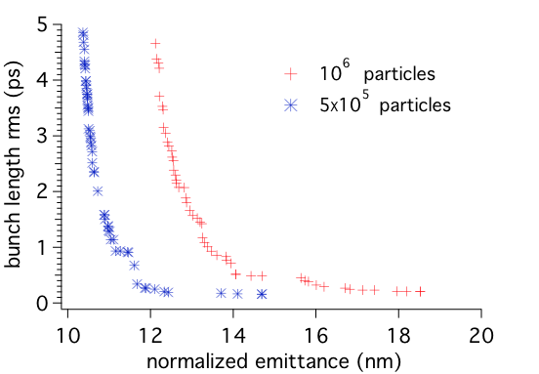


Preliminary beamline optimizations
Use the Astra code with the Genetic optimizer (NSGA-II)
Free parameters:
rf buncher amplitude and phase
Gun phase,
Solenoids’ fields
transverse and longitudinal laser beam size
Example: optimize for emittance and bunch length at the sample,
Constraint: beam Size smaller than 50μm
σ_{t}=100 fs
σ_{x}=50 μm
ε= 15 nm

Slide 18



Science drivers
    Focus on ultrafast, reversible processes (though single shot possible):
    Faster integrated measurements
    Higher SNR in shorter time, weakly scattering targets
    Gas phase/hydrated samples
    3D imaging of aligned molecules
    Rep. rate matches with droplet injectors
    sample waist minimized (biology)
May enable new science, as “tickle and probe”
    Weakly pumped systems. Non need to wait for relaxation time. Fully exploit the repetition rate. Lasers could be microfocused on sample via fibers.
C.J. Hensley et al
Phys. Rev. Lett. 109, 133202 (2012)
    D.P. DePonte et al.,
    J. Phys. D: Appl. Phys. 41, 195505 (2008)

Slide 19



Pump Lasers
100 W/1MHz/11ps Cryo-Yb:Yag laser system is already in house as result of a
STTR with Qpeak.
Provides high quality transverse quality (M^2=1.2)
Can be used as pump laser for less demanding experiments (molecule alignment), or as pump for OPCPA systems, amplifying ultrashort ti-saf pulses

Slide 20
Conclusions
State of the art MHz electron sources can enable high average flux MeV ED
System phase noise can be substantially decreased by high BW feedbacks, providing ultrastable probes at MHz.
A dedicated UED beamline is being designed@LBNL.
Working the CSD and MSD for possible experiments
The ultimate goal for the source: e- equivalent of a synchrotron source, with femtosecond resolution.

