Slide 1




Laboratory for Ultrafast Microscopy and Electron Scattering
Time-domain observation of coherent phenomena in
solids and nano-structures
Fabrizio Carbone
Ecole Polytechnique Federale de Lausanne
Key West, December 2013

Slide 2
Outline, overview of LUMES activities
Overview of ultrafast experiments in solids:
- The mechanisms behind phase transitions and the formation of different states of matter.
- Where are these phenomena observable?
- Information in multiple dimensions, static (steady state) and time-resolved.
- How to perform specific excitations in solids.
Examples
- The ISRS mechanism and the coherent oscillations of Cooper pairs.
- Laser-induced uniaxial pressure to probe orbital-ordering or topological transitions
(talk by Luca Piazza).
Perspective, combining tools
- Choose what to excite and where to probe it……….X-ray pump/TEM probe

Slide 3
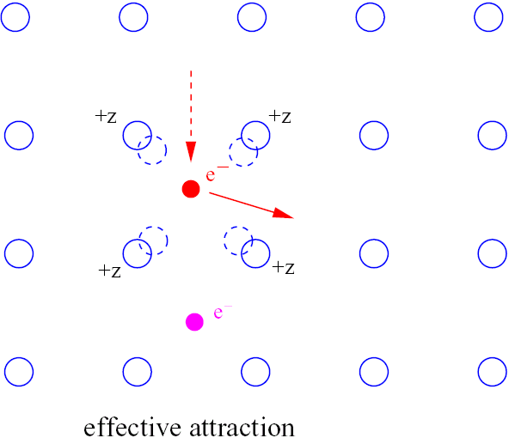
BCS superconductivity (structurally driven)

Slide 4
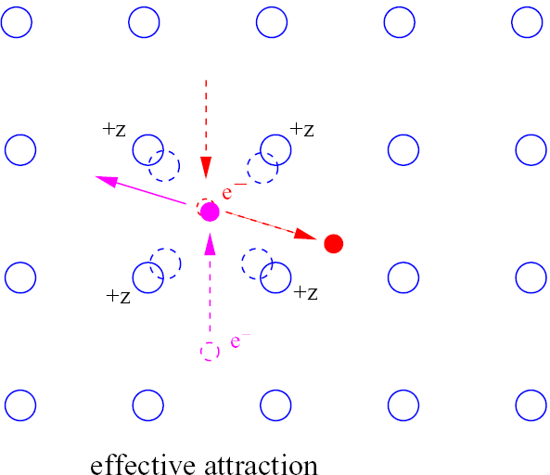
BCS superconductivity (structurally driven)

Slide 5
Strongly correlated systems physics (Mott, CT) electronic driven
Half-filling
U>W, Mott insulator
U=0
Cu
E_{CT}
E_{F}
U
E_{CT} = 2 eV
t = 0.3 eV
U = 9 eV
O
B
NB
AB
E
B
NB
LHB
UHB
E
Hole doping
Doping hybridization, splits B
U
U>E_{CT}, CT insulator
U
E_{CT}
E_{CT}
ZRS
E_{F}
LHB
B
NB
UHB
LHB
T
NB
ZRS
UHB
E
W. Stephan, and P. Horsch, Phys. Rev. B 42 8736 (1990).

Slide 6
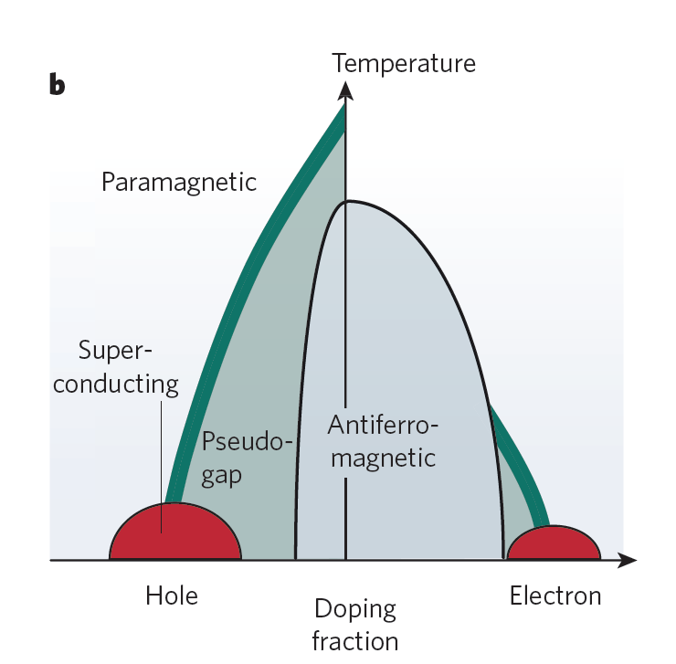
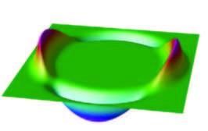
Cuprates phase diagram
d-wave order parameter
antinodes
nodes
Fermi
liquid
Fermi
liquid
Mazin, Nature 464 (2010)

Slide 7
Manganites Jan-Taller, magnetic exchange, spin-orbit (structure+electronic)
M. B. Salamon and M. Jaime, “The physics of manganites: Structure and transport,” Rev. Mod. Phys. 73, 583 (2001).

Slide 8
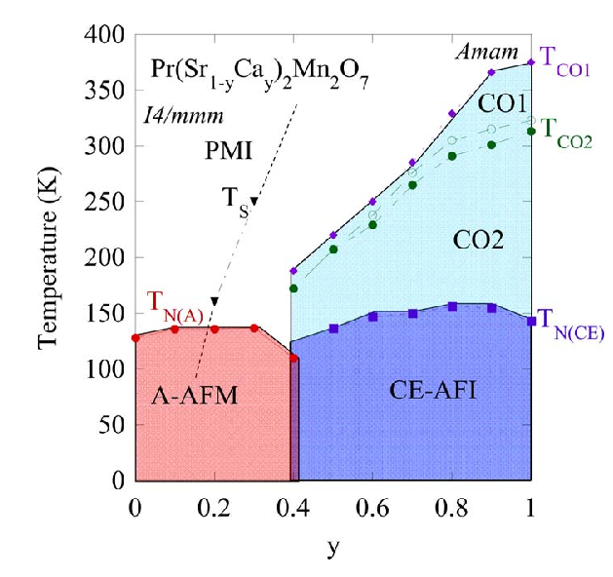
Manganites phase diagram
Competition between:
CF, J, SO
Tuning:
doping, pressure, magnetic field,
laser light?
Z. A. Li et al., “A checkerboard orbital-stripe phase and charge ordering transitions in Pr(SrxCa2x)Mn2O7 (0<x<0.45),”
Europhys. Lett. 86, 67010 (2009).

Slide 9
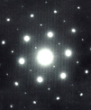
Energy/momentum(rec. space)/intensity diagram of excitations in solids
Many-body absorptions
Bi-magnon
multiphonons….
0.1 eV
Electronic states
gaps
magnons….
0.01 eV
Phonons
acoustic
optical
CT, Mott gaps
1-2 eV
d-d
1 eV
TM L-edges
300-1000 eV
K-edges
XANES
EXASF
1-10 keV
ARPES
rec.space, (A⁻¹)
optics
diffraction
EELS
XAS
RXD
deeper levels
no dispersion
center of mass
XAS
Energy loss, (eV)

Slide 10
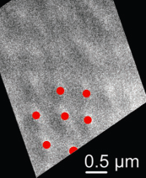
Energy/real-space/intensity diagram of excitations in solids
(X-ray microscopy)
nm
o
A
ZL
X-ray magnetic
speckle
Energy, (eV)
μm
10² μm
Plasmons (eV)
10² nm
core
10² eV
PRB 88, 014505 (2013)
TEM
Real space, (A)

Slide 11
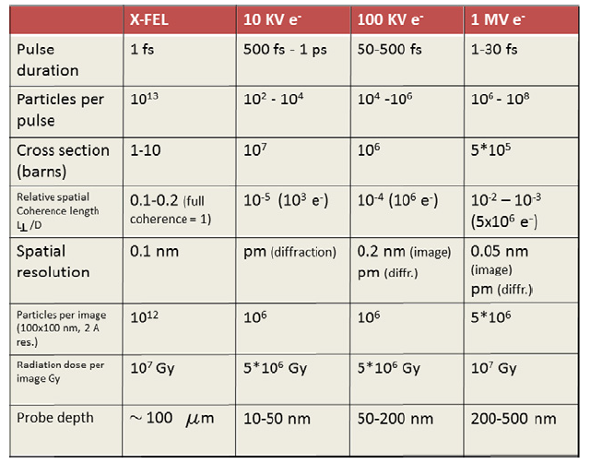
X-rays/electrons comparison
"A perspective on novel sources of ultrashort electron and X-ray pulses", F. Carbone, P. Musumeci, O.J. Luiten, C. Hebert, Chemical Physics, 392, 1, (2012)

Slide 12
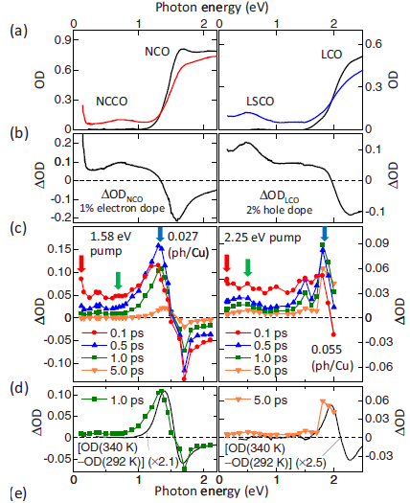
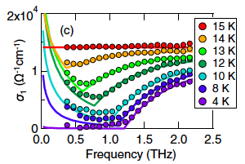
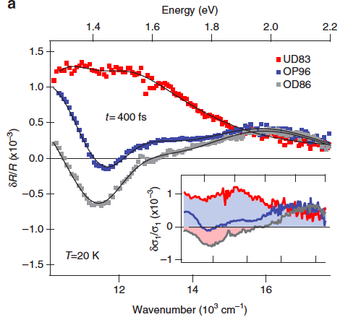
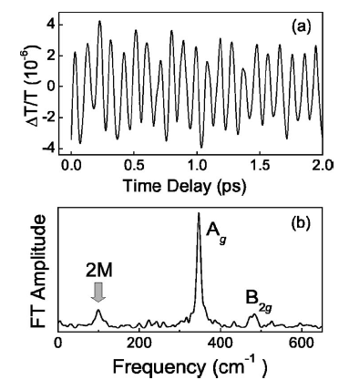
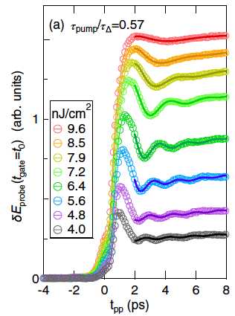
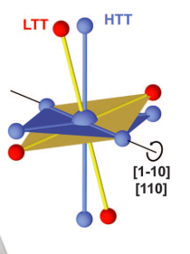
Excitation mechanisms
Excitation processes in solids
PRB 82 (2010)
Science 331, 189 (2011);
PNAS 110, 4539 (2013)
Many-body absorptions
Bi-magnon
multiphonons….
0.1 eV
NatComm 2:353 (2011)
Electronic states
gaps
magnons….
0.01 eV
Phonons
acoustic
optical
CT, Mott gaps
1-2 eV
PRL 111, 057002 (2013)
PRB 73, 184434 (2006)
d-d
1 eV
TM L-edges
300-1000 eV
rec.space, (A⁻¹)
X-ray excitation:
Direct absorption photodoping
Resonant Raman, chemically
selective excitation
Momentum-resolved
Direct absorption
THz
Direct absorption
FIR
ISRS
XFEL
Direct absorption
ISRS
VIS
Energy loss, (eV)

Slide 13
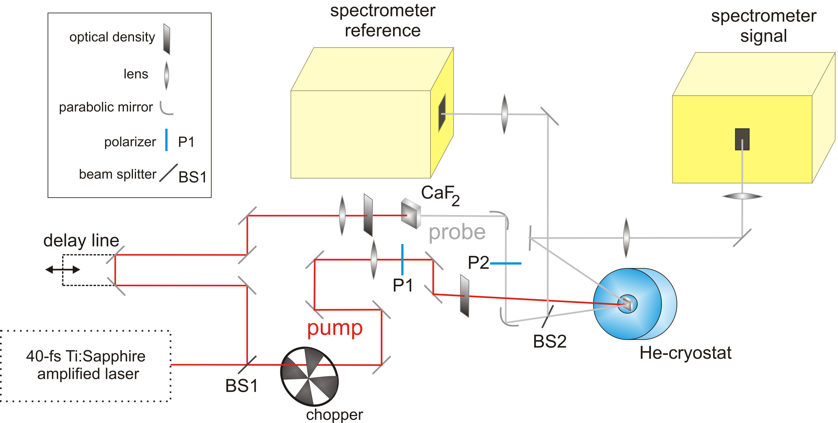
Excitation mechanisms
Example: fs-optical spectroscopy of the coherent oscillation of Cooper pairs
"Evidence for a Peierls phase-transition in a three-dimensional multiple charge-density waves solid."
B. Mansart, M.J.G. Cottet, T. Penfold, S. Dugdale, R. Tediosi, M. Chergui, F. Carbone. PNAS109, 5603 (2012).

Slide 14
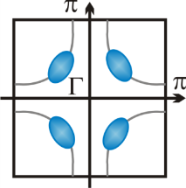
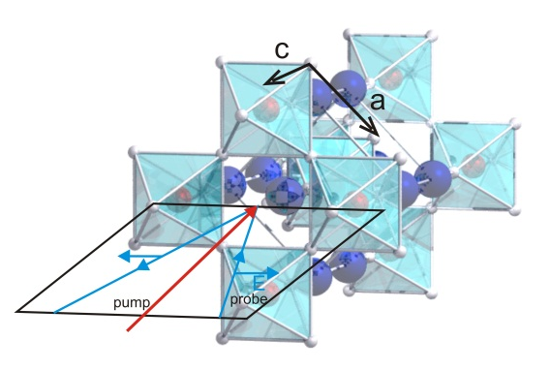
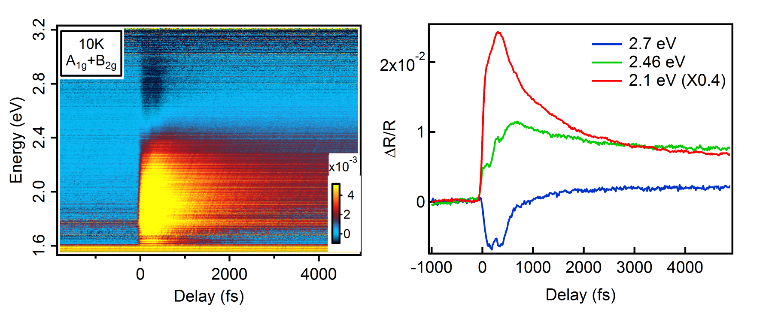
Excitation mechanisms
Transient reflectivity in B_{2g} Raman geometry
E_{pump}//(110), E_{probe}//(110), k//001
F ~ 300 μJ/cm²
A_{1g}+B_{2g} Raman excitation
The signal changes sign as a function of wavelength
Observation of coherent oscillations
"Coupling of a high-energy excitation to superconducting quasiparticles in a cuprate from coherent charge fluctuation spectroscopy",
B. Mansart, J. Lorenzana, A. Mahn, A. Odeh, M. Scarongella,M. Chergui, and F. Carbone, PNAS 110, 4539 (2013).
“Investigating pairing interactions with coherent charge fluctuation spectroscopy",
J. Lorenzana, B. Mansart, A. Mann, A. Odeh, M. Chergui, F. Carbone, EPJ 222, 1223-1239, (2013).

Slide 15
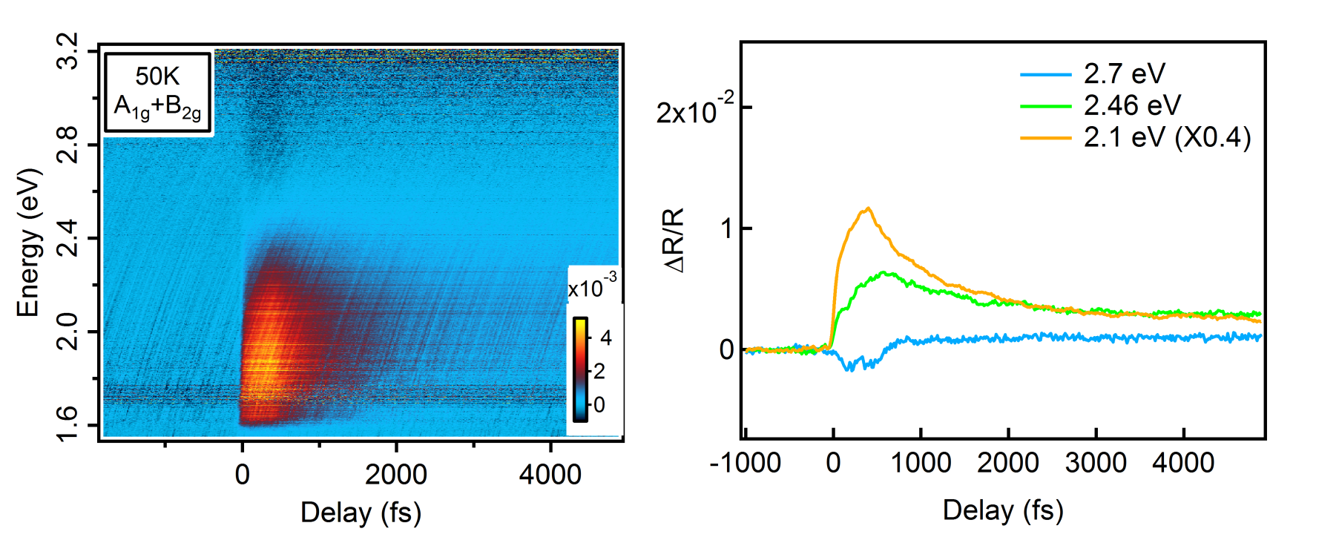
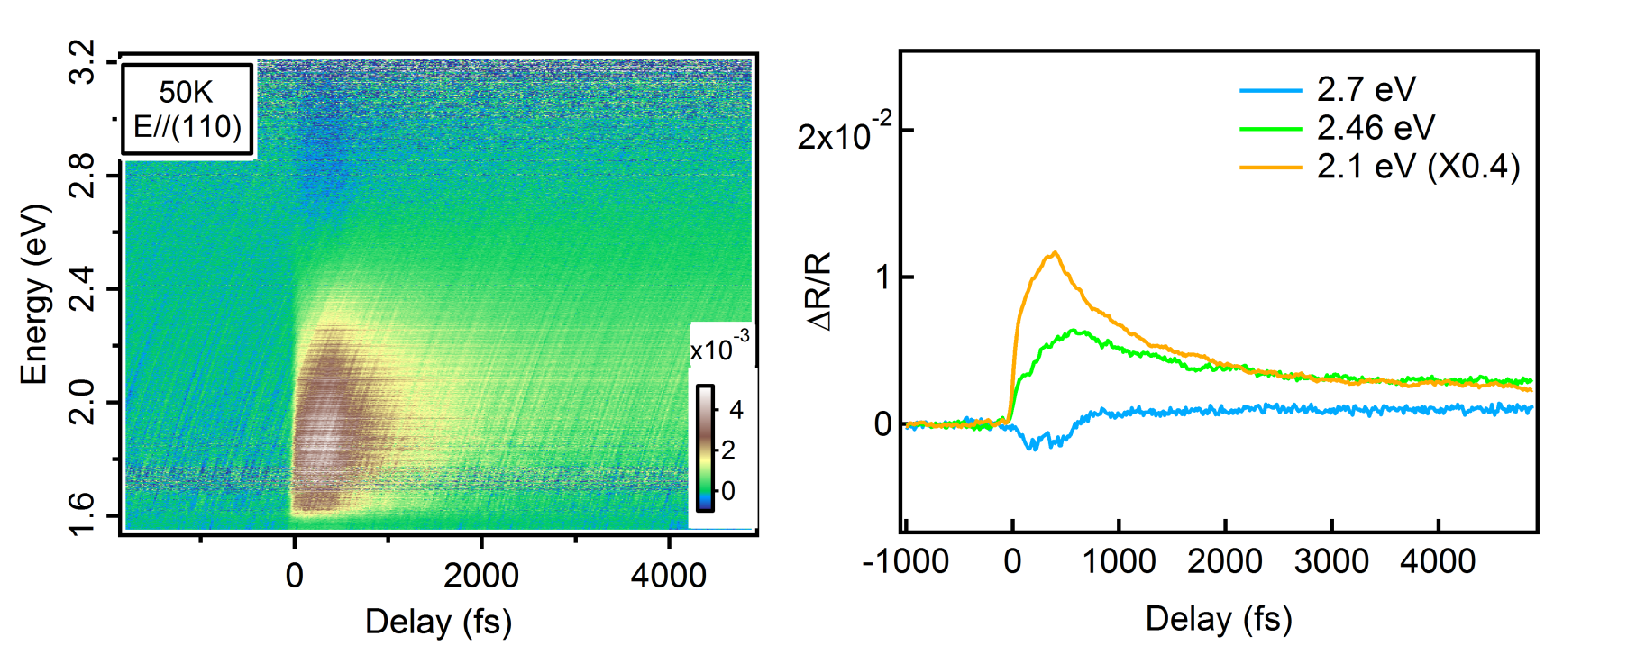
Excitation mechanisms
Transient reflectivity in B_{2g} Raman geometry
E_{pump}//(110), E_{probe}//(110), k//001
F ~ 300 μJ/cm²
A_{1g}+B_{2g} Raman excitation
The signal changes sign as a function of wavelength
The coherent oscillations vanish above T_{c}
"Coupling of a high-energy excitation to superconducting quasiparticles in a cuprate from coherent charge fluctuation spectroscopy",
B. Mansart, J. Lorenzana, A. Mahn, A. Odeh, M. Scarongella,M. Chergui, and F. Carbone, PNAS 110, 4539 (2013).
“Investigating pairing interactions with coherent charge fluctuation spectroscopy",
J. Lorenzana, B. Mansart, A. Mann, A. Odeh, M. Chergui, F. Carbone, EPJ 222, 1223-1239, (2013).

Slide 16
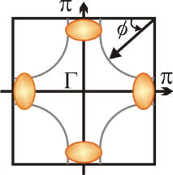
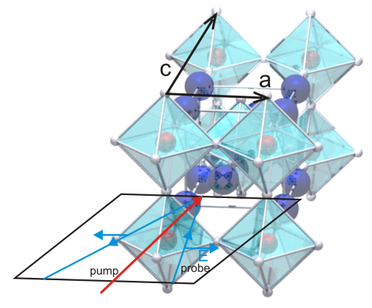
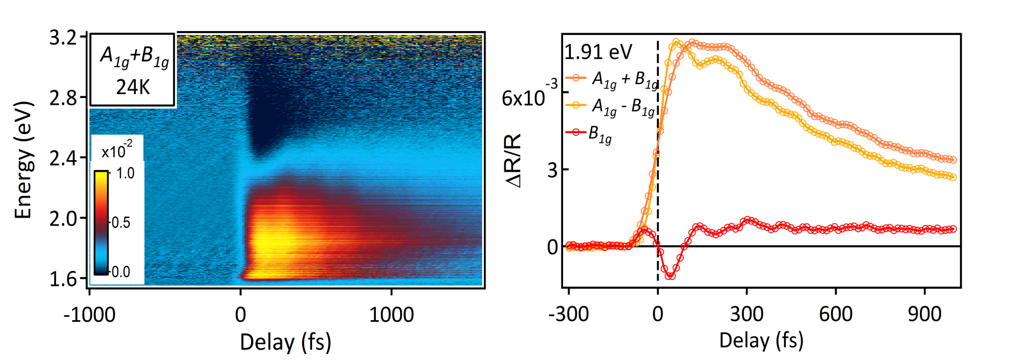
Excitation mechanisms
Transient reflectivity in B_{1g} Raman geometry
E_{pump}//(100), E_{probe}//(100), k//001
F ~ 300 μJ/cm²
A_{1g}+B_{1g} Raman excitation
The signal changes sign as a function of wavelength
The coherent oscillations vanish above T_{c}
"Coupling of a high-energy excitation to superconducting quasiparticles in a cuprate from coherent charge fluctuation spectroscopy",
B. Mansart, J. Lorenzana, A. Mahn, A. Odeh, M. Scarongella,M. Chergui, and F. Carbone, PNAS 110, 4539 (2013).
“Investigating pairing interactions with coherent charge fluctuation spectroscopy",
J. Lorenzana, B. Mansart, A. Mann, A. Odeh, M. Chergui, F. Carbone, EPJ 222, 1223-1239, (2013).

Slide 17
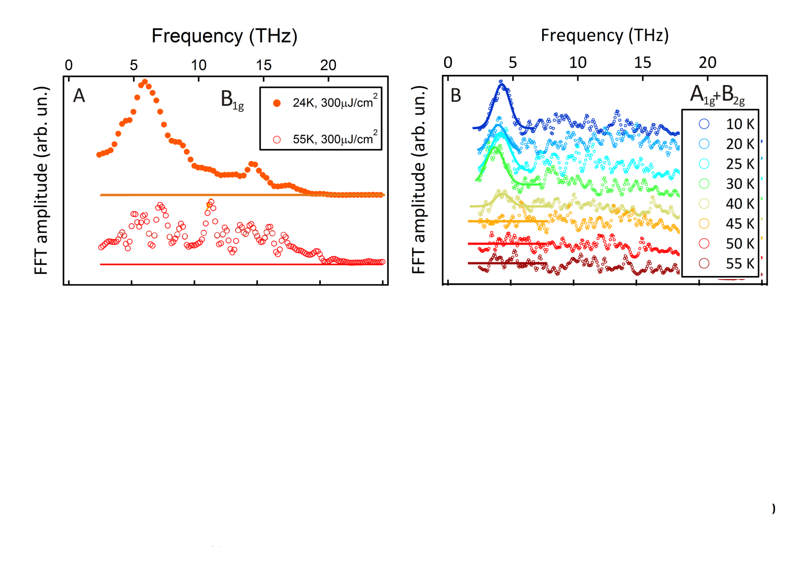
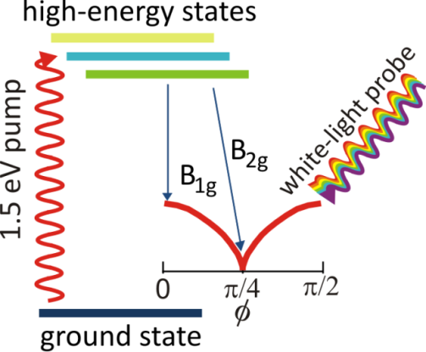
Excitation mechanisms
FFT of the time-domain signal and the SC gap
Ultrafast experiments compared to static Raman scattering
"Coupling of a high-energy excitation to superconducting quasiparticles in a cuprate from coherent charge fluctuation spectroscopy",
B. Mansart, J. Lorenzana, A. Mahn, A. Odeh, M. Scarongella,M. Chergui, and F. Carbone, PNAS 110, 4539 (2013).
“Investigating pairing interactions with coherent charge fluctuation spectroscopy",
J. Lorenzana, B. Mansart, A. Mann, A. Odeh, M. Chergui, F. Carbone, EPJ 222, 1223-1239, (2013).

Slide 18
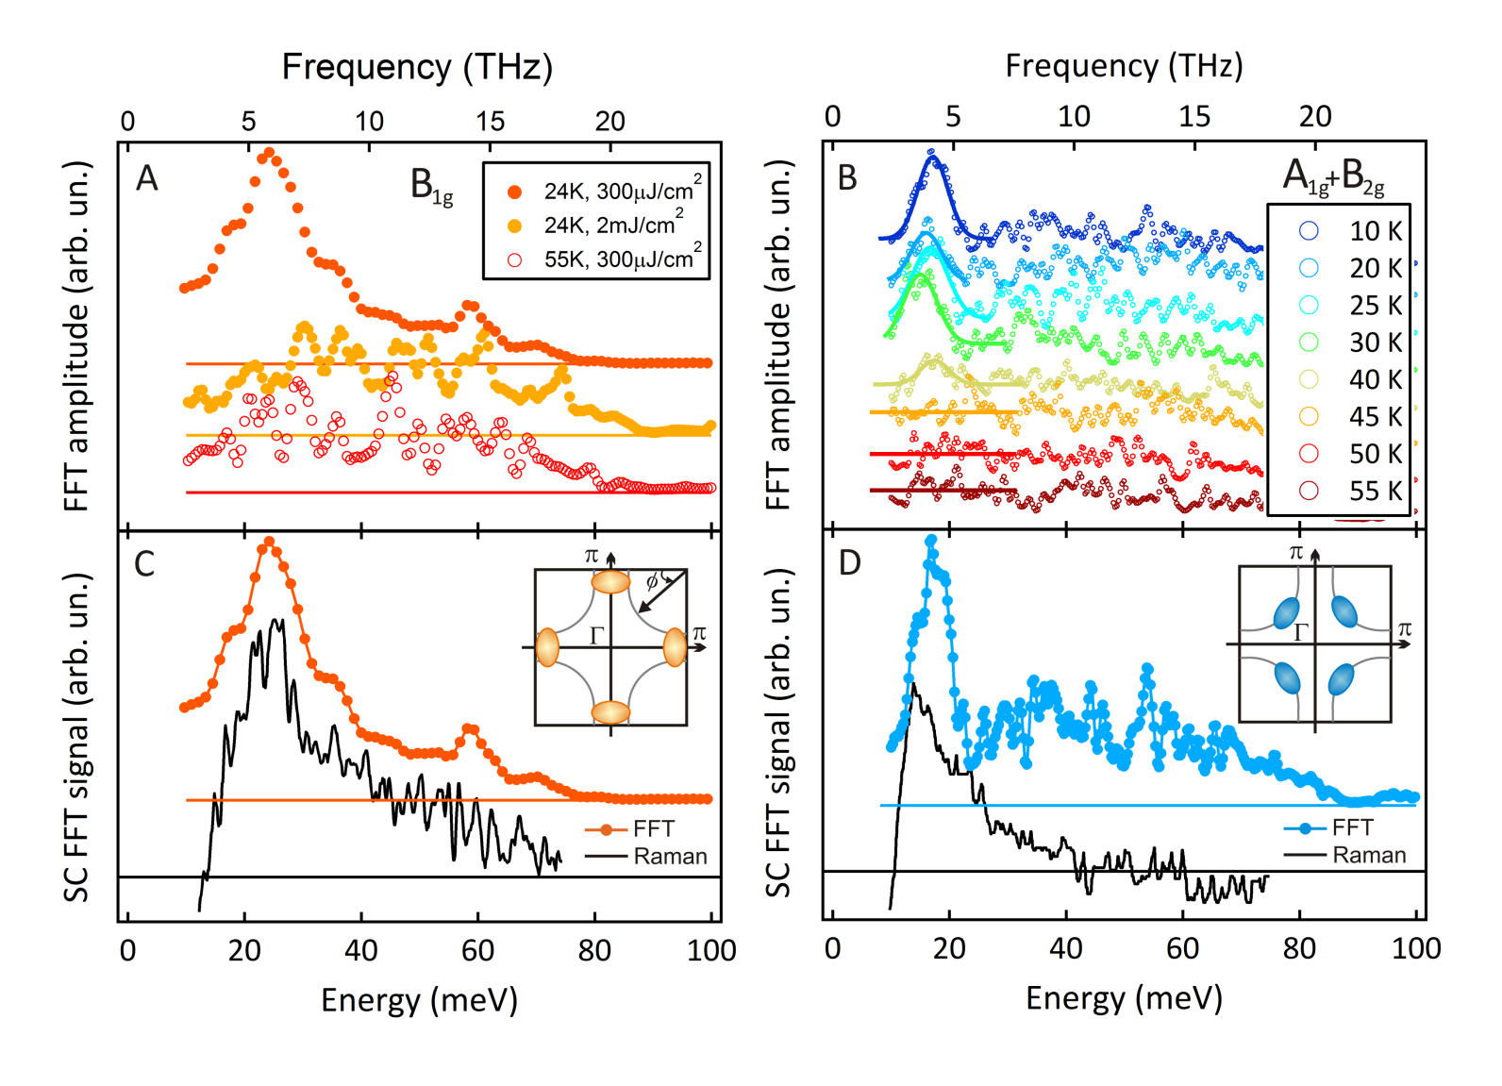
Excitation mechanisms
FFT of the time-domain signal and the SC gap
Ultrafast experiments compared to static Raman scattering
"Coupling of a high-energy excitation to superconducting quasiparticles in a cuprate from coherent charge fluctuation spectroscopy",
B. Mansart, J. Lorenzana, A. Mahn, A. Odeh, M. Scarongella,M. Chergui, and F. Carbone, PNAS 110, 4539 (2013).
“Investigating pairing interactions with coherent charge fluctuation spectroscopy",
J. Lorenzana, B. Mansart, A. Mann, A. Odeh, M. Chergui, F. Carbone, EPJ 222, 1223-1239, (2013).

Slide 19
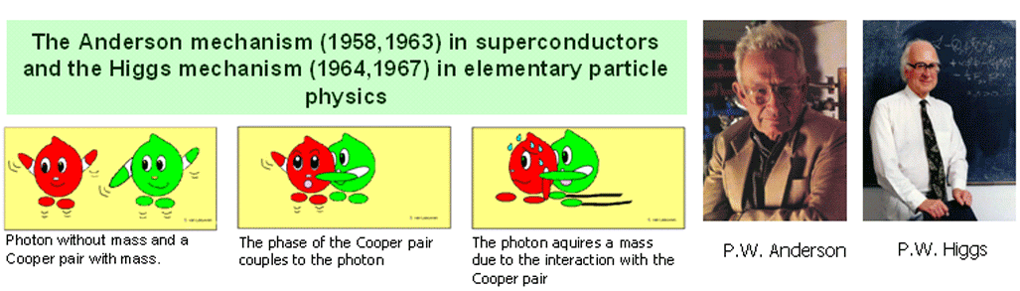
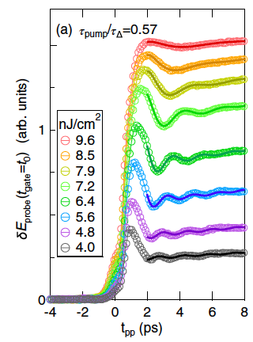
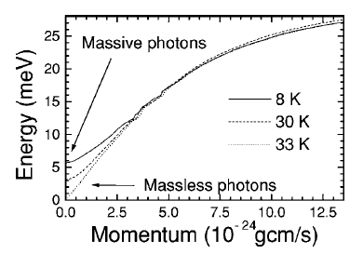
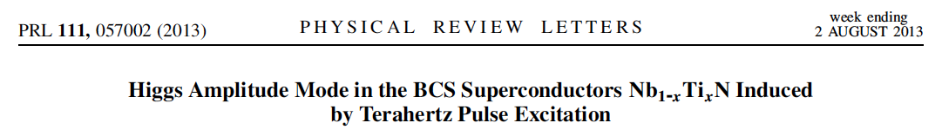
Excitation mechanisms
Intimate meaning of the gap in SC
PNAS 110, 4539 19 March (2013)
Coupling between photons and
Cooper pairs in the gap region
Yields massive bosons

Slide 20
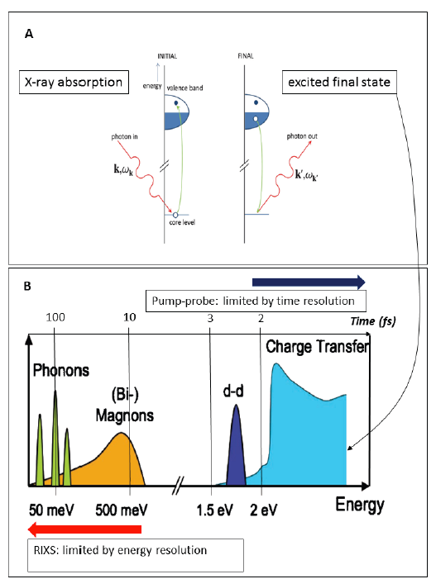
Excitation mechanisms
Coherent control via chemical selectivity and momentum sensitivity
X-ray pump:
Higher yield for ISRS processes
@ comparable fluence, 10-100
more population of the excited state
Chemical selectivity
tuning excitation energy at resonances
Momentum sensitivity
ability to prepare carriers anywhere in
k-space
“A proposal for fs-electron microscopy experiments on
high-energy excitations in solids.”
Submitted to Micron

Slide 21
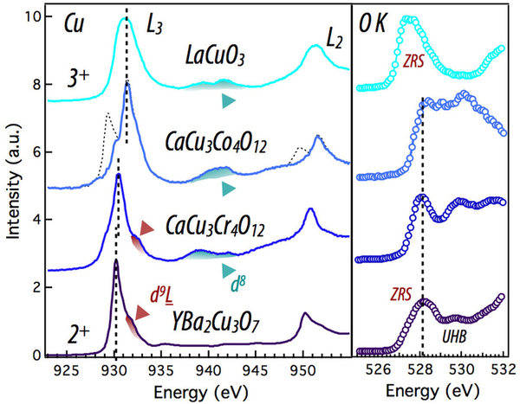
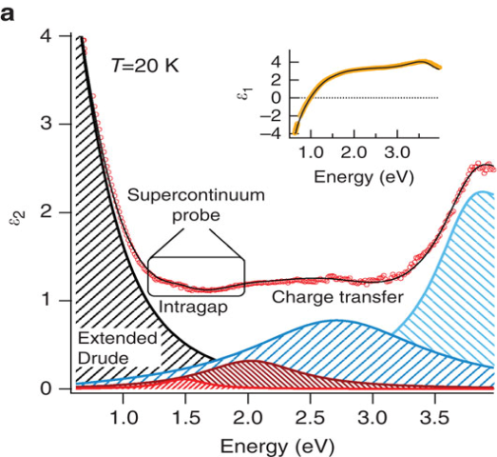

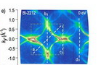
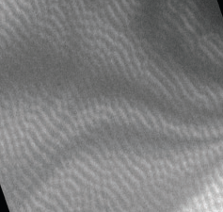
Excitation mechanisms
The highest potential for the excitation, the widest selection for the probe
optics
diffraction
photoemission
Lorentz microscopy
Choosing the probe
Tuning the pump
L-edge excitation yields 10-100 times more Bogoliubons
then 1.55 eV excitation at comparable fluence
Broad search for SC resonance
“A proposal for fs-electron microscopy experiments on high-energy excitations in solids.” Submitted to Micron

Slide 22
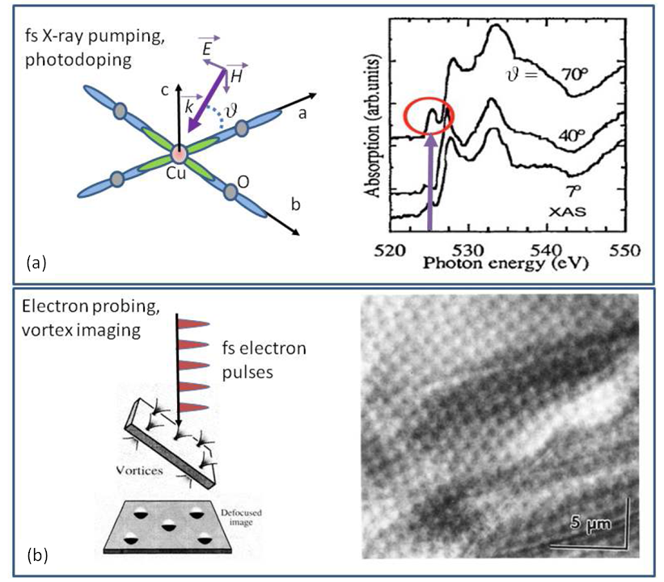
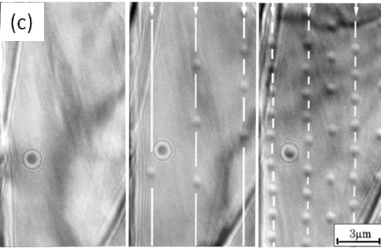
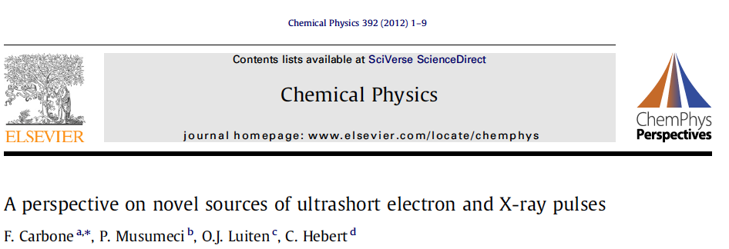
Excitation mechanisms
SC dynamics, photodoping

Slide 23


Excitation mechanisms
Combine broad probing and pumping range
Many-body absorptions
Bi-magnon
multiphonons….
0.1 eV
Phonons
acoustic
optical
Electronic states
gaps
magnons….
0.01 eV
Pump:
XFEL
Laser
d-d
1 eV
CT, Mott gaps
1-2 eV
TM L-edges
300-1000 eV
rec.space, (A⁻¹)
X-ray excitation:
Direct absorption photodoping
Resonant Raman, chemically
selective excitation
Momentum-resolved
Direct absorption
THz
Direct absorption
FIR
Energy loss, (eV)
ISRS
Direct absorption
ISRS
VIS
XFEL
Probe:
photons
electrons
Many-body absorptions
Bi-magnon
multiphonons….
0.1 eV
(X-ray microscopy)
nm
Electronic states
gaps
magnons….
0.01 eV
Phonons
acoustic
optical
CT, Mott gaps
1-2 eV
d-d
1 eV
TM L-edges
300-1000 eV
K-edges
XANES
EXASF
1-10 keV
o
A
ZL
X-ray magnetic
speckle
ARPES
Energy, (eV)
μm
10² μm
Plasmons (eV)
10² nm
rec.space, (A⁻¹)
core
10² eV
optics
diffraction
EELS
XAS
RXD
deeper levels
no dispersion
center of mass
Energy loss, (eV)
XAS
TEM
Real space, (A)

Slide 24
Conclusions:
Current facilities at LUMES:
- fs optical spectroscopy (40 meV-4 eV, q=0) (Coherent control of SC)
- fs electron diffraction (20 KHz, 10⁵ e⁻/pulse, 200 fs)
- fs TEM (250 KHz-5 MHz, 350 fs, Lorentz, 1-1000 eV, q dependence)
(Uniaxial pressure effects in a Manganite) L. Piazza et al. Structural Dynamics 1, 1 (2013) Cover.
- fs ARPES (0-1 eV, q dependence, under construction)
EPFL center for ultrafast science (collaboration with prof. Chergui)
- fs X-ray diffraction (200 fs, slicing beamline at PSI)
- fs X-ray absorption spectroscopy (>1000 eV, 200 fs, slicing beamline at PSI)
Perspective experiments:
- XFEL-pump/multidimensional probe (optics, TEM) (under propaganda)
References:
"Evidence for a Peierls phase-transition in a three-dimensional multiple charge-density waves solid."
B. Mansart, M.J.G. Cottet, T. Penfold, S. Dugdale, R. Tediosi, M. Chergui, F. Carbone. PNAS109, 5603 (2012).
"Design and implementation of a flexible beamline for fs electron diffraction experiments"
G.F. Mancini, B. Mansart, S.Pagano; B. van der Geer,M. de Loos, F. Carbone, Nucl. Instr. Meth. in Phys. Res. A, 691, 113-122 (2012).
"Coupling of a high-energy excitation to superconducting quasiparticles in a cuprate from coherent charge fluctuation spectroscopy",
B. Mansart, J. Lorenzana, A. Mahn, A. Odeh, M. Scarongella,M. Chergui, and F. Carbone, PNAS 110, 4539 (2013).
"Quantitative imaging of flux vortices in the type-II superconductor MgB2 using cryo-Lorentz transmission electron microscopy",
M. Cottet, M. Cantoni, B. Mansart, D. T. L. Alexander, C. Hébert, J. Karpinski, F. Carbone. PRB 88, 014505 (2013). Editors' Suggestion.
"Design and implementation of a fs-resolved transmission electron microscope based on thermionic gun technology",
L. Piazza, D.J. Masiel, T. LaGrange, B.W. Reed, B. Barwick, F. Carbone, Chem. Phys., Volume 423, pp 79-84 (2013).

