Slide 1

Imaging at the nanometer and femtosecond
scales with ultrafast electron microscopy
Brett Barwick
Trinity College Physics Department
Hartford, CT
time

Slide 2
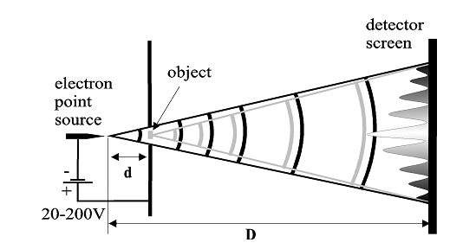
Ultrafast electron microscopy at Trinity College
UEM in my lab is based on a point projection ultrafast electron microscope
Chosen for its simplicity, cost and flexibility

Slide 3
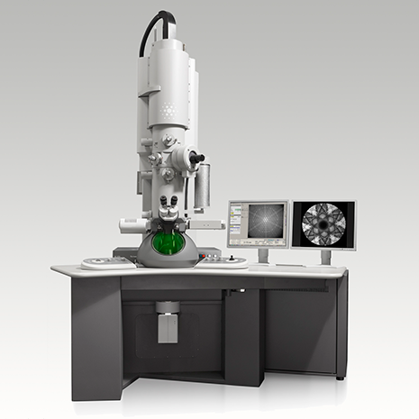
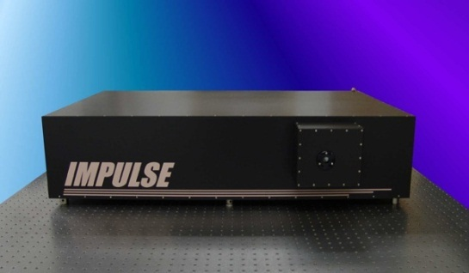
At Caltech:
TEM~ $1 million
laser~ $500k
Lab ~ $1 million
Post docs, graduate students

Slide 4
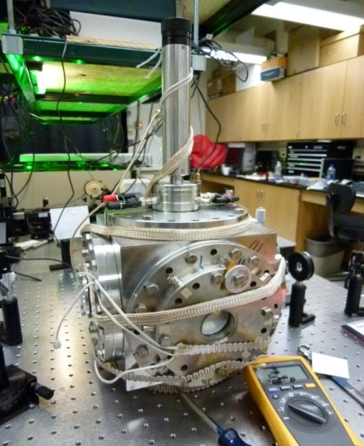
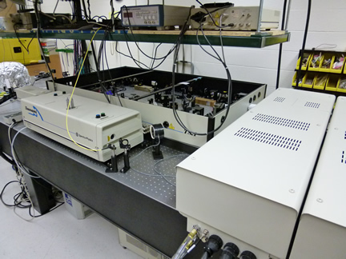
At Caltech:
At Trinity:
TEM~ $1 million
Point projection/UEM
~$40k, homebuilt
laser~ $500k
laser ~ donated
Lab ~ $1 million
Post docs, graduate students
Undergraduates

Slide 5
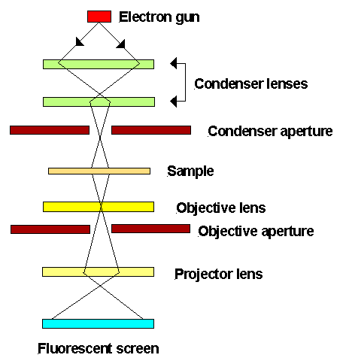
Dispersion in UEM base on standard TEM:
Causes of temporal spread:
Space charge
Dispersion
Assuming no space charge how can we get around dispersion?
TEM

Slide 6
Dispersion in UEM base on standard TEM:
Causes of temporal spread:
Space charge
Dispersion
Assuming no space charge how can we get around dispersion?
1) RF compression, already shown successful for UED in multiple groups
TEM

Slide 7
Dispersion in UEM base on standard TEM:
Causes of temporal spread:
Space charge
Dispersion
Assuming no space charge how can we get around dispersion?
1) RF compression, already shown successful for UED in multiple groups
2) Optical/ponderomotive compression, should work in principle not demonstrated
TEM

Slide 8
Dispersion in UEM base on standard TEM:
Causes of temporal spread:
Space charge
Dispersion
Assuming no space charge how can we get around dispersion?
1) RF compression, already shown successful for UED in multiple groups
2) Optical/ponderomotive compression, should work in principle not demonstrated
3) Don’t let the pulse have the time to disperse
TEM

Slide 9
Length scales in TEM versus point projection EM:
TEM
PPEM
~1 m
~10 µm

Slide 10
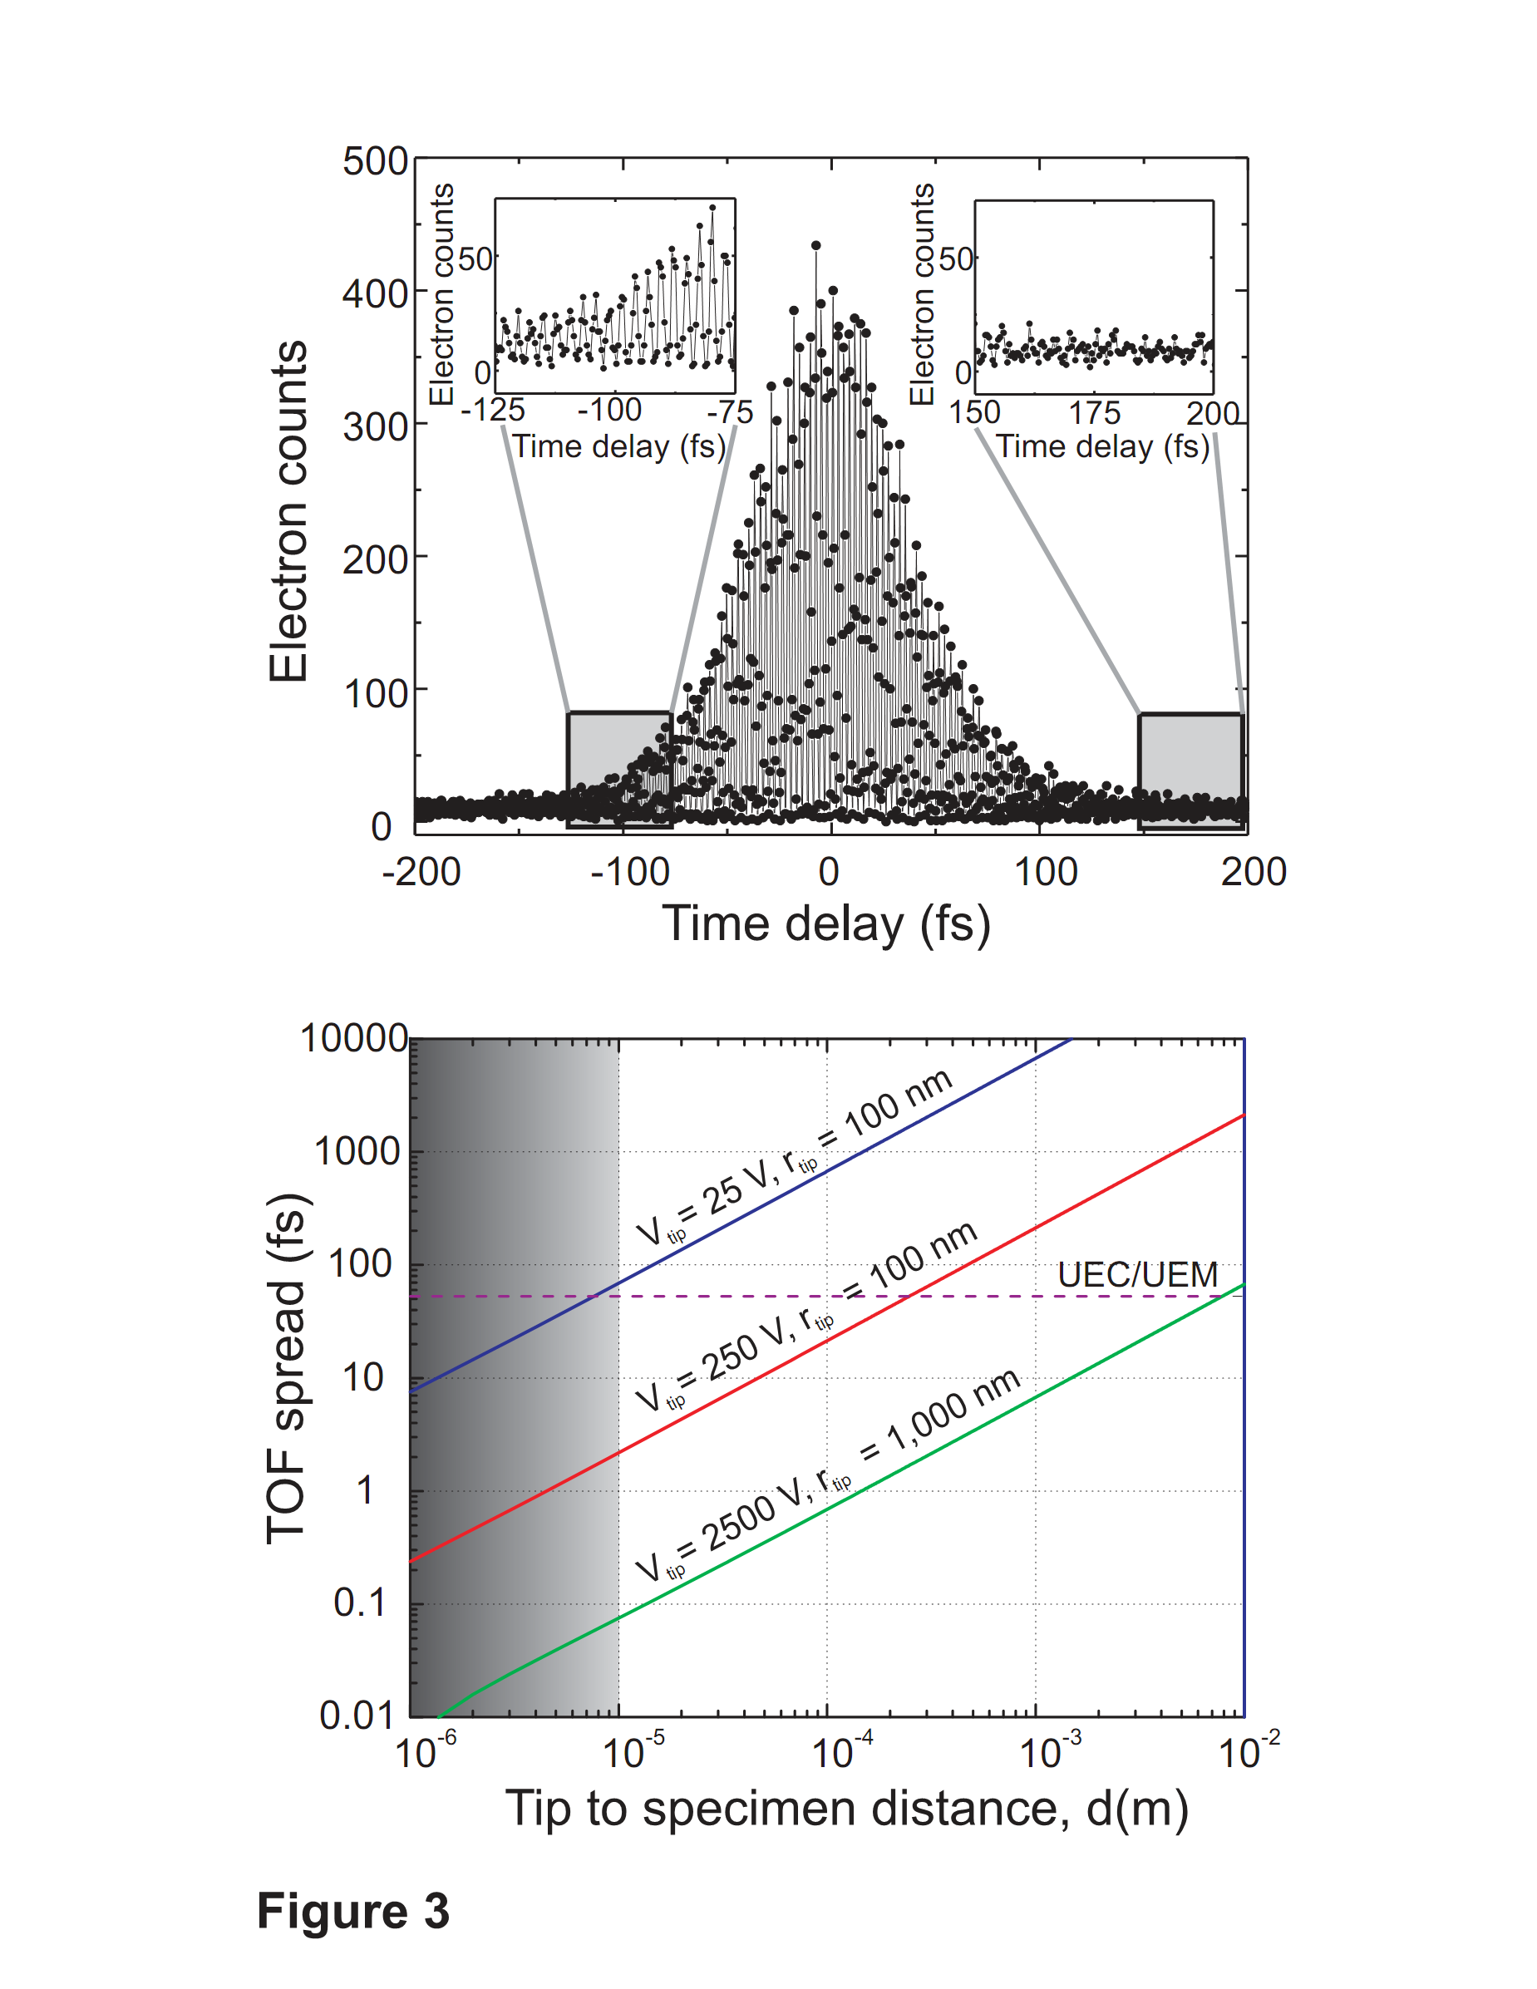
Modeling: Advantage of point projection versus
UEM base on standard TEM
- Standard UEM’s are limited – dispersion causes reduction in temporal resolution
- PPUEM, with tip very close to specimen can be one solution to this problem
“Femtosecond photoelectron point projection microscope”,
Erik Quinonez, Jonathan Handali and Brett Barwick. Review of Scientific Instruments. 84, (2013) 103710.

Slide 11
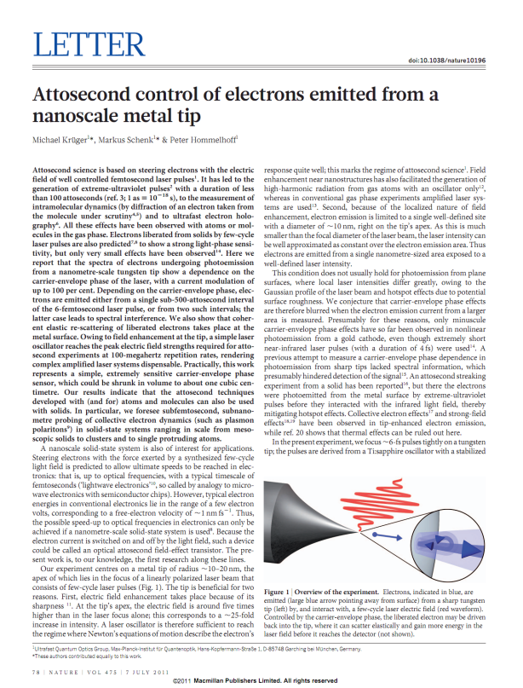
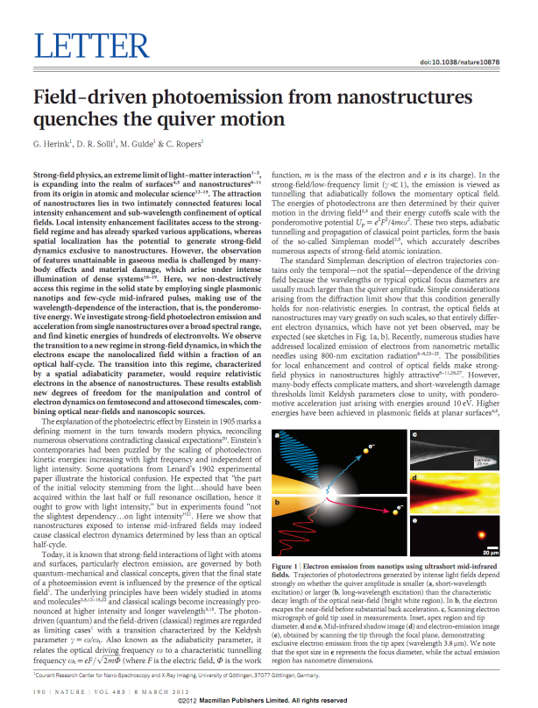
Ultrafast nanometer tip sources have been shown to produce sub-cycle attosecond electron packets

Slide 12
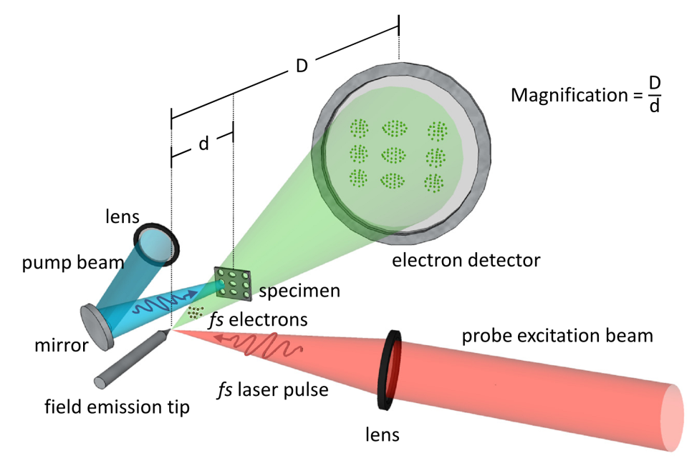
Current progress and device characterization
Our device:
“Femtosecond photoelectron point projection microscope”,
Erik Quinonez, Jonathan Handali and Brett Barwick. Review of Scientific Instruments. 84, (2013) 103710.

Slide 13
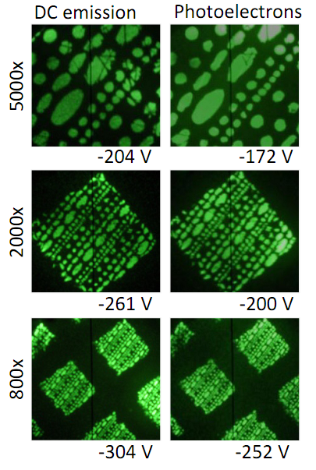
Characterization: Imaging with photoelectrons
“Femtosecond photoelectron point projection microscope”,
Erik Quinonez, Jonathan Handali and Brett Barwick. Review of Scientific Instruments. 84, (2013) 103710.

Slide 14
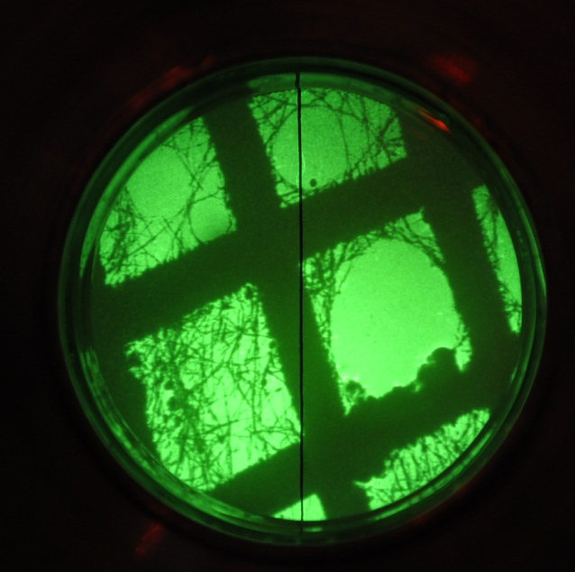
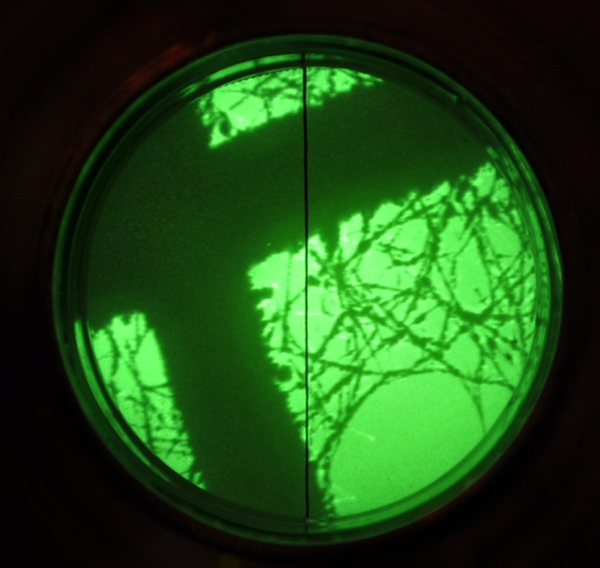
Characterization: Imaging with photoelectrons
56 eV
photoelectrons
~80MHz,
~1 sec exposure
“Femtosecond photoelectron point projection microscope”,
Erik Quinonez, Jonathan Handali and Brett Barwick. Review of Scientific Instruments. 84, (2013) 103710.

Slide 15
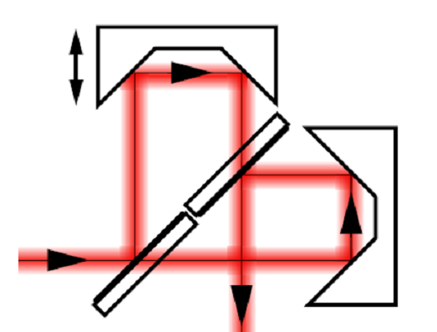
Characterization: Emission time of electrons
Δt
single
pulse
Δt
double
pulse
electron
detector
tip
electron pulse
“Femtosecond photoelectron point projection microscope”,
Erik Quinonez, Jonathan Handali and Brett Barwick. Review of Scientific Instruments. 84, (2013) 103710.

Slide 16
Characterization: Emission time of electrons
Δt
single
pulse
Δt
double
pulse
electron
detector
tip
electron pulse
“Femtosecond photoelectron point projection microscope”,
Erik Quinonez, Jonathan Handali and Brett Barwick. Review of Scientific Instruments. 84, (2013) 103710.

Slide 17
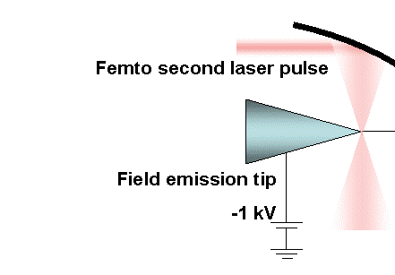
Characterization: Time of flight energy analysis
Femtosecond laser pulses
2-D Electron
detector
13 ns
Correlation
electronics
Photodiode
“Femtosecond photoelectron point projection microscope”,
Erik Quinonez, Jonathan Handali and Brett Barwick. Review of Scientific Instruments. 84, (2013) 103710.

Slide 18
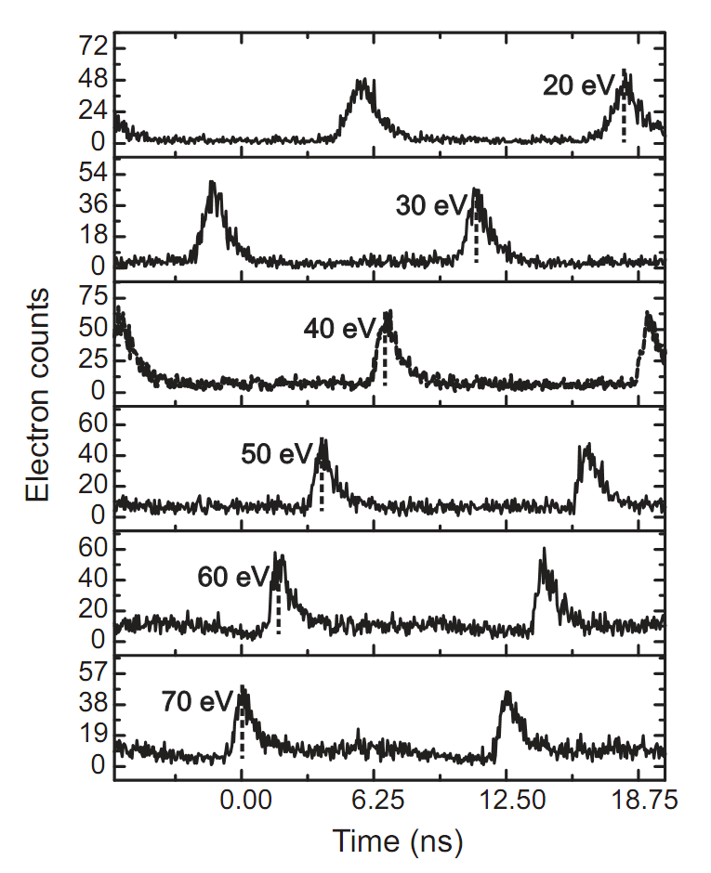
Characterization: Time of flight energy analysis
Femtosecond laser pulses
TOF spectra
2-D Electron
detector
13 ns
Correlation
electronics
Photodiode
“Femtosecond photoelectron point projection microscope”,
Erik Quinonez, Jonathan Handali and Brett Barwick. Review of Scientific Instruments. 84, (2013) 103710.

Slide 19

Characterization: Time of flight energy analysis
Femtosecond laser pulses
TOF spectra
2-D Electron
detector
13 ns
camera
Correlation
electronics
Photodiode
Simultaneously
obtain an image
-need a delay line
detector
“Femtosecond photoelectron point projection microscope”,
Erik Quinonez, Jonathan Handali and Brett Barwick. Review of Scientific Instruments. 84, (2013) 103710.

Slide 20
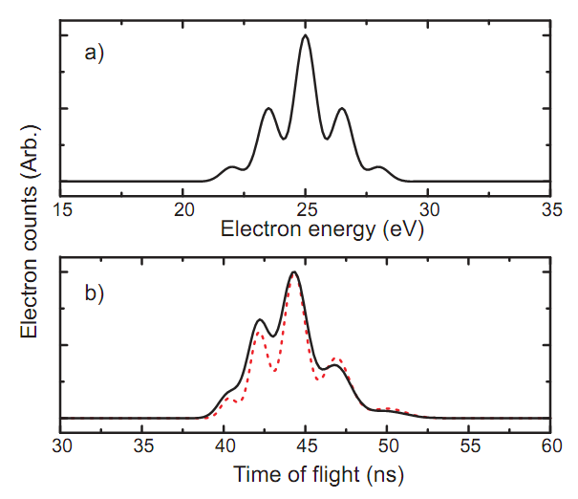
Simulation: Sample spectra of photon induced near field spectra
25 eV electrons
pump laser of 800 nm
convoluted with detector resolution of 1 ns

Slide 21
Current progress:
- Modeling shows very little dispersion in principle
- Imaging in pulsed mode with ~ 10 nm resolution
- TOF energy spectroscopy is demonstrated

Slide 22
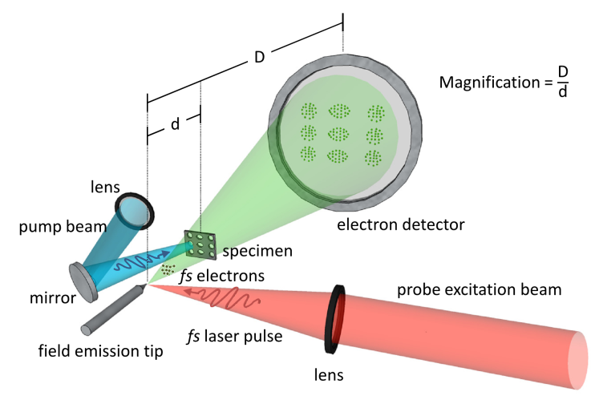
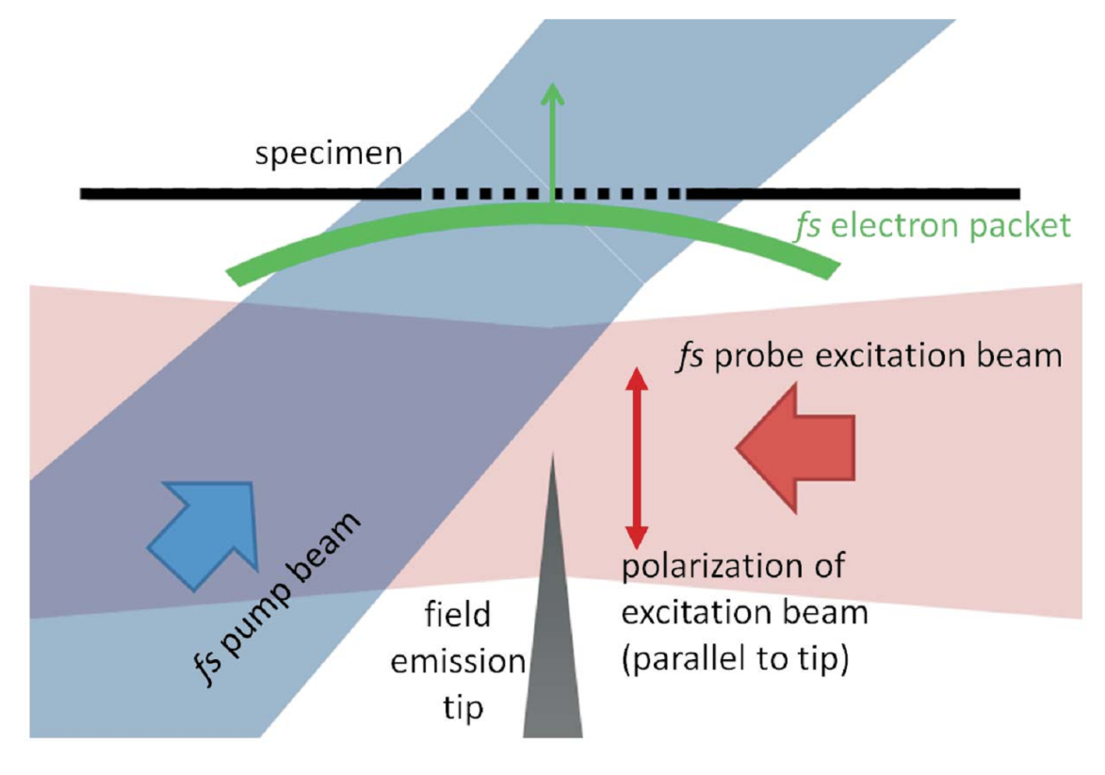
Currently: Need to find “time zero”
“Femtosecond photoelectron point projection microscope”,
Erik Quinonez, Jonathan Handali and Brett Barwick. Review of Scientific Instruments. 84, (2013) 103710.

Slide 23
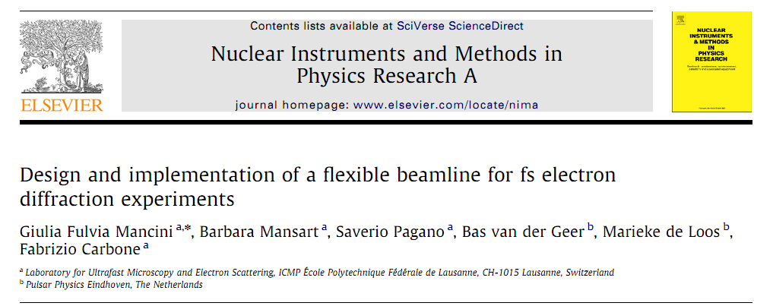
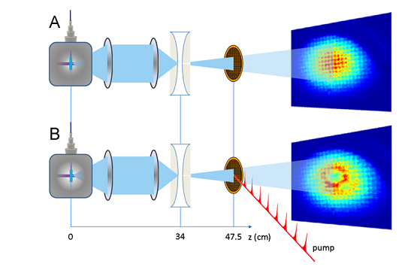
Currently: Need to find “time zero”
pump with tens of mJ/cm^2

Slide 24
Currently: Need to find “time zero”
Two main lasers in my lab
Oscillator, 80MHz, several nJ, 100 fs
Amplifier, 20Hz, 20 mJ, 100fs
Oscillator, enough electrons, not enough pump pulse energy
Amplifier, not enough electrons, plenty of pump pulse energy
  Need ~ 1 MHz, ~ 1 µJ and 100 fs or less for this method
pump with tens of mJ/cm^2

Slide 25
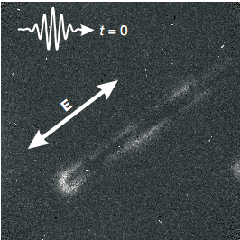
Currently: Need to find “time zero”
- Instead use oscillator and use local field enhanced fields due to optically excited plasmons
Image taken using photon induced near field electron microscopy
Use enhanced field to deflect the electron pulses
Advantages:
- excitation can be pumped with an oscillator
- microscope has sufficient spatial resolution
- low energy electrons are very sensitive
- excited fields follow the optical field of the excitation laser
“Photon Induced Near-Field Electron Microscopy”
Nature, 462 (2009) 902-906.

Slide 26

Future: Imaging attosecond dynamics at the nanoscale?
metallic nanoparticle (d<<λ)
E
-
+
-
-
+
+
-
-
+
+
t
+
+
-
-
-
-
+
+
-
+
time t
time t+T/2
-attosecond PEEM is already at as and nm scales

Slide 27
Femtosecond laser pulses
2-D Electron
detector
13 ns
Correlation
electronics
Photodiode

Slide 28
Ultrafast low energy electron interferometry
Interaction region for experiments
Femtosecond laser pulses
13 ns
Electron
detector
2-D Electron
detector
Correlation
electronics
Photodiode
Correlation
electronics
“AMO” type experiments include
- Scalar AB effect
- Time-dependent decoherence effects
- Hanbury-Brown Twiss effect (or antibunching of electrons)

Slide 29

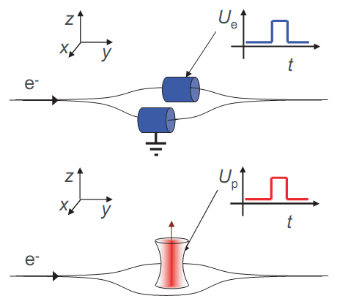
Aharonov-Bohm effect
Two AB effects:
Magnetic (vector) and electric (scalar)
-Tonomura completed experiments demonstrating the magnetic AB version
-To date no attempts of electric version
-Needs pulsed electron source!

Slide 30
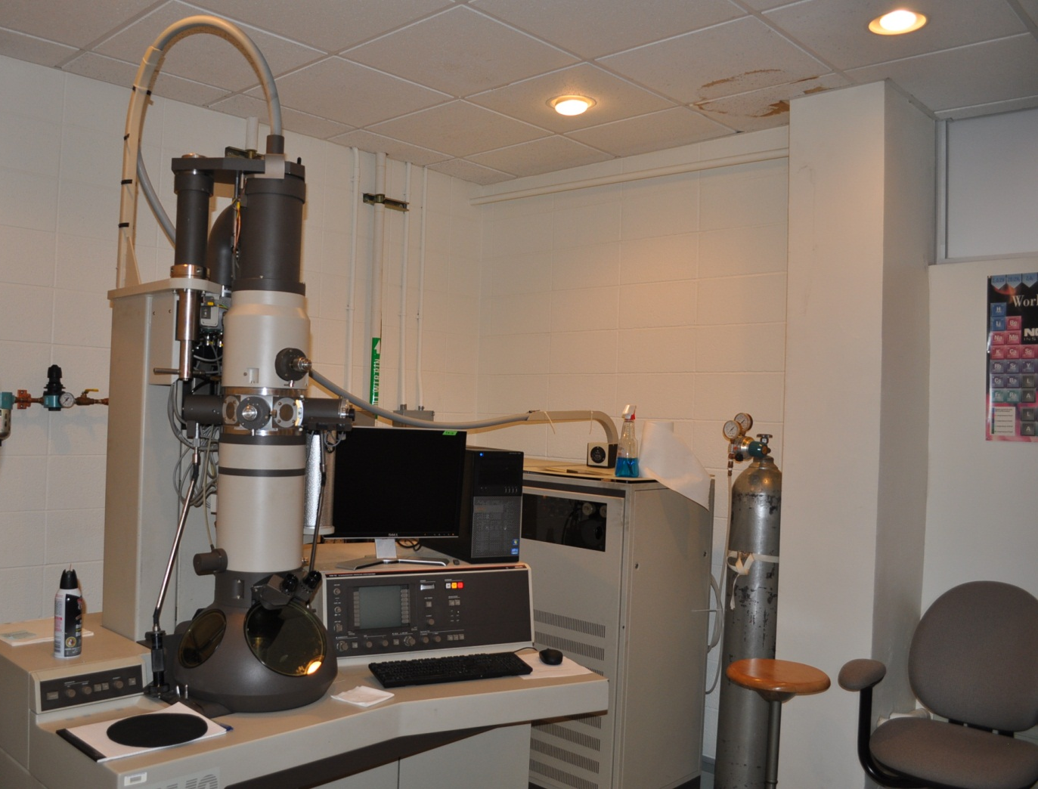
Future: TEM based UEM at Trinity?

Slide 31






Trinity Students that have worked on
these projects:
Jonathan D. Handali, 2013
Erik Quinonez, 2014
Bhola Uprety, 2014
Pratistha Shakya, 2015
Abhishek Khanal, 2015
This work was supported by FRC, Trinity Startup Funds and CT Space Grant, and special thanks to Prof. Ahmed Zewail for donation of the laser system.

Slide 32

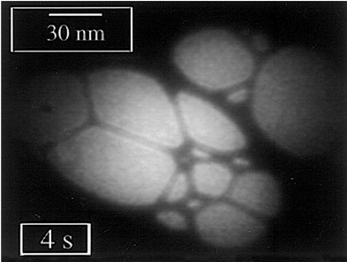
Ultrafast Electron Point
Projection Microscope
fs e⁻ excitation
pulse
-V
e⁻ tip source
d₁
specimen
fs specimen
excitation
pulse
d₂
Typical image achieved
in an e⁻ point projection
microscope of carbon
fibers, adapted from
reference [5].
fs electron pulse
e⁻ detector

