Slide 1
Traceless Totally Symmetric Tensor Based Fast Multipole Method for Space Charge Field Calculation
He Zhang¹, He Huang², Rui Li¹, Jie Chen¹, Li-Shi Luo²
Jefferson Lab
Old Dominion University
FEIS-2, 05/15/2015

Slide 2
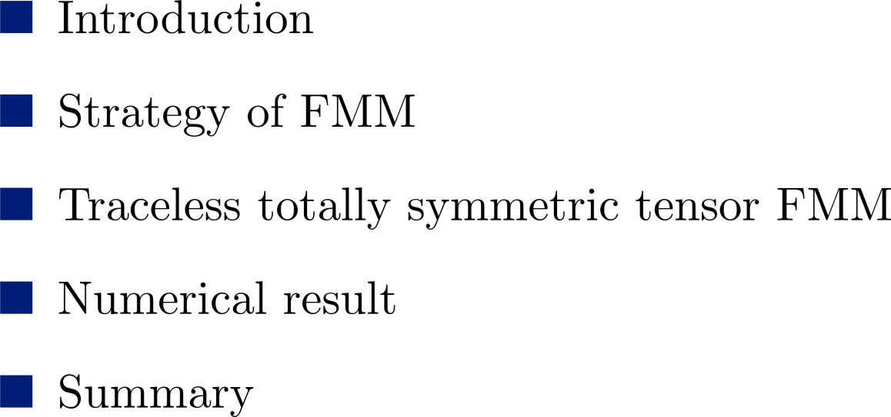
Outline

Slide 3
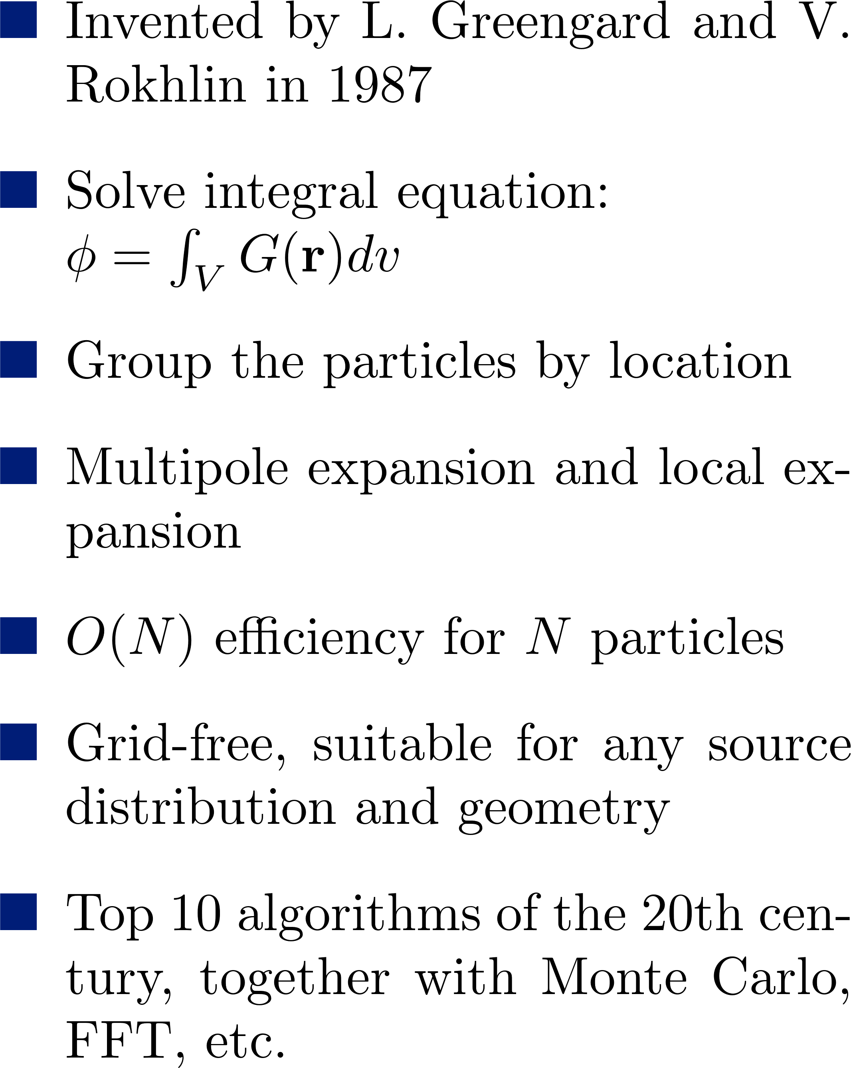
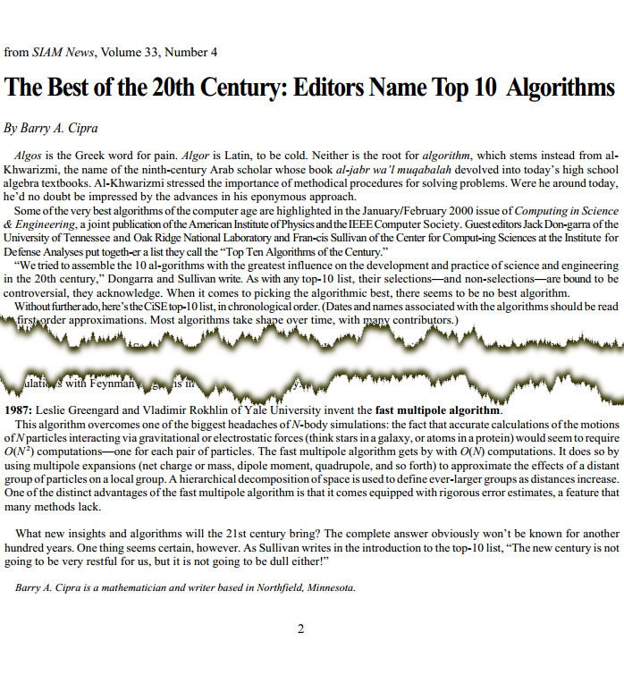
Introduction of FMM

Slide 4
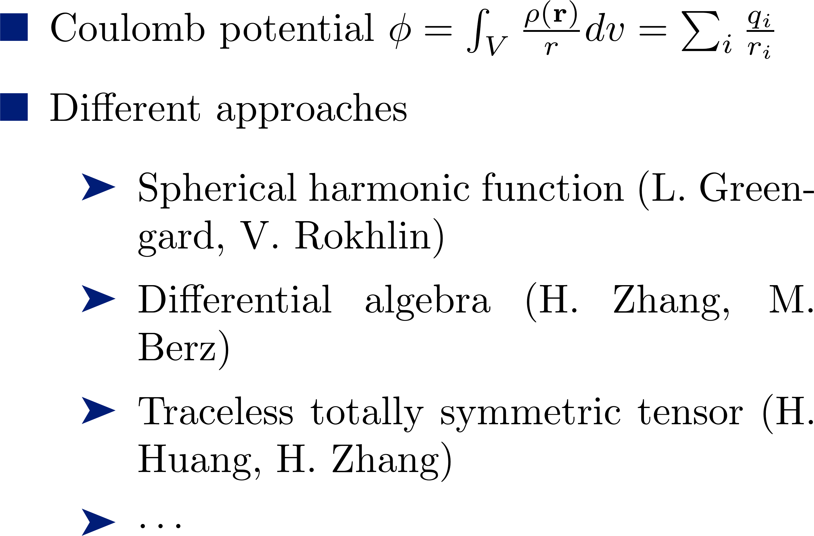
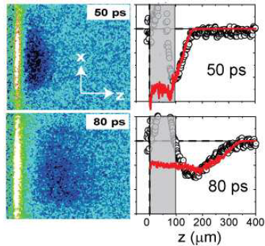
FMM for Coulomb Interaction

Slide 5
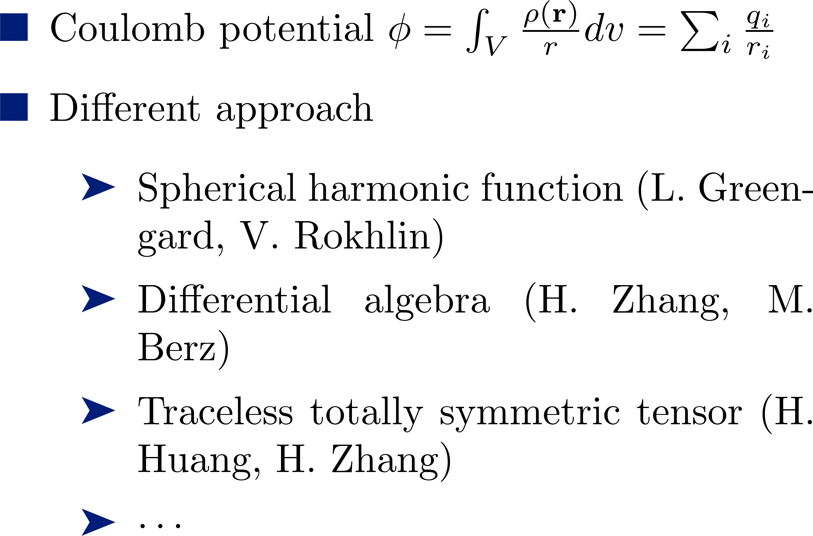
FMM for Coulomb Interaction

Slide 6
Strategy of FMM

Slide 7
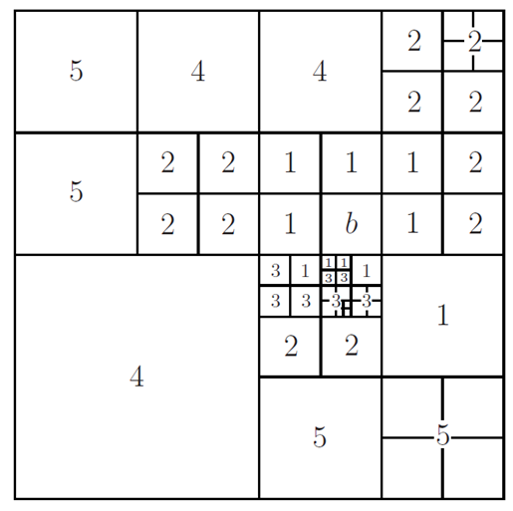
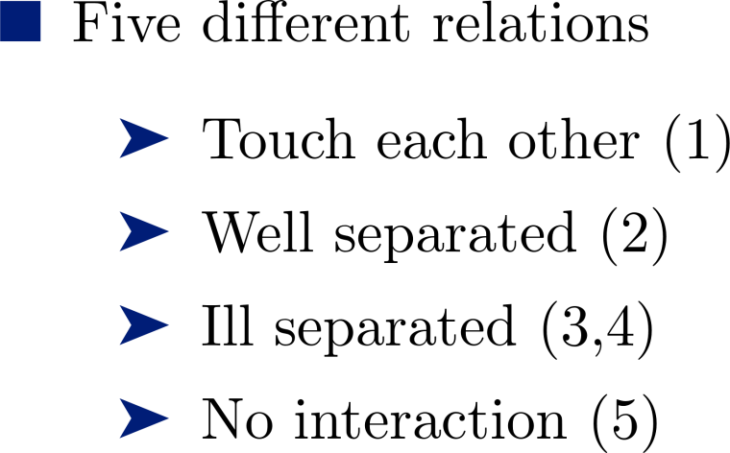
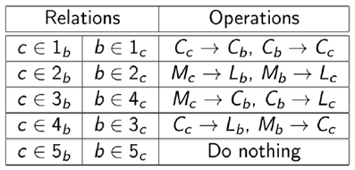
Strategy of FMM

Slide 8
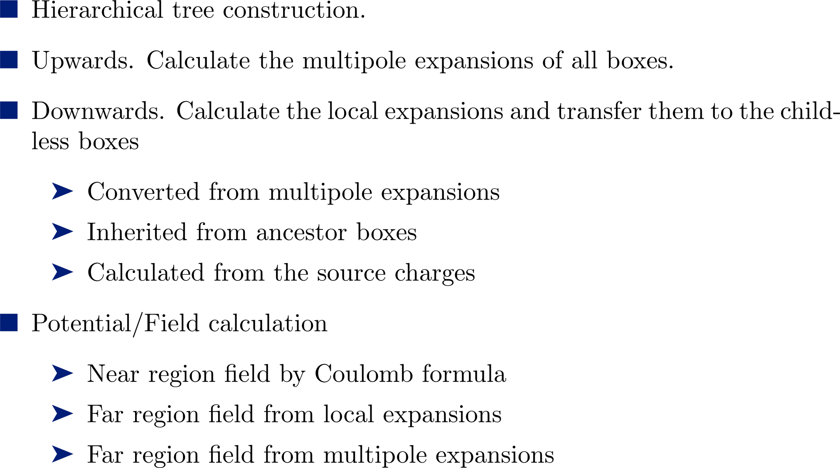
Steps of FMM

Slide 9
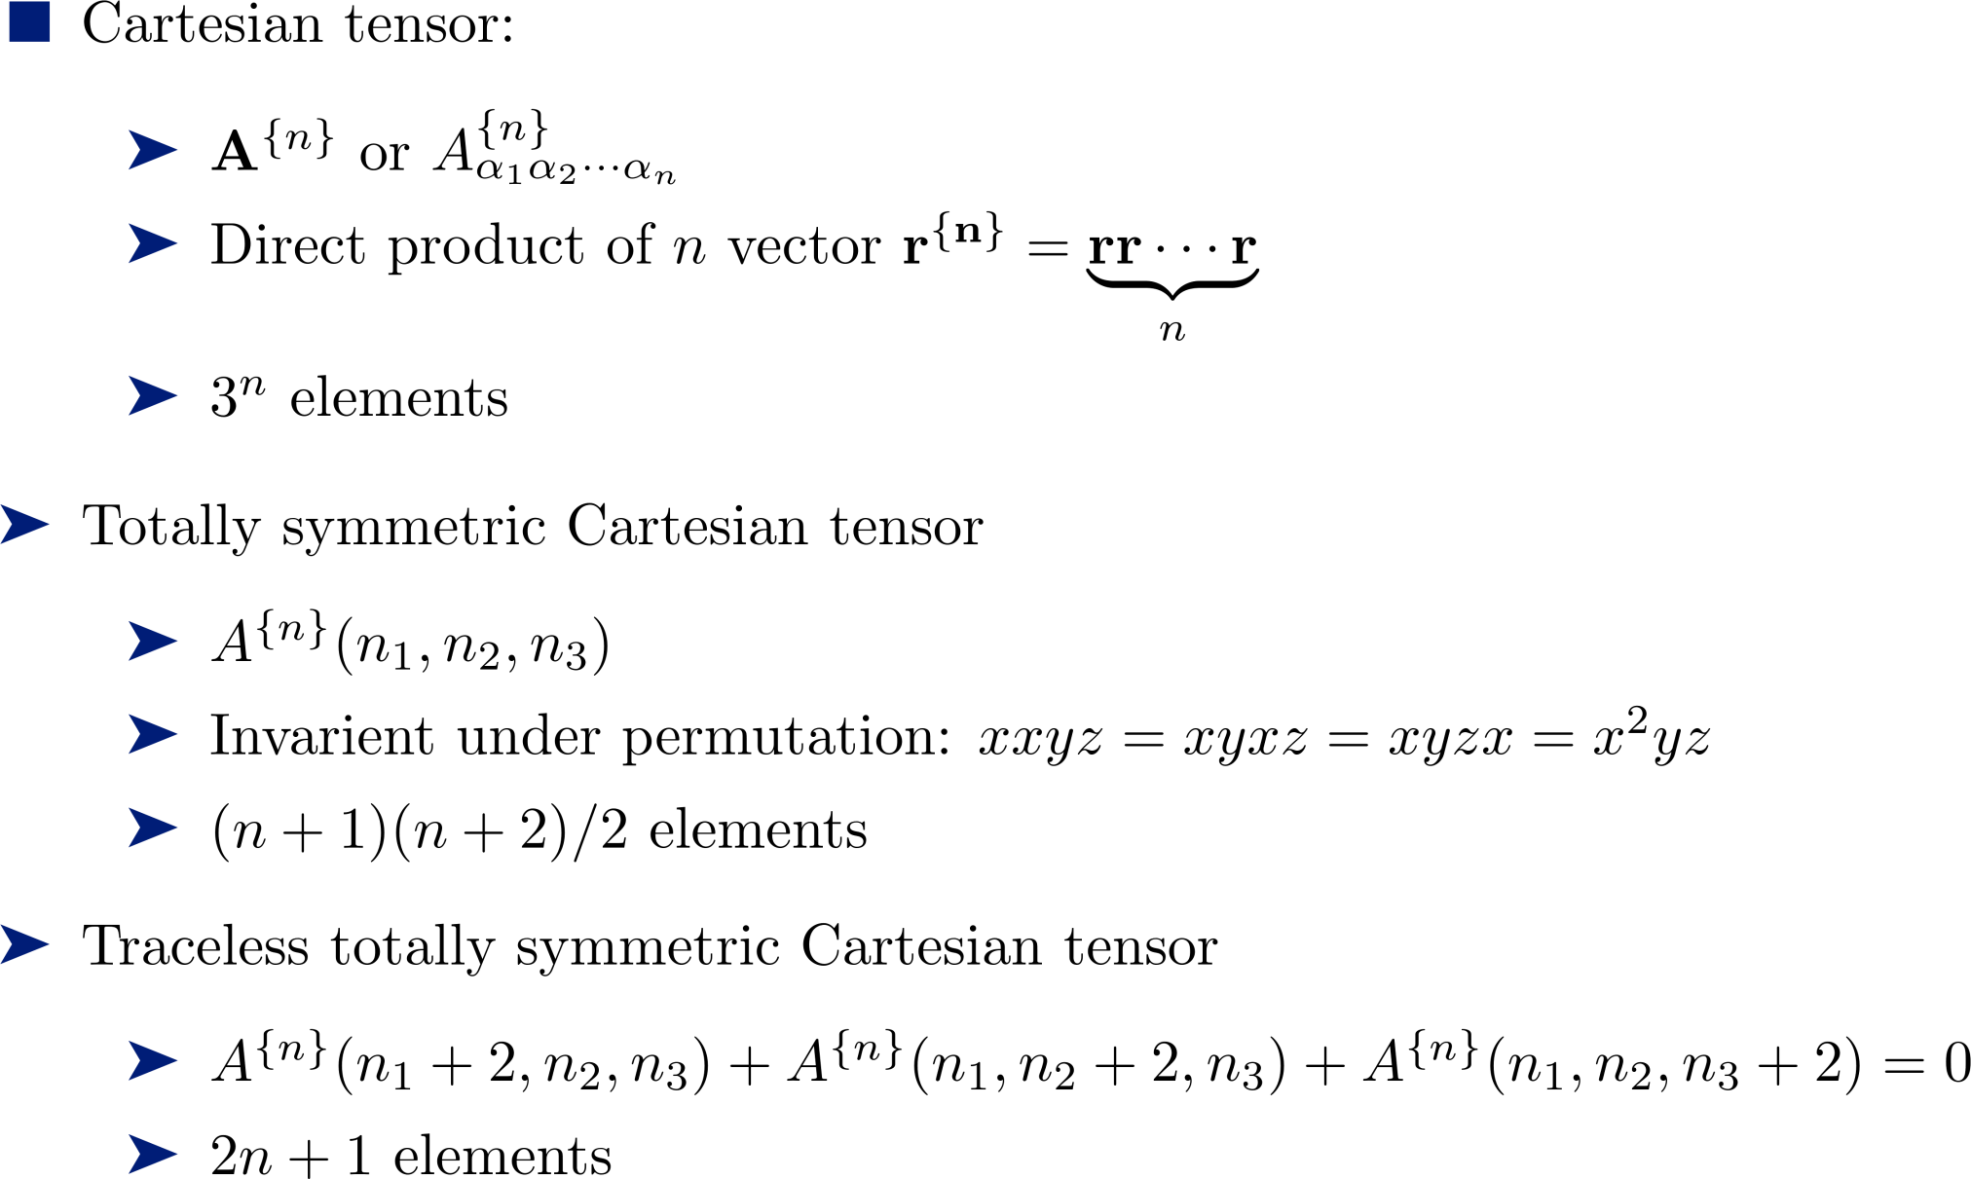
Traceless Totally Symmetric Tensor FMM

Slide 10
Traceless Totally Symmetric Tensor FMM
n | General Cartesian tensor $3^{n}$ terms |  | Totally symmetric tensor (n+1)(n+2)/2 terms |  | Traceless totally symmetric tensor $2n+1$ terms
 | In n^{th} order | Total terms | In n^{th} order | Total terms | In n^{th} order | Total terms
0 | 1 | 1 | 1 | 1 | 1 | 1
1 | 3 | 4 | 3 | 4 | 3 | 4
2 | 9 | 13 | 6 | 10 | 5 | 9
3 | 27 | 40 | 10 | 20 | 7 | 16
4 | 81 | 121 | 15 | 35 | 9 | 25
5 | 243 | 364 | 21 | 56 | 11 | 36
6 | 729 | 1093 | 28 | 84 | 13 | 49

Slide 11
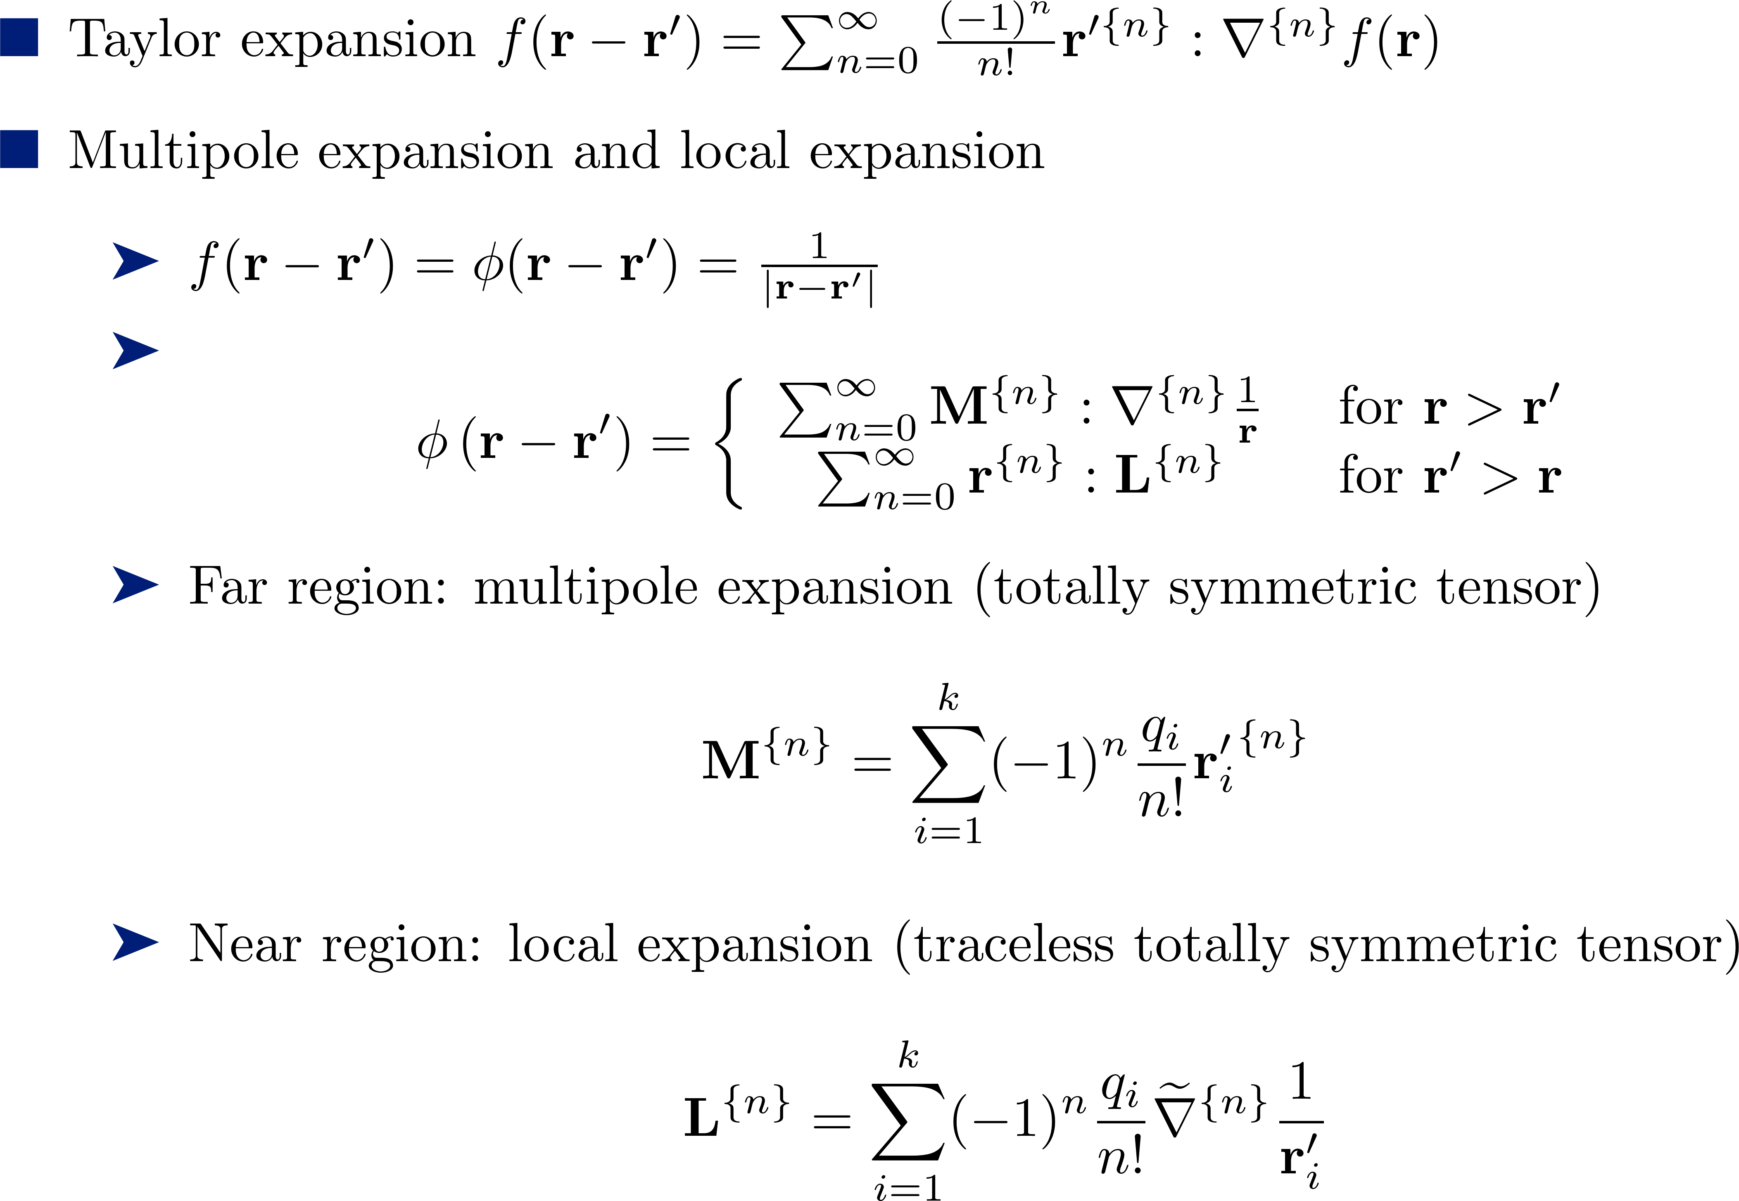
Multipole Expansion and Local Expansion

Slide 12
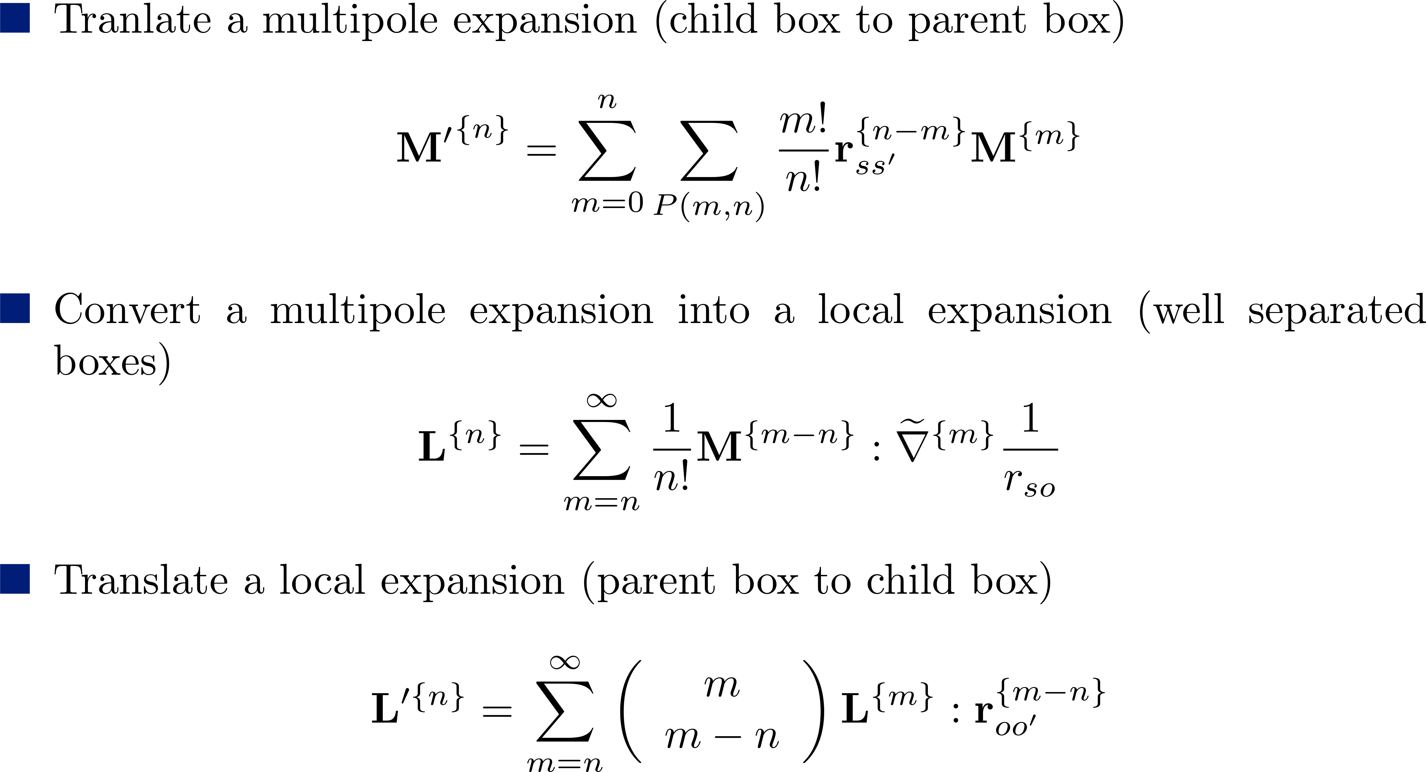
Translation and Conversion of the Expansions

Slide 13
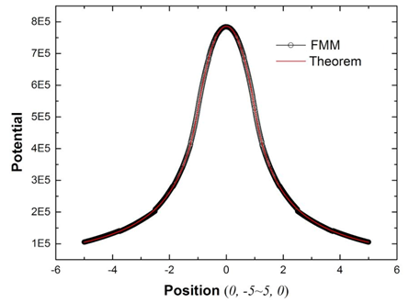
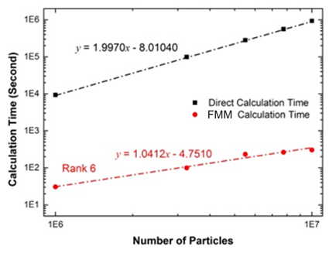
Potential Calculation

Slide 14
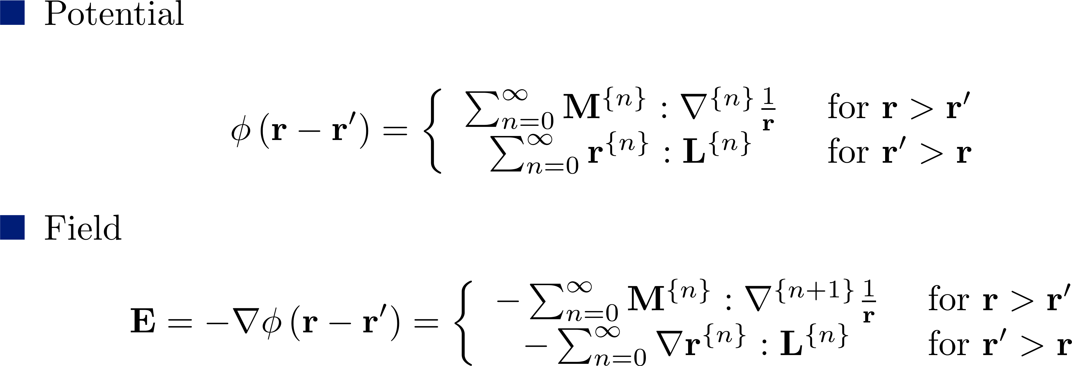
3D Space Charge Field Calculation

Slide 15
3D Space Charge Field Calculation
Uniform distribution (1048576 particles) |  |  | Normal distribution (1048576 particles)
Order | Time (s) | Relative error | Order | Time (s) | Relative error
2 | 11.77 | $$1.099×{10}^{−2}$$ | 2 | 15.48 | $$2.576×{10}^{−2}$$
3 | 13.12 | $$4.473×{10}^{−3}$$ | 3 | 20.81 | $$7.116×{10}^{−3}$$
4 | 15.81 | $1.191×{10}^{−3}$ | 4 | 29.67 | $$2.089×{10}^{−3}$$
5 | 20.52 | $$4.127×{10}^{−4}$$ | 5 | 43.70 | $$7.237×{10}^{−4}$$
6 | 28.36 | $$2.344×{10}^{−4}$$ | 6 | 65.45 | $$3.413×{10}^{−4}$$
7 | 39.54 | $$1.775×{10}^{−4}$$ | 7 | 77.09 | $$2.110×{10}^{−4}$$
8 | 56.36 | $$9.642×{10}^{−5}$$ | 8 | 95.96 | $$1.345×{10}^{−4}$$
9 | 79.80 | $$6.664×{10}^{−5}$$ | 9 | 121.80 | $$1.045×{10}^{−4}$$
10 | 82.90 | $$5.231×{10}^{−5}$$ | 10 | 156.13 | $$7.422×{10}^{−5}$$

Slide 16
Summary and Outlook

