Slide 1
Ultrafast Electron Diffraction from Molecules in the Gas Phase
Martin Centurion
Department of Physics and Astronomy
University of Nebraska – Lincoln

Slide 2
Outline
Diffraction from aligned molecules:
  3D molecular images with sub-Angstrom resolution
  Imaging of transient structures: Molecules in intense laser fields.
New sources for femtosecond resolution and high current.

Slide 3
Ultrafast Molecular Dynamics Group
Group Members
Jie Yang (grad)
Omid Zandi (grad)
Kyle Wilkin (grad)
Matthew Robinson (postdoc)
Alice DeSimone (postdoc)
Collaborators
Vinod Kumarappan (KSU).
Cornelis Uiterwaal (UNL).
Xijie Wang (SLAC)
Renkai Li (SLAC)
Markus Guehr (PULSE)

Slide 4
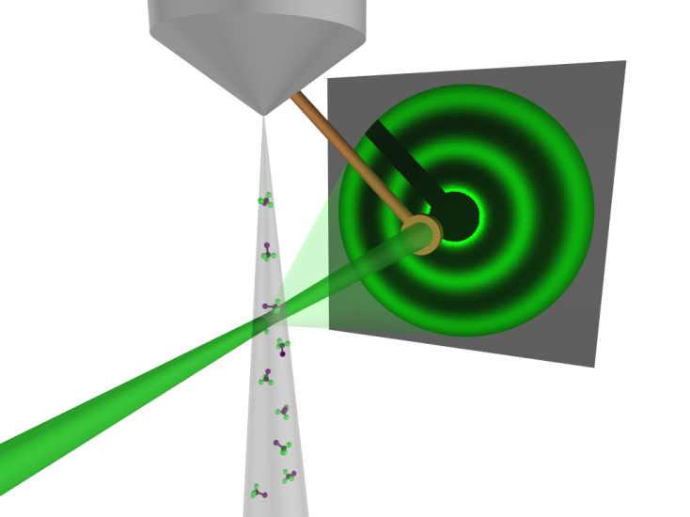
Gas Electron Diffraction
Advantages
High scattering cross section.
High spatial resolution.
Compact setup.
Limited by the random orientation of molecules
1D Information.
Structure is retrieved by iteratively comparing the data with a theoretical model.
Low contrast.

Slide 5
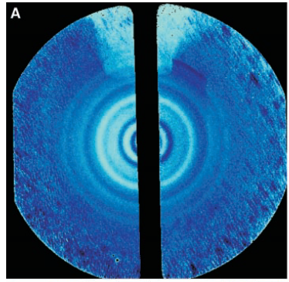
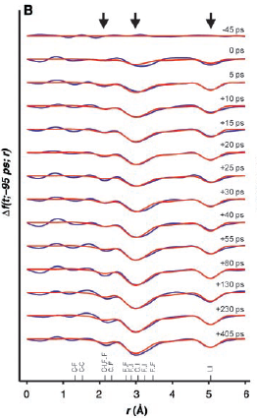
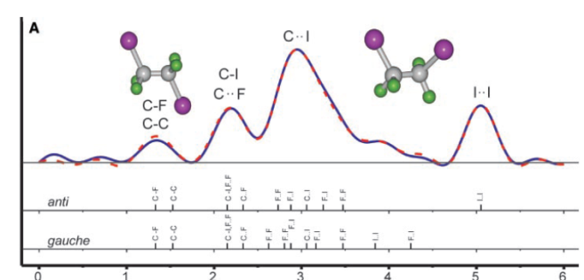
Ultrafast Gas Electron Diffraction
Background
Diffraction pattern of C₂F₄I₂
Changes in interatomic distances on ps times
Radial distribution function
Experiment
Direct Imaging of Transient Molecular Structures with Ultrafast Diffraction, H. Ihee, V.A. Lobastov, U.M. Gomez, B.M. Goodson, R. Srinivasan, C.Y. Ruan, A. H. Zewail, Science 291, 458 (2001).
Ultrafast Electron Diffraction (UED). A New Development for the 4D Determination of Transient Molecular Structures R. Srinivasan, V. A. Lobastov, C.Y. Ruan, A.H. Zewail, Helv. Chem. Act. 86, 1763 (2003).
Ultrafast Diffraction Imaging of the Electrocyclic Ring-Opening Reaction of 1,3-Cyclohexadiene, R.C. Dudek, P.M. Weber , J. Phys. Chem. A, 105, 4167 (2001).
Theory

Slide 6
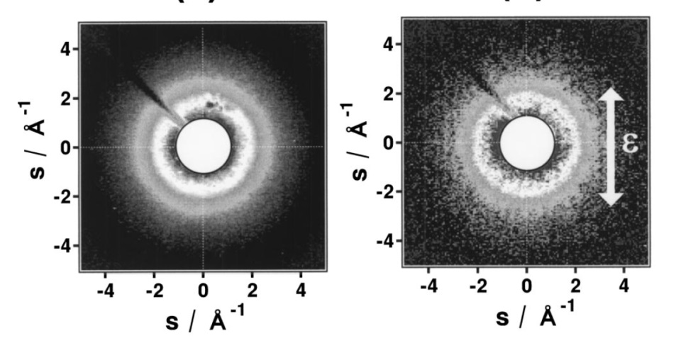
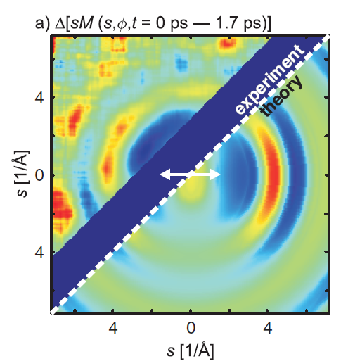
Diffraction from Aligned Molecules – Previous Work
Adiabatic Alignment (7 ns pulses)
Alignment of CS2 in intense nanosecond laser fields probed by pulsed gas electron diffraction
K. Hoshina, K. Yamanouchi, T. Takashi, Y. Ose and H. Todokoro, J. Chem. Phys. 118, 6211 (2003)
Selective alignment by dissociation (3 ps pulses)
Time-resolved Electron Diffraction from Selectively Aligned Molecules
P. Reckenthaeler, M. Centurion, W. Fuss, S. A. Trushin, F. Krausz and E. E. Fill, Phys. Rev. Lett. 102, 213001 (2009).
Notes:
Alignment of CS2 in intense nanosecond laser fields probed by pulsed gas electron diffraction, K. Hoshina, K. Yamanouchi, T. Takashi, Y. Ose and H. Todokoro, J. Chem. Phys. 118, 6211 (2003)
Time-resolved Electron Diffraction from Selectively Aligned Molecules, P. Reckenthaeler, M. Centurion, W. Fuss, S. A. Trushin, F. Krausz and E. E. Fill, Phys. Rev. Lett. 102, 213001 (2009).

Slide 7
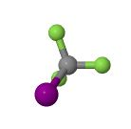
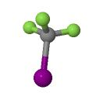
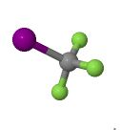
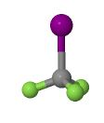
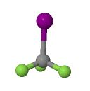
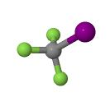
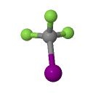
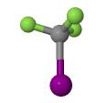
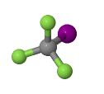
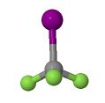
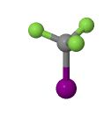
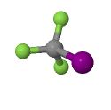
Diffraction from Aligned Molecules
Non-adiabatic (field-free) alignment
Random orientation
Limited to 1D information.
Aligned molecules
3D structure is accessible.

Slide 8
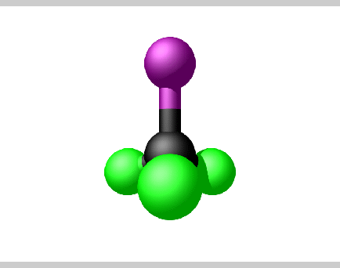

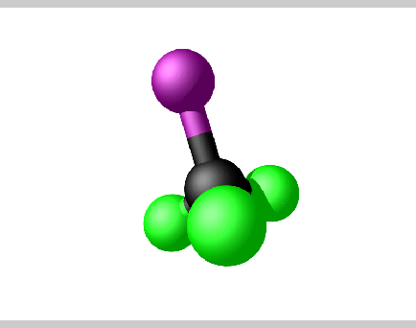
From diffraction pattern to structure - Theory
Perfect alignment — <cos²α> = 1
r
Fourier-Hankel Transform^{1,2}
z
Partial alignment — <cos²α> = 0.50
α
Fourier-Hankel Transform^{1,2}
¹P. Ho et. al. J. Chem. Phys. 131, 131101 (2009).
²D. Saldin, et. al. Acta Cryst. A, 66, 32–37 (2010).
Notes:
"Molecular structure determination from x-ray scattering patterns of laser-aligned symmetric-top molecules"
by P. J. Ho, D. Starodub, D. K. Saldin, V. L. Shneerson, A. Ourmazd, and R. Santra,
J. Chem. Phys. 131, 131101 (2009).
"Reconstruction from a single diffraction pattern of azimuthally projected electron density of molecules aligned parallel to a single axis"
by D. K. Saldin, V. L. Shneerson, D. Starodub, and J. C. H. Spence,
Acta Cryst. A, 66, 32-37 (2010).

Slide 9
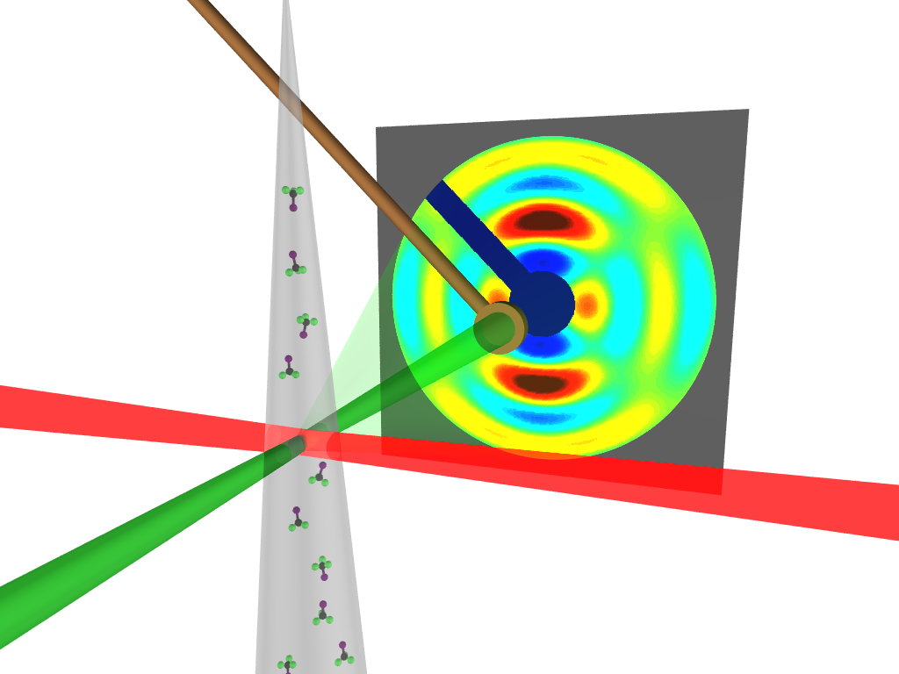
Experiment – Target Interaction Region
100 µm diameter interaction region
Overall resolution 850 fs
(first gas phase experiment with sub-ps resolution)
Supersonic seeded gas jet (helium)
Target:
CF₃I
alignment laser
electron pulse
Simple molecule with 3D structure
DC photoelectron gun at 10 kHz rep. rate.
500 fs (on target), 25 keV, 2000 e/pulse

Slide 10
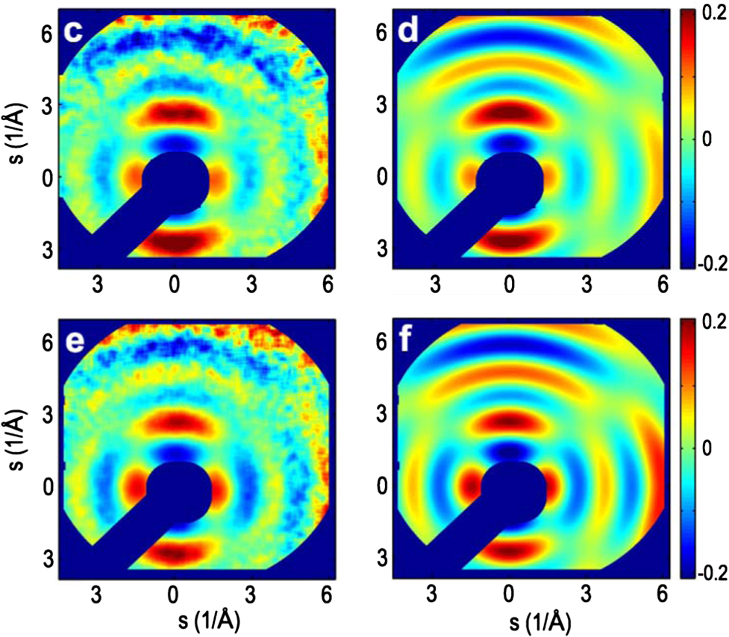
Data vs Theory
Experiment
Simulation
90°
<cos²α> = 0.5
e⁻
α
60°
e⁻

Slide 11
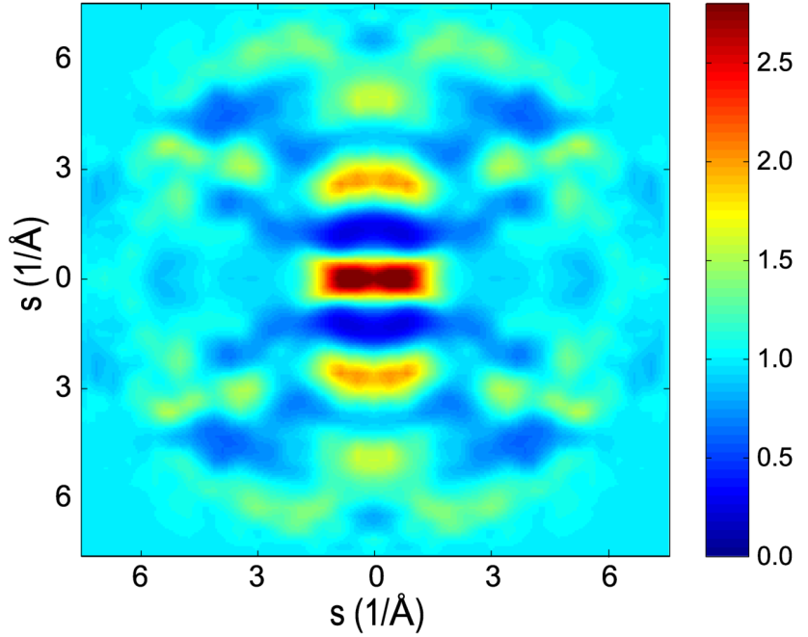
Structure retrieval
Different projections are combined using a genetic algorithm.
100k iterations
~1 hour
The algorithm also optimizes for the degree of alignment.

Slide 12
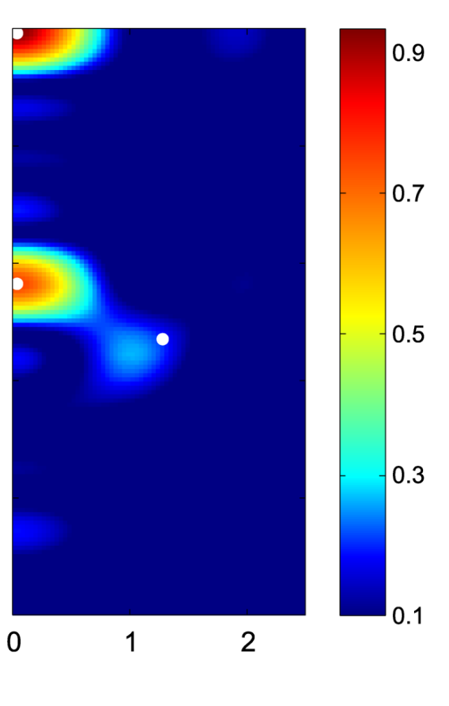
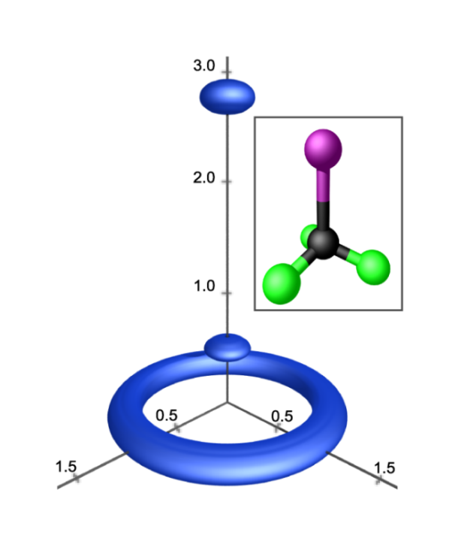
Reconstruction of CF₃I
Structure from experimental data
The image is retrieved form the data without any previous knowledge of the structure
 | Experiment | Literature
r_{CI} | 2.19±0.07Å | 2.14 Å
r_{FI} | 2.92±0.09Å | 2.89 Å
I-C-F Angle | 120±9⁰ | 111⁰
z (Å)
r (Å)
C. J. Hensley, J. Yang and M. Centurion, Phys. Rev. Lett. 109, 133202(2012)

Slide 13
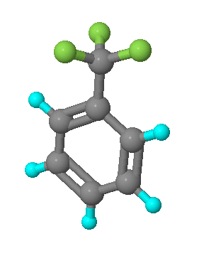
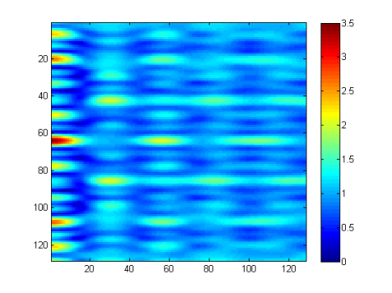
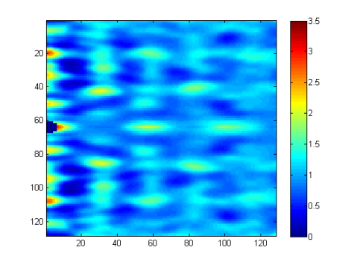
Imaging More Complex Molecules (Theory)
Fluorine
Carbon
Simulated Diffraction Patter for <cos²θ>=1
Hydrogen
Benzotrifluoride (C₇H₅F₃)
Aligned
<cos²θ>=0.56
Iterative Algorithm
Random Orientation
Reconstructed from partial alignment
Notes:
Impulsively aligned (I_{aligned}-I_{random})/I_{at}, <cos²θ>=0.56
Random Oriented I/I_{at}

Slide 14
3D Reconstruction
3D Reconstruction
The structure is reconstructed using a phase retrieval algorithm.
The algorithm uses constraints on the molecular structure (atomicity, size of molecule) and splits the diffraction into cylindrical harmonics.
3D isosurface rendering done by combining mulitple harmonics
“Reconstruction of three-dimensional molecular structure from diffraction of laser-aligned molecules,” J. Yang, V. Makhija, V. Kumarappan, M. Centurion, Structural Dynamics 1, 044101 (2014);
The overlapped blue bars show the frame of the molecule

Slide 15
Outline
Diffraction from aligned molecules:
  3D molecular images with sub-Angstrom resolution
  Imaging of transient structures: Molecules in intense laser fields.
New sources for femtosecond resolution and high current.

Slide 16

Molecules in an Intense Laser Field
A broad range of dynamics is possible under 10¹¹ to 10¹³ W/cm² , including excitation of rotational, vibrational and electronic states leading to alignment, deformation, dissociation and ionization
Possible processes:
- Alignment
- Deformation
- Dissociation
- Ionization
Carbon disulfide (CS₂)

Slide 17
From Diffraction to Object
Difference Pattern (Aligned – Random)
Retrieved Object
Fourier
Transform
Autocorrelation of object convolved with the angular distribution
Information contained in diffraction:
Angular distribution.
Molecular structure (distances and angles).
Bond breaking (intensities in FT).

Slide 18
Fluence/Intensity Dependence
Experiment
Theory
200 fs pulse
60 fs pulse
0.05 mJ
0.15 mJ
0.25 mJ
0.35 mJ
0.45 mJ
Anisotropy vs fluence measured for two laser pulse durations (200 fs and 60 fs).
Alignment increases with laser pulse energy, but not as expected from theory.
In the short pulse limit, alignment depends only on fluence (not intensity).
Simulation includes only excitation of rotational states.

Slide 19
Multiphoton Ionization
Number of ions vs Intensity was measured with a time of flight mass spectrometer.
Ionization measured by J. Beck and C. J. Uiterwaal at U. of Nebraska.
Number of ions vs Intensity
Fraction of Molecules Ionized
Point I: < 0.01%
Point III: 1%
Point V: 60%
I
III
V

Slide 20

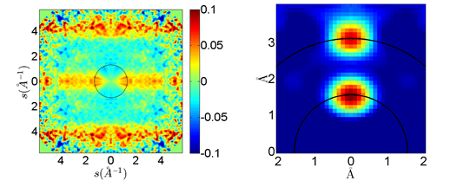
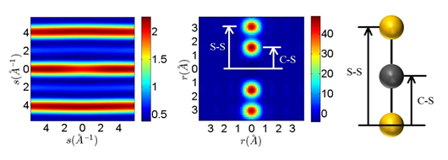
Diffraction patterns
II – I
Fourier Transform
I
II
Simulated perfect alignment

Slide 21
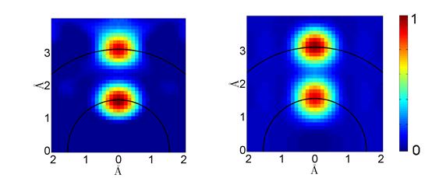
Molecular image at low intensity
Data point “II”
7×10¹² W/cm²
Ground State CS₂ Simulation
 | C-S Distance (Å) | S-S Distance (Å)
Expected Interatomic Distances for Ground State | 1.553 | 3.105
Data Point “II” | 1.53±0.03 | 3.11±0.03

Slide 22
Structural Changes at high intensity
Bond lengthening
III
IV
V
Simulated
¹B₂ Excited state
Data point “IV”
1.3×10¹³ W/cm²
Data point “V”
2.4×10¹³ W/cm²
Ground State Simulation
Notes:
Reference
Townsend D1, Satzger H, Ejdrup T, Lee AM, Stapelfeldt H, Stolow A,
1B2(1Sigma(u)+) excited state decay dynamics in CS2, J Chem Phys. 125, 234302 (2006)

Slide 23
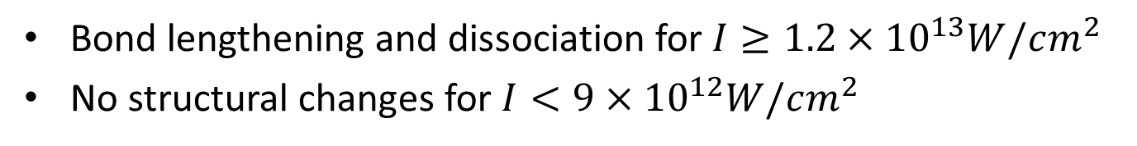
Structural changes at high intensity
IV
V
Bond lengthening
Dissociation
 | C-S Distance (Å) | S-S Distance (Å)
Expected Interatomic Distances for Ground State | 1.553 | 3.105
Data Point “IV” | 1.52±0.03 | 3.27±0.03
Data Point “V” | 1.55±0.03 | 3.31±0.03
Bond lengthening and dissociation for $I≥1.2×{10}^{13}W/cm^{2}$
No structural changes for $I<9×{10}^{12}W/cm^{2}$

Slide 24
Outline
Diffraction from aligned molecules:
  3D molecular images with sub-Angstrom resolution
  Imaging of transient structures: Molecules in intense laser fields.
New sources for femtosecond resolution and high current.

Slide 25
New Gas-phase UED experiments
SETUP | Gun | Energy | Avg Beam Current | Pulse duration | GVM Compensation | Status
UNL-1 | DC | 25 keV | 10⁷ e/s | 500 fs | None | In operation (2012)
UNL-2 | DC+RF | 100 keV | 10⁹ e/s | 300 fs | Tilted laser pulse | Pulse charact. ongoing.
SLAC* | RF | 2-5 MeV | 3x10⁷ e/s | 100 fs | Relativistic | Experiments in progress
*SLAC – PULSE – UNL collaboration (Xijie Wang, Renkai Li, Markus Guehr + many others and our group at UNL).

Slide 26
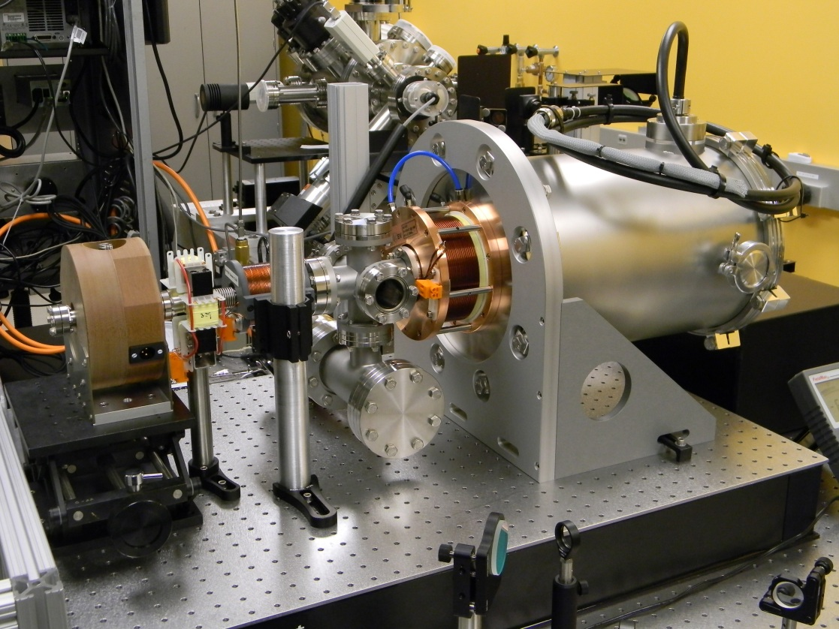
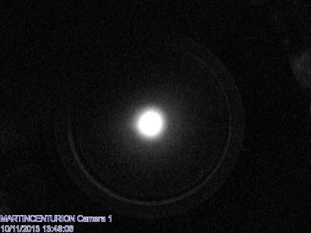
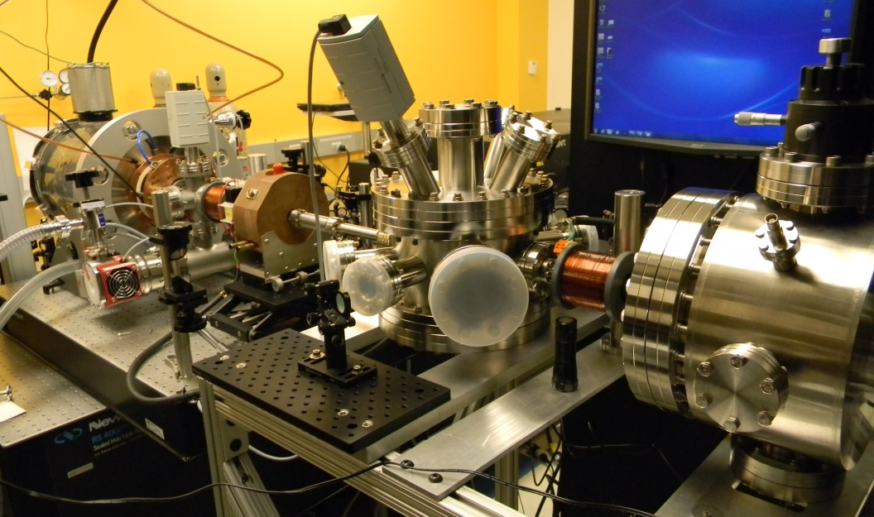
RF Pulse Compressor at UNL
RF Cavity
10⁶ e/pulse
Target Chamber
Detector Chamber
100 kV DC Gun
Solenoid lenses
Deflector
Currently measuring pulse duration and stability.

Slide 27
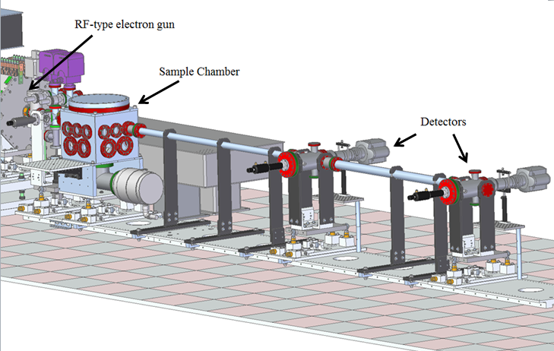
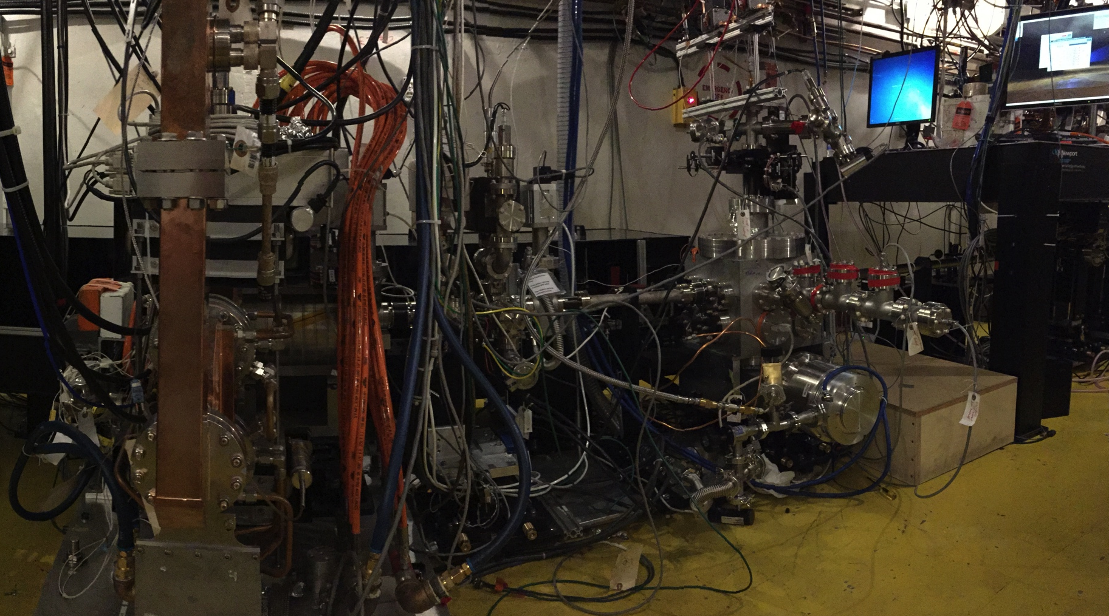
Gas Phase UED at SLAC
First static GED patterns recorded.
Time resolved experiments coming soon.

Slide 28


Summary
3D imaging is possible with laser-aligned molecules. Molecules can be probed in a field free environment.
Imaging of molecular dynamics of CS₂ under high intensity.
Improved spatial and temporal resolution will be available with new sources.
This work was supported by the supported by the U.S. Department of Energy (DOE), Office of Science, Basic Energy Sciences (BES) under Grant # DE-SC0003931 and by the Air Force Office of Scientific Research, Ultrashort Pulse Laser Matter Interaction program, under grant # FA9550-12-1-0149..

